Slide 1

Minerva

Slide 2
Roadmap of session
Website Functions and Features
Mobile Functions and Features
Forum
Announcements
Quiz creation
Product Overview
Problem Statement
Minerva’s purpose
Anonymous questions
In-class quizzes
Live feedback system

Slide 3
Why Minerva?
Web & Mobile education-based software suite
Give students a voice, teachers a way to keep engagement of students
Integration of multiple websites’ functions in one place
Communication in and out of class
Mobile Web
Attendance
In-class quiz
Live feedback
Discreet and anonymous
question system
Forums
Announcements
File and class enrollment management
Teacher Hub
Gradebook
Quiz Creation

Slide 4
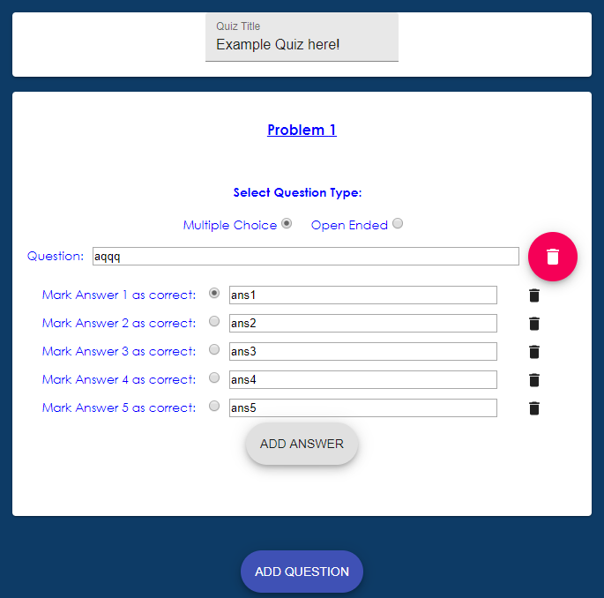
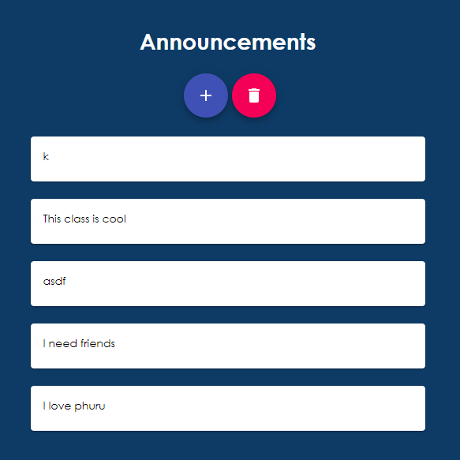
Web Showcase

Slide 5
Mobile Showcase

Slide 6
Minerva

