Slide 1
WEB SECURITY MONITORING TOOL
KRISHNA SHRESTHA

Slide 2
TABLE OF CONTENT
Introduction
Background
Tools, Technologies & Methodology
Unique Features
Gantt Chart
Potential Feature Expansion for Future Development
Conclusion

Slide 3
INTRODUCTION
Comprehensive Web Analytics and Monitoring Solution
Seamless Integration of Multiple Security and Monitoring Tools
Centralized Platform for Streamlined Web Operations
Empowering Businesses with Unified Web Insights and Controls
Optimized Web Visibility and Protection in One Robust Tool

Slide 4
BACKGROUND
The growing reliance on web-based applications and services.
Evolving web security threats (DDoS, vulnerabilities, malware, data breaches).
Limitations of traditional security approaches.
Every problem has solutions but in different place
Need for an integrated web security monitoring solution.

Slide 5
TOOLS
Python
Flask
Built in Modules ( Requests, flask, hashlib, Time, graph_tools )
Monitoring Tools and Analytical Tools

Slide 6
METHODOLOGY
Information Gathering
Vulnerability Analysis
Monitoring
Tracking And Solving Problem

Slide 7
UNIQUE FEATURES
Real-time threat detection and alerting
Comprehensive web application traffic visibility
Advanced analytics for vulnerability identification
Automated mitigation and response solutions

Slide 8
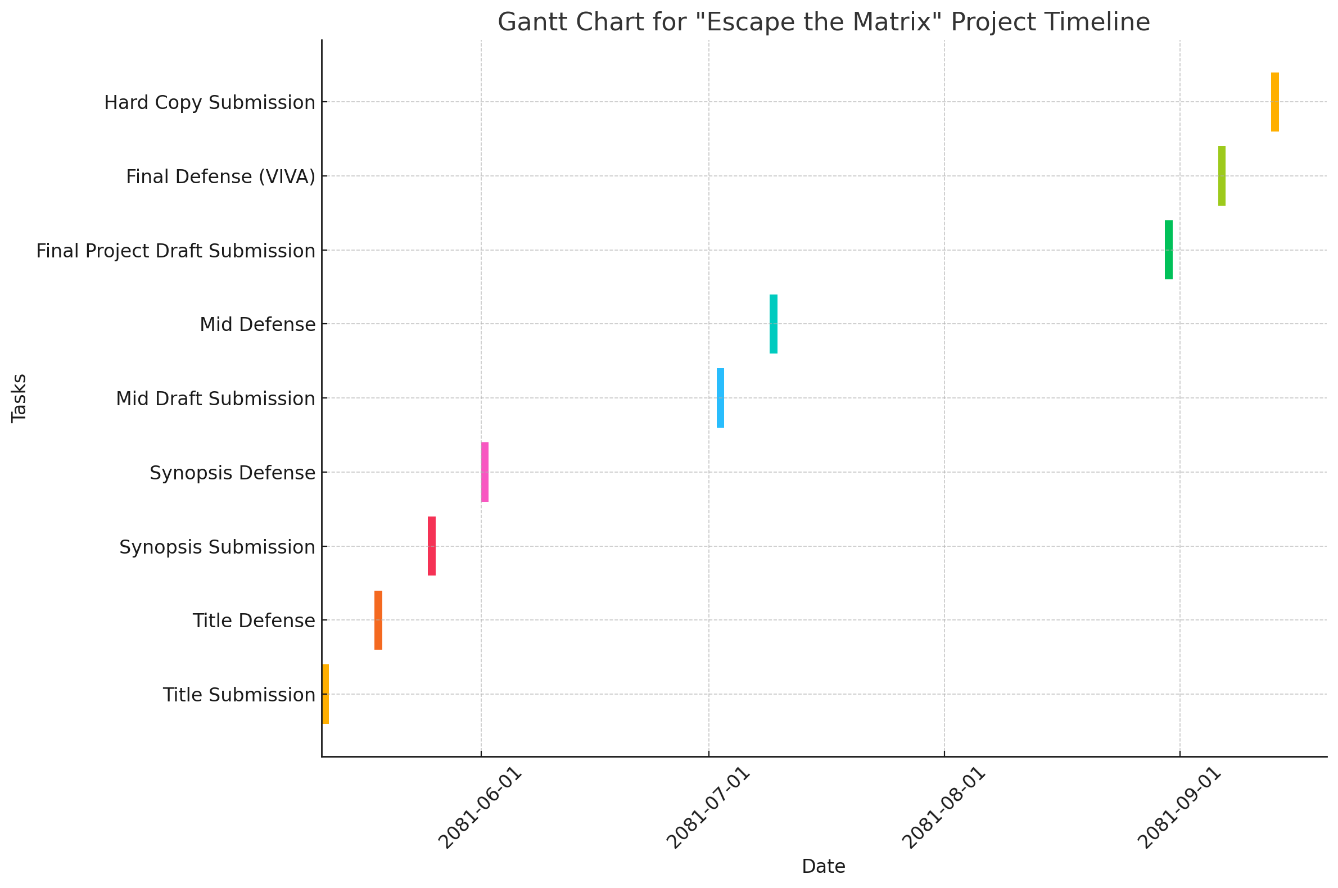
GANTT CHART

Slide 9
POTENTIAL FEATURE EXPANSION
Web security monitoring tool with advanced security + multiple tools integration
Key components (Web traffic monitoring, threat analysis) Advanced
Integration with other security systems ( ALL IN ONE PLACE )
Multi Environment Support

Slide 10
CONCLUSION
Enhanced web application security posture
Reduced risk of web-based attacks and data breaches
Improved compliance with regulatory requirements
Increased operational efficiency through automated security processes

