Slide 1


Smart Water Management: Enhancing Efficiency and Conservation
Discover the world of smart water management and unlock the potential of IoT sensors and mobile applications in optimizing water usage. Dive into fascinating diagrams, schematics, and screenshots that illustrate this innovative technology.
TJ
by T Joshvanth

Slide 2
Introduction
Welcome to the future of water management. In this section, we will explore the groundbreaking technology behind smart water management systems. Discover how IoT sensors and mobile applications work harmoniously to revolutionize the way water is monitored, controlled, and conserved.

Slide 3

Exploring Smart Water Management Technology
Imagine a future where water is managed with precision, efficiency, and sustainability. In this section, we will delve into the fascinating world of smart water management technology. Learn how advanced sensors and intelligent algorithms enable accurate detection, analysis, and response to water usage patterns in real-time.

Slide 4
IoT Sensors: The Brains Behind Smart Water Management
Flow Sensors
Pressure Sensors
Quality Sensors
Monitor water flow rates to detect leaks, unusual consumption, and optimize usage.
Measure water pressure in pipelines to ensure efficient distribution and prevent pipe failures.
Analyze water quality parameters to ensure safe and healthy water consumption.

Slide 5
Mobile Application: Empowering Users in Water Management
1
Real-time Monitoring
2
Smart Recommendations
3
Remote Control
Effortlessly control water systems, irrigation, and appliances from anywhere using the app.
Track water usage, detect anomalies, and receive alerts through an intuitive mobile app.
Receive personalized insights, tips, and recommendations for optimizing water consumption.

Slide 6
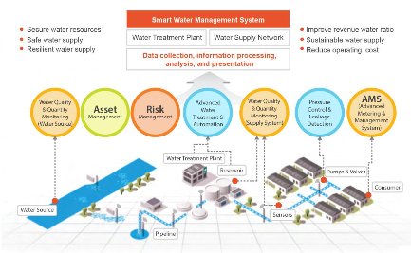
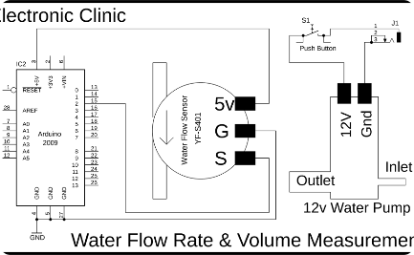
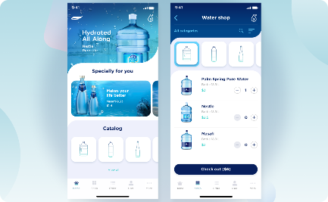
Diagrams and Schematics: Visualizing Smart Water Management
A comprehensive diagram showcasing the interconnected components and flow of a smart water management system.
A detailed schematic illustrating the inner workings and design of a water flow sensor.
Get a glimpse of the sleek and user-friendly interface of the mobile app for managing water usage.

Slide 7
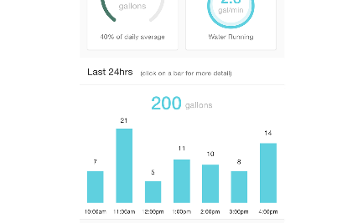
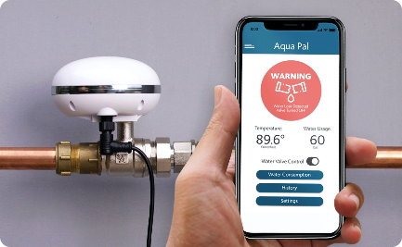

Screenshots: Intuitive Mobile App Interface
View your water consumption history, usage patterns, and trends at a glance.
Instantly receive alerts and notifications regarding potential leaks or abnormal water usage.
Access a curated collection of water-saving tips and tricks to promote efficient water usage.

Slide 8
Conclusion
By harnessing the power of IoT sensors and mobile applications, smart water management offers an unprecedented level of control and sustainability. Embrace this cutting-edge technology, and together, let's shape a brighter future where water is conserved, efficiency is maximized, and our planet thrives.

