Slide 1
Smart Water Management: Optimizing Resources for a Sustainable Future
Discover the importance of smart water management and explore the different activities involved in ensuring efficient and sustainable water usage.

Slide 2
Feature Engineering: Unveiling Insights in Water Management
1
Definition & Purpose
Learn how feature engineering in smart water management aids in identifying relevant patterns and variables for analysis.
2
Factors to Consider
Understand the parameters to consider when selecting features, including data quality and data relevance.
3
Techniques for Extraction
Explore various techniques such as statistical methods and domain knowledge-based approaches.

Slide 3
Model Training: Powering Predictive Insights in Water Systems
1
Modeling Process
Get an overview of the steps involved in training and deploying machine learning models for water management.
2
Types of Models
Discover the machine learning models commonly used to forecast water demand, detect leaks, and optimize water distribution.
3
Training Techniques
Explore methods like supervised learning, unsupervised learning, and ensemble techniques for model training.

Slide 4
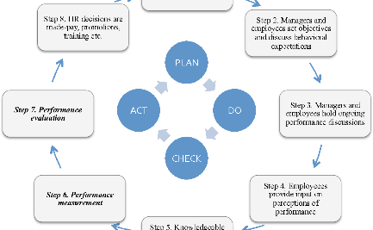

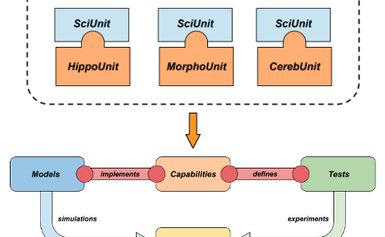
Model Evaluation: Assessing Accuracy and Reliability
Importance of Evaluation
Evaluation Metrics
Validation Techniques
Explore key metrics like root mean square error (RMSE) and coefficient of determination (R²) used in model evaluation.
Discover techniques such as cross-validation and holdout validation for validating and fine-tuning models.
Understand the crucial role of model evaluation in ensuring accurate and reliable predictions.

Slide 5
Unlocking the Potential: Smart Water Management Benefits
Optimized Resource Allocation
Early Leak Detection
Efficiently allocate water resources based on demand patterns, reducing wastage and ensuring sustainability.
Identify leaks and potential infrastructure issues promptly, minimizing water loss and infrastructure damage.
Improved Decision-making
Environmental Conservation
Make informed decisions using predictive insights, enhancing water management strategies and operations.
Protect and preserve water ecosystems by reducing water consumption and minimizing ecological impact.

Slide 6
Final Thoughts: Embracing the Future of Water Management
1
Reflect on the key factors of smart water management, from feature engineering to model evaluation, and envision a sustainable future for water resources.
2
Recognize the significant benefits and potential impact of implementing smart water management strategies on a global scale.

