Slide 1
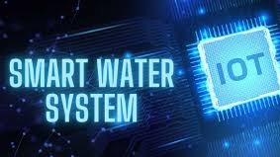
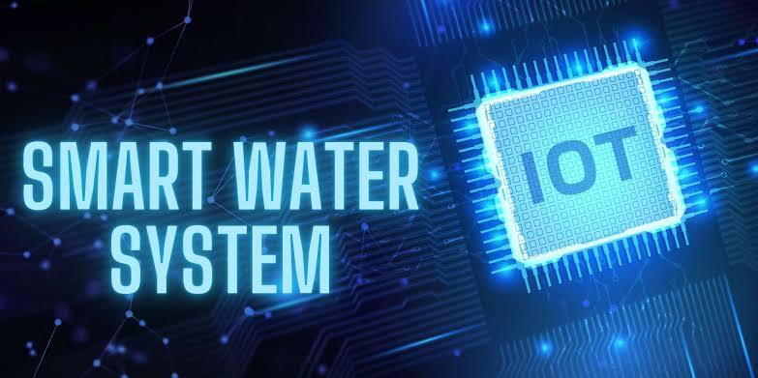

Slide 2
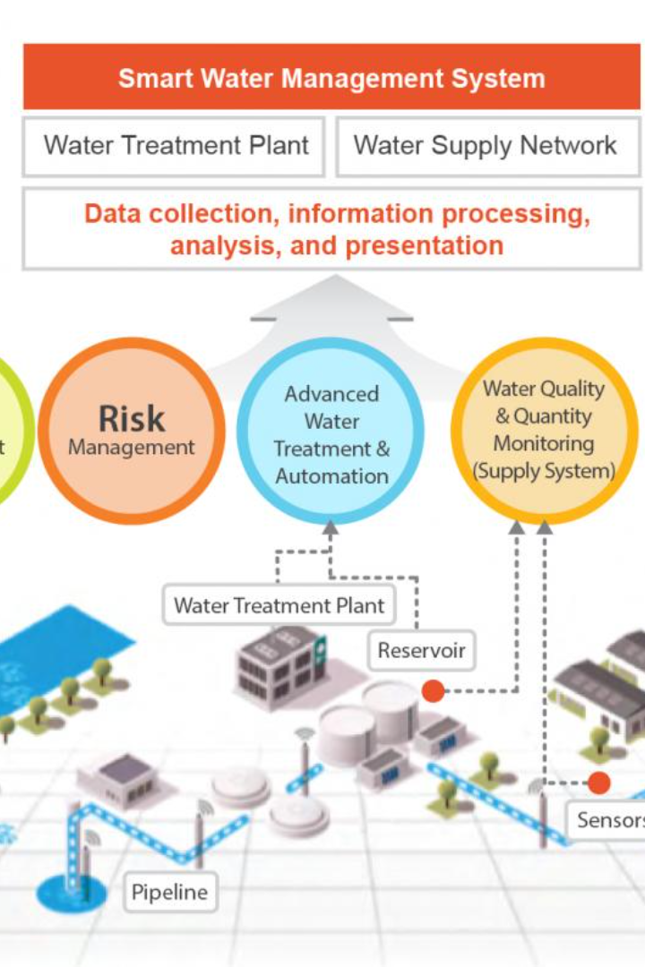

Smart Water System IoT
Revolutionize your water management with the power of IoT. Discover the benefits of this technology and how it can help you conserve water and reduce costs.

Slide 3
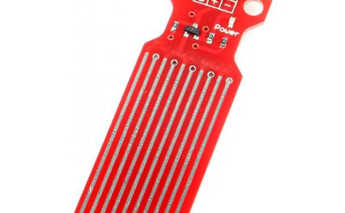
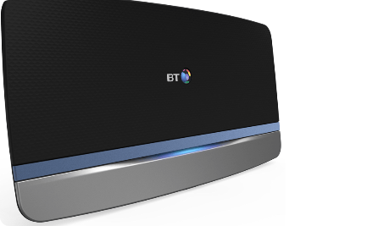
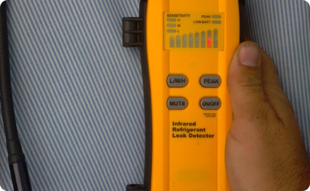
How It Works
A smart water system uses sensors to collect data on water usage. This data is sent to a central hub that analyzes it and identifies patterns. The system then makes adjustments to optimize water usage and detect leaks.
Sensors
Central Hub
Leak Detection
Smart sensors are installed in various locations to collect water usage data.
The central hub collects and analyzes the data received from the sensors to optimize water usage.
The system is capable of detecting leaks through pressure changes in the pipes and alerting the user.

Slide 4

Benefits of Using a Smart Water System
A smart water system offers several advantages, including:
1
Water Efficiency
2
Cost Savings
3
Convenience
The system reduces water waste and helps conserve this precious resource.
By conserving water, you can save on water bills and avoid costly repairs due to leaks.
The system is easy to use and provides real-time information on water usage.

Slide 5
Key Features and Components
The system consists of different components that work together to optimize water usage:
Sensors
Gateway
Smart sensors are installed in various locations to collect water usage data.
The gateway collects data from sensors and sends it to the central hub.
Central Hub
Mobile App
The central hub analyzes the data and makes adjustments to optimize water usage.
The user can monitor water usage and receive alerts about leaks through a mobile app.

Slide 6
Real-World Applications
A smart water system can be used in various settings:
1
Residential
Homeowners can use the system to monitor water usage and detect leaks to save on water bills.
2
Commercial
Businesses can use the system to optimize water usage, minimize waste, and reduce costs.
3
Agricultural
Farmers can use the system to monitor soil moisture levels and optimize irrigation.

Slide 7

Challenges and Limitations
While a smart water system offers many benefits, there are some challenges and limitations:
1
Cost
2
Accuracy
The initial investment in the system can be high, although the long-term savings can outweigh the cost.
The system may not be 100% accurate in detecting leaks or optimizing water usage.
3
Accessibility
The system may not be accessible to everyone, especially those who live in areas with limited internet connectivity.

Slide 8
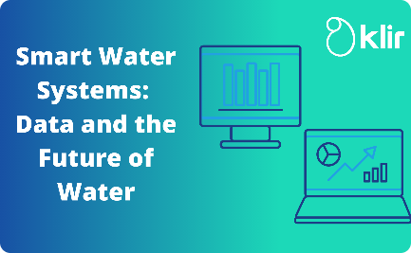

Future of Smart Water System IoT
The future of smart water systems looks promising with the emergence of new technologies such as machine learning and AI. These technologies can help improve the accuracy and efficiency of the system and make it more accessible to everyone.
Machine Learning
Artificial Intelligence
App Development
The system can learn from past usage patterns and make adjustments accordingly.
The system can make real-time adjustments based on the weather forecast and other factors.
Advanced mobile apps can provide more insights and features to help users optimize water usage.

Slide 9

THANK YOU
By ECE 3RD year student's:
* T. Joshvanth
* B. Santhosh
* V. Vishva
* G. Sabari
* B. Harish

