Slide 1
Health-Link Pro: Home Remedies, Medicine Access & Hospital Finder
Submitted by:
joshwa jeba kumar . A [210221104014]
syed Ibrahim [210221104038]
surendhar .g [210221104037]
Guided by:

Slide 2
Introduction:
The app aims to provide homemade remedies for common diseases. It includes information on 24/7 medical services, such as shops, hospitals, clinics, and doctors, making healthcare more accessible. Users can purchase medicines by uploading prescriptions, which will be delivered to their doorsteps. The app also highlights government hospitals and pharmacies for affordable care. Users will have personal login details for easy access and record-keeping. A rewards system offers coins on purchases, redeemable for discounts.

Slide 3
Problem statement
As in this century humans are busy with their work life and don’t have that much time for the treatment of the common disease or to know about the Government Schemes, the facilities that are provided by the government in their hospitals and medical store.

Slide 4
Aim and scope:
Aim:
Provide easy access to homemade remedies for common diseases.
Increase awareness of lower-cost treatments in government hospitals.
Highlight the affordability of medicines from government medical stores compared to private pharmacies.
Scope:
Develop a specialized medical search engine (Med Search) for effective handling of clinical queries.
Offer Wide-ranging and relevant search results for medical information.
Suggest related medical terms to enhance user understanding and refine searches.
Educate users on cost differences between government and private healthcare services.

Slide 5

Existing system :.
Dependency on hospitals and lack of awareness limit access to medical services and government facilities
Dependency on Hospitals.
Lack of Awareness.
Limited Access to Medical Services
Unawareness of Government Facilities
Complexity in Medical Purchases
No Reward System

Slide 6




ARCHITECTURE DIAGRAM
USER
MAIN PORTAL
AUTHENTICATION
HEALTHCARE REMEDY EXPLORATION
LOCAL HEALTHCARE PROVISION AVAILABILITY
PHARMACEUTICAL DELIVERY FOLLOWING PRESCRIPTION AUTHENTICATION
REGISTERATION
DATABASE
REMEDIES FROM DOCTORS
HOSPITAL , PHARMACY AND THEIR FACILITIES , SUBSIDIES

Slide 7
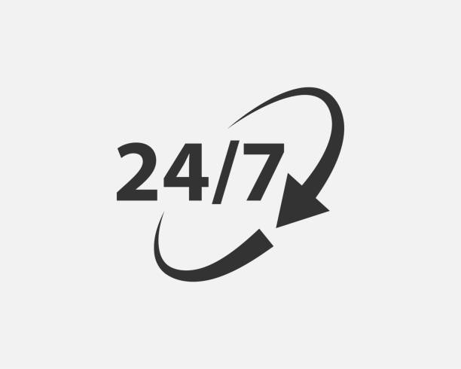

Proposed system:
Mobile health applications offer key advantages such as enhanced accessibility to medical services, cost-effectiveness, and convenience.
Accessibility:
Cost-Effective:
Convenience:

Slide 8
Hardware Requirements
Processor: Multi-core CPU (e.g., Intel Core i5 or above).
RAM: At least 8 GB (16 GB recommended for smooth performance).
Storage: SSD with at least 256 GB of free space for development tools and emulators.
Graphics: A decent GPU for handling UI/UX design tools.
Internet Connectivity
Reliable broadband or mobile internet connection for accessing online resources, cloud services, and app store deployment.

Slide 9
Software Requirements:
Operating System:
Windows 10 or higher / Linux
macOS 12.0 or later
Integrated Development Environments (IDEs):
Android Studio
Visual Studio Code.
Programming Languages and Frameworks:
Java/Kotlin
Flutter (Dart) or React Native (JavaScript)
Backend Development:
Node.js, Python (Django/Flask), or Ruby on Rails:
Database:
Firebase/Firestore (NoSQL)
MySQL/PostgreSQL (SQL)
APIs and Integrations:
Health APIs
Payment Gateway APIs

Slide 10
Proposed model:
Technology Usage
Lack of Existing Solutions
Remedy Provision
User Benefit
Comprehensive Information
Unique Offering

Slide 11
Module:
Exploration of Healthcare Solutions
Availability of Local Healthcare Services
Identification of Specialized Medical Services across Healthcare Facilities
Pharmaceutical Distribution Following Prescription Verification

Slide 12
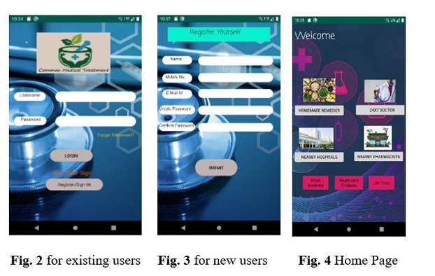
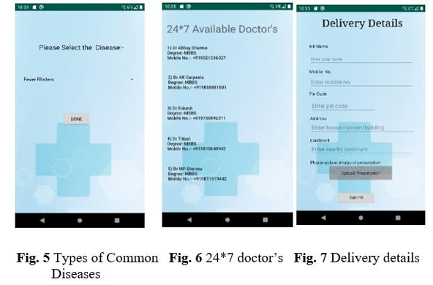

Slide 13
Reference:
[1]. Can, A. B., & Baykal, N. (2007). MedicoPort: A medical search engine for all. Computer methods and programs in biomedicine, 86(1), 73-86.
[2]. Hanauer , D. A. (2006). EMERSE: the electronic medical record search engine. In AMIA annual symposium proceedings (Vol. 2006, p. 941). American Medical Informatics Association.
[3]. Luo, G., Tang, C., Yang, H., & Wei, X. (2008, October). MedSearch: a specialized search engine for medical information retrieval. In Proceedings of the 17th ACM conference on Information and knowledge management (pp. 143-152). ACM.
[4]. Luo, G. (2009, March). Design and evaluation of the iMed intelligent medical search engine. In 2009 IEEE 25th International Conference on Data Engineering
[5]. Cooper, C. P., Mallon, K. P., Leadbetter, S., Pollack, L. A., & Peipins, L. A. (2005). Cancer Internet search activity on a major search engine, United States 2001 2003. Journal of medical Internet research, 7(3), e36.
[6]. Boulos, M. N. K. (2004). A first look at Health CyberMap medical semantic subject search engine. Technology and Health Care, 12(1), 33-41.

Slide 14
[7]. Dragusin, R., Petcu, P., Lioma, C., Larsen, B., Jørgensen, H. L., Cox, I. J., ... & Winther, O. (2013). FindZebra: a search engine for rare diseases. International journal of medical informatics, 82(6), 528-538. [8]. Dunne, S., Cummins, N. M., Hannigan, A., Shannon, B., Dunne, C., & Cullen, W. (2013). A method for the design and development of medical or health care information websites to optimize search engine results page rankings on Google. Journal of medical Internet research, 15(8), e183.
[9]. Allam, A., Schulz, P. J., & Nakamoto, K. (2014). The impact of search engine selection and sorting criteria on vaccination beliefs and attitudes: two experiments manipulating Google output. Journal of medical internet research, 16(4), e100. [10]. Mourão, A., & Martins, F. (2013, May). NovaMedSearch: A multimodal search engine for medical case-based retrieval. In Proceedings of the 10th conference on open research areas in information retrieval (pp. 223-224). LE CENTRE DE HAUTES ÉTUDES INTERNATIONALES D'INFORMATIQUE DOCUMENTAIRE.
[11]. Palotti, J. R., Zuccon, G., Goeuriot, L., Kelly, L., Hanbury, A., Jones, G. J., ... & Pecina, P. (2015). CLEF eHealth Evaluation Lab 2015, Task 2: Retrieving Information About Medical Symptoms. In CLEF (Working Notes) (pp. 1-22).
[12]. Jo, S. H., Lee, K. S., & Seol, J. W. (2016). CBNU at TREC 2016 Clinical Decision Support Track. In TREC.
[13]. Abu-Nasser, B. (2017). Medical Expert Systems Survey. International Journal of Engineering and Information Systems (IJEAIS), 1(7), 218-224. [14]. Bielecki, Z., Stacewicz, T., Wojtas, J., Mikołajczyk, J., Szabra, D., & Prokopiuk, A. (2018). Selected optoelectronic sensors in medical applications. OptoElectronics Review, 26(2), 122-133.
[15]. Apidi, N. A., Murugiah, M. K., Muthuveloo, R., Soh, Y. C., Caruso, V., Patel, R., & Ming, L. C. (2017).

Slide 15
S.NO | AUTHOR | PROBLEM IDENTIFIED | METHODS | ADVANTAGES | DISSADVANTAGES
1. | A. B., &Baykal | Information Overload | Medical Ontologies User-Centered Design | Improved Relevance Time Efficiency | Limited Scope Dependence on Ontologies
2. | Hanauer , D. A. | Difficulty in Finding Relevant Medical Information | Ontology Development and Integration. | Improved Accuracy Enhanced Relevance | Limited Coverage Outdated Information
3. | Luo, G., Tang, C | Data Privacy Concerns | Query Optimization | Improved Search Accuracy Time Efficiency | Integration Issues User Training
4. | Luo, G. | Data Overload Access to Care | Fuzzy Logic | Improved Diagnosis Accuracy Cost Reduction | Data Privacy Concerns Integration Challenges
5. | C. P., Mallon, K. | Inaccurate Search Results | Semantic Analysis | Improved Search Accuracy | Accuracy Limitations

