Slide 1



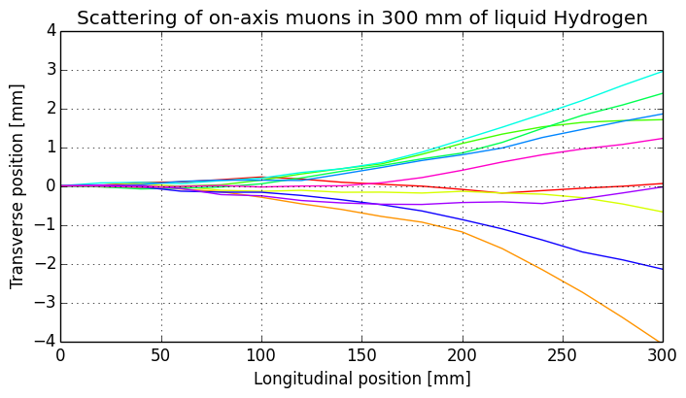
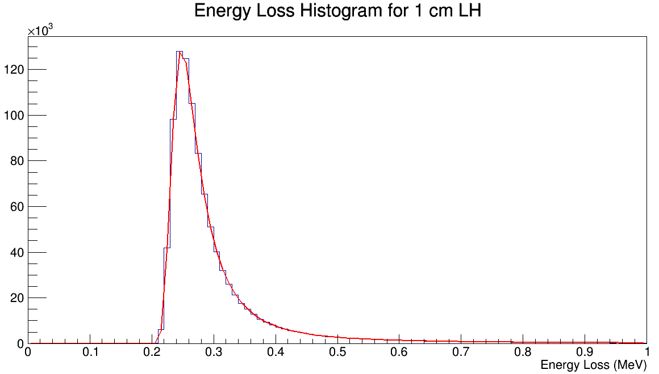
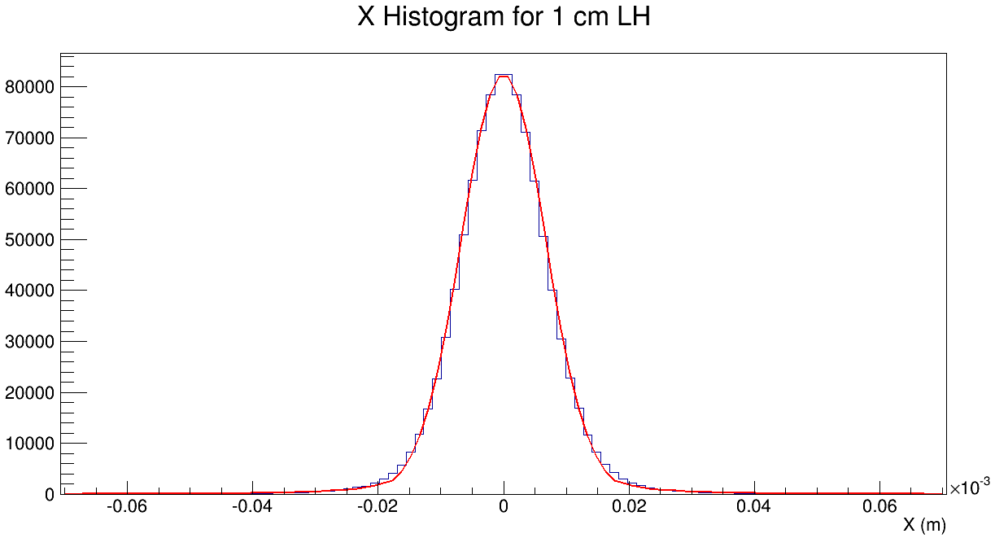
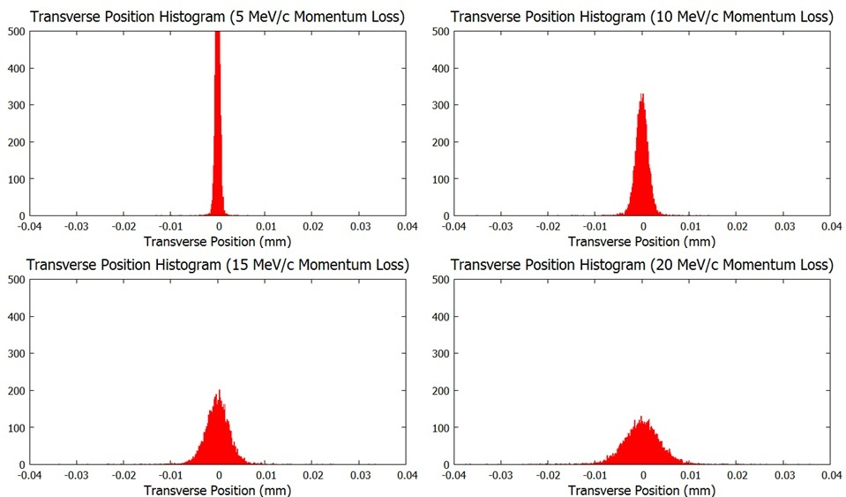
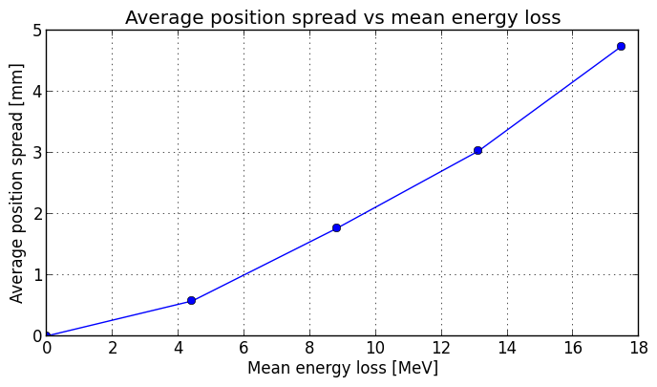
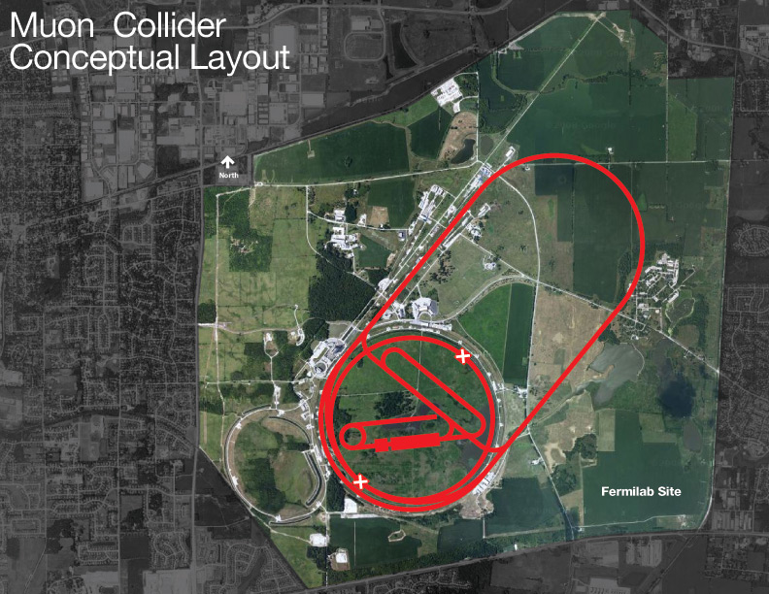
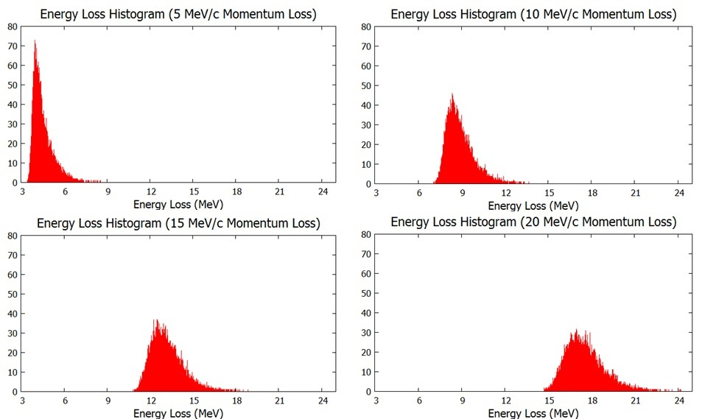
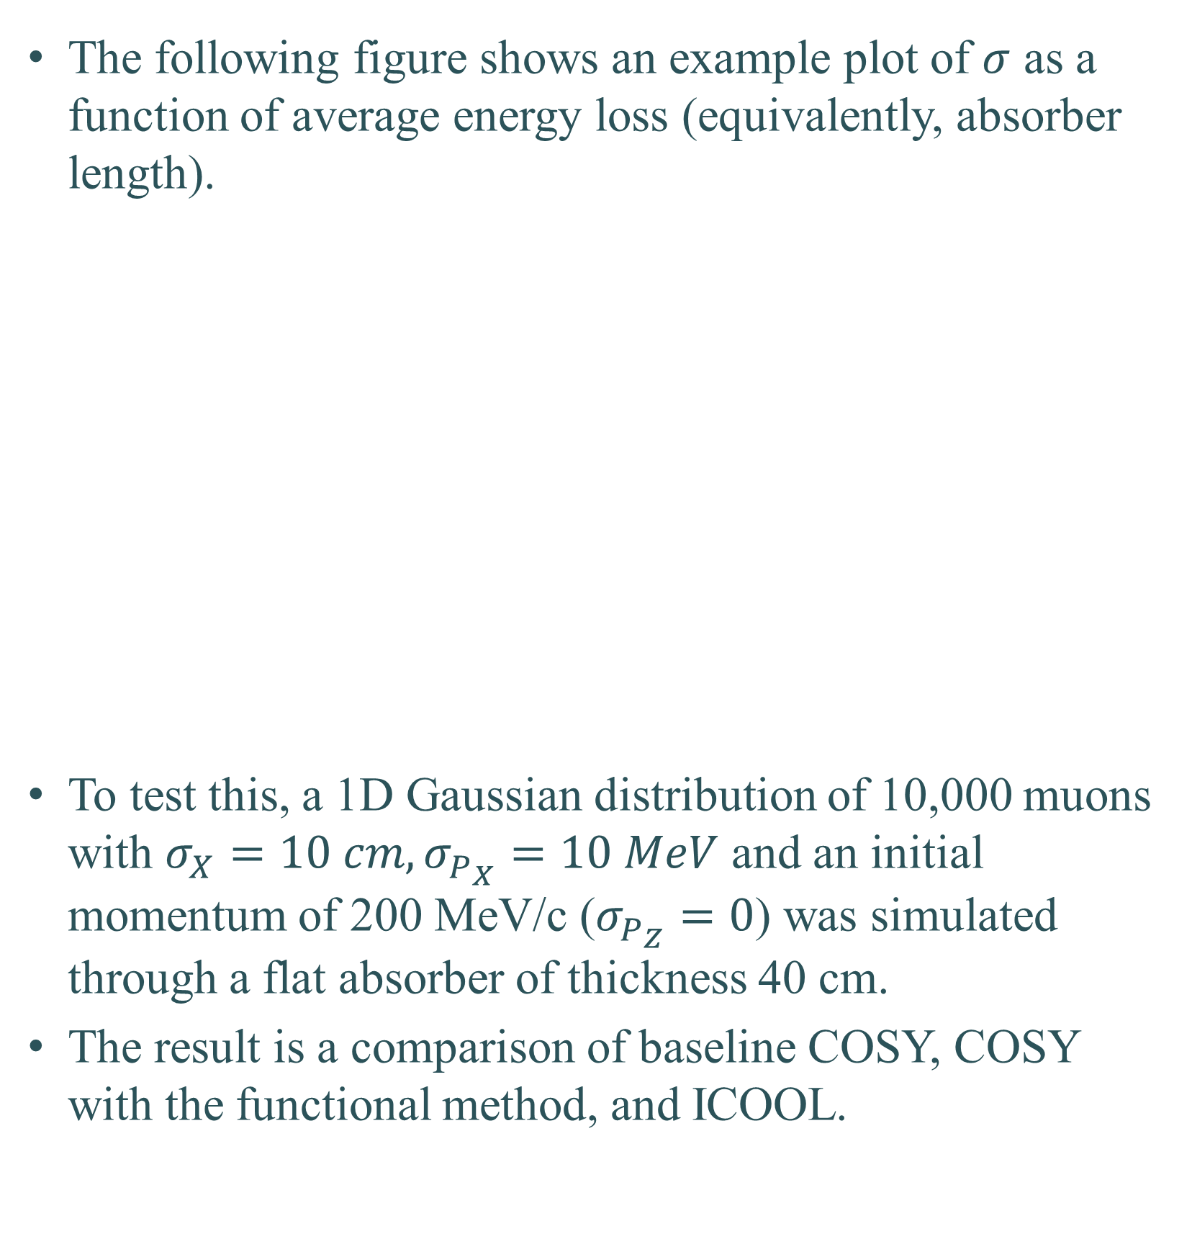
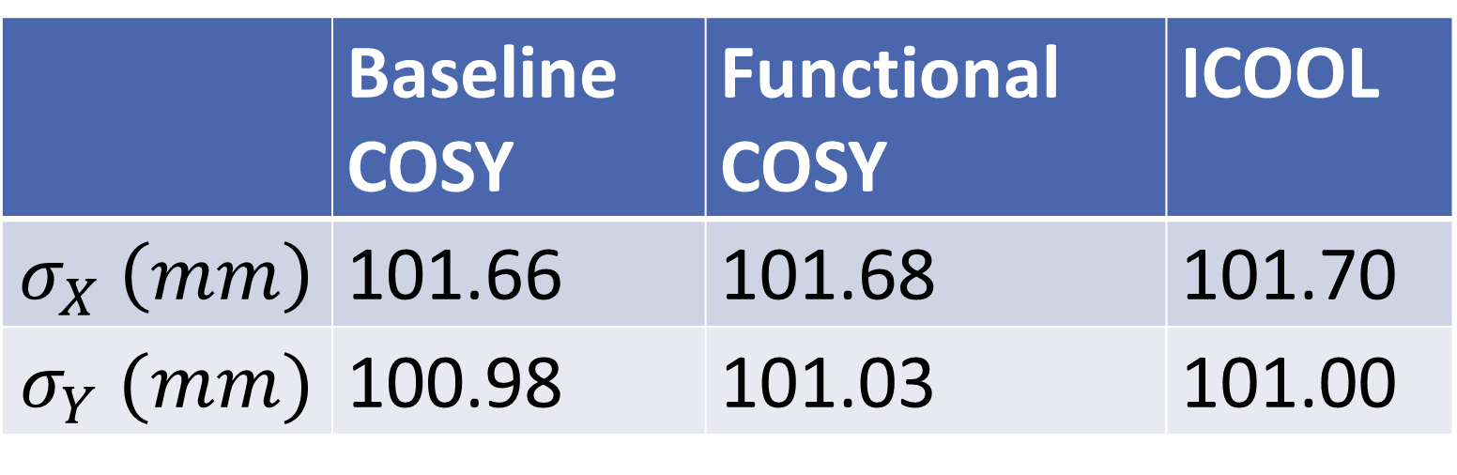
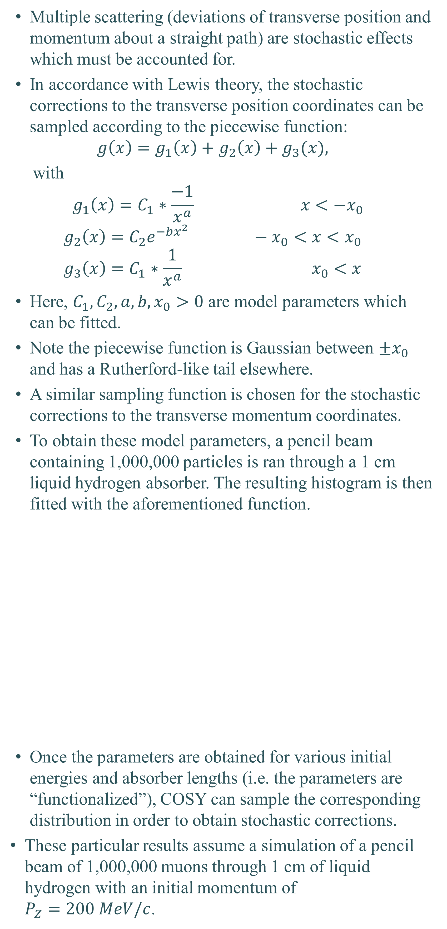
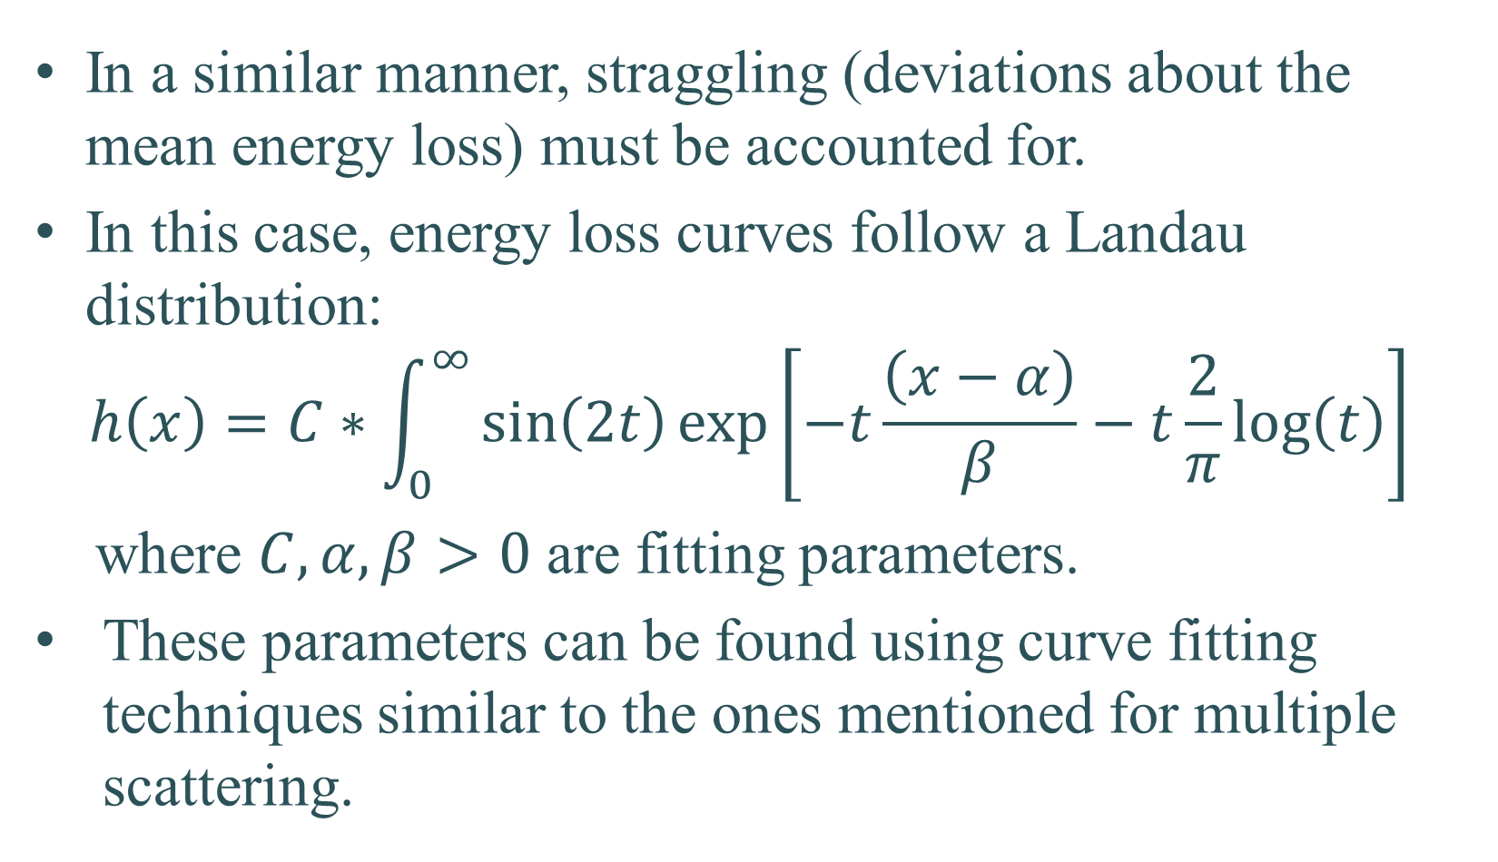
The Development of Stochastic Processes in COSY Infinity#
J. Kunz*, P. Snopok, Illinois Institute of Technology, Chicago, IL 60616, USA
M. Berz, K. Makino, Michigan State University, East Lansing, MI 48824, USA
Introduction
Stochastic Effects
Transverse Coordinates: Multiple Scattering
Longitudinal Coordinates: Straggling
Muons for acceleration are produced as tertiary particles which result from the collision of a proton beam onto a target.
Ionization cooling methods have been proposed to reduce the size of the muon beam as it passes through matter.
To confirm feasibility and to perfect this technique, a detailed simulation is necessary cross-checked by multiple codes.
COSY Infinity uses transfer map techniques for fast simulations. However, currently it only supports deterministic processes when sending a beam of particles through matter.
To account for stochastic effects, a perturbative random kick is applied at the end of each absorber. The strength and variety of this emulative kick can be functionalized by the initial energy and the amount of absorber which was traversed.
The end goal is to use COSY’s fast transfer map method in conjunction with this “functional method” in order to simulate a realistic beam of particles as they traverse a variety of matter types.
Stochastic effects are effects which necessarily have a random nature.
An example of this can be seen in the figure below, where ten identical particles “just happen” to scatter at different angles.
If the simulation in the figure below had been executed in COSY, all ten particles would travel straight through without deviation.
The plots below show a pencil beam of 10,000 muons with an initial momentum of 200 MeV/c through various lengths of liquid hydrogen.
These pseudo-random effects follow predictable patterns.
For example, the transverse position distributions are roughly Gaussian with μ = 0.
The Gaussian σ, however, depends on two parameters: initial energy and absorber length.
Multiple scattering (deviations of transverse position and momentum about a straight path) are stochastic effects which must be accounted for.
In accordance with Lewis theory, the stochastic corrections to the transverse position coordinates can be sampled according to the piecewise function:
$$g\left(x\right)=g_{1}\left(x\right)+g_{2}\left(x\right)+g_{3}(x),$$
with
$$g_{1}\left(x\right)=C_{1}∗\frac{−1}{x^{a}} x<−x_{0}$$
$$g_{2}\left(x\right)=C_{2}e^{−bx^{2}} −x_{0}<x<x_{0}$$
$$g_{3}\left(x\right)=C_{1}∗\frac{1}{x^{a}} x_{0}<x$$
Here, $C_{1}, C_{2}, a, b, x_{0}>0$ are model parameters which can be fitted.
Note the piecewise function is Gaussian between $±x_{0}$ and has a Rutherford-like tail elsewhere.
A similar sampling function is chosen for the stochastic corrections to the transverse momentum coordinates.
To obtain these model parameters, a pencil beam containing 1,000,000 particles is ran through a 1 cm liquid hydrogen absorber. The resulting histogram is then fitted with the aforementioned function.
Once the parameters are obtained for various initial energies and absorber lengths (i.e. the parameters are “functionalized”), COSY can sample the corresponding distribution in order to obtain stochastic corrections.
These particular results assume a simulation of a pencil beam of 1,000,000 muons through 1 cm of liquid hydrogen with an initial momentum of $P_{Z}=200 MeV/c$.
In a similar manner, straggling (deviations about the mean energy loss) must be accounted for.
In this case, energy loss curves follow a Landau distribution:
$$h\left(x\right)=C∗\int_{0}^{∞}{\sin\left(2t\right)\exp\left[−t\frac{\left(x−α\right)}{β}−t\frac{2}{π}log\left(t\right)\right]}$$
where $C,α, β>0$ are fitting parameters.
These parameters can be found using curve fitting techniques similar to the ones mentioned for multiple scattering.
Simulation Results
Motivation
The following figure shows an example plot of $σ$ as a function of average energy loss (equivalently, absorber length).
To test this, a 1D Gaussian distribution of 10,000 muons with $σ_{X}=10 cm, σ_{P_{X}}=10 MeV$ and an initial momentum of 200 MeV/c ($σ_{P_{Z}}=0$) was simulated through a flat absorber of thickness 40 cm.
The result is a comparison of baseline COSY, COSY with the functional method, and ICOOL.
Research primarily focuses on muons through matter, and specifically as it pertains to the muon accelerator program.
A high energy muon collider could have CoM energies up to 6 TeV while still fitting on the existing Fermilab complex (~6 km in circumference), as seen below.
A muon collider as a Higgs factory (CoM ~125 GeV) is also an exciting possibility, as the Higgs coupling to leptons has never been conclusively observed.
Moreover, since muon branching fractions are 100% to two neutrinos, a muon accelerator could serve as a luminous neutrino beam source.
 | Baseline COSY | Functional COSY | ICOOL
$$σ_{X} \left(mm\right)$$ | 101.66 | 101.68 | 101.70
$$σ_{Y} (mm)$$ | 100.98 | 101.03 | 101.00
#Work supported by the Department of Energy *kunz.josiah@gmail.com

