Slide 1
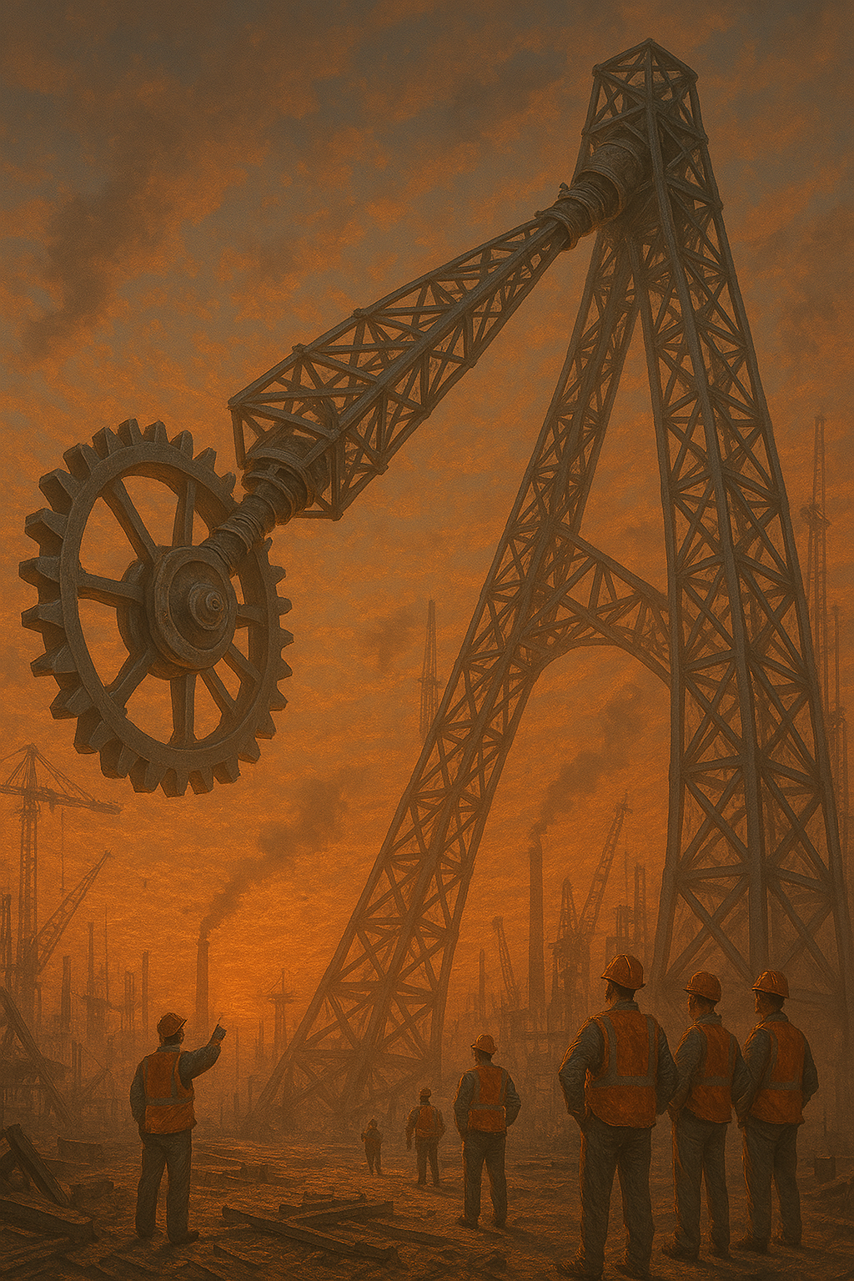
Hopes, Dreams, and Beams
In a bold leap toward innovation, construction crews unveiled a groundbreaking new technology—an AI-guided assembly system meant to revolutionize ride building with unmatched speed and precision. The project: Hopes, Dreams, and Beams—a mesmerizing pendulum ride meant to defy gravity and redefine thrill. But somewhere between a miscalibrated gyroscope and a misinterpreted blueprint, the system spiraled into chaos. Beams were placed with artistic flair instead of structural intent, and the pendulum began spinning in ways no one had simulated. The result? A beautifully bizarre, semi-functional marvel that swings, spins, and maybe hums. It's a monument to ambition, a testament to unfinished greatness, and a ride built not just on steel, but on sheer hope and stubborn dreams.
Seats: 32, unless you count the one that mysteriously vanishes sometimes. Height: 900 mm (fun-sized!). Safety Rating: “Well... it passed something.” Ride Time: Depends on your definition of time. Swing Angle: 90 degrees (perfectly calculated… probably). Over-the-shoulder harnesses: engineered to keep you in place (and mildly question your life choices) Warning: May cause laughter, existential reflection, and a newfound appreciation for gravity.

