Slide 1
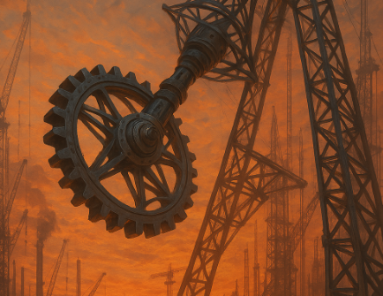
Hopes, Dreams, and Beams
Story:
Earlier this year, construction crews implemented a groundbreaking new technology into their routine construction processes—an AI-guided assembly system. However, somewhere between a mis-calibrated coding schematic and a misinterpreted blueprint, the system spiraled into chaos. The result? A semi-functional marvel that swings, spins, and maybe hums. If you dare to ride this halfway hanger, step right up and take the challenge.
Ride Details:
Seats: 32, unless you count the one that fell off yesterday.
Height: 900 mm (fun-sized!).
Ride Time: 1 minute, depending on your definition of time.
Swing Angle: 90 degrees (perfectly calculated… probably).
Over-the-shoulder harnesses: engineered to keep you in place (and mildly question your life choices).
Warning: May cause a mild fear of life following by extreme happiness.

