Slide 1
Project 1
Hari Ramanan, John McCain, Audrey Evans, Alan Wang

Slide 2
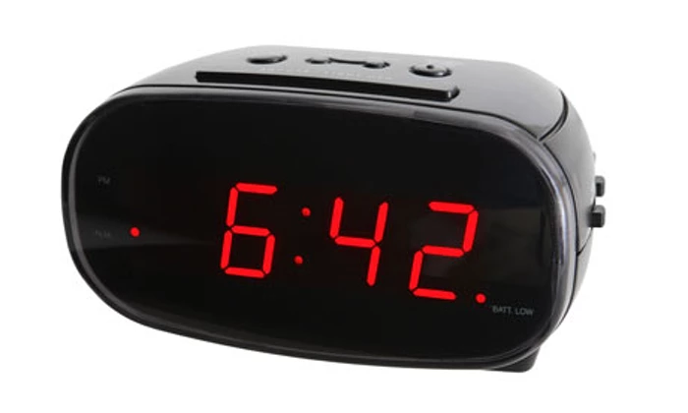
Demo

Slide 3
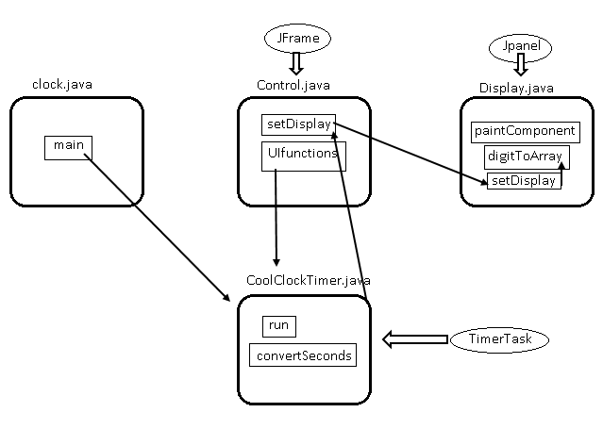
Platform
Java
Javaswing
GUI

Slide 4
Work allocation
John – GUI, Control.java, Display.java
Alan – user interface
Hari and Audrey– CoolClockTimer.java

Slide 5
Challenges
Work allocation
Choosing what library to use for timing
Java documentation

Slide 6
Reflection
It's good to have people who are specialized
Scrum is good.

