Slide 1
R Markdown to PowerPoint

Slide 2
Why?
“Reports of my death have been greatly exaggerated”.
— Mark Twain

Slide 3
How?
Given that we communicate with PowerPoint, how can we do so most efficiently? In particular, how can we close the distance between our analyses and pptx outputs?
With R Markdown!

Slide 4
Example, Vanilla
In the RStudio IDE, click on File > New File > R Markdown…
Then in the pop-up, click Presentation > PowerPoint > OK.
Then click Knit. Voila!

Slide 5
Example, Vanilla w/Chocolate Sauce
PowerPoint usage is often correlated with a desire for things to look a certain way. Fortunately, we can export directly into an existing PowerPoint template, which means the slides will look a certain way, have a certain logo… These sort of aesthetic changes are often the most painful to replicate and so this functionality can save us a great deal of time.
Let’s run through an example. First, in the RStudio IDE, let’s open a new text file: File > New File > Text File. Then, go to the R Markdown book, Section 4.4 and copy that code into a the Text file, save it as “example_for_template.Rmd”, and Knit it. Next, download a PowerPoint template into the same directory where you just saved your file. Then edit the start of your .Rmd script like in Section 4.4.1, changing the reference_doc to be the name of your PowerPoint template you saved. Save and Knit the R Markdown file again. It should populate the slides with that templates formatting already in place.

Slide 6
FAQ’s, how to make bullets? Use a dash
Bullet 1
Bullet 2
Bullet 3

Slide 7
FAQ’s, can I insert a plot or table? Yes
Note that any tables or images will be on their own slides. Like the next slide.

Slide 8
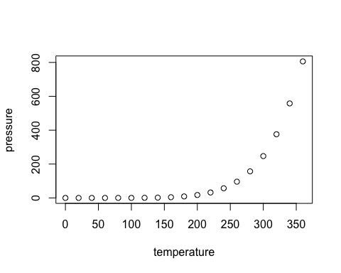

Slide 9
The Official Guide
To dig further, please see our book on R Markdown, and this section in particular.

