Slide 1
ZFP Hardware Implementation
Floating-point Compression
Scott Lloyd, Peter Lindstrom

Slide 2
Introduction
The trend in HPC is an effective decrease in memory bandwidth per core
Substantial increase in core counts
Little increase in memory bandwidth
Other bandwidth limitations exist between
CPU and GPU memory
System nodes
Node memory and storage
Compression has the potential to
Reduce data movement across communication channels
Reduce memory footprint for floating-point arrays
ZFP, implemented in software, is gaining traction
Performance gains are limited to spare compute cycles
A hardware implementation of ZFP has the potential to raise the bar on performance

Slide 3
Hardware Description of ZFP
The hardware implementation of ZFP has been validated with the software implementation of ZFP.
The implementation in SystemC makes use of C++ templates to specify the bit width of floating-point numbers and the array dimension of the encoder.
A test bench program has been created with several test cases, some with continuous data that is ideal for ZFP, and others with extreme cases containing numbers near or at the maximum or minimum values supported by the number format.
Notes:
The hardware implementation of ZFP has been validated with the software implementation of ZFP. The SystemC ZFP implementation makes use of C++ templates to specify the bit width of floating-point numbers and the array dimension of the encoder. A test bench program has been created with several test cases, some with continuous data that is ideal for ZFP, and others with extreme cases containing numbers near or at the maximum or minimum values supported by the number format.

Slide 4
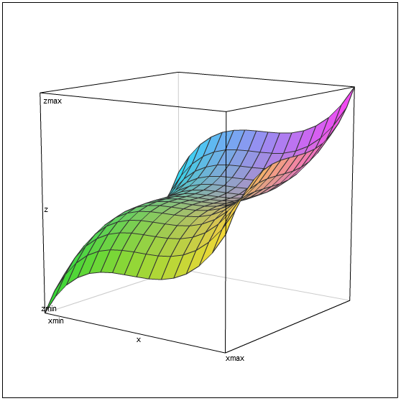
Testbench Options
Typing "make help" will show the compile options:
$ make help
Make targets (make <targ>):
all build the target
run run the target
clean delete target build products
vars show makefile variables
Compile options through define (make D=DEF1=m,DEF2=n,...):
DATAW=<int> bit width of encoded data stream
DIMS=<int> number of dimensions
PREC=<int> precison of floating-point numbers
VCD output a value change dump (VCD) file
ZCHK use ZFP lib for checking encoded blocks
P_DATA print data buffers, uncompressed and compressed
P_IO print I/O, time stamps and data
Makefile variables (make VAR1=x VAR2=y):
OPT=<str> optimization flags
RUN_ARGS="<arg1> <arg2> ..." target run time arguments
Test | Description
-t1 | Hard coded numbers borrowed from the speed test in the ZFP software release (examples/speed.c)
-t2 | All zero
-t3 | Range from zero upward, increment by numeric_limits<R>::min() or denorm_min() if denomals are supported
-t4 | Range from normal numbers down to minimum (or subnorm if supported), increment /= 2
-t5 | Range from normal numbers up to maximum (not including infinity), increment *= 2
-t6 | Continuous function, see 2-D example in figure below, f() = e*(x³ + y³ + ...), (0,0,0) is at the center
Run time options can be displayed by typing "./test ?":
$ ./test ?
Usage: test -b<int> -r<fp> -t<int>
-b number of blocks, default: 1
-r rate, default: 64
-t test case, default: 1
Six tests are available:
Notes:
To prevent the data in test case 6 from being too smooth or regular, +- 0.1% jitter is added to the function value.
More detail about the test cases can be found in the source file "tcase.h".

Slide 5
ZFP Compression Pipeline
encode
Normalize block, convert to integer
Transform, reorder block, convert to negabinary
Block (4^{d}) of floating-point numbers enter in a stream
Find max
exponent
Block buffer
Encode bit planes
Serialize bit planes
Reduced stream of bits for block
find_emax
FP
fwd_cast
encode_block
block_
buffer
encode_ints
plane
encode_stream
FP
Stream Split
block
block
block
emax
ssplit
emax
4^{d}+2
1
4^{d}
6d+1
1
2
p+3
minbits
maxbits
maxprec
minexp
FIFO
Estimated cycles
d = block dimension
p = bit planes
Configuration
from CPU

Slide 6
ZFP Decompression Pipeline
decode
Convert from
negabinary,
reorder block,
transform
Deserialize
bit planes
Decode bit
planes
Block buffer
Convert from
integer to FP
Block (4^{d}) of floating-point numbers exit in a stream
ZFP encoded stream of bits for block
decode_stream
plane
decode_ints
block_
buffer
decode_block
block
inv_cast
block
block
FP
emax
emax
p+3
2
1
6d+1
4^{d}
minbits
maxbits
maxprec
minexp
FIFO
Estimated cycles
d = block dimension
p = bit planes
Configuration
from CPU
Notes:
The decompression pipeline is the inverse of the compression pipeline. For decompression, the find_emax sub module is not needed.

Slide 7
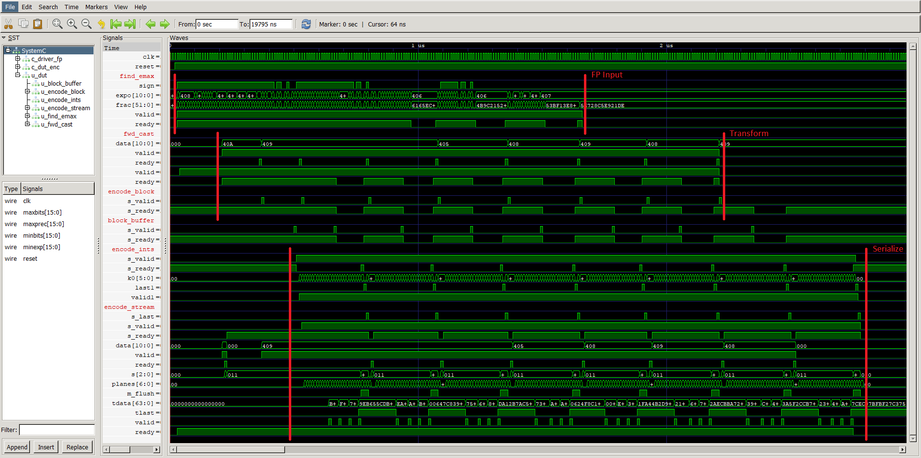
ZFP Encode Wave Diagram
2-D example encoding 8 blocks of 64-bit numbers at a fixed rate of 16 bits/num
Gaps (low value) on a “ready” signal indicates that a down stream module is not ready for input and that the preceding module must wait.
Notes:
This is a waveform diagram showing the flow of data through the ZFP encoding pipeline. Floating-point numbers enter the unit as a stream and compressed data exits the unit as a stream of words (flits). Sub-modules are identified along the left of the diagram. Signal names are also shown, which are mostly the ready-valid handshake signals between modules. The red markup identifies three major groups of sub-modules, FP Input, Transform, and Serialize. Each of these groups can be seen to function in parallel with a small amount of latency between groups. Test case 6 (continuous function) is shown encoding 8, 2-D blocks at a rate of 16 bits per 64-bit floating-point number. Back pressure can be seen on the ready signal at the input of the find_emax module (low value, gaps).

Slide 8
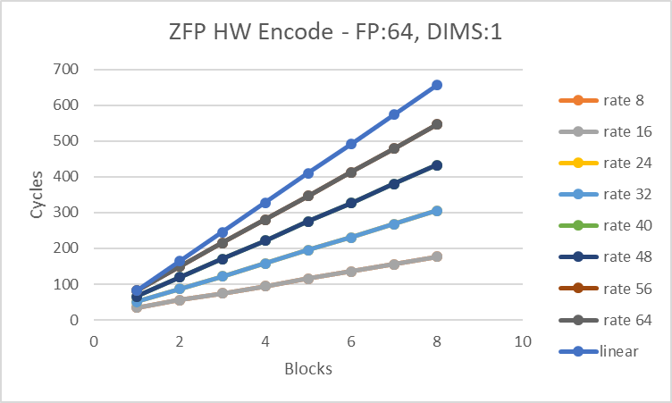
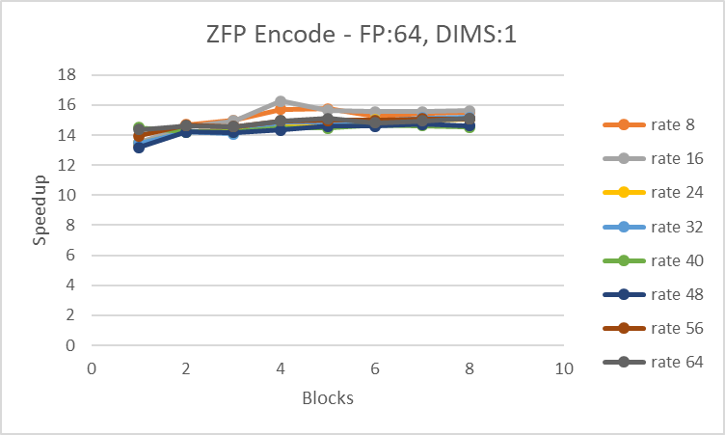
ZFP Hardware Encode Performance 1-D Blocks
Up to 15x
“linear” extrapolates the cycle time for one block (rate 64) to many blocks. It shows the benefit of encoding batches of blocks through the hardware pipeline.
Compared with single x86_64 core, Intel i7, Linux
Notes:
Using test case 6 with a sweep of parameters varying the dimension, the number of blocks encoded, and the compression rate; cycle times were recorded for both the hardware and software implementations. For the hardware cycles, the integrated SystemC event simulator was used. For software cycles, the x86 cycle counter was accessed with inline assembly instructions using the public release of ZFP from github. The "linear" data set in the charts extrapolates the cycle time of encoding one block (rate 64) to many blocks, all encoded one at a time. It shows the benefit of encoding batches of blocks through the hardware pipeline. Batch timing starts when the first floating-point number enters the unit and stops when the last word (flit) of compressed data leaves the unit. The benefit of encoding blocks in a batch is nearly a factor of 3 in the 3-D case. Speedup of the hardware implementation over the software ranges from about 15x in the 1-D case to over 200x in the 3-D case.

Slide 9
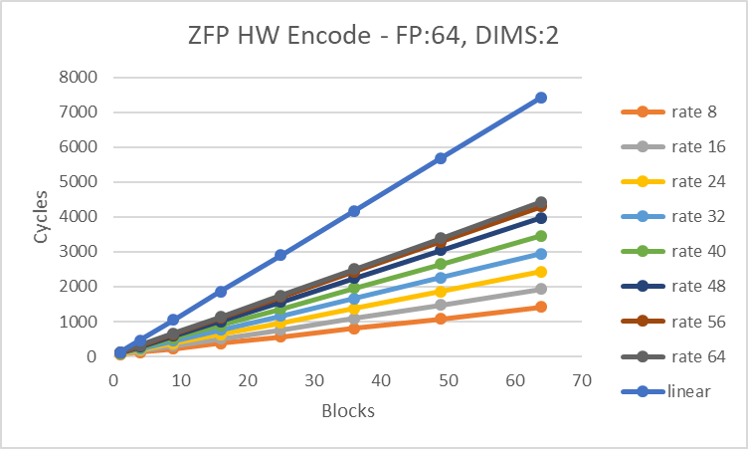
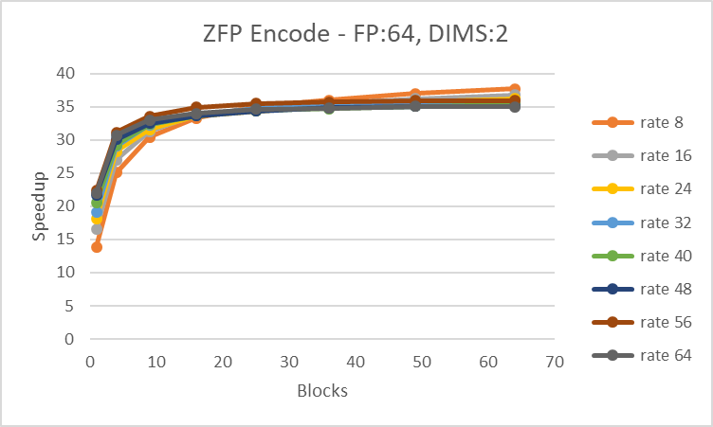
ZFP Hardware Encode Performance 2-D Blocks
Up to 37x
“linear” extrapolates the cycle time for one block (rate 64) to many blocks. It shows the benefit of encoding batches of blocks through the hardware pipeline.
Compared with single x86_64 core, Intel i7, Linux

Slide 10
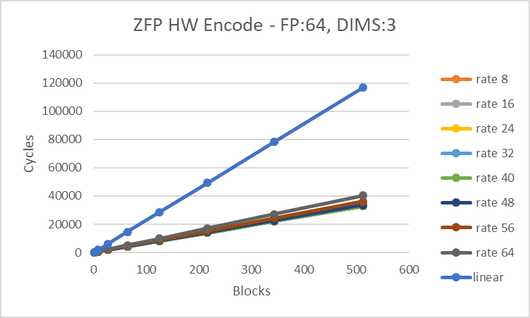
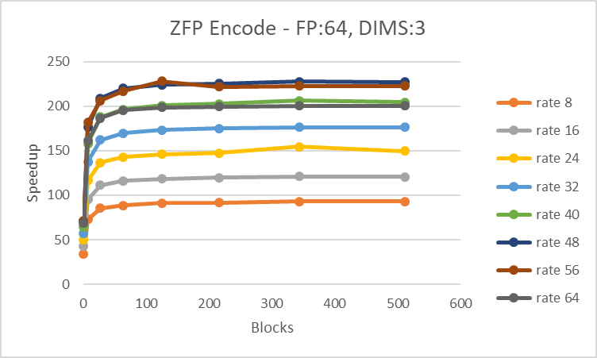
ZFP Hardware Encode Performance 3-D Blocks
Up to 227x
“linear” extrapolates the cycle time for one block (rate 64) to many blocks. It shows the benefit of encoding batches of blocks through the hardware pipeline.
Compared with single x86_64 core, Intel i7, Linux

Slide 11
Application Runtime with ZFP Cached Arrays
Notes:
LULESH - Livermore Unstructured Lagrangian Explicit Shock Hydrodynamics
Diffusion - forward Euler finite difference solution to the heat equation on a 2D grid

Slide 12
Conclusions
ZFP IP can target an FPGA or be added to a new chip design
Latency for compressing one block ranges between:
34 - 84 cycles in 1-D
64 - 118 cycles in 2-D
172 - 247 cycles in 3-D
Speedup of the hardware implementation over the software ranges from about 15x for 1-D arrays to over 200x for 3-D arrays
The implementation can support performance studies for applications of interest to LLNL
Using simulation on a standard platform
Using FPGA emulation with LiME

Slide 13
Disclaimer
This document was prepared as an account of work sponsored by an agency of the United States government. Neither the United States government nor Lawrence Livermore National Security, LLC, nor any of their employees makes any warranty, expressed or implied, or assumes any legal liability or responsibility for the accuracy, completeness, or usefulness of any information, apparatus, product, or process disclosed, or represents that its use would not infringe privately owned rights. Reference herein to any specific commercial product, process, or service by trade name, trademark, manufacturer, or otherwise does not necessarily constitute or imply its endorsement, recommendation, or favoring by the United States government or Lawrence Livermore National Security, LLC. The views and opinions of authors expressed herein do not necessarily state or reflect those of the United States government or Lawrence Livermore National Security, LLC, and shall not be used for advertising or product endorsement purposes.

