Slide 1
Uploading Files to GBIF Collections

Slide 2
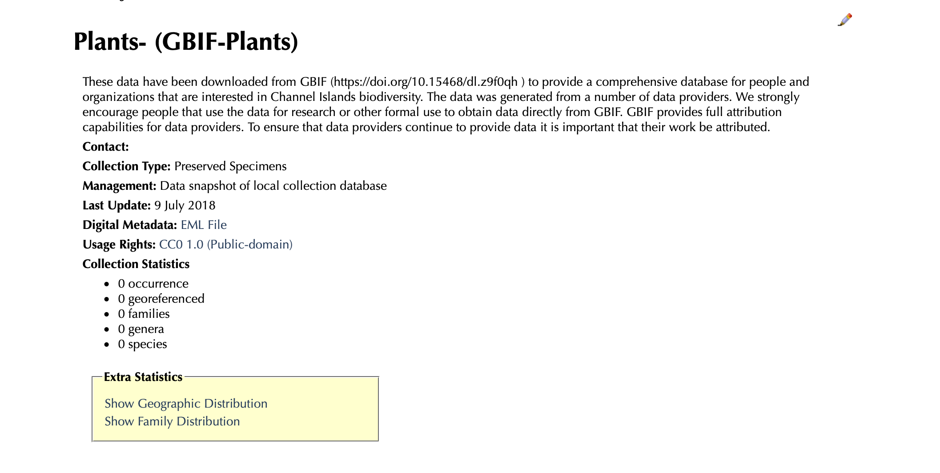
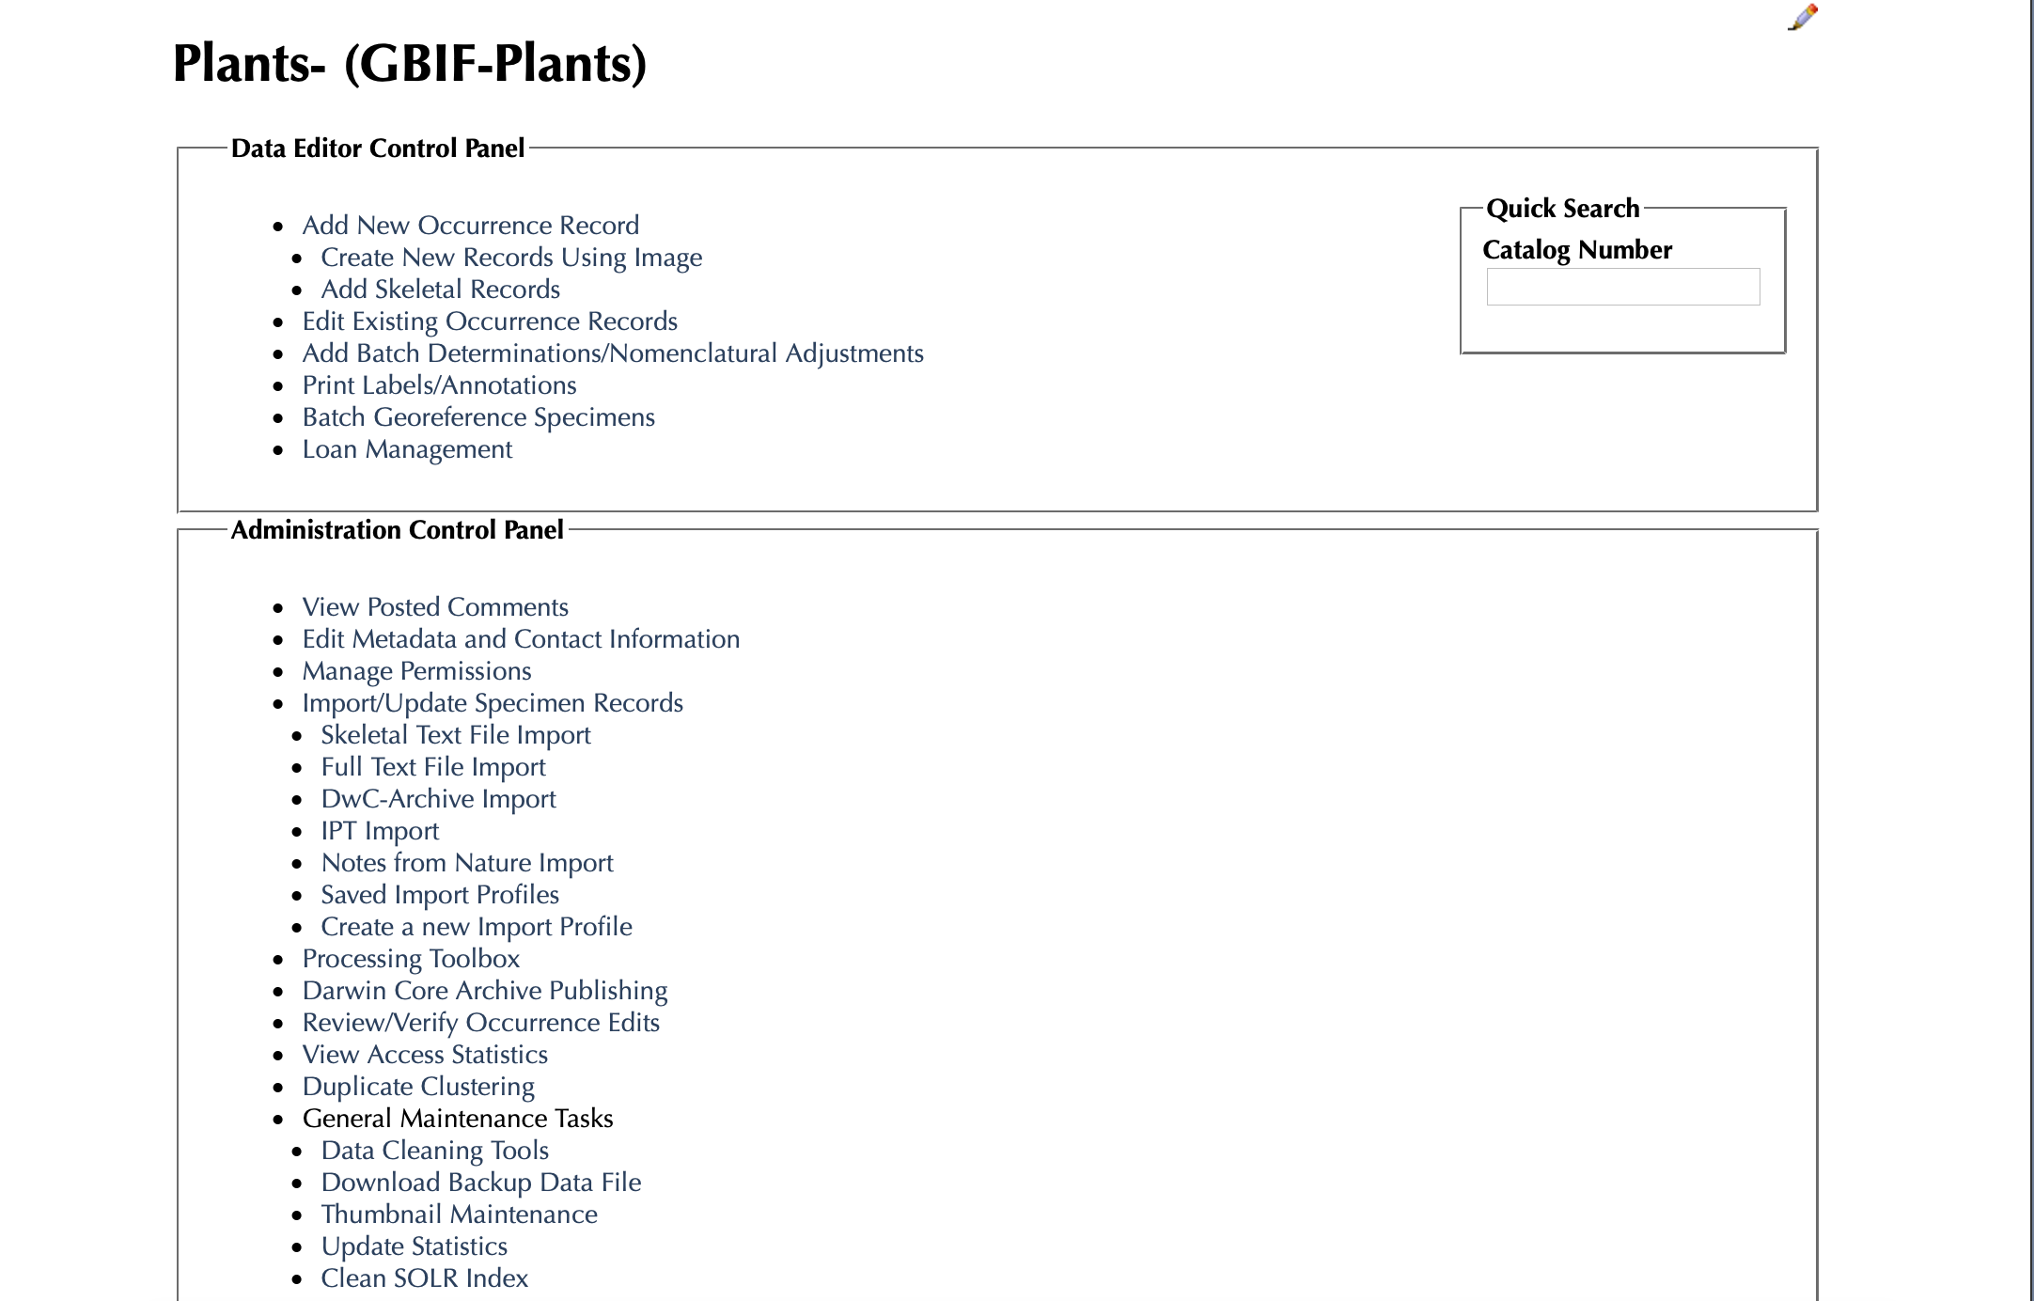
STEP 1: Go to collection page and select the pencil
STEP 2: Click on ”Import/Update Specimen Records” and choose Full Text File Import from the list

Slide 3
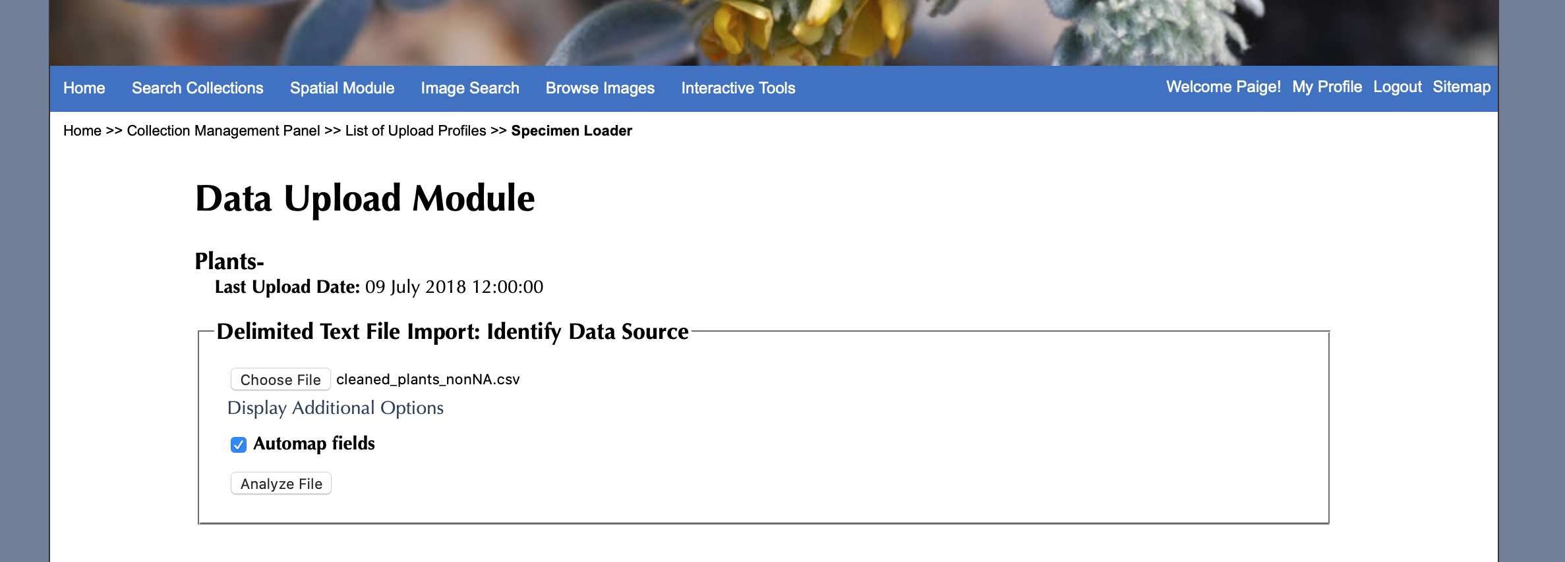
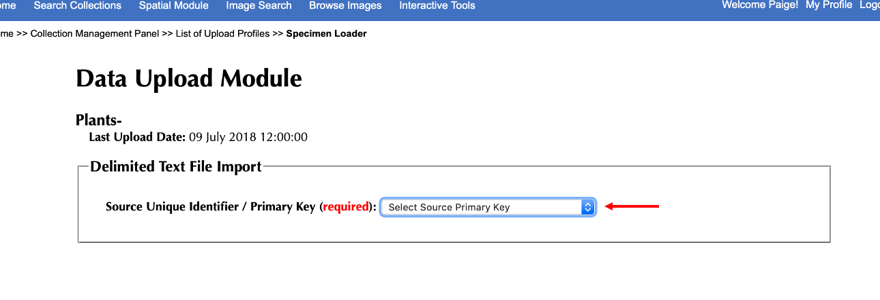
STEP 3: Choose your csv and then click “Analyze File”
STEP 4: Choose your source primary key to be gbifid (from the dropdown)

Slide 4
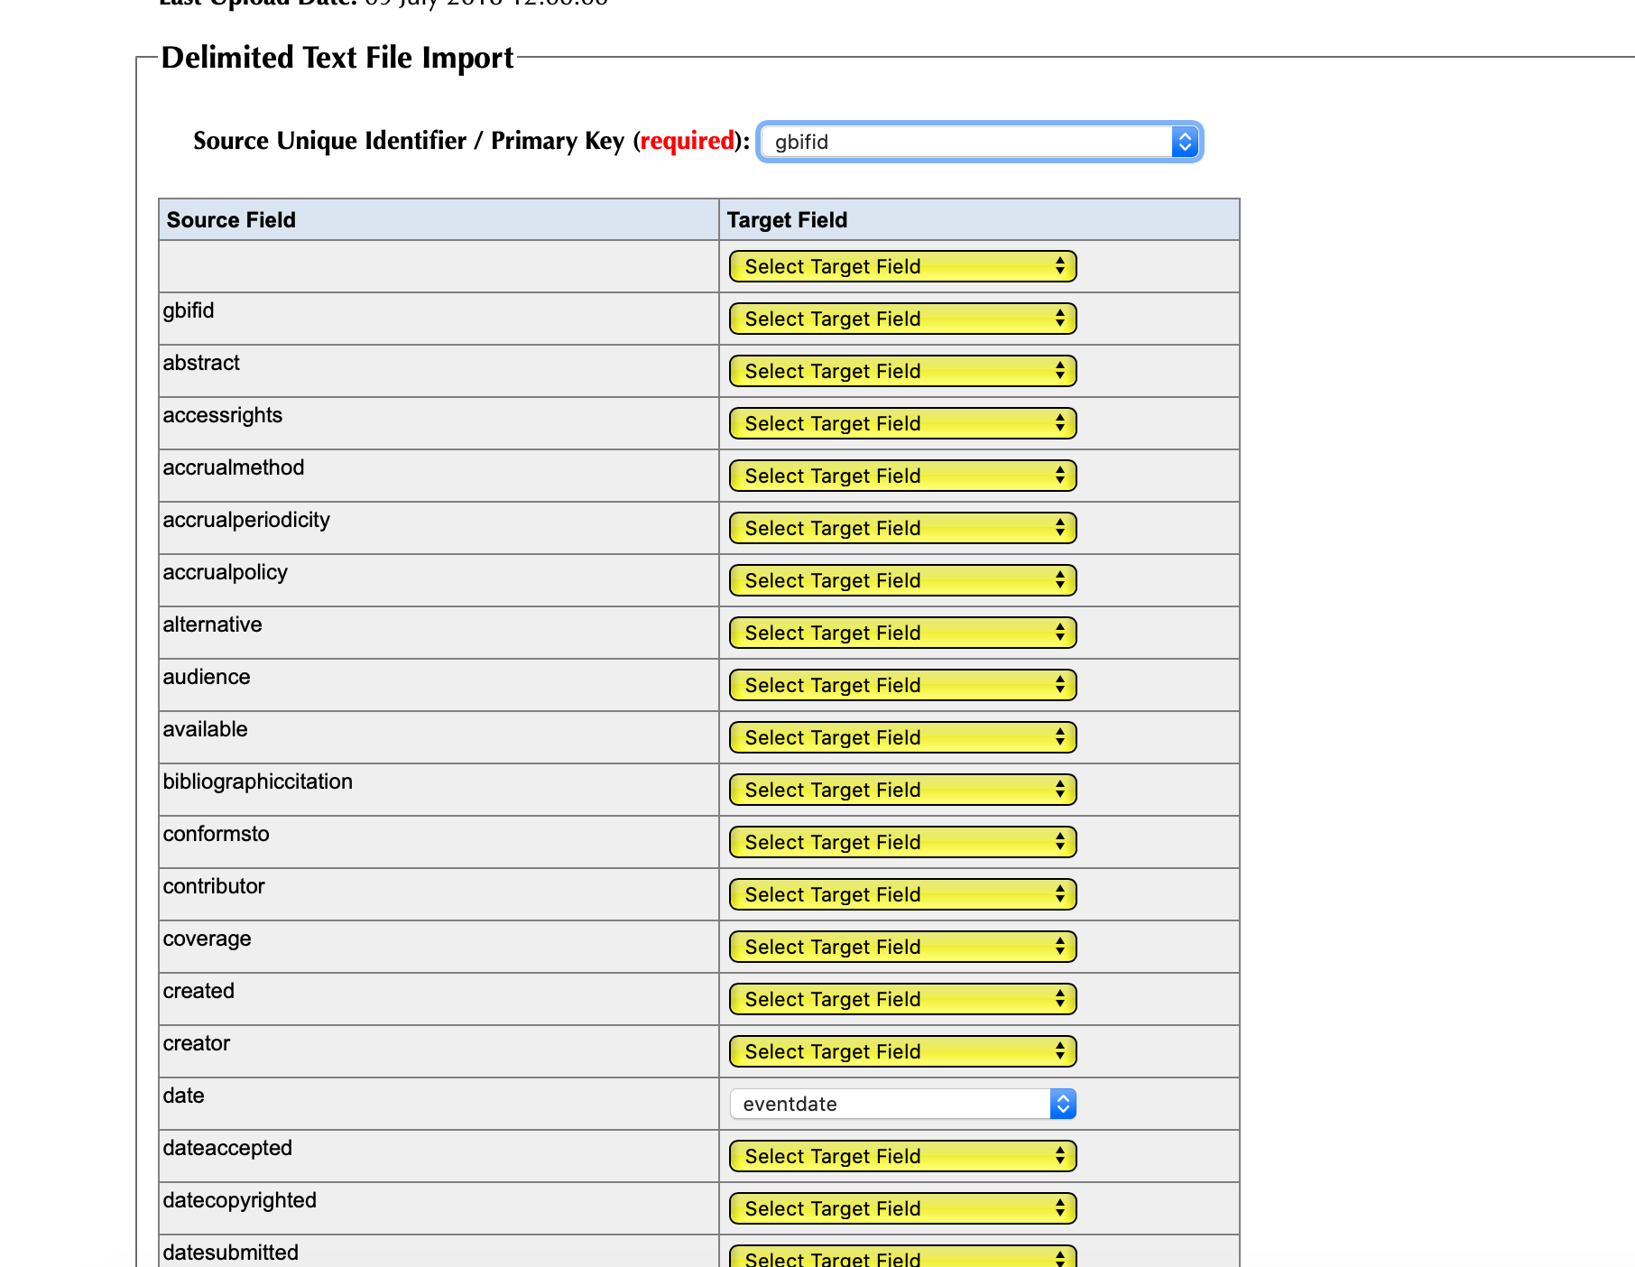
STEP 5: On this table, you leave everything alone except 3 things. Change these 3 things:
Make “date” map to “Leave Field Unmapped”
Make “species” map to to “sciname”
Make “scientificname” map to “scientificname”
**These need to be changed so that a) website statistics are correct and b) genus and species columns in the database are correct
For example, change this one

Slide 5
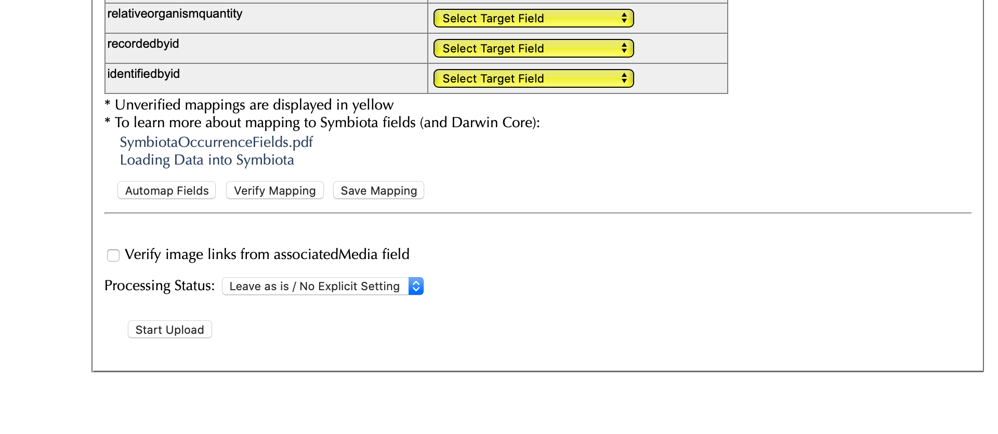
STEP 6: Hit “start upload”

Slide 6
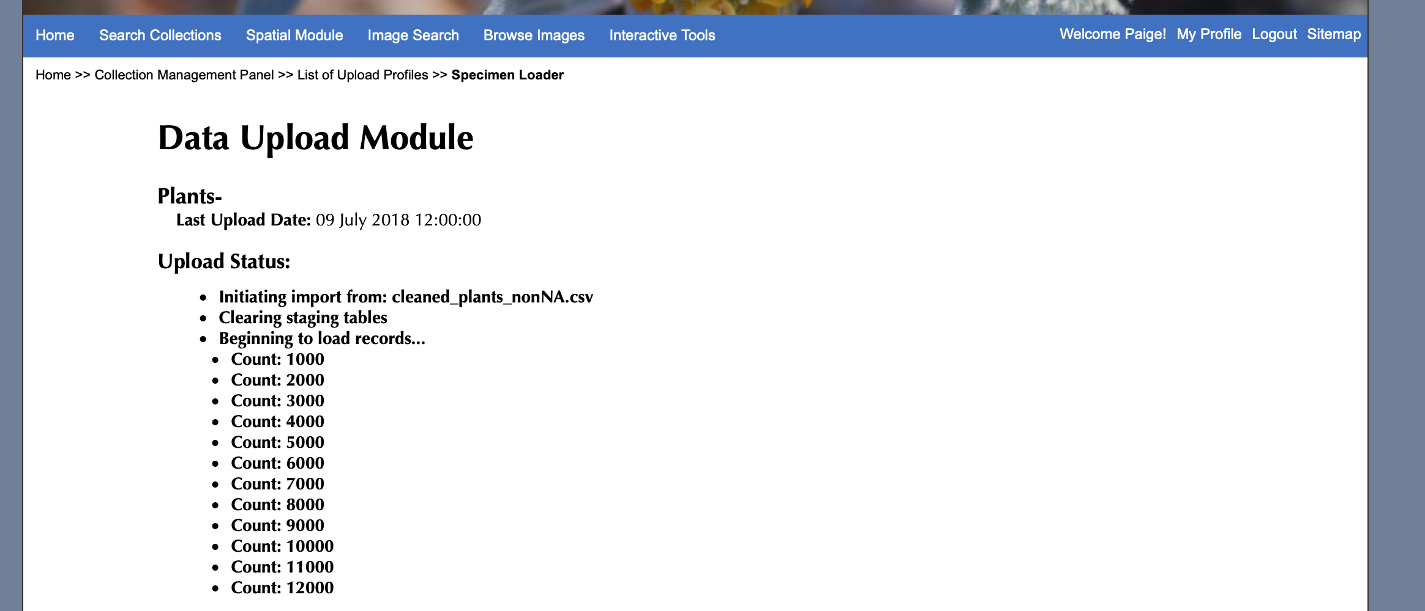
STEP 7: Wait for it to finish uploading, it will look like this as it goes through the process:

Slide 7
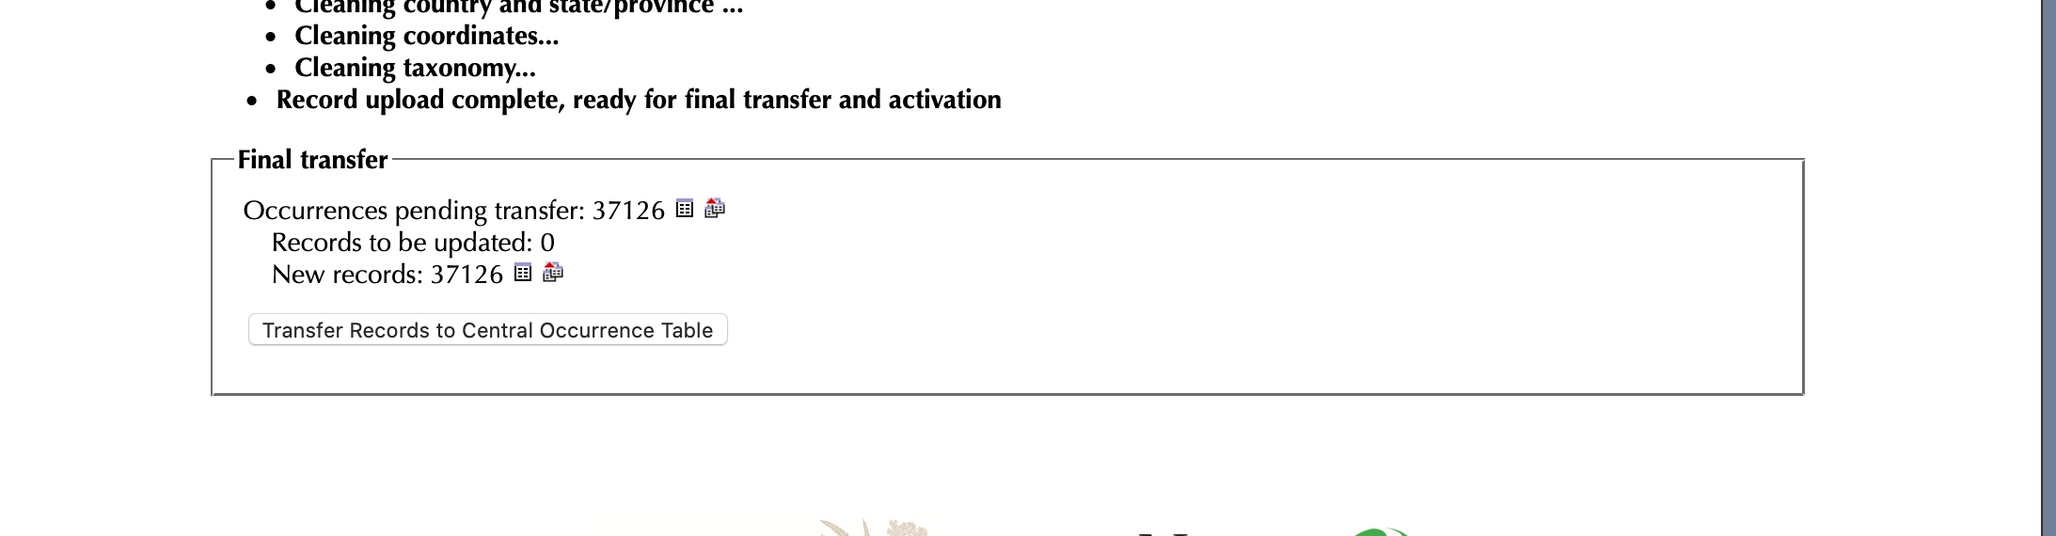
STEP 8: Once finished, you will be informed how many records are being added or updated.
Select this
NOTE: This screenshot shows that none are being updated and everything being added is new.
In the future, the report should indicate that some ## are new and some ## are getting updated. This screenshot is just an example

Slide 8
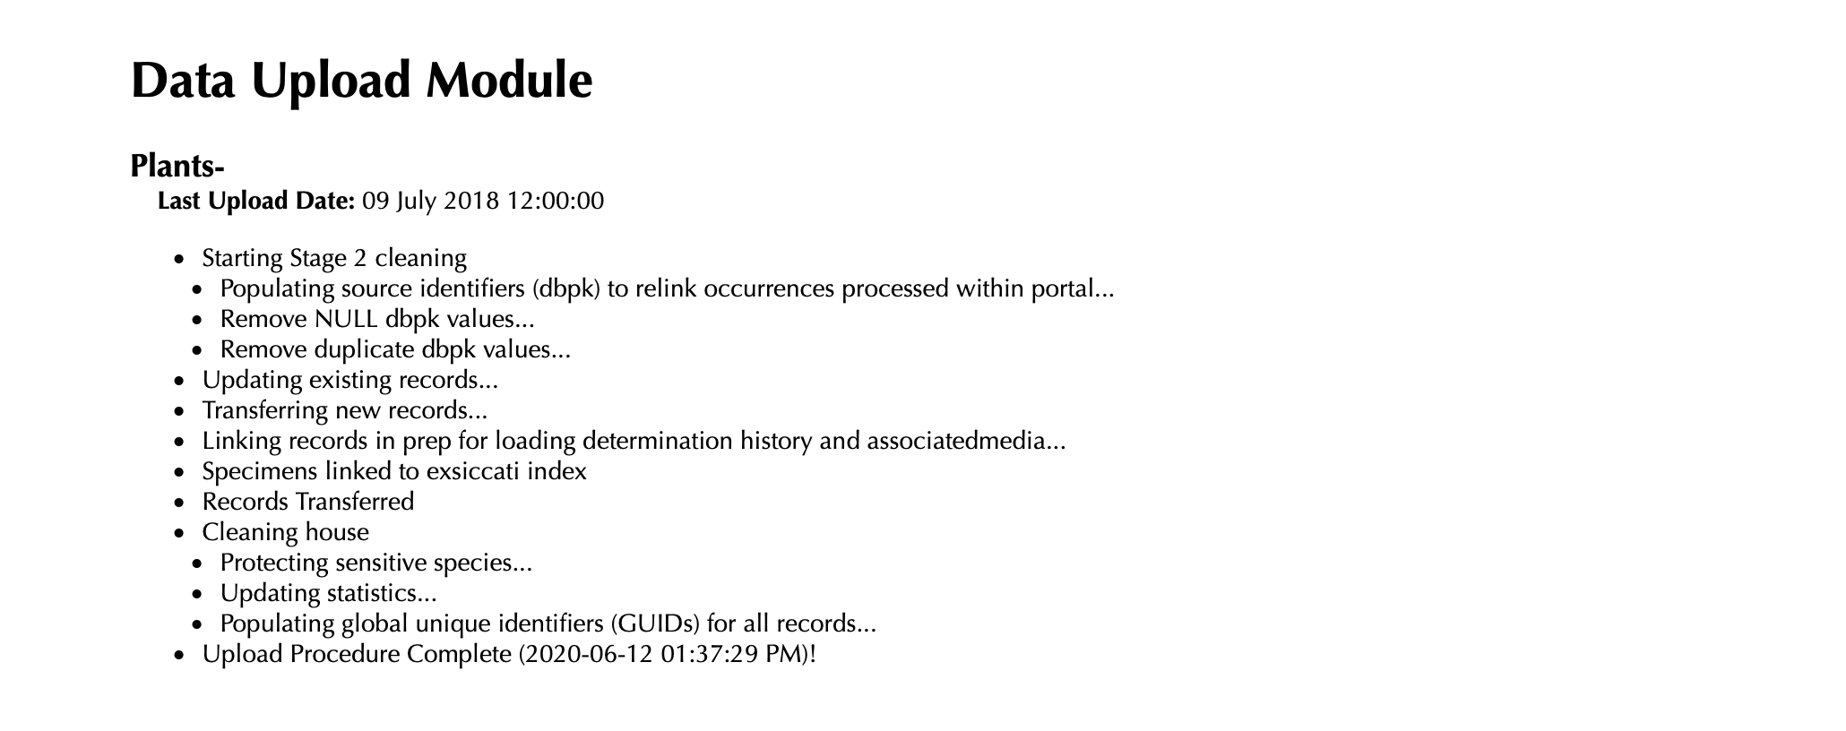
STEP 9: Wait for the process to complete. You know that it is done when the last sentence is the following:

Slide 9
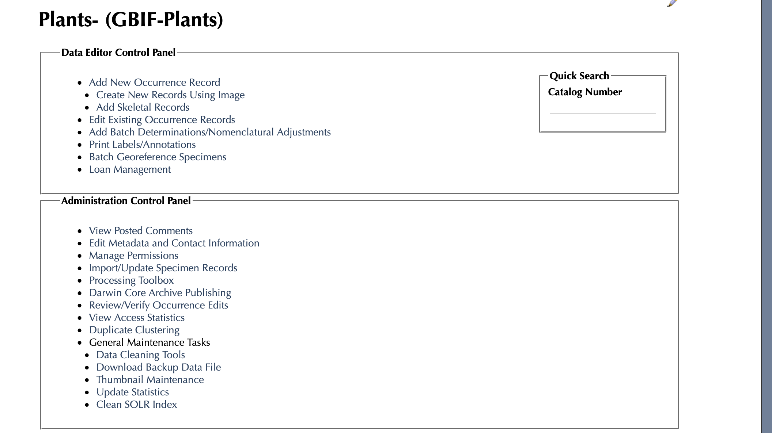
STEP 10: Need to go back to the collection page and update the statistics

