Slide 1
Possible Monte Carlo Seed Use Error In the MARS Model (with feedback from GE)
SRP Resource Planning Team
Biweekly Touchpoint with Ops
2019-03-22

Slide 2
Description of Monte Carlo Application in MARS
The Monte Carlo simulation uses a random number generator to determine the availability of units through time.
The seed for the random number generator should be a six- to eight-digit integer ending in 1, 3, 7, or 9.
This seed will be used to generate the seeds used by the random number generators assigned to the individual generating units.
INTVAL(8)
Input 1 to use the same random number generator seed for each year of a multi-year study.
Otherwise, a new random seed will be generated for each year. The default is 0.

Slide 3
RNA 2018 Use of Monte Carlo Seed
Seed for Random Number Generator (ISEED)
73951247
This seed has remained unchanged for all documented case runs going back to 2009. We do not have data beyond that.
Same Seed for Multi-Year (INTVAL8)
0
This is the default value. It tells MARS to generate a new random seed for every year of the study.

Slide 4
Description of Possible Error
When running MARS, the Monte Carlo Seed remains unchanged for all years of the study
We run our 10-year study using 10 separate cases in MARS.
This sets the Monte Carlo Seed to 73951247 (our set value) for every year of the study.
As the case is set up to be the same MIF for the 10 years (other than the GEN-TIME table for setting the study year), the same forced outage schedule for all non-DS units is used.

Slide 5
Verification of Behavior: Set Up
Cases used: Y2026 and Y2027 of CRP-Peaker Base Case
Alterations Made:
Removed Fixed Maintenance (MNT-FIXD)
Removed Unplanned Maintenance (MNT-UNOP)
Removed Unit Derations (UNT-DERT)
These alterations were made to isolate the forced outages/derates being applied to all non-DS units
Data collected:
Isolated Margins
Hourly Loads (LFU-weighted)
DS Shape values
Operational Reserves

Slide 6
Verification of Behavior: Results
Zonal Capacity = Isolated Margin + LFU Load – DS Shape – Op Reserve
Capacity Delta = ABS( Y2026 Zonal Capacities – Y2027 Zonal Capacities )
All non-Zero values are due to MARS truncating values in hourly-modifers.csv
DS data is input in .h5 format rounded to 2 decimal places.
MARS uses the data exactly as input but outputs the data by truncating to the tenths place
This behavior is likely causing the large LOLE shift between years that we previously attributed to (only) SCRs.
This is due to the forced outage schedule remaining the same as the underlying load shape is shifted up to 6 days.
The SCR impact, while measurable, is only a component

Slide 7
Other Notes
In researching this issue, we also found that EL1 unit forced outage schedules change when a leap year is run.
It was our understanding that when no energy limit is being applied to EL1 units that they would behave as thermal units.

Slide 8
Notes from Discussion with GE
Is the observed seed behavior intended?
Wes:
If only one year is being simulated it should use the same seed
For each year of a 10 year study a different seed should be used, if this is not being done (with correct INTVAL(8) setting) then the behavior should be reviewed
Gary:
If 2025 is being evaluated in two different studies they should use the same random seed
Both stated that running multiple years in a single MARS case is not a good design practice due to runtime and output file constraints
GE will be looking into this to validate behavior

Slide 9
Notes from Discussion with GE (cont.)
Why is the EL1 outage schedule changing when TH is consistent for leap years?
GE will be looking into this, consistency is expected
Wes like to have a monthly conference call to promote better developer/customer communication
Future MARS versions will feature a new versioning scheme
[Major].[Minor].[Build] (see PEP 440 for reference)

Slide 10
Possible Next Steps
Continue with Business as Usual while GE investigates
Develop a set of seed numbers for future years, such as:
A block of 10 seeds to use for each RNA
A lookup table of seeds for 2001 – 2100

Slide 11
MARS Release Schedule
Version 3.22.8 Available Now
No one ever told us… it’s been available for months
Version 3.22.9 Available by Apr 5
The snappy module has recently been updated to version 0.1.28

Slide 13
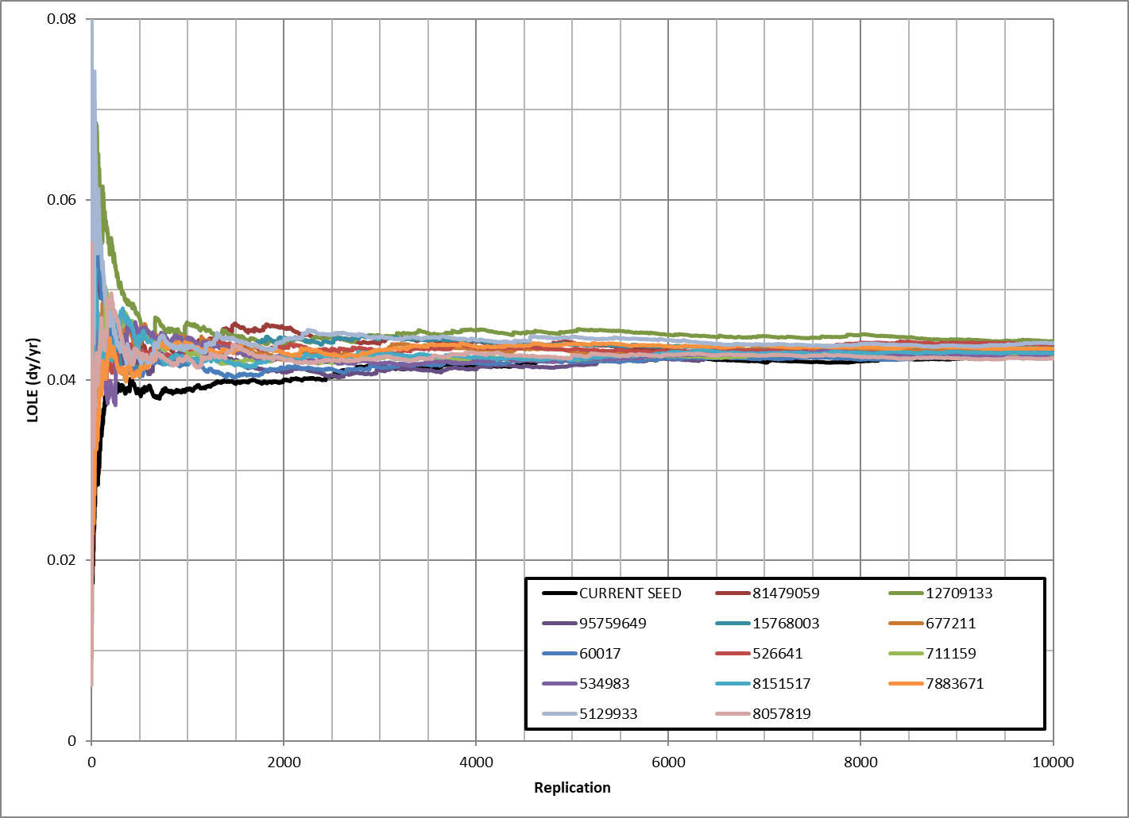
Additional Information – Testing Different Seeds
Ben performed work in 2016 to gauge the impact of changing the seed on LOLE
We observed that for the first 2500 replications the current seed had a lower LOLE than the other tested values
In aggregate, the current seed had the lowest LOLE for 5341 observations

