Slide 1
Analyzing Loss of Load Events
Mike Welch
SENIOR PLANNING ENGINEER, SYSTEM & RESOURCE PLANNING, NYISO
NERC PAF 2019

Slide 2
Roles of the NYISO
Reliable operation of the bulk electricity grid
Managing the flow of power on 11,000 circuit-miles of transmission lines from hundreds of generating units
Administration of open and competitive wholesale electricity markets
Bringing together buyers and sellers of energy and related products and services
Planning for New York’s energy future
Assessing needs over a 10-year horizon and evaluating projects proposed to meet those needs
Advancing the technological infrastructure of the electric system
Developing and deploying information technology and tools to make the grid smarter

Slide 3
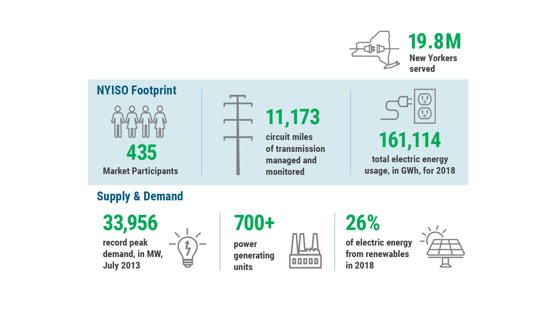
NYISO by the numbers

Slide 4
Reliability Planning at the NYISO
The Reliability Planning Process (RPP) is one of the foundational components of the Comprehensive System Planning Process (CSPP)
The RPP sets a biennial process where we perform:
The Reliability Needs Assessment (RNA) to understand possible threats to reliability in the next 10 years
The Comprehensive Reliability Plan (CRP) to evaluate and if necessary select solutions to identified needs from the RNA

Slide 5
Performing Probabilistic Studies
The NYISO uses GE MARS
We apply a criterion that at no point in time will the probability of the unplanned disconnection of firm load exceed 0.1 days per year
General study parameters:
A 10 year study period (e.g. 2021-2030 for the upcoming 2020 RNA)
We apply 7 load forecast uncertainty levels to the load forecast
We have started looking at new ways to review our case results, as described in this presentation

Slide 6
Test Case Overview
Assumptions for a hypothetical 2026 power system:
Use 2026 load forecast from the 2019 “Gold Book” Load and Capacity Data
Resource mix adjusted from the existing generation fleet
Transfer limits based on 2019 CRP topology
No energy storage resources are modeled (e.g. batteries)
We simulate 10,000 Monte Carlo replications
Notes:
What was the peak load in 2018? Overall?

Slide 7
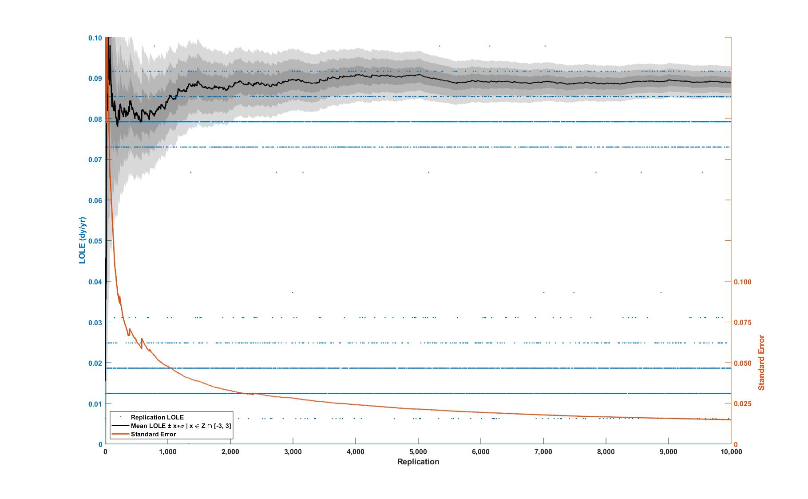
Test Case Results
Metric | Base Case
LOLE (dy/yr) | 0.0881
LOLH (hr/yr) | 0.3188
LOEE (MWh/yr) | 187.19

Slide 8
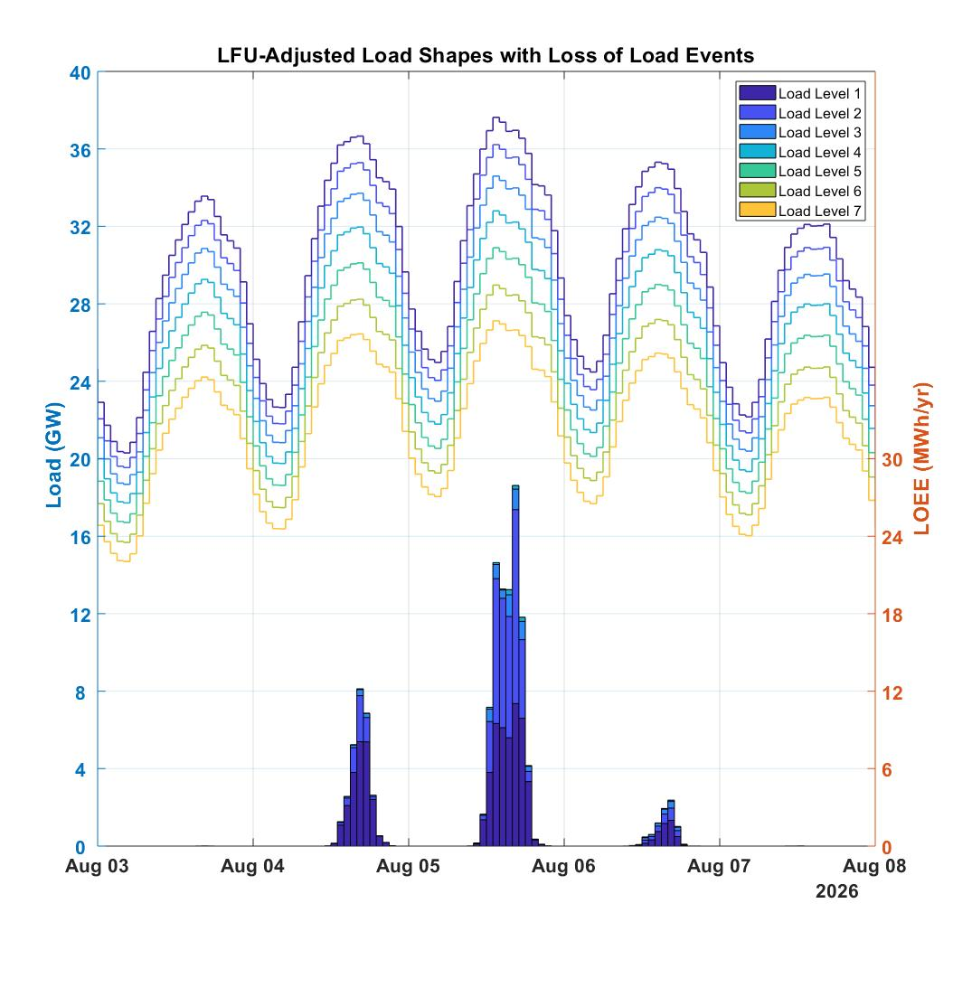
Developing Insights
We can superimpose load and event data, plotting:
the adjusted load values
the hourly energy deficiencies (LOEE)
This lets us see where the events are occurring

Slide 9
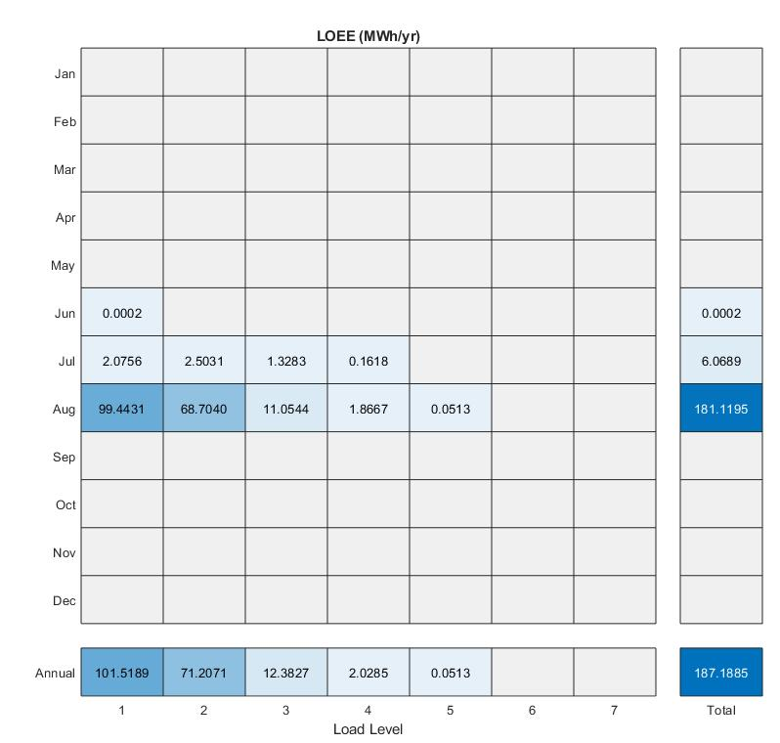
Developing Insights
We can create a heatmap to show where the events are occurring
For the test case, events are concentrated in:
the summer months, and
the highest load levels

Slide 10
Developing
New Insights

Slide 11
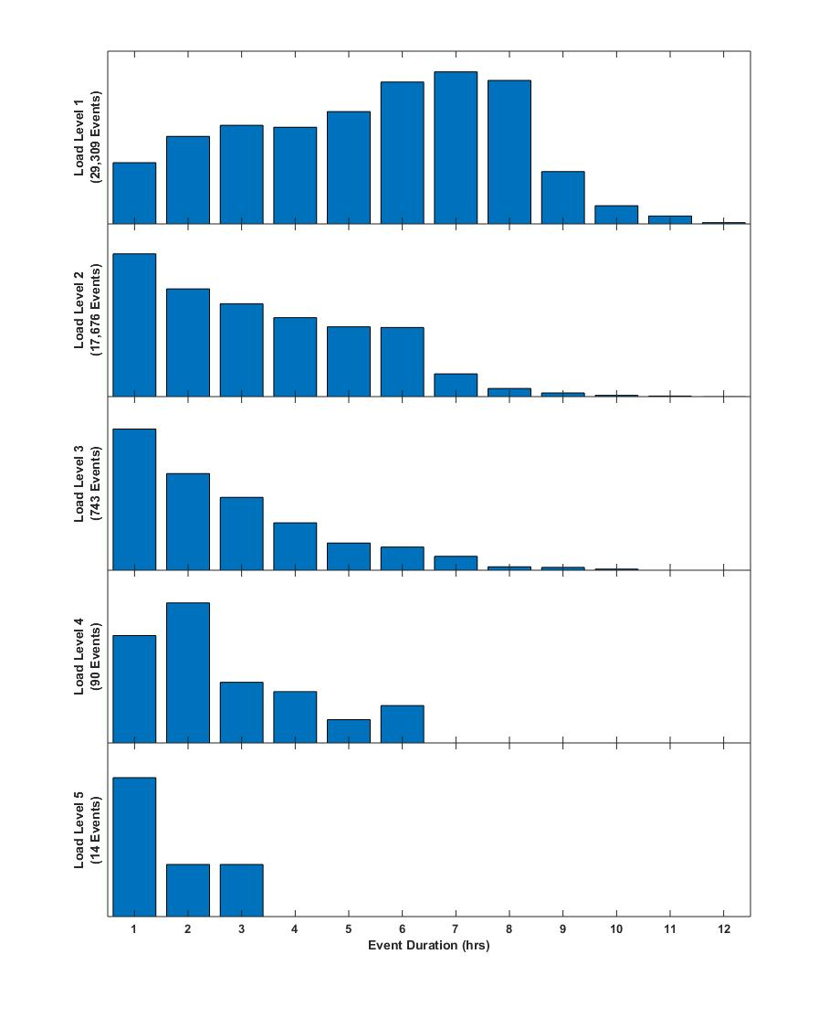
Event Duration
By processing the margin data for each area, we were able aggregate the hourly events into daily events
The higher load levels show a bias for longer events

Slide 12
Event Summary
Replication | Date | Load Level | Duration (hours) | MinDef (MW) | MaxDef (MW) | EnergyDef (MWh)
1 | 2026-08-04 | 1 | 5 | 325.00 | 1,688.57 | 5,547.22
1 | 2026-08-05 | 1 | 8 | 116.69 | 2,032.46 | 10,890.41
1 | 2026-08-06 | 1 | 3 | 893.04 | 1,133.82 | 3,105.14
2 | 2026-08-04 | 1 | 2 | 104.04 | 559.09 | 663.13
2 | 2026-08-05 | 1 | 6 | 360.41 | 1,023.90 | 4361.00
Summarizes the hourly deficiencies – MinDef/MaxDef
Total unserved energy – EnergyDef

Slide 13
What’s Next?

Slide 14
Applying Analysis to Energy Storage
The Event Summary contains the information to model a simple energy storage resource, such as:
Length of Event
Maximum Deficit during the Event
Overall Energy Deficit from the Event
Using MATLAB® we developed a simple battery storage model to reduce deficits

Slide 15
Simple Battery Storage Model
Assumptions:
Batteries are fully charged at the start of each event
Batteries are local resources and cannot assist neighboring areas
Parameters:
23 Batteries Modeled in New York
Total 2,000 MW nameplate
Total 9,000 MWh of storage

Slide 16
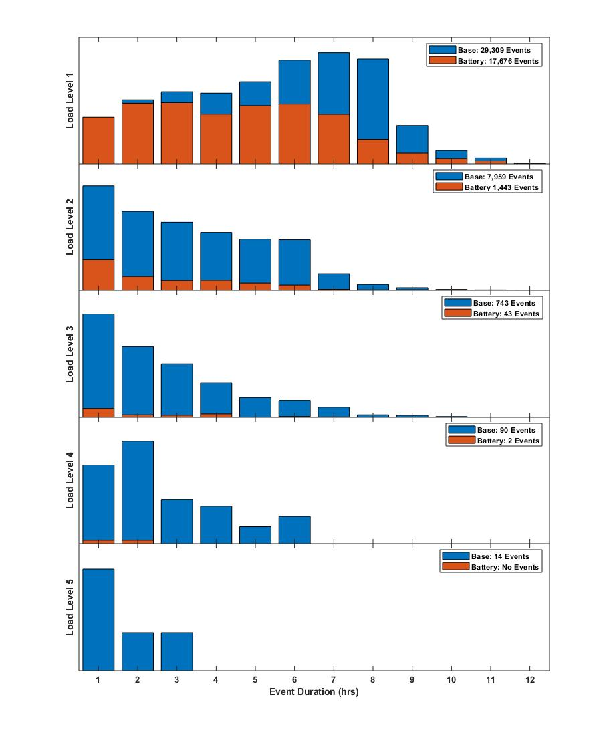
Impact of Battery Storage
Metric | Base Case | Battery Scenario | Delta
LOLE (dy/yr) | 0.0881 | 0.0208 | -0.0673
LOLH (hr/yr) | 0.3188 | 0.0757 | -0.2431
LOEE (MWh/yr) | 187.19 | 49.53 | -134.66
Avg. Duration (hr) | 2.31 | 1.32 | -0.99
Future Work:
Add a charging constraint
Define round-trip efficiency constraint

Slide 17
Questions?

Slide 18
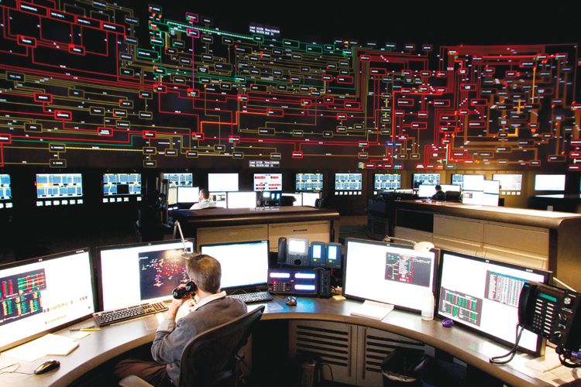
Our mission, in collaboration with our stakeholders, is to serve the public interest and provide benefit to consumers by:
Maintaining and enhancing regional reliability
Operating open, fair and competitive wholesale electricity markets
Planning the power system for the future
Providing factual information to policymakers, stakeholders and investors in the power system

