Slide 1
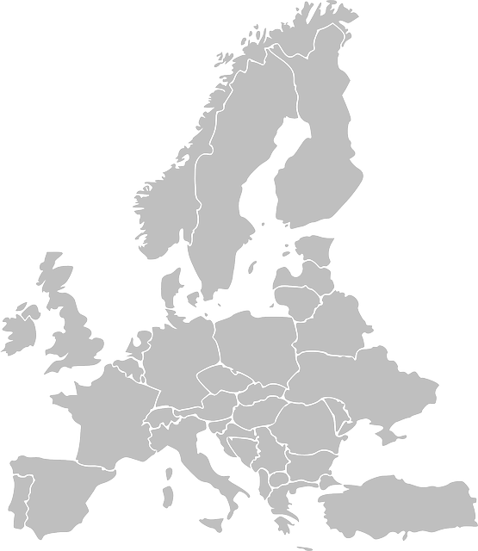


Slide 2
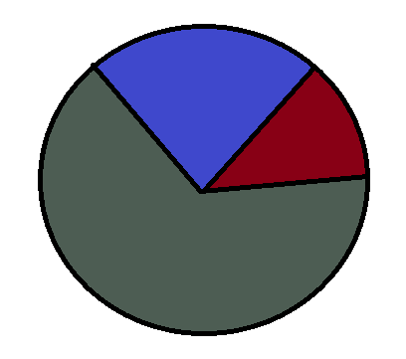
Number of planes per country
Mision date: 16.10.1917.
Country: UK Servis: RAF
Unit: No. 55 SQDN
MDS: AIRCO DH4 DAY BOMBER
Takeoff time: day
Target location: Saarbrucken
Target country: Germany
Altitude: 10 000
France
UK
Germany

Slide 3

Number of planes per country
Mision date: 16.10.1917.
Country: UK Servis: RAF
Unit: No. 55 SQDN
MDS: AIRCO DH4 DAY BOMBER
Takeoff time: day
Target location: Saarbrucken
Target country: Germany
Altitude: 10 000
France
UK
Germany

Slide 4

Target country takeoff ratio
Takeoff base:
Country: UK Servis: RAF
France
A-H
Germany

