Slide 1
CAFÉ POINT OF SALE
Requirements, Analysis and Architectural Design
Advanced Software Engineering Project
University of Zambia
Project presentation

Slide 2
PROJECT OVERVIEW
One system brings café operations together
The project replaces disconnected manual processes with a centralized point-of-sale system that supports daily service and management decisions.
CORE SCOPE
Sales processing
Inventory control
Customer records
Outcome
Employee access
Faster checkout, more reliable stock information and clearer accountability.
Sales reporting
CAFÉ POS • ADVANCED SOFTWARE ENGINEERING
02

Slide 3
BUSINESS CASE
Manual work creates avoidable delays and errors
CURRENT CHALLENGES
EXPECTED VALUE
Slow order and checkout processing
Quicker, more consistent service
Inaccurate or outdated stock records
Automatic stock updates after sales
Billing and inventory errors
Daily, weekly and monthly reporting
Limited sales information for decisions
Lower losses and less manual reporting
CAFÉ POS • ADVANCED SOFTWARE ENGINEERING
03

Slide 4
DEVELOPMENT APPROACH
Each Unified Process phase reduces uncertainty
1
2
3
4
INCEPTION
ELABORATION
CONSTRUCTION
TRANSITION
Scope, feasibility and initial risks
Detailed use cases and architecture
Implementation and testing
Deployment, training and adoption
Current focus
The project has moved into Elaboration, where requirements, domain concepts, architecture and key risks are refined before full implementation.
CAFÉ POS • ADVANCED SOFTWARE ENGINEERING
04

Slide 5
REQUIREMENTS MODEL
Four actors shape the system’s responsibilities
CUSTOMER
Receives completed sales and receipts
CASHIER
Logs in, processes sales and registers customers
STORE MANAGER
Controls stock, reports and employee records
SUPER ADMIN
Onboards employees and assigns roles
CAFÉ POS • ADVANCED SOFTWARE ENGINEERING
05

Slide 6
REQUIREMENTS BASELINE
The essential functions support service and control
Secure login with role-based access
Process a complete sale and calculate totals
Update inventory automatically after each sale
Add, edit, deactivate and review menu items
Register customers and retrieve purchase history
Generate sales reports and manage employee access
CAFÉ POS • ADVANCED SOFTWARE ENGINEERING
06

Slide 7
ELABORATION PRIORITIES
Five use cases define the most important workflows
UC1
Login
Fully dressed use-case description
UC2
Process Sale
First end-to-end implementation priority
UC3
Restock Inventory
Fully dressed use-case description
UC4
Manage Employees
Fully dressed use-case description
UC5
Manage Menu Items
Fully dressed use-case description
CAFÉ POS • ADVANCED SOFTWARE ENGINEERING
07

Slide 8
CORE TRANSACTION
Process Sale connects revenue, payment and stock
01
02
03
Start a new sale
Enter menu items and quantities
Calculate subtotal, VAT and total
04
05
06
Validate and record payment
Update inventory
Generate the customer receipt
Transaction safety
If the final commit fails, the system rolls back the sale so no partial payment or stock update remains.
CAFÉ POS • ADVANCED SOFTWARE ENGINEERING
08

Slide 9
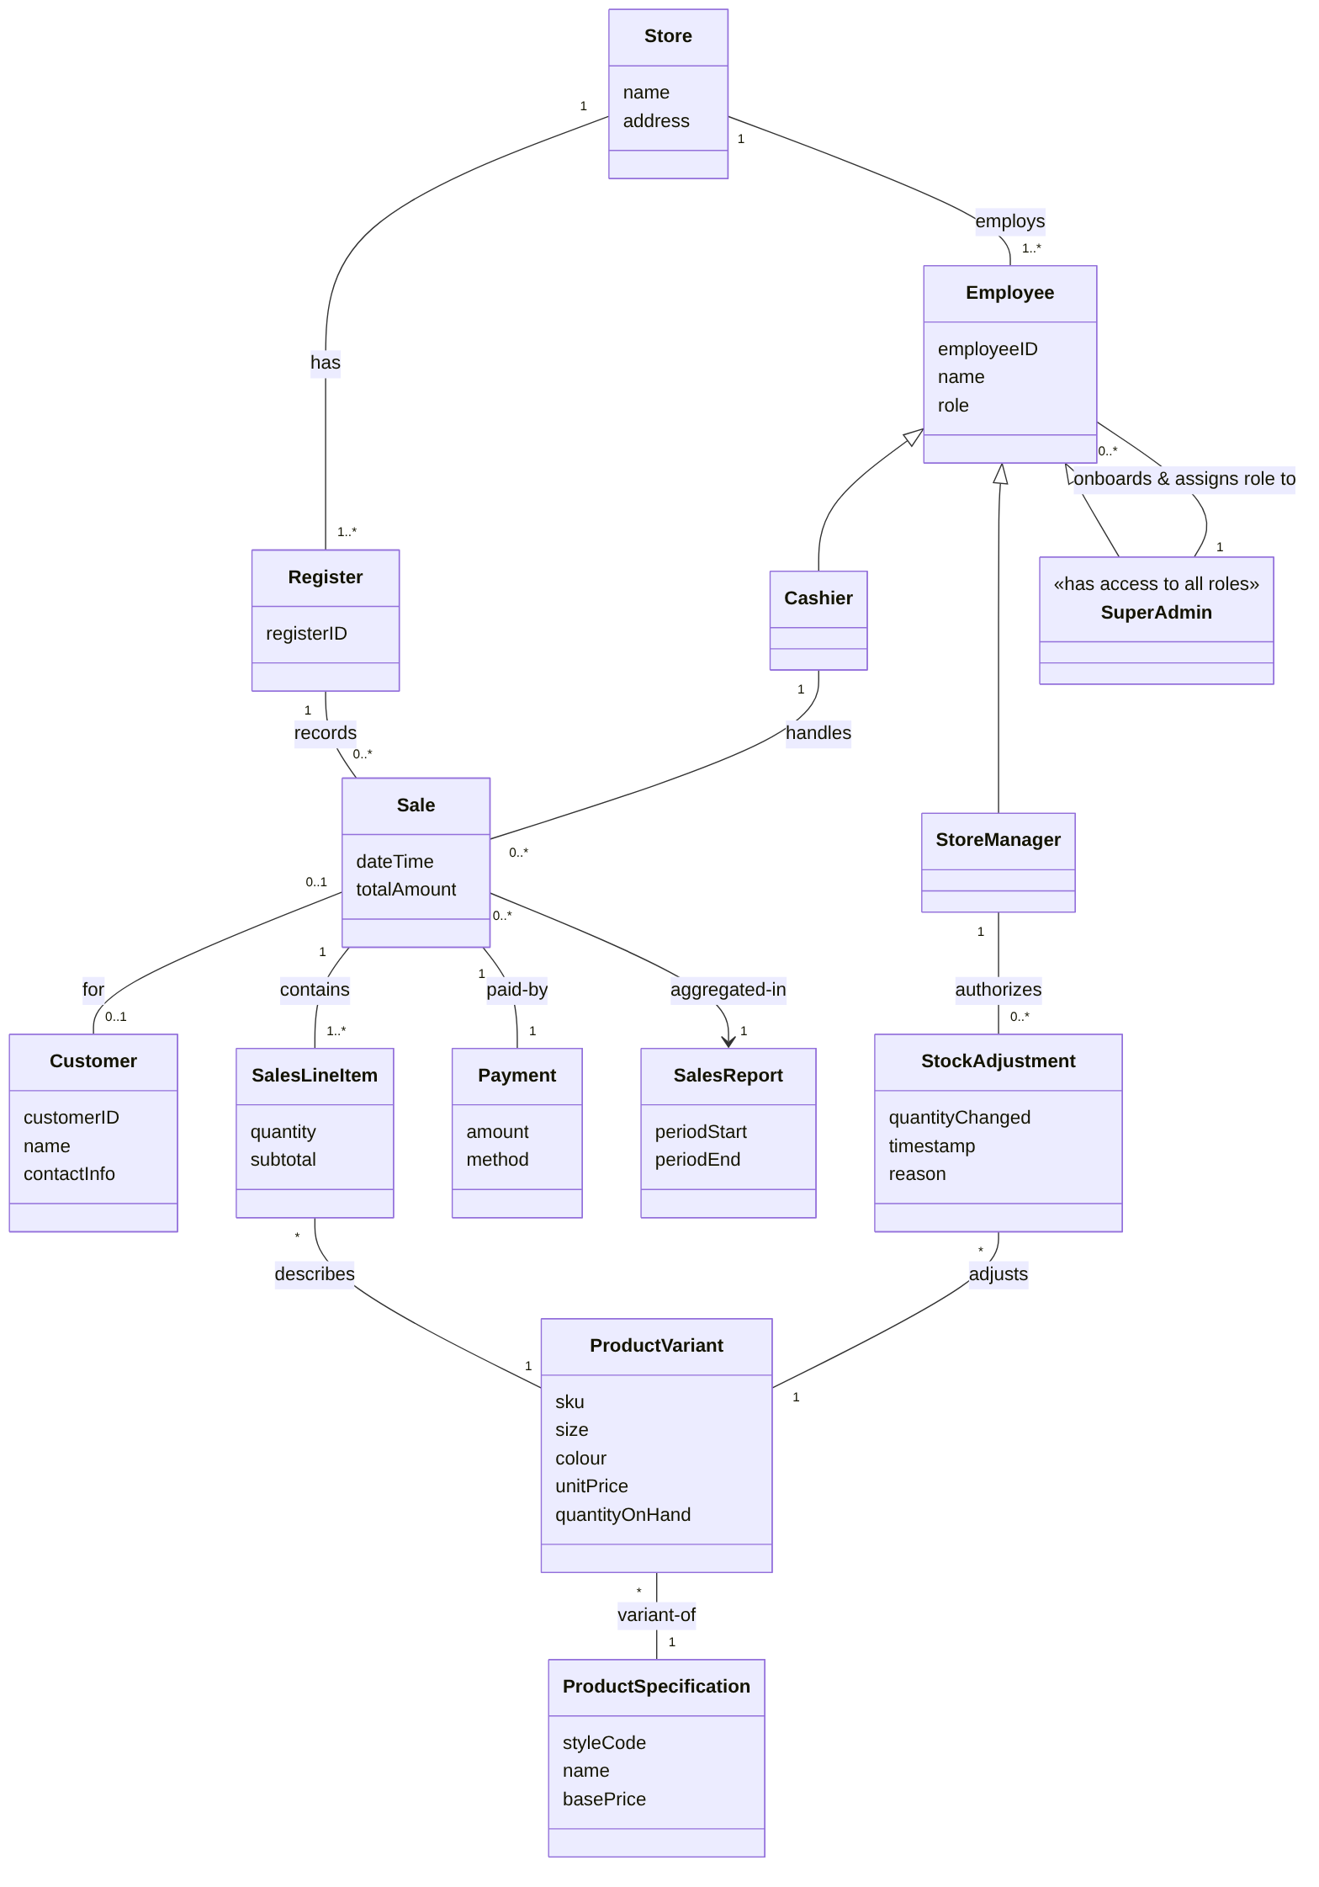
CONCEPTUAL VIEW
The domain model links the key business concepts
CAFÉ POS • ADVANCED SOFTWARE ENGINEERING
09

Slide 10
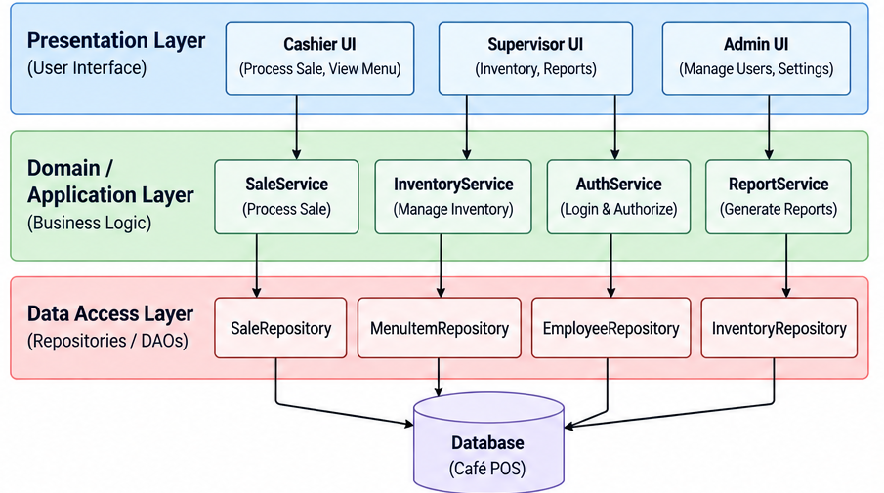
TECHNICAL DESIGN
Three layers keep responsibilities separate
Presentation → Domain / Application → Data Access → Database
CAFÉ POS • ADVANCED SOFTWARE ENGINEERING
10

Slide 11
DESIGN RATIONALE
Layering improves security, testing and maintainability
DATABASE CONTROL
ROLE SECURITY
TESTABILITY
Schema and query changes stay in the data-access layer.
Protected operations pass through authentication and authorization.
Business logic can be tested without the interface or a live database.
Validation priority
Implement Process Sale through all three layers first because it exercises the system’s highest-value transaction.
CAFÉ POS • ADVANCED SOFTWARE ENGINEERING
11

Slide 12
FEASIBILITY
The system is feasible, but four risks need continued control
Data loss
Backup and transaction logging
Security
Role-based access and account controls
Schedule
Milestones and iterative delivery
Admin dependency
Strong recovery and audit procedures
Conclusion: technically, economically and operationally achievable within the proposed scope.
CAFÉ POS • ADVANCED SOFTWARE ENGINEERING
12

Slide 13
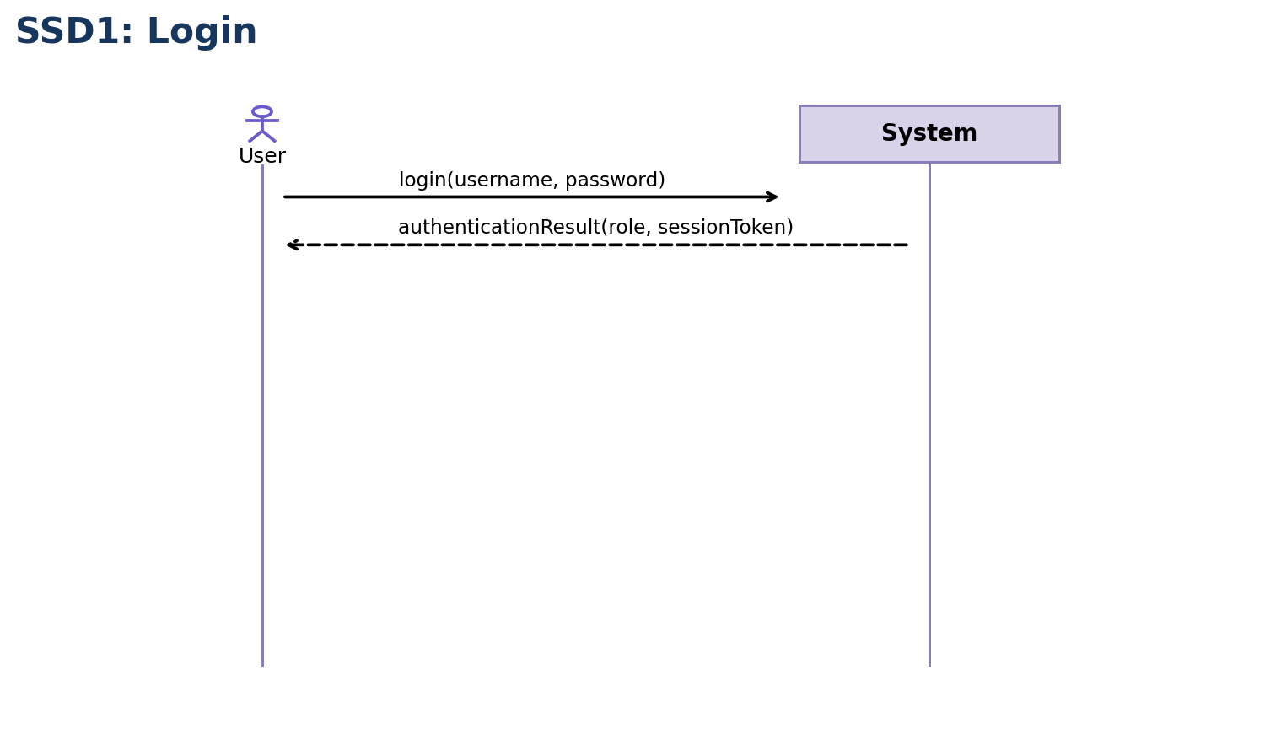
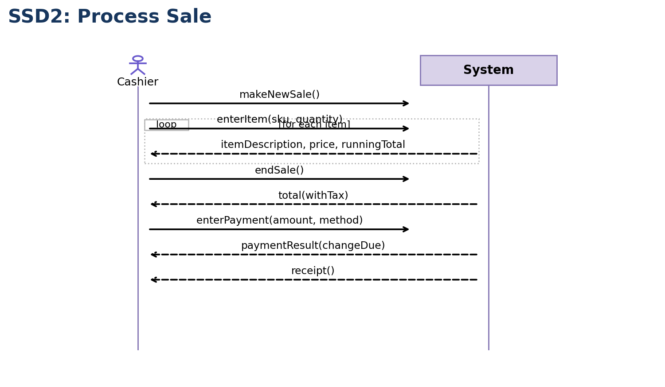
SYSTEM INTERACTIONS
Login and Process Sale show the main actor–system exchanges
SSD1: Login
SSD2: Process Sale
CAFÉ POS • ADVANCED SOFTWARE ENGINEERING
13

Slide 14
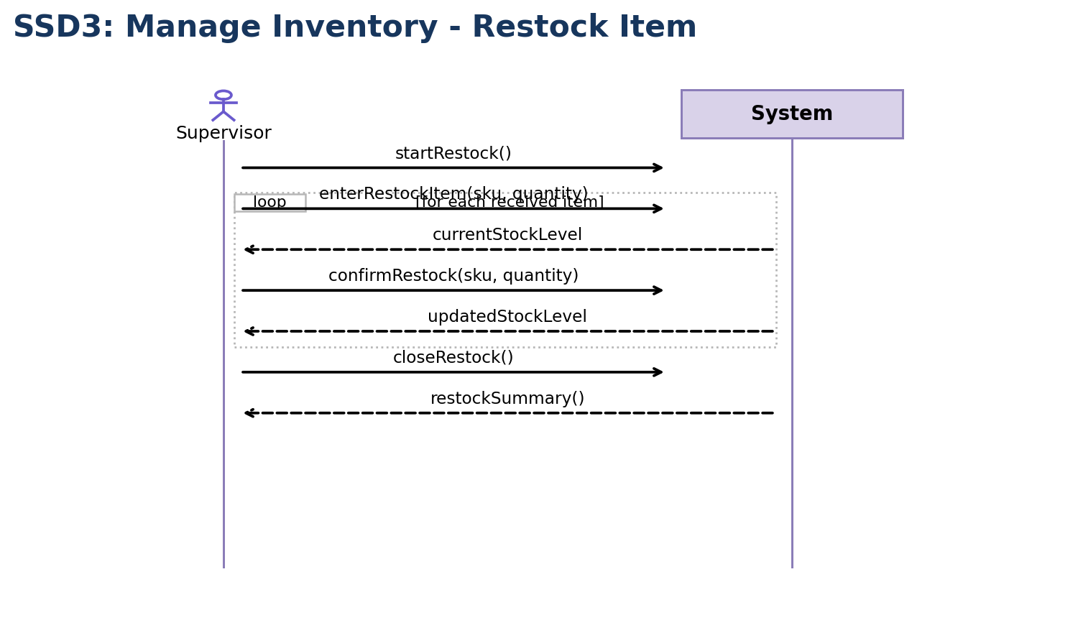
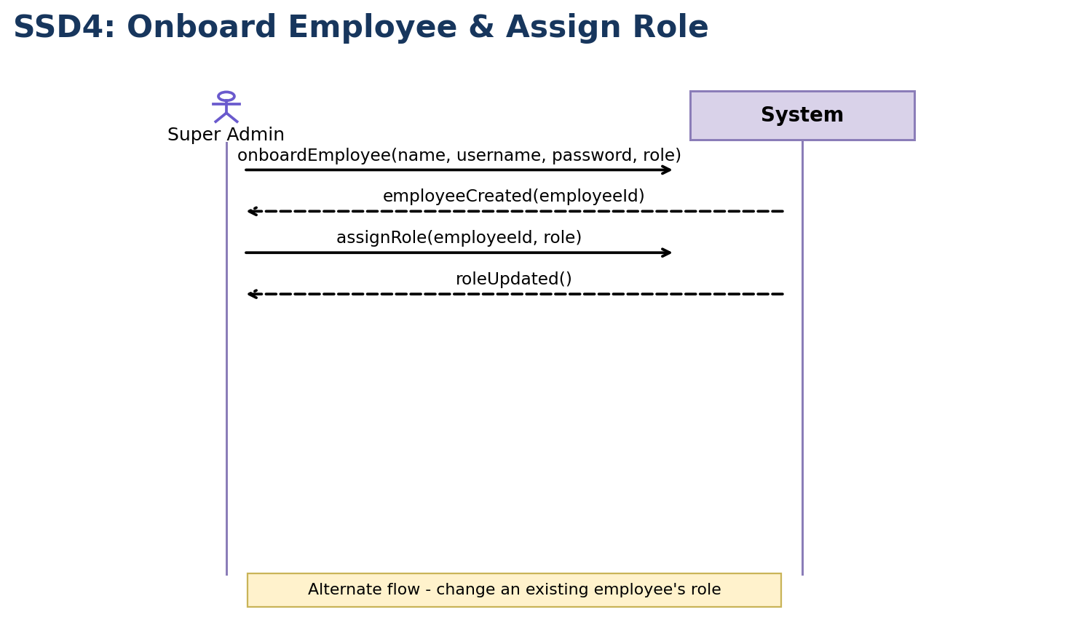
SYSTEM INTERACTIONS
Inventory and onboarding complete the priority scenarios
SSD3: Restock Inventory
SSD4: Onboard Employee
CAFÉ POS • ADVANCED SOFTWARE ENGINEERING
14

Slide 15
THE DESIGN IS READY TO MOVE INTO CONSTRUCTION
The requirements define the work. The domain model explains the concepts. The architecture separates responsibilities. The SSDs show how users interact with the system.
NEXT PRIORITY
Validate Process Sale end to end, then complete the deferred reporting, stock-view and customer-registration workflows.
CAFÉ POS • ADVANCED SOFTWARE ENGINEERING
15

