Slide 1
Technology of nuclear fuel cycle IV DECOMMISSIONING
Strategy
Variants
Legislation
Stages
1

Slide 2
(NUCLEAR) DECOMMISSIONING
(+ NPP disposal)
=
the process whereby a nuclear facility is dismantled to the point that:
measures for radiation protection no longer required
i.e
NPP released from regulatory control

Slide 3
Key points to safety, planning and implementation
Final shutdown – end of lifetime period, or important components of the power plant are in a state that do not guarantee safe operation  expensive repair  low competitiveness
Requires significant financial resources – the operator saves in its own reserves (so-called "escrow account") and on the state-owned and controlled so-called "nuclear account" (in CZE)
Planning begins already at the stage of preparation of construction – remember the availability and spatial location of technological elements Secondary use of the power plant buildings is preferred
Supervision of regulatory office (license) Protection of workers, the public and the environment

Slide 4
Decommissioning options
Two parts with substantially different technology and construction Common technologies without radioactivity  common disposal
„Nuclear island “ – radioactive contaminated technologies
Immediate decommissioning – shortest + most expensive – immediately after final shutdown – high radiation exposure  financially and technically most demanding (remote-controlled manipulators, radiation protection and alternation of operators)
Deferred decommissioning – temporary (but long-term, 20–50 years) preservation  deferred liquidation – lower radiation load  easier dismantling of equipment  cheaper
Combination of 1st and 2nd – part of the device (secondary circuit, low active technology) is dismantled immediately and the nuclear island is preserved  time >= 2. opt., finance < 1. opt. (preferred in CZE)
Entombment and long-term monitoring of equipment (unplanned in the EU)

Slide 5
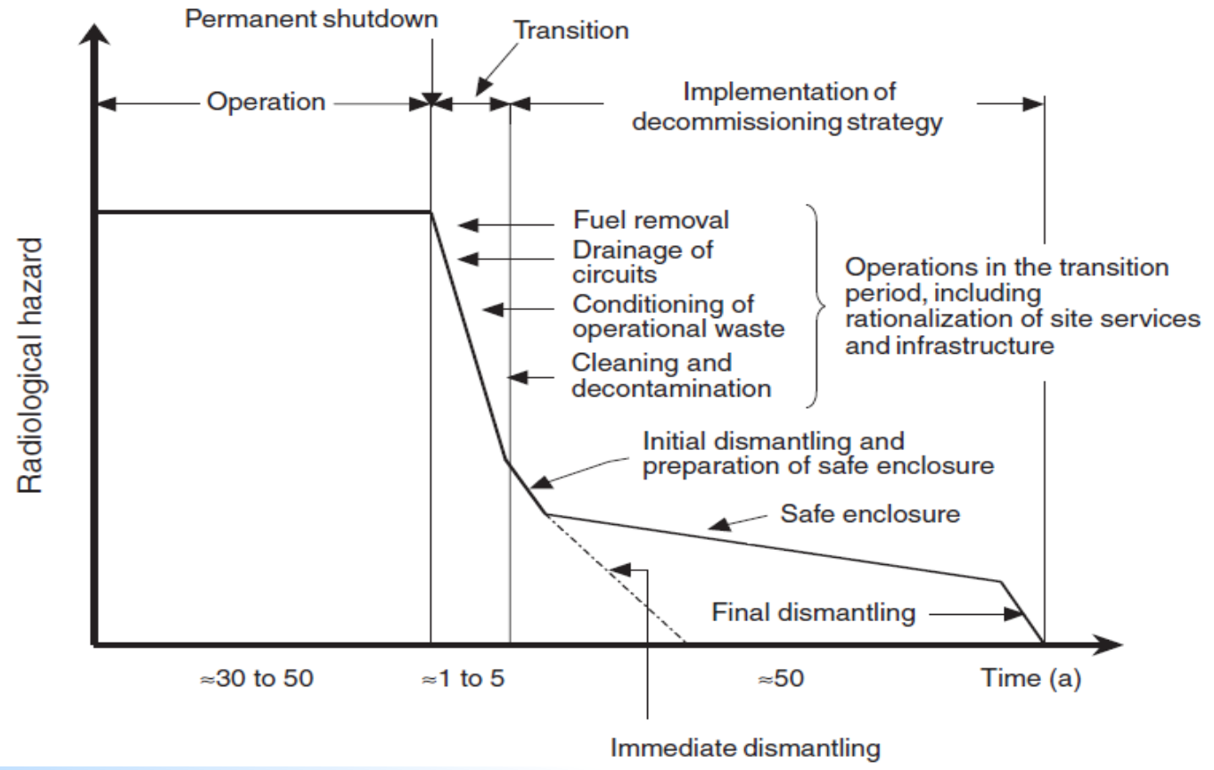

Slide 6
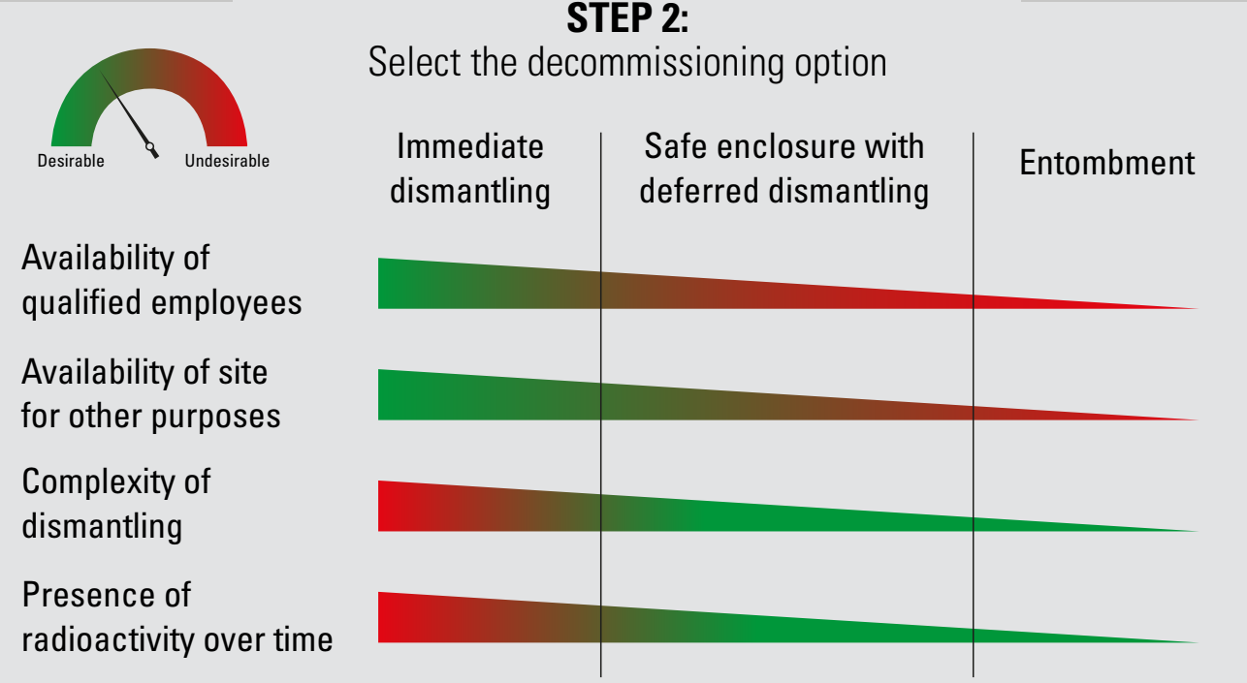
Decommissioning option
Zdroj: tuvsud.com/cs-cz/-/media/global/pdf-files/infographics/tuvsud-nuclear-decommissioning-infographic.pdf

Slide 7
Decommissioning process
Removal of radioactive sources – SNF (10 y), coolant, pools
Contamination analysis – (Non-)radioactive inventory
Decontamination and cleaning of equipment and buildings Dismantling of technologies + segmentation
Treatment, storage and disposal of (non-)radioactive waste Radiation monitoring (all the times, inside and outside the NPP, persons and activities)
Exploration and release of plant for other construction Environmental remediation

Slide 8
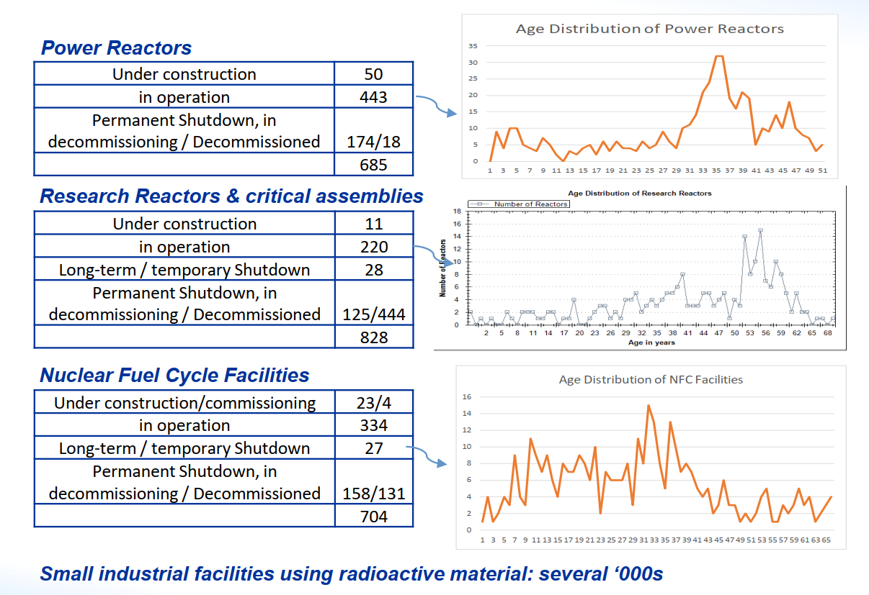

Slide 9
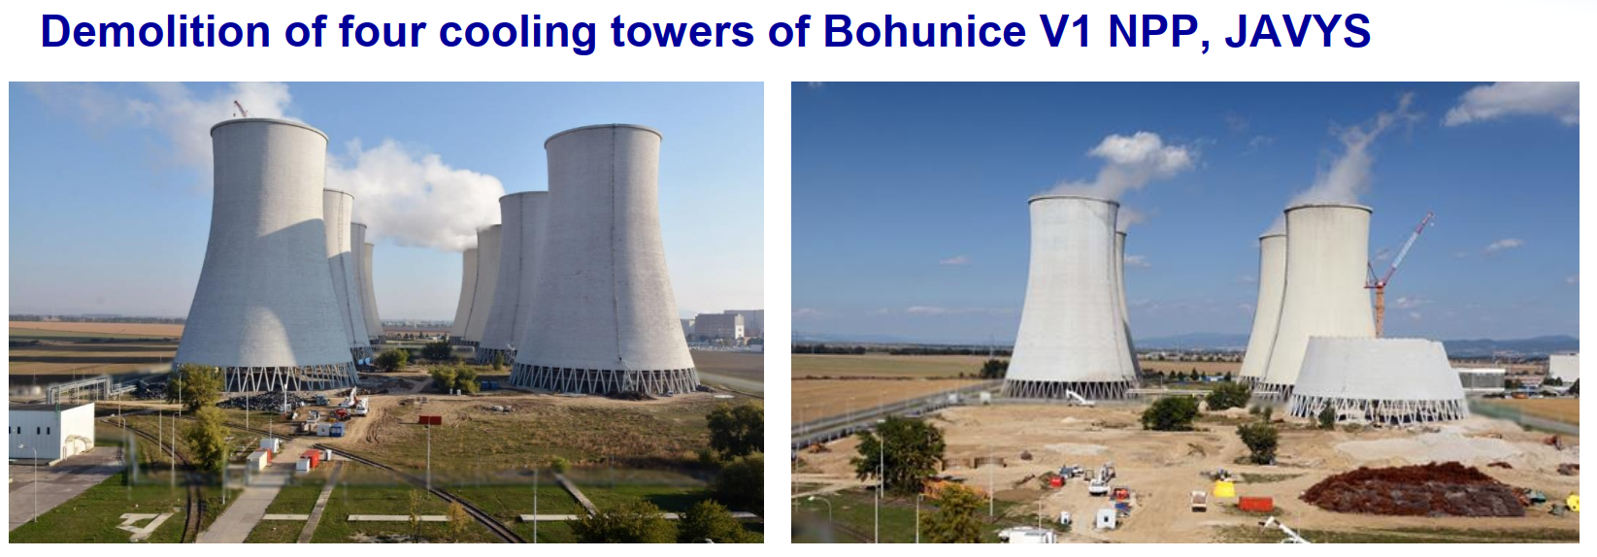

Slide 10

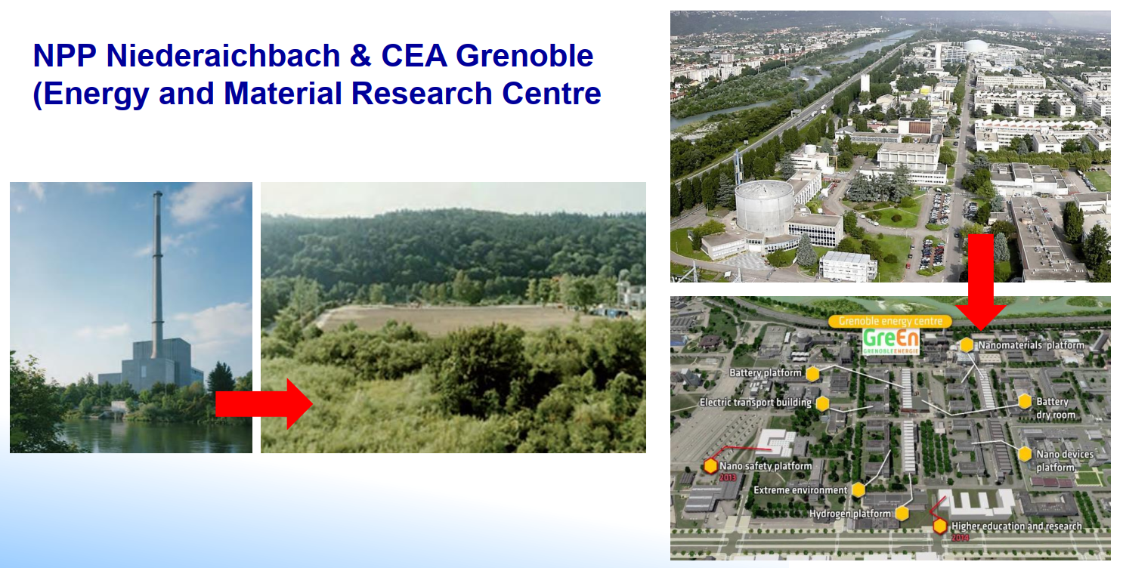
Decommissioning to the "Greenfield status" (1975 – 1995)
More expensive than construction

Slide 11
Legal aspects
Decommissioning is already part of site selection, construction plan, physical start-up, etc.
Act No. 263/2016 Coll., Atomic Act (CZE)
decommissioning objective, scale and responsibilities, planning requirements, financing
Council Directive 2011/70/EURATOM establishing a Community framework for the responsible and safe management of spent fuel and radioactive waste
Inform about national programme (incl. inventory SNF and RAW, estimate future quantities, incl. decommissioning)
regular assessment of programmes 1 time in ten years international evaluation of program by the IAEA

Slide 12
Decree No. 377/2016 Coll., on requirements for safe management of radioactive waste and on decommissioning of a nuclear facility or workplace III. or IV. Category
requirements for the content of the closure documentation and the decommissioning plan (schedules, safety analyses, radiation protection during decommissioning)
Decree No. 266/2019 Coll., on the Concept of Radioactive Waste and Spent Nuclear Fuel Management
implementation of the requirements of the Directive into national legislation
Decree No. 422/2016 Coll., on radiation protection and security of a radionuclide source

Slide 13
Concept of Radioactive Waste and Spent Nuclear Fuel Management in the Czech Republic
ensure safe storage of VJP and RAO non-storable in existing repositories until the deep geological repository is put into operation construction of deep repository on the territory of CZE
regular update (currently from 2019)

Slide 14
Principles of radiation protection
Principle of justification – Decommissioning  planned exposure situations  drawing benefits ↔ the benefit of removing contaminated technology and disposal of the power plant after the end of operation
Principle of optimization (ALARA) – technical and organisational measures to achieve a level of radiation protection such that the risk to the health of humans and the environment was as low as can reasonably be achieved taking into account economic and social considerations
Principle of limitation – that the doses received are at the lowest reasonably achievable level and below dose limits laid down in Decree No 422/2016

Slide 15
Obligations of the holder of the operating authorisation Regularly submit plans for decommissioning to SÚJB
Inform SÚJB at least two years before the planned closure of the NPP Start decommissioning immediately after closure
Take SNF to another nuclear facility before transition to the first stage of decommissioning – SNF storage Create a financial reserve for future decommissioning (escrow account) Choice of decommissioning option:
Immediate decommissioning – decommissioning is performed continuously in continuous sequence – always must be considered, does not have to be chosen Deferred decommissioning – activities divided into several stages, with possible a time lag

Slide 16
Decommissioning strategies and stages
NPP Temelín 2 x VVER 1000
2002, 2003
60 let (do r. 2062)
2067
2068
2088
2098
NPP Dukovany 4 x VVER 440/510 MW
1985 až 1987
60 let (do r. 2046+-)
2056
2057
2078
2090
Commissioned: Estimated time production of el. E:
Closure:
Expected start of decommissioning: (protective closure of active buildings)
Decommissioning:
End of Decommissioning:

Slide 17
NPP Dukovany
The first decommissioning plan approved in year 1998 (now 5. version)
Variant of Deferred decommissioning
protective closure of active buildings for 20 years  followed by dismantling and demolition Goal:
Unlimited plant release (i.e. without the need for regulatory supervision and monitoring)
Commercial use of the plant after decommissioning (continue to be property of ČEZ)

Slide 18
Decommissioning stages
 | JE Dukovany | JE Temelín
Period of non-energy operation (fuel cooling, RAO disposal) | 8 y | 5 y
Preparation for protective closure (decontamination) | 3 y | 2 y
Protective closure (monitoring, maintenance) | 20 y | 19 y
Decommissioning (decontamination, dismantling, demolition) | 12 y | 10 y
Each stage requires SÚJB permission (monitoring, financing).

Slide 19
Measures to facilitate decommissioning
Reduction of the amount of stored RAW
maximum permitted amount of RAW stored operational RAWs are continuously modified into a form suitable for storage
paved RAW ready for storage must be immediately (within 2 years at the latest) handed over to SÚRAO for storage
data on the amount and radionuclide composition of RAW arising from the operation and future decommissioning of NPPs are delivered to RAWRA  RAWRA plans and ensures the capacity for storage

Slide 20
Handling with RAW
RAW from decommissioning will be processed by standard and proven technologies (centrifugation, evaporation, bitumenation, fragmentation, crushing, pressing, combustion)
Fragmentation of large components of the primary circuit (reactor pressure vessel, steam generator, volume compensator) is considered The composition of the RAO is monitored in terms of their acceptability to the Dukovany ÚRAO (unacceptable RAW will be stored in the deep repository)

Slide 21
RAO volumes from nuclear decommissioning
 | NPP Dukovany | NPP Temelín
Storage Dukovany | 4 371 m³ 21 705 barrels | 4 196 m³ 20 978 barrels
Deep repository | 2 050 t 2 050 containers | 847 t 288 containers

Slide 22
Characterization of a nuclear power plant for decommissioning purposes
Passport – characterization of all building objects (BO) in the NPP area in terms of their demolition and waste management
NPP Dukovany – 118 BO: nuclear island – 10, conventional part – 108
NPP Temelím – 146 BO: nuclear island – 15, conventional part – 131

Slide 23
Passport contains:
general description of the building including material (i.e. concrete, reinforced concrete, panels) connection to NPP systems – water supply, sewerage, special sewerage, air conditioning, etc. Foundation depth / Object height / Building length / Object width / Base slab thickness / Maximum wall thickness / Built-up area / Object volume Possibility of use during decommissioning, for other nuclear facilities in the NPP area Schedule and method of dismantling and demolition Determination of the amount of materials/wastes produced and cost valuation

Slide 24
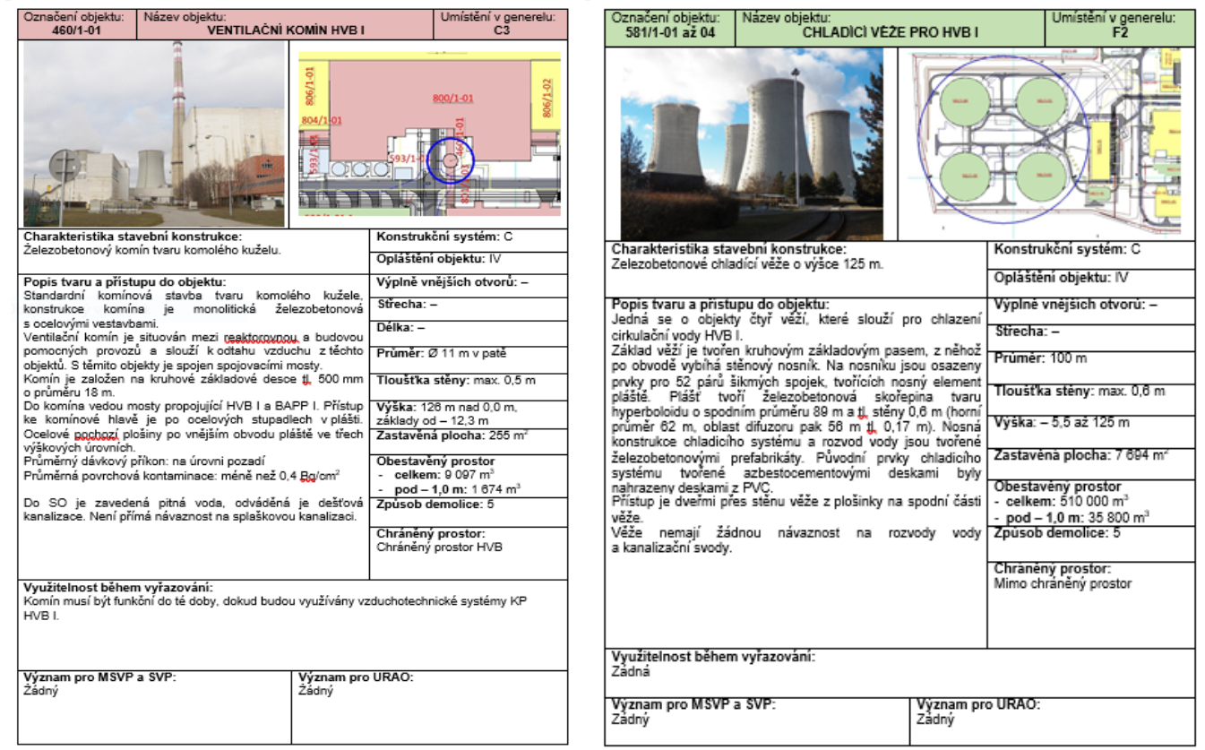
Example of a passport – ventilation chimney and cooling tower

Slide 25
Material balance from the demolition of the ventilation chimney of the Dukovany NPP
 | Concrete rubble | Metal | Total
Above +1 m | 4 305 t | 90 t | 4 395 t
Under -1 m (to leave) | 4 067 t | 120 t | 4 187 t
Material balance from the demolition of cooling tower
 | Concrete rubble | Metal | Total
Above +1 m | 9 200 t* | 228 t | 9 428 t
Under -1 m (to leave) | 11 458 t** | 102 t | 11 560 t
* prefabricated, reinforced concrete ** reinforced concrete, building concrete

Slide 26
Balance of inactive wastes from dismantling and demolition of NPP
Waste consists of:
Material released from the controlled area Material from dismantling of inactive power plant objects Material from demolitions of buildings
 | NPP Dukovany | NPP Temelín
Recyclable construction waste | 1 304 700 t | 1 503 278 t
Recyclable metal waste | 204 000 t | 176 728 t
Non-recyclable waste | 71 500 t | 89 624 t

