Slide 1

The Null Pointers
By Josua, Joshua, Abdul, Frikkie, Antony, Nico, Darius

Slide 2
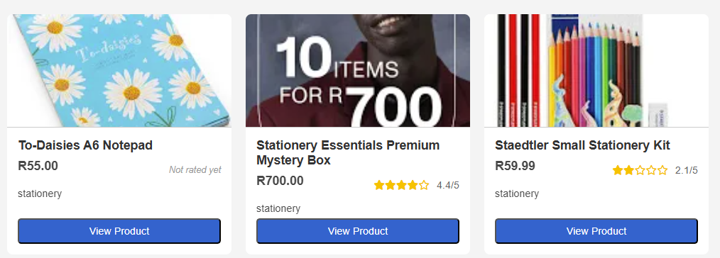
Introduction
What the website does ?
The features of the websites ?
The type of users of the website ?

Slide 3
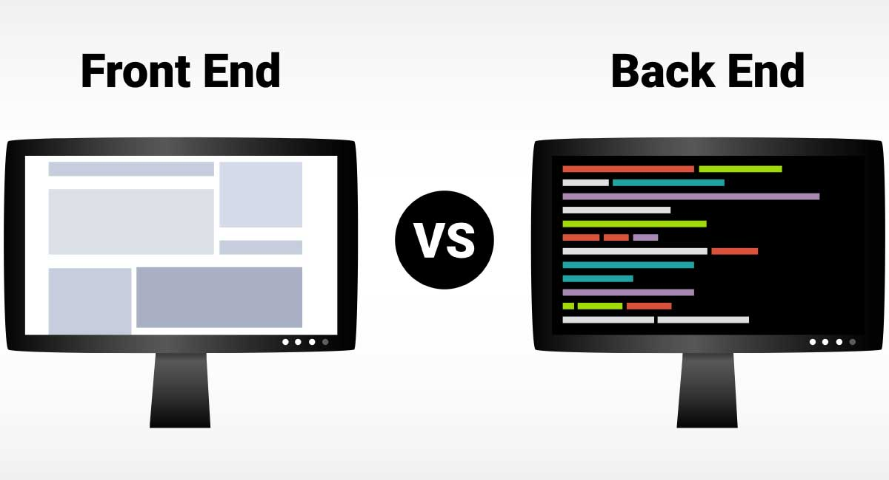
How we split it
Back End:
Abdul and Darius
Front End:
Nico, Frikkie, and Josh
Integration:
Josua was responsible for ensuring the connection between the front end and back end worked correctly.
He handled API integration and ensured data was correctly inserted into the database.

Slide 4
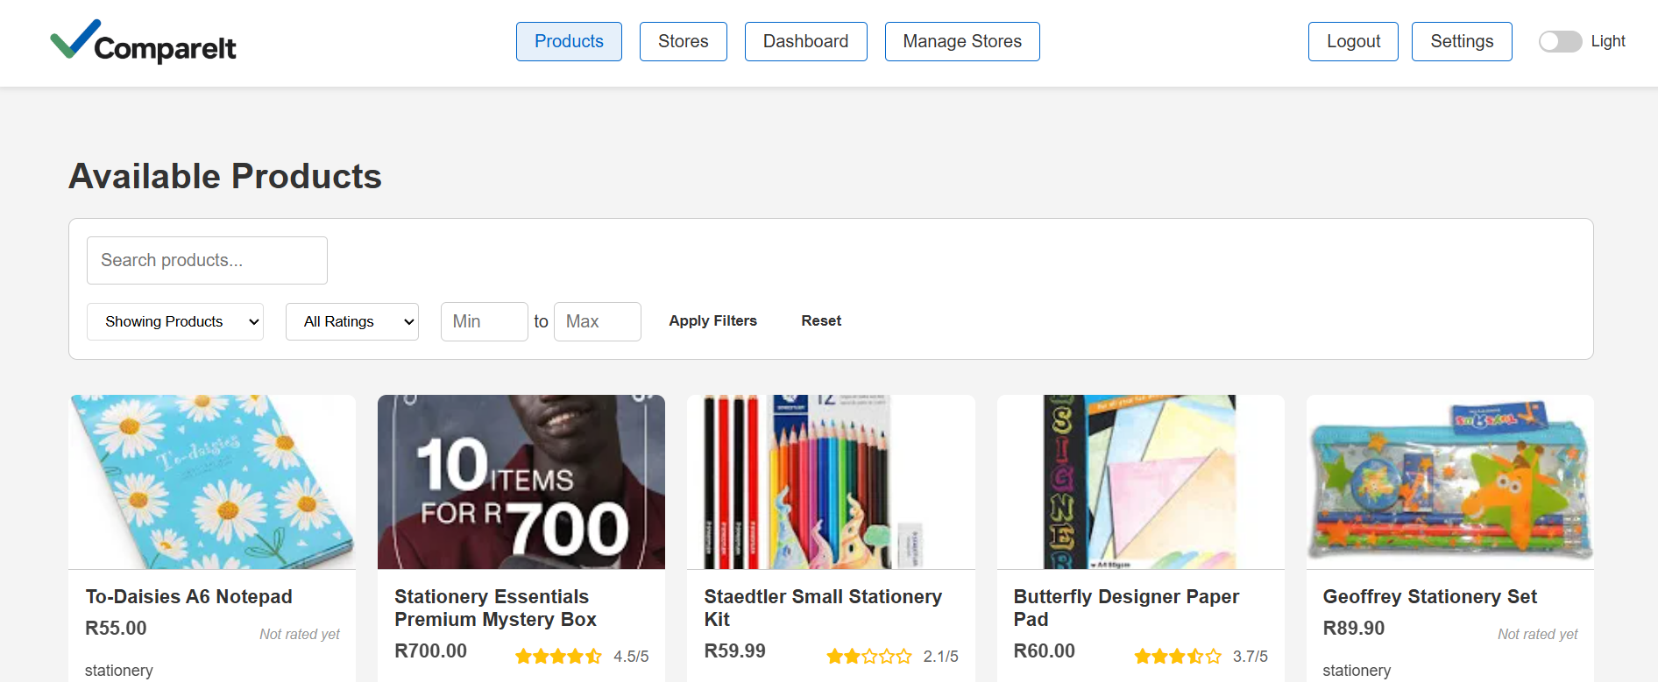
What will we be discussing?
Data
Login and register
Header and general CSS styling
Settings page
Products
Rating
Stores
Back end
Usage of github
Query

Slide 5

Data
📥 How did we get the data?
🧾 Explanation of the data ?
🧾 phpMyAdmin

Slide 6
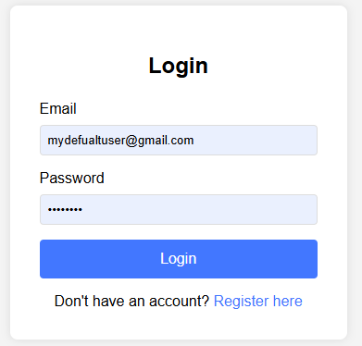
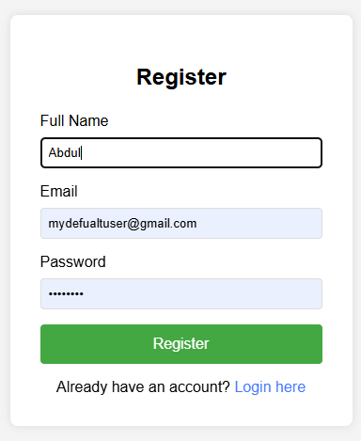
Login and register
Registration Page
Users can register as Customer or Store Owner
Form shows registration number field if "Store Owner" is selected on submission
Login Page
Users enter email and password. JavaScript sends credentials to the API.
The API key is saved in sessionStorage

Slide 7

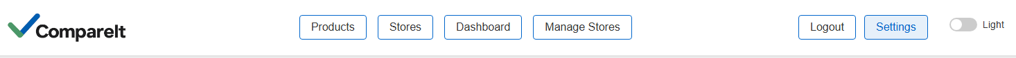
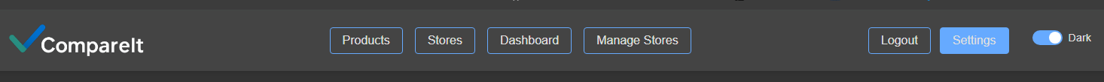
Header and general CSS styling
Refined global CSS styling for clean, minimalist aesthetic
Streamlined visual design across pages created by different team members
Ensured UI consistency: spacing, font sizes, button styles, and color themes
Use of shared components (e.g. buttons, navbars) to promote visual harmony
Focused on a design that enhances user experience and accessibility

Slide 8
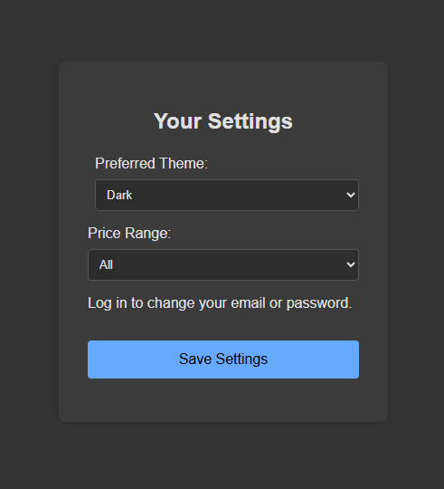
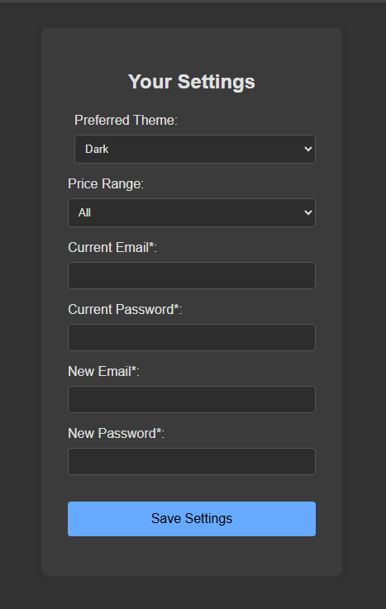
Settings page
Theme selection using sessionStorage and user preferences
Any user can modify theme and preferred price range (stored in session)
Only logged-in users can update email and password (verified via API)
Styling adapted dynamically to reflect user choices across the interface

Slide 9
Products
On load, checks if apikey is in sessionStorage
On a success it sends a request to API to fetch all available products
The API validates access
The JavaScript dynamically renders product listings using DOM manipulation and pagination.

Slide 10
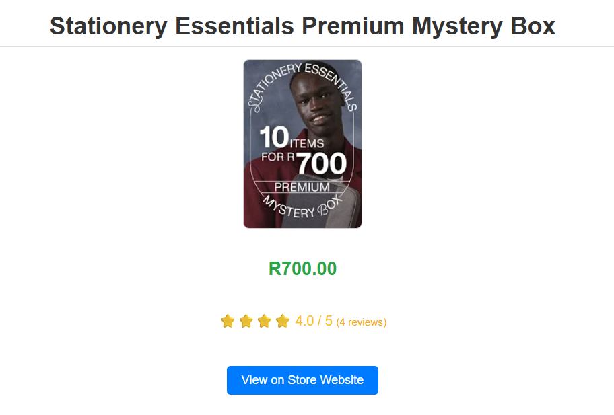
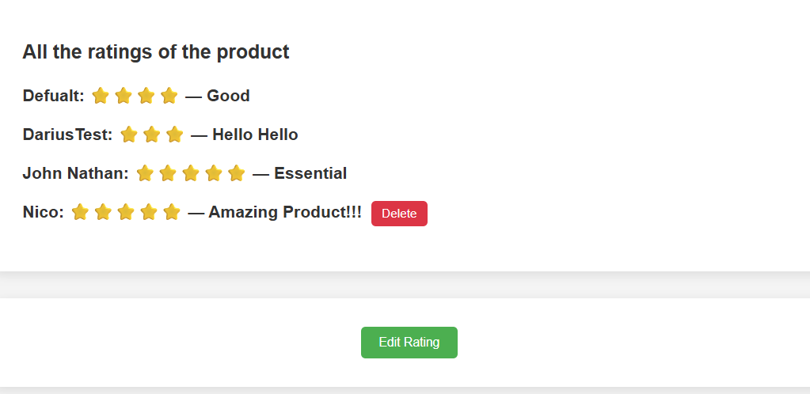
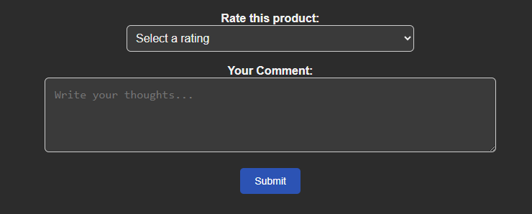
Rating
On view product click, data is saved in sessionStorage
Loads view_product.php with the product details
Page fetches product info and ratings via API using prod_id
Product details (title, price, image, description) are rendered
Reviews are dynamically loaded and displayed using JavaScript
Authenticated users can submit, edit, or delete their own reviews
Uses conditional UI logic to toggle between Submit and Edit modes

Slide 11
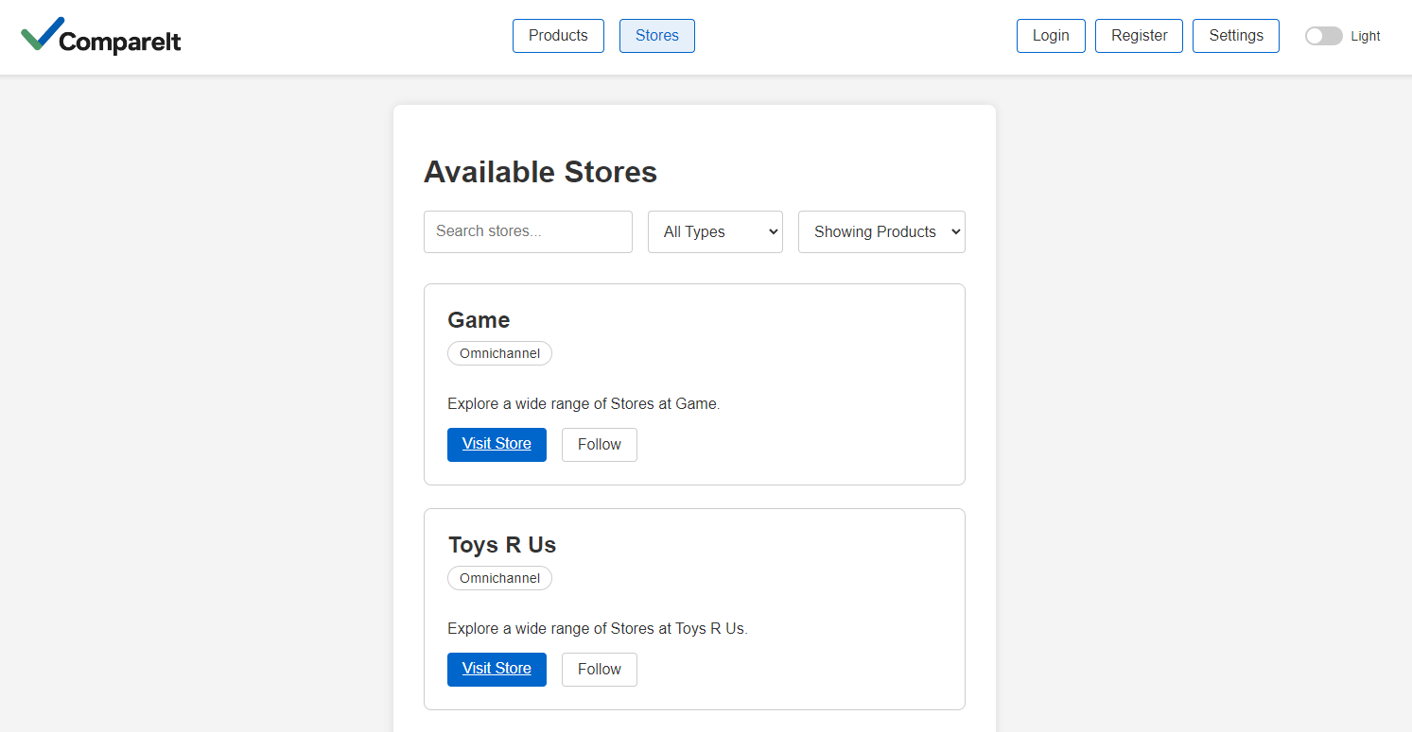
Stores
On load, stores apikey and fetches all stores from the database with API request.
Filter and search functionality. Search is fuzzy and manually filters with JS filter logic.
Follow functionality for users, gets stored in ‘follows’ table. Uses ‘Follow’/’Unfollow’ API requests.
“Visit Store” button on click redirects user to url stored in ‘store’ table.

Slide 12
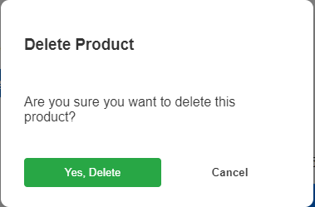
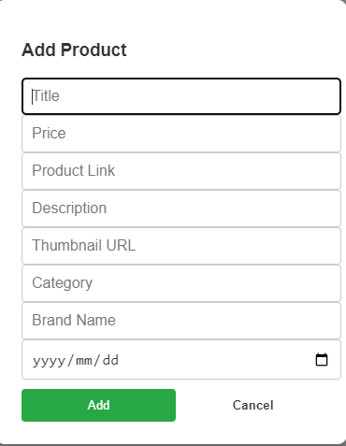
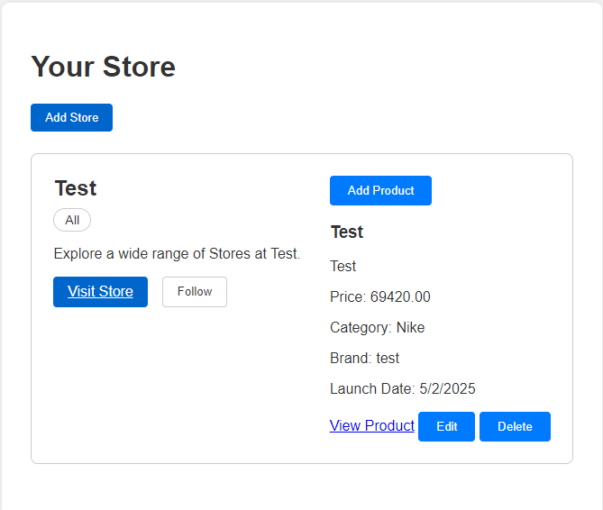
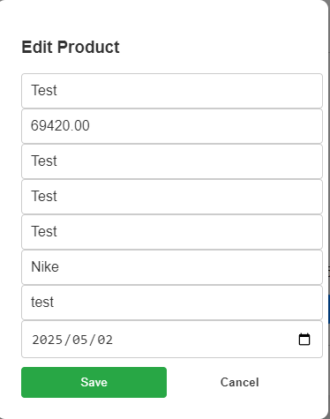
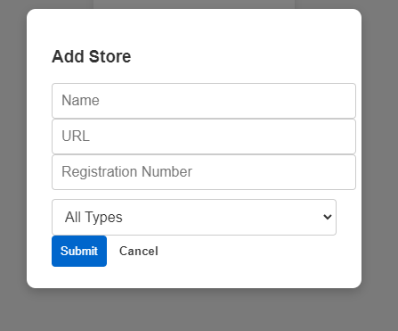
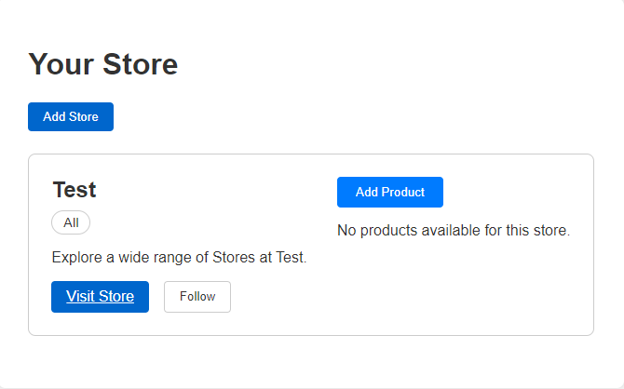
Manage Store
Page only accessible if logged in. Allows user to add store to ‘store’ database, add product to store, edit the product and delete. User can only have one store.
All done by API requests.
Store is dependent on apikey for create, edit and delete. User only becomes store owner in database when a store is created.

Slide 13

Back-end
🔒 Security
⚠️ Make errors clear for front end
🎁 Implemented the bonus question regarding security

Slide 14

Usage of github
🌿 Everyone created their own branch
🧪 Testing branches were used before merging into main
✅ Finally, all changes were merged into the main branch

Slide 15

Query optimizing
Before
After
SELECT p*, AVG(r.rating) as average_rating FROM products p LEFT JOIN ratings r ON p.product_id = r.product_id GROUP BY p.product_id ORDER BY average_rating DESC
Currently it takes 0.078 sec to retrieve the data
SELECT p*, average_rating FROM products AS p LEFT JOIN ( SELECT AVG(r.rating) AS average_rating, product_id FROM ratings AS r GROUP BY r.product_id ) AS r ON p.product_id = r.product_id ORDER BY average_rating DESC;
This now takes 0.016 sec to retrieve the data

Slide 16
Demo
📽️ We will now proceed with a demonstration of the features outlined in the previous slides.

Slide 17

Conclusion
Unified frontend-backend communication via fetch/XMLHttpRequest ensures real-time product filtering (e.g., by ratings) while maintaining security.
Robust Security
API key validation (sessionStorage) and PBKDF2 hashing protect user data without compromising performance.
Intuitive User Experience
Dynamic rating filters enhance discoverability, with client-side rendering for speed and server-side validation for accuracy.
Scalable Architecture
Hybrid filtering (client + server) balances performance and flexibility, handling large datasets efficiently.

Slide 18

Questions ?

Slide 19
Thank you! We hope you enjoyed exploring our website.

