Slide 1

Josua Carl
Student
M. Sc. Bioinformatics
Integrated pipeline of feature finding, molecular networking and annotation

Slide 2
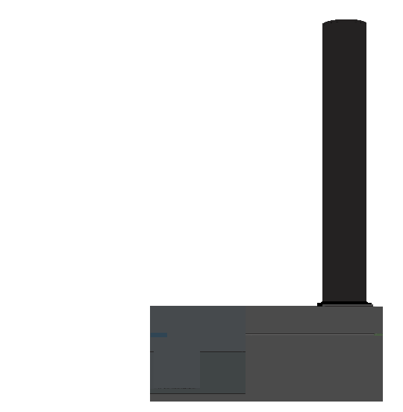



Starting question
Can the composition of microbial communities be inferred through the analysis of flow-injection mass spectrometry runs?
Notes:
About information content of FI-MS

Slide 3



Notes:
Processing time for you

