Slide 1

Josua Carl
Student
M. Sc. Bioinformatics
Integrated pipeline of feature finding, molecular networking and annotation

Slide 2
Analysis Pipeline of LC-MS difference essay
Notes:
About information content of FI-MS

Slide 3
Conversion
From .d to .mzML
Tool mimics folder structure

Slide 4
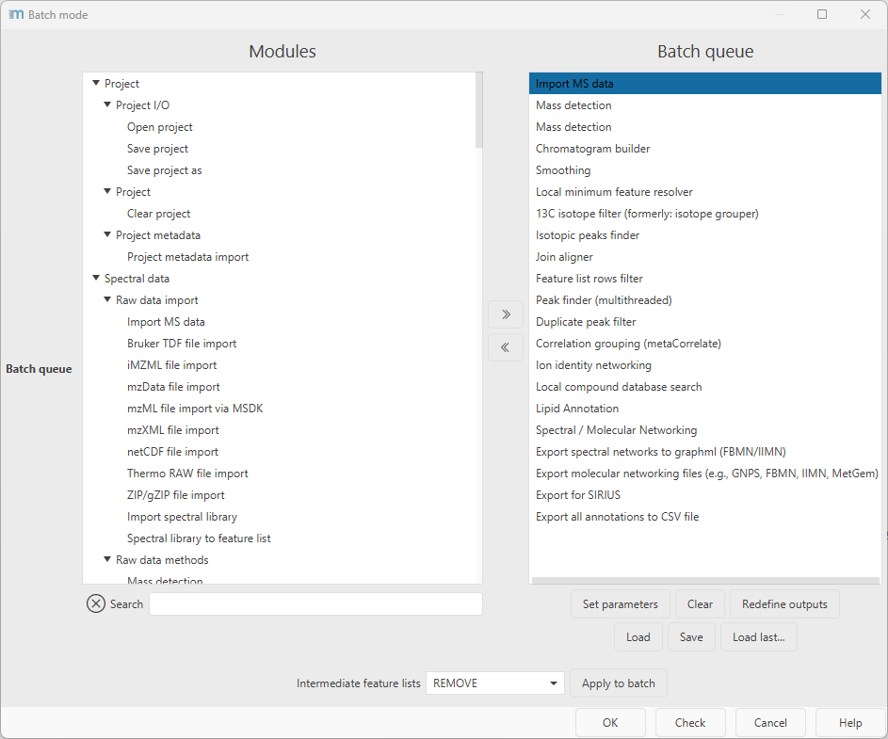
Feature finding
With mzmine
Batch mode

Slide 5
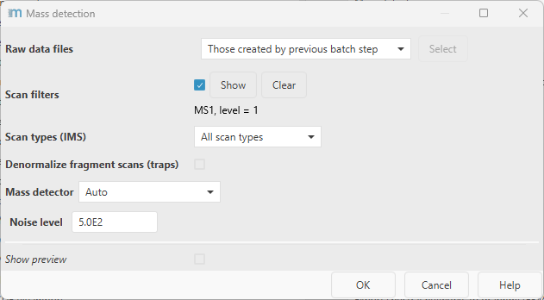
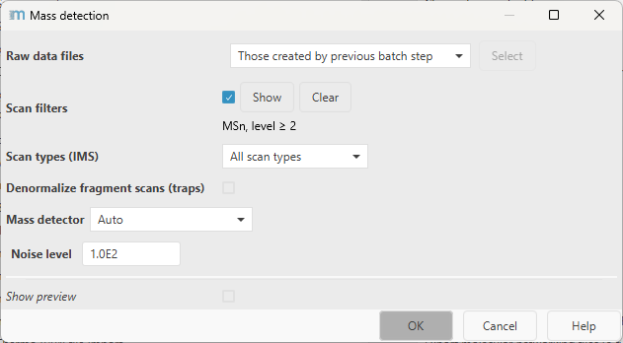
Mass detection / Thresholds

Slide 6
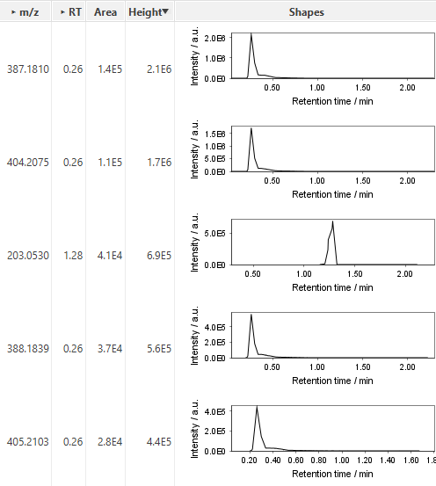
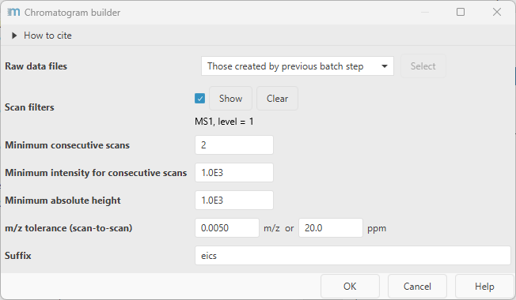
Chromatogram builder
Makes EICs

Slide 7
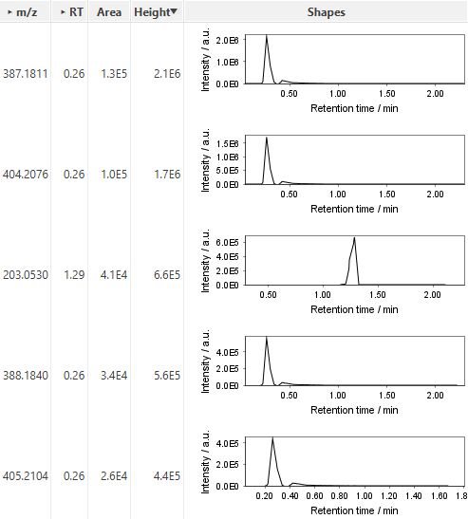
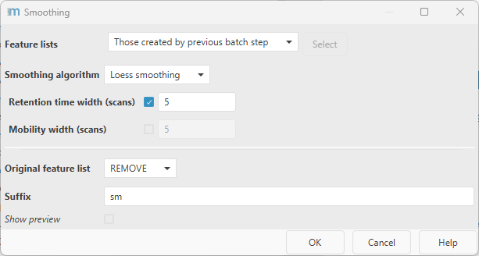
Smoothing
Loess smoothing over retention time

Slide 8
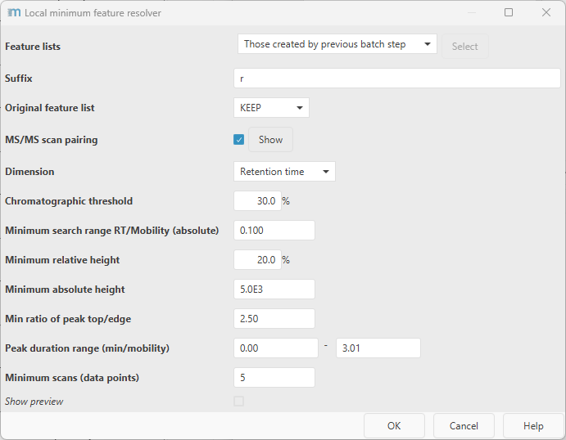
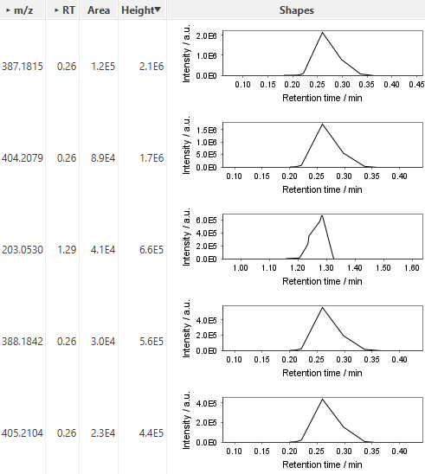
Feature resolver (Local minima)

Slide 9
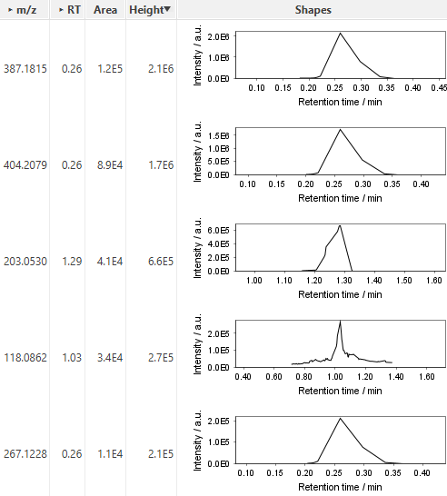
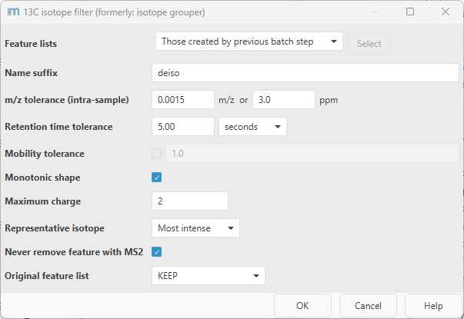
Isotope filter

Slide 10
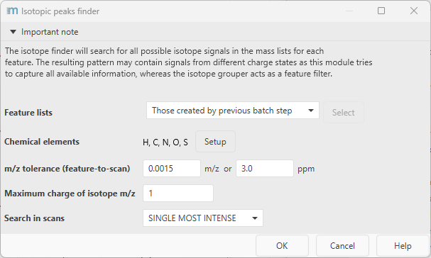
Isotope peaks finder
Finds isotope patterns of most intense peak in original mass spectra

Slide 11
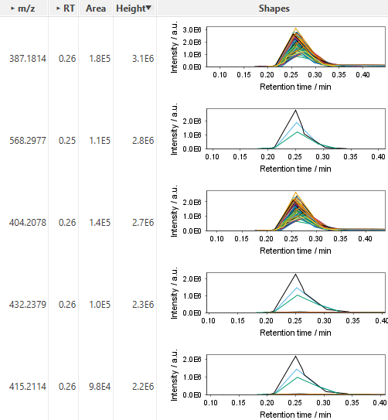
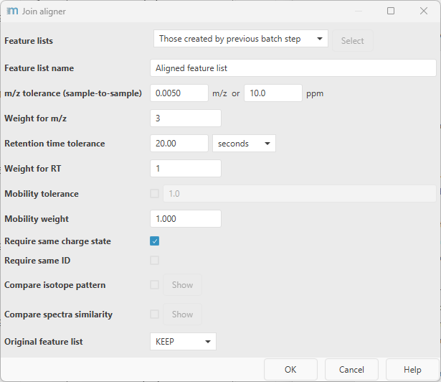
Alignment

Slide 12
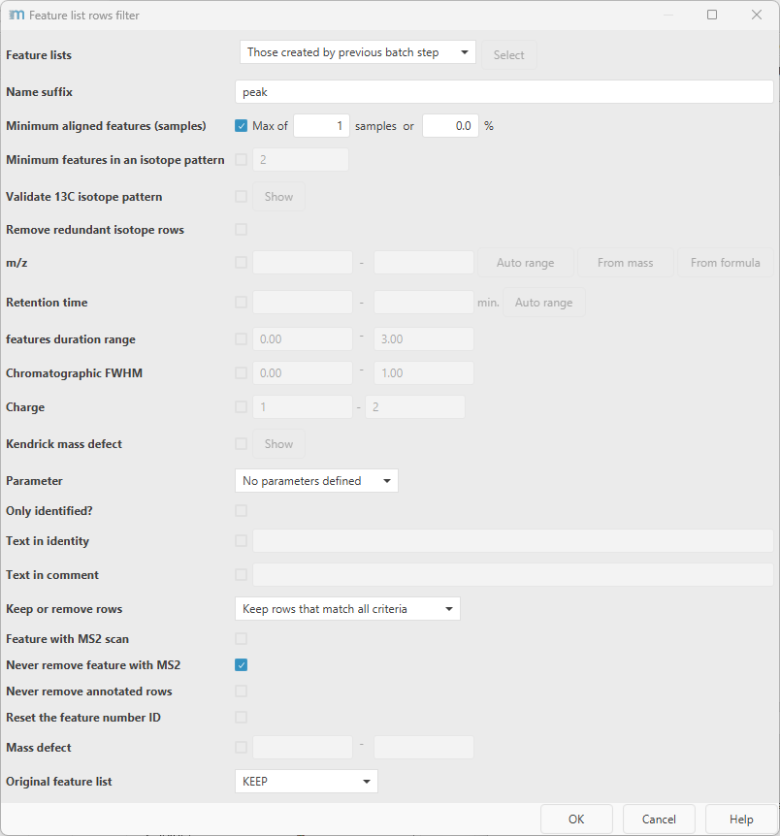
Row filter
Currently no effect (potentially: appearance in n spectra)

Slide 13
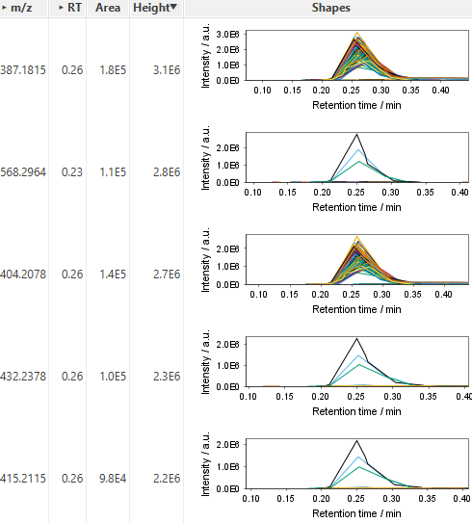
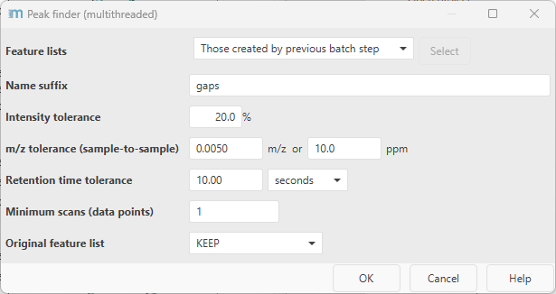
Gap filling
With weaker aligned signals

Slide 14
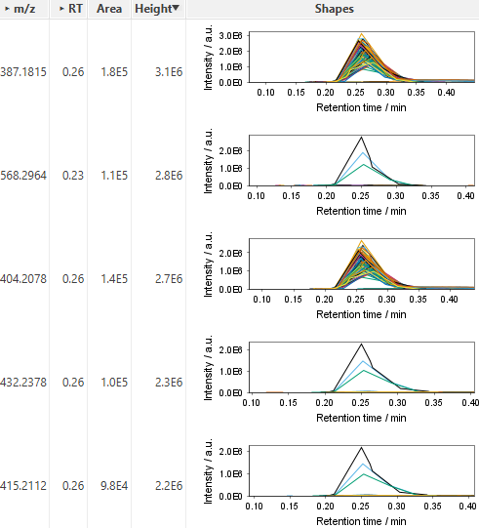
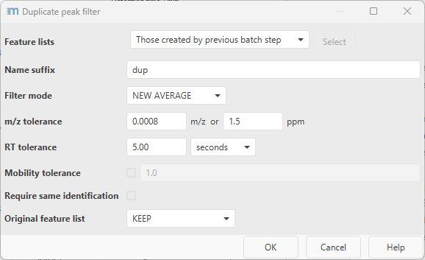
Duplicate peak filtering

Slide 15
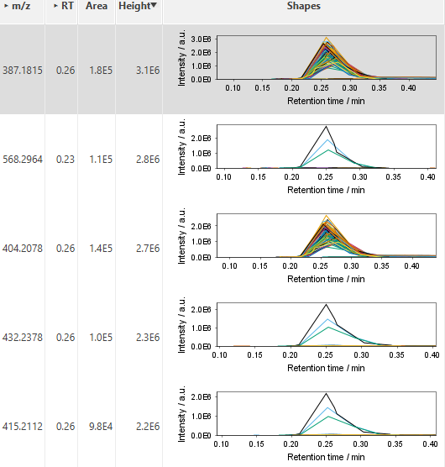
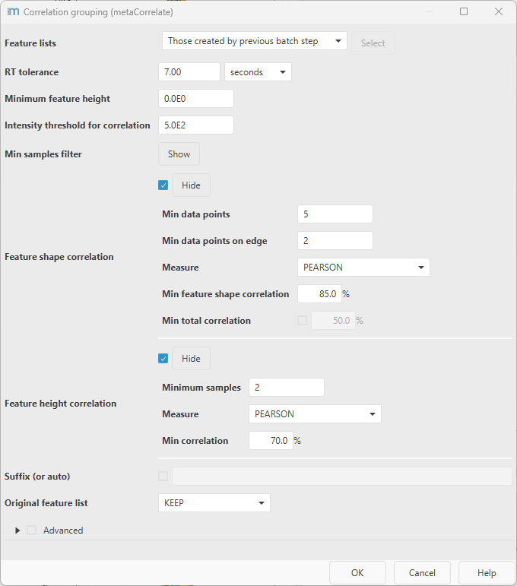
Correlation grouping
Group closely correlated features along RT

Slide 16
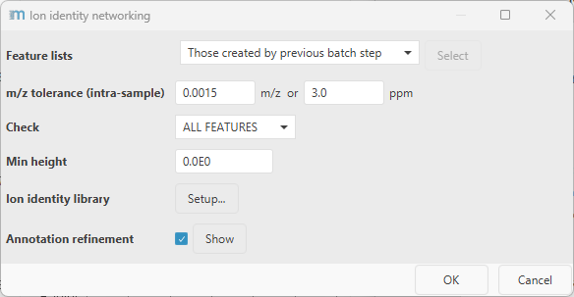
Ion identity networking
Preliminary networking for GNPS

Slide 17
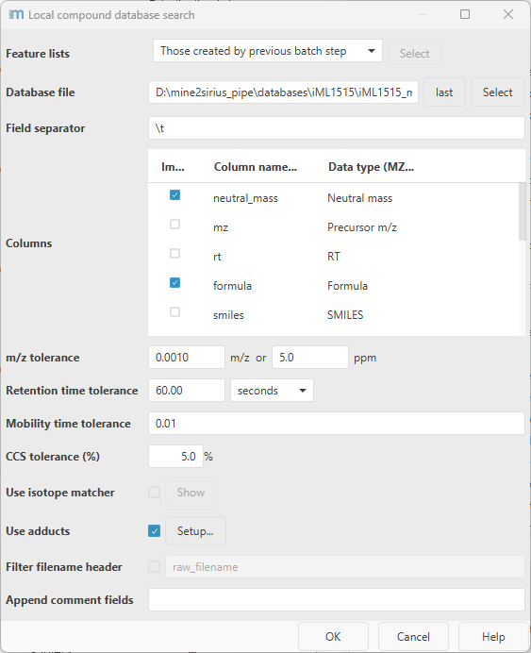
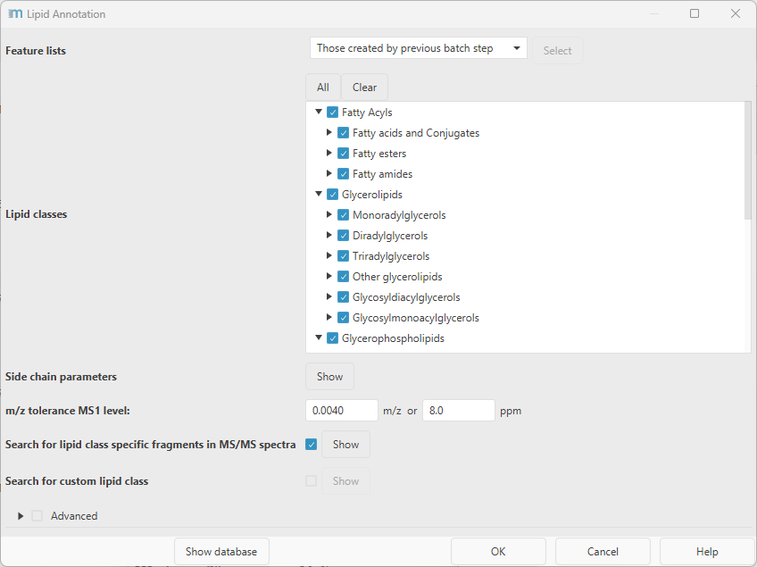
Local database search + Lipid annotation

Slide 18
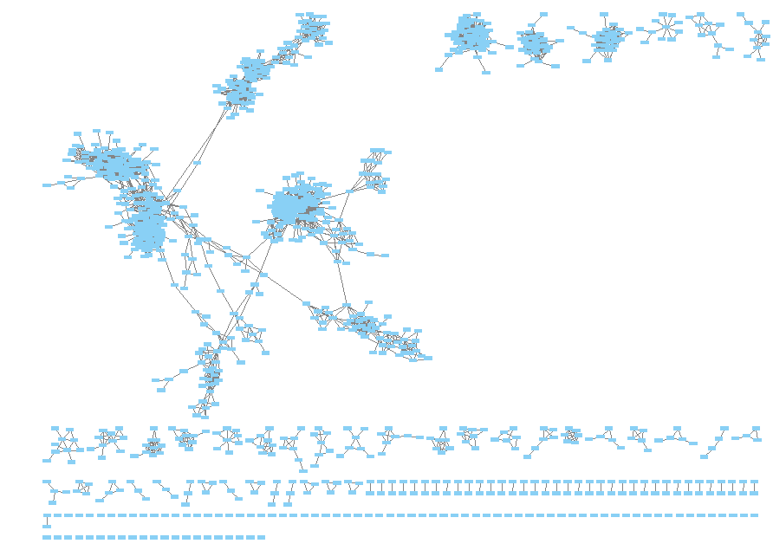
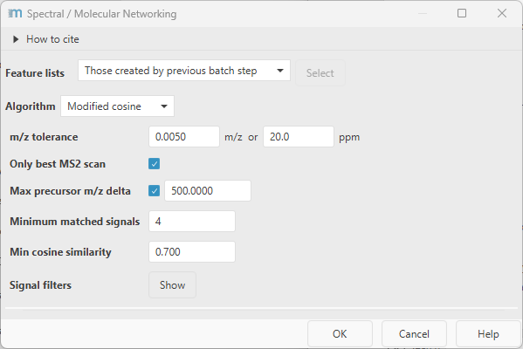
Spectral / Molecular Networking
Like GNPS, but only low masses & cosine similarity metric

Slide 19
Export
As a quantification table (.csv) + MS2 feature information (.mgf)
For GNPS
Feature-based-molecular-networking (FBMN) job can be started directly
MS1 + MS2 feature information (.mgf)
For SIRIUS
Annotations (.csv)

Slide 20
Annotation
Custom DB (iML1515)
GNPS
SIRIUS
SIRIUS-ClassyFire classes

Slide 21
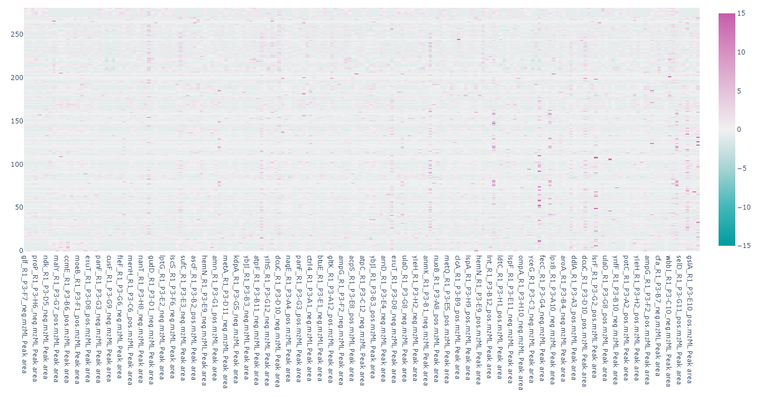
Feature differences

Slide 22
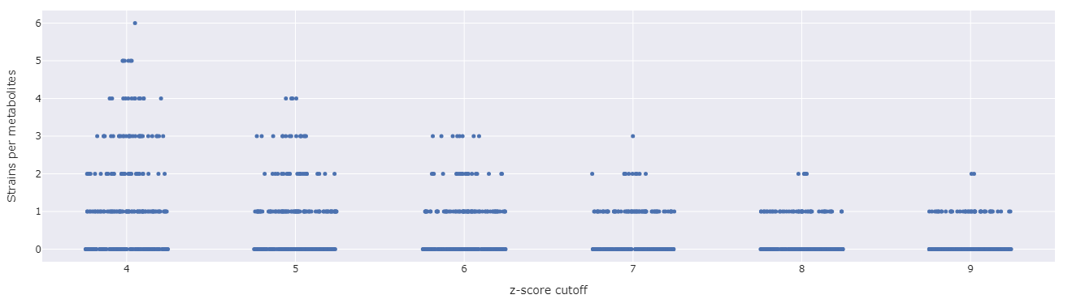
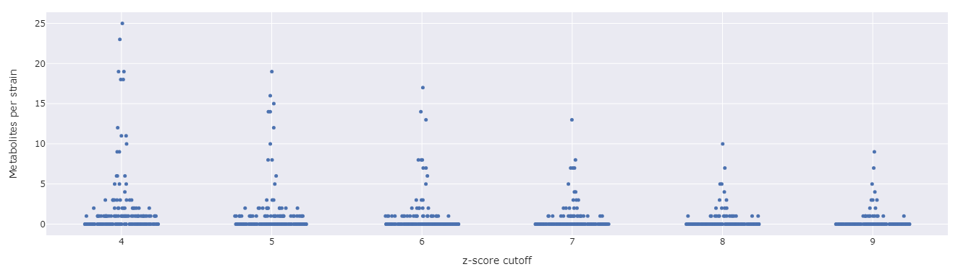
Feature differences

Slide 23



Notes:
Processing time for you

