Slide 1
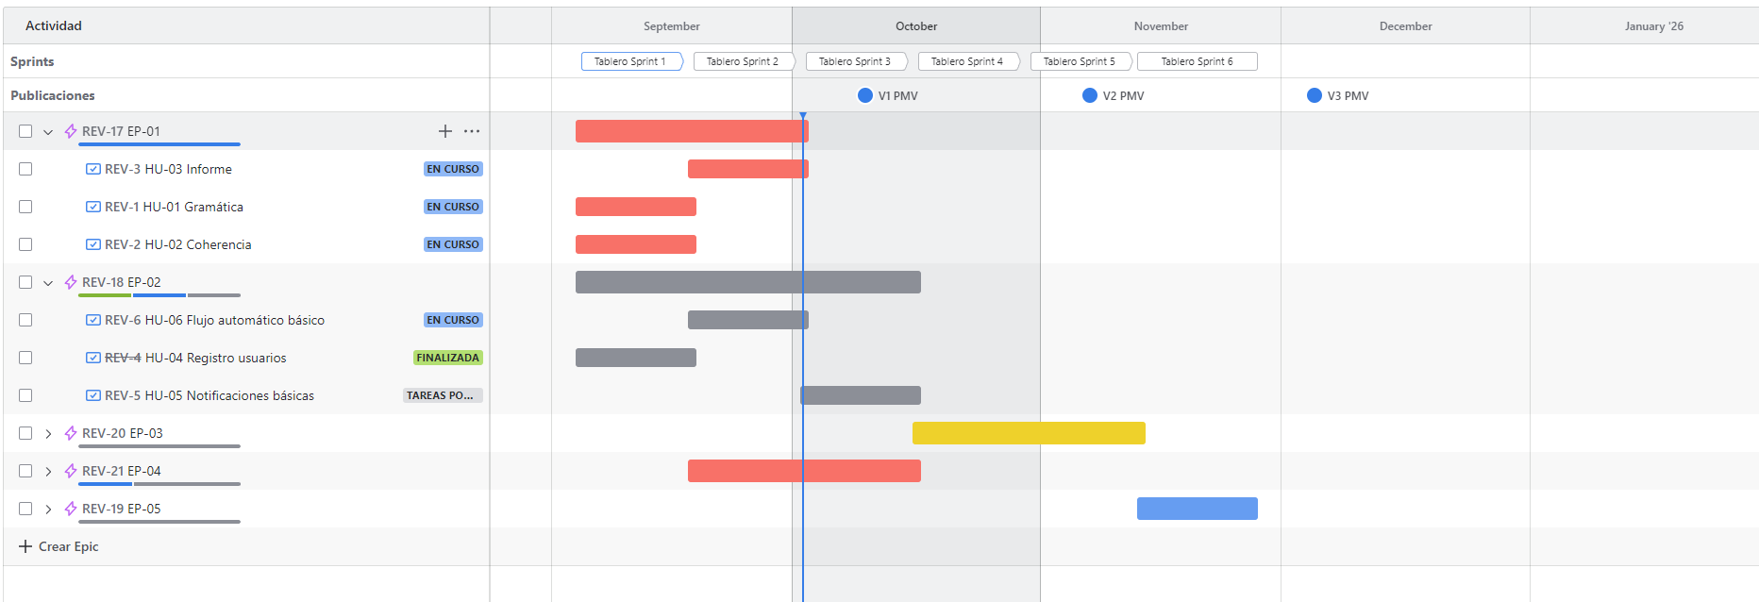
Milestone 2
Mar 7
Milestone 1
Milestone 3
Milestone 6
Jan 10
Mar 14
Milestone 4
Milestone 5
Nov 30
Jun 29
Oct 20
2018
Jan
Feb
Mar
Apr
May
Jun
Jul
Aug
Sep
Oct
Nov
Dec
2019
Today
Task 1
100%
Jan 5 - Mar 1
Task 2
50%
Feb 2 - Mar 14
Task 3
38%
Mar 14 - May 2
Task 4
40%
Mar 25 - Oct 20
Task 4
Oct 21 - Nov 15
Task 6
Nov 16 - Dec 20

