Slide 1
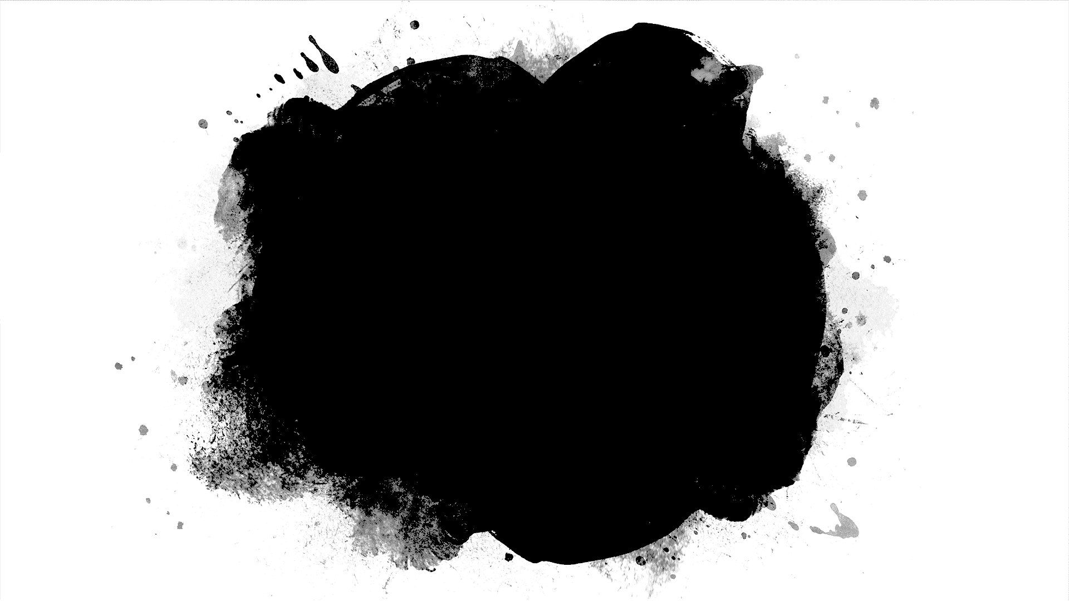
Hangman GUI
By Josue Molina Morales

Slide 2
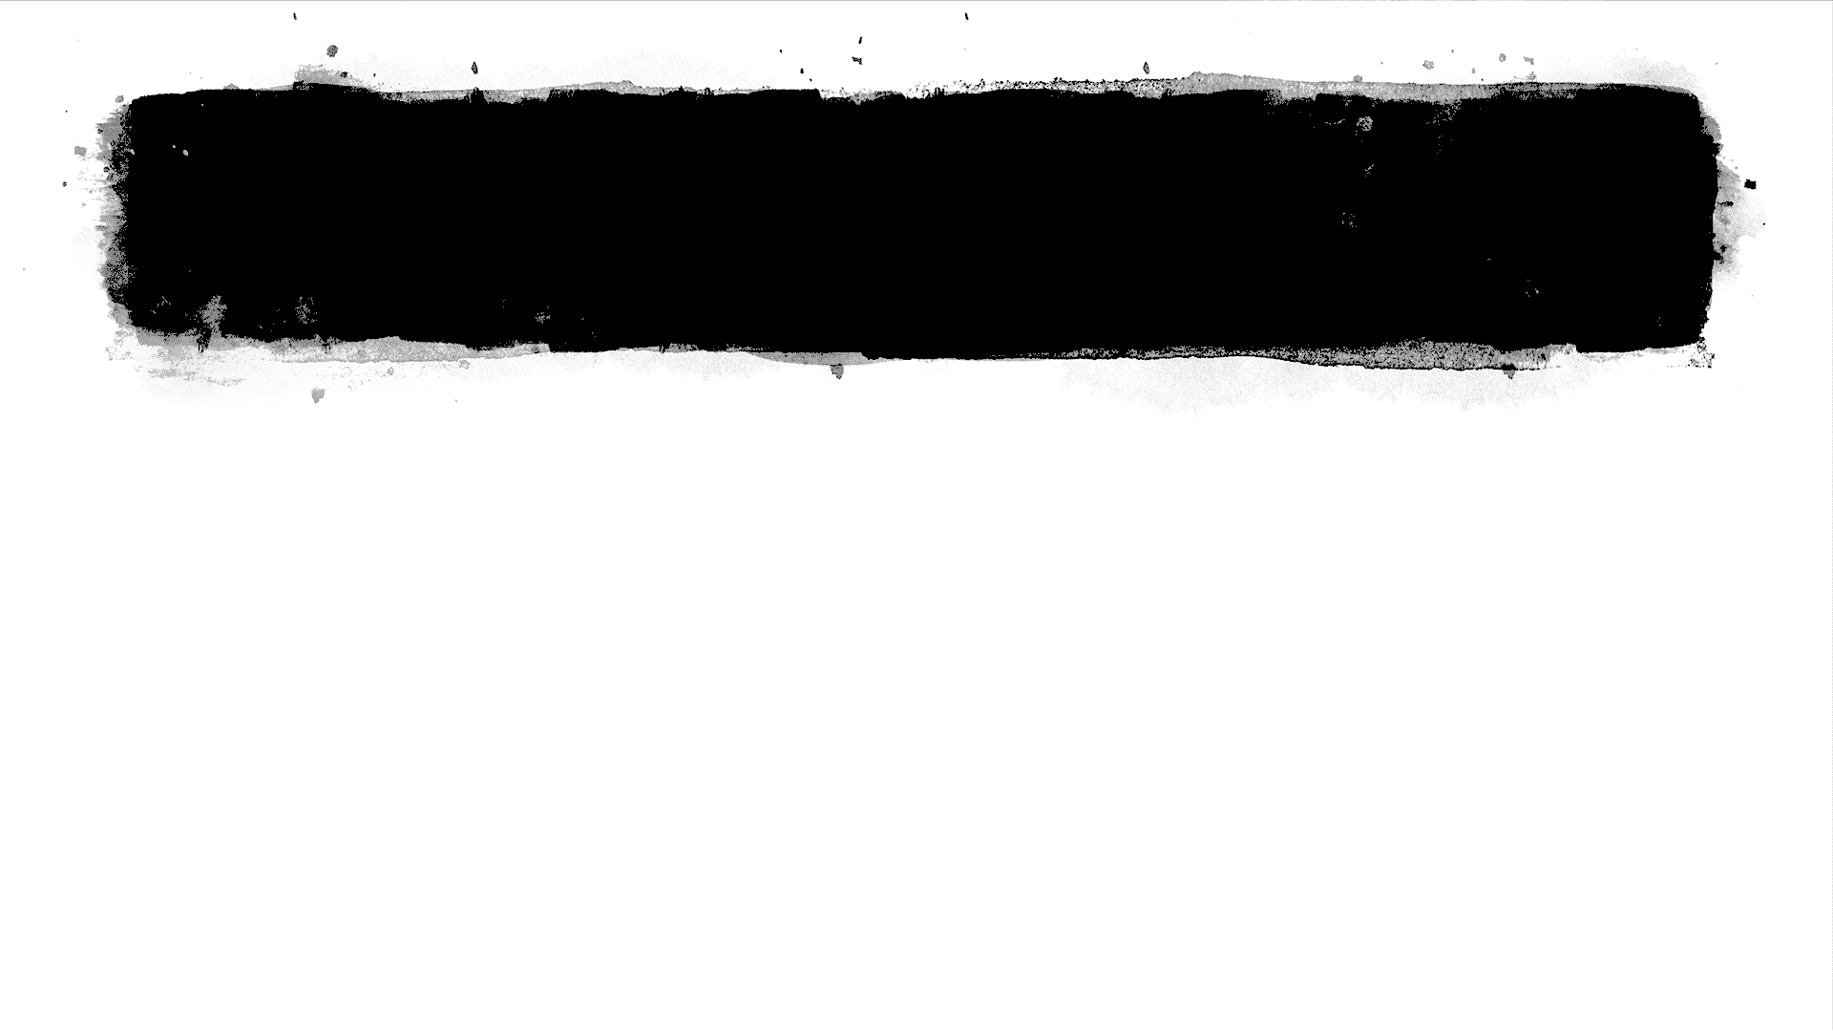
Project Description
For this project I wanted to do something new. This class has been nothing but fun, so I thought my project should reciprocate that feeling.
I thought about the Tic-Tac-Toe project and how exciting it was. I wanted to do another well known game, so I chose Hangman.
The problem was how did I want it to look and feel for the user.

Slide 3
The Design
During this phase of development, I started thinking about doing a Graphical User Interface (GUI).
I thought it would be a lot fun, I just didn’t know how to use any GUI modules in python!
I went basic and made the Hangman game how the Tic-Tac-Toe game came out, in the terminal.
I finished in a day and thought this wasn’t enough. So I went back and did the GUI.

Slide 4
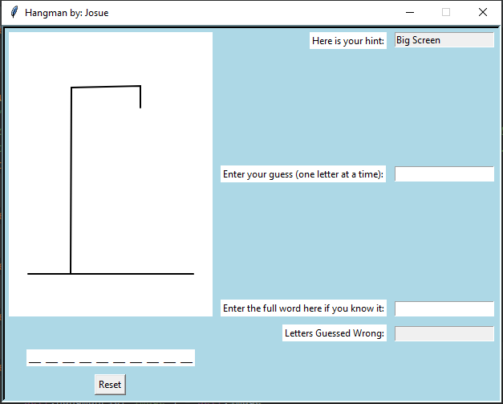
Instructions
For this program you are given a picture of your starting board.
The underscores represent every character in the word
On the top right you have a hint for the current word
In the middle right you have the area where you enter your guess
Only one character at a time or you’ll get an error message!
On the bottom right you have a box where you can enter the full word if you know it
And the box below that is where your wrong guesses appear
The Reset button if for resetting everything on the screen and giving you a new word.

Slide 5
Difficulties encountered
I didn’t know anything about GUI’s!
Lots of bugs
Features that I wanted to add but didn’t know how to.
Pressing the enter key instead of pressing a button after every guess.
Emptying the input box after the user pressed enter so the user didn’t have to press delete
Working a lot so not having much time to work on the project.

Slide 6
How They Were Solved
To solve not knowing about GUI’s, I know there are at least two chapters about it in our current textbook. I know that if I found time and read, I could understand the basics.
BUGS! I always trace my program and try to find what causes the bugs and what I can do to fix them. I know that my first thought isn’t always the best thought. So I always come back and revisit ideas.
StackOverFlow became my friend when it came to finding out how to implement features that weren’t in the book. I made sure I knew how the line of code worked before using it.
Dedication and wanting to be the best kept me motivated even after working long hours.

Slide 7
The “Somethings”
Something old
Mostly everything we learned in this class I used: OOP, Dictionaries, Loops, Selection Statements, Functions.
Something new
I had to learn a lot of new material to understand how to use and implement the GUI.
Something borrow
The help of the internet to help me find how to add a feature.
Something blue
The background of the game is a light blue!

Slide 8
Things I Would Have Added
If I had the time, I would have loved to add a picture or GIF after the user wins or loses.
Mores subtle features that could’ve made the game better.
Learned how to use a more advance GUI module to make the program look better.
Added more words to the game.

