Slide 1
Web - service
Alejandro Sanchez
Josue Rodriguez
Jesus menacho
Limbert Vargas

Slide 2
What is a Web Service
A web service is a network accessible interface to application functionality, built using standard Internet technologies.
Clients of web services do NOT need to know how it is implemented.

Slide 3
PROJECT diagram
AT-10 Web-Service
3rdparty
gradle
main/java/com/ fundation/webservice
rsrc
Src
test/java/com/ fundation/webservice
model
common
Controller
Database

Slide 4
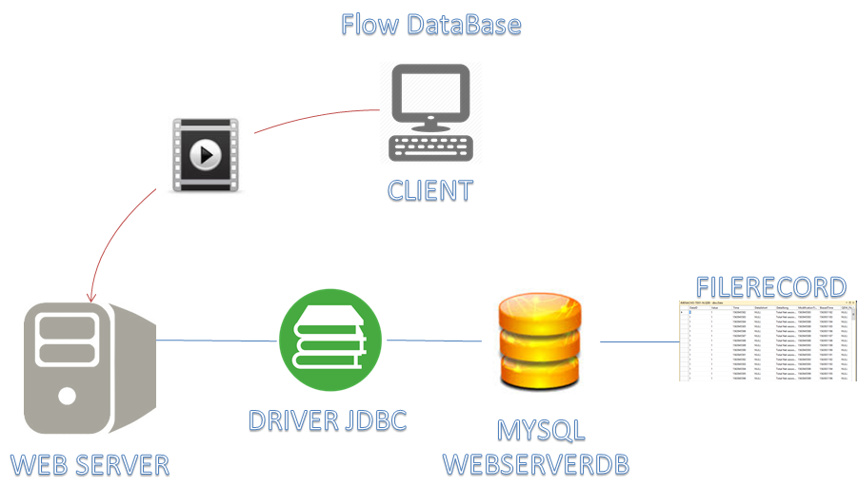
Data base

Slide 5
Tools
PDF Box
Ffmpeg
ImageMagick
ApachePOI
Exif tool
OfficeToPDF
Pandoc
PopplerUtils
Im4java
SpringBoot for REST

Slide 6
bugs
DESCRIPTION | STATUS
When an invalid key is sent, the web application does not display a descriptive message. | Not Fixed
When not enter any value in config field the conversion is not realized with defect values. | Fixed
The output name files show with errors. | Fixed
Errors in boolean values in keys. | Fixed
enhancements
DESCRIPTION
Defect values for output field (name, ext)
Error handling with logger tool.
After convertion, delete the selected intermediate files
Rename upload files
Refactor repeated code.
Include a logger

Slide 7
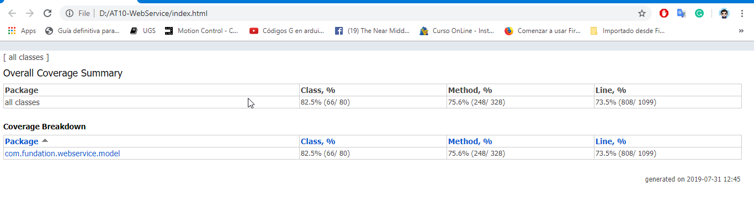
Code coverage

