Slide 1
Hyphal Waviness
Diagrams and Figures

Slide 2
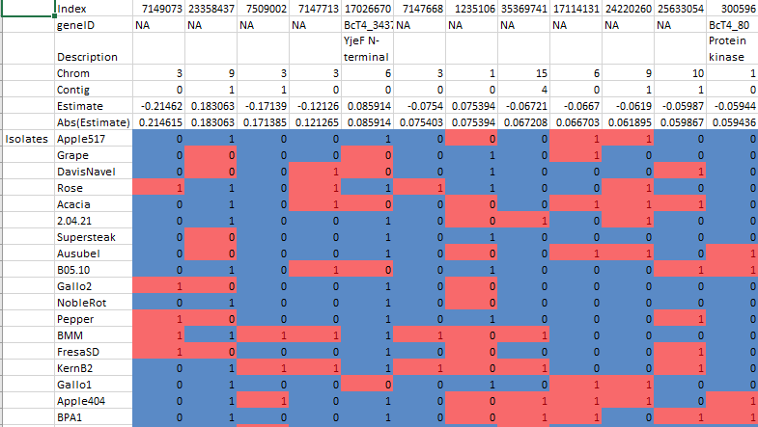
Table #. Top 30 SNP Effect Estimates for 97 B. cinerea Isolates affecting Hyphal Waviness.
The top 30 SNP effect estimates of hyphal waviness on 91 Botrytis cinerea isolates. The isolate column is organized by descending hyphal waviness. Zero is an indication that the SNP was the same as the reference while 1 shows a difference in the SNP from the reference. The blue indicates a low effect relationship between the SNP and the isolate’s reference SNP while red indicates a high effect. The color corresponds to the positive or negative effect per isolate to the hyphal waviness.
Notes:
This is just an excerpt of the graph (can be found in paper folder)
Will use entire table for input
Likely for supplemental information
GeneID and description can be excluded
Isolates are ordered by descending hyphal waviness

Slide 3
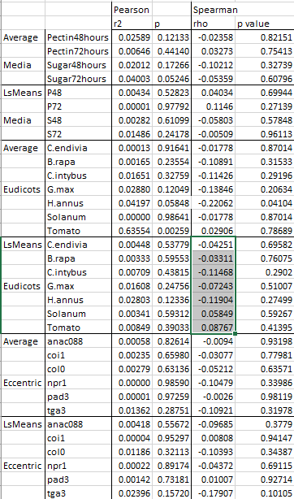
Notes:
This is just an excerpt of the graph (can be found in paper folder)
Likely for supplemental information
Besides the column being properly renamed, is there any recommendation for how to make the information more interesting?
Should the average hyphal waviness be included? Or only include the LsMeans
Table #. Pearson and Spearman Correlations Values for Multiple B. cinerea Interactions with Hyphal Waviness.
Listed are correlation values for multiple Botrytis cinerea interactions. Columns listed are of B. cinerea interactions with multiple types of media, multiple eudicots and eccentricity of lesions on Arabidopsis thaliana. Types of media included Sugar and Pectin growth of B. cinerea with recorded growth at 48 and 72 hours. Measurements for the eudicots were done using B. cinerea’s lesion size on each species. Eccentricity was measured computationally (not sure how this was measured) on growth of B. cinerea infecting multiple strains of Arabidopsis.

Slide 4
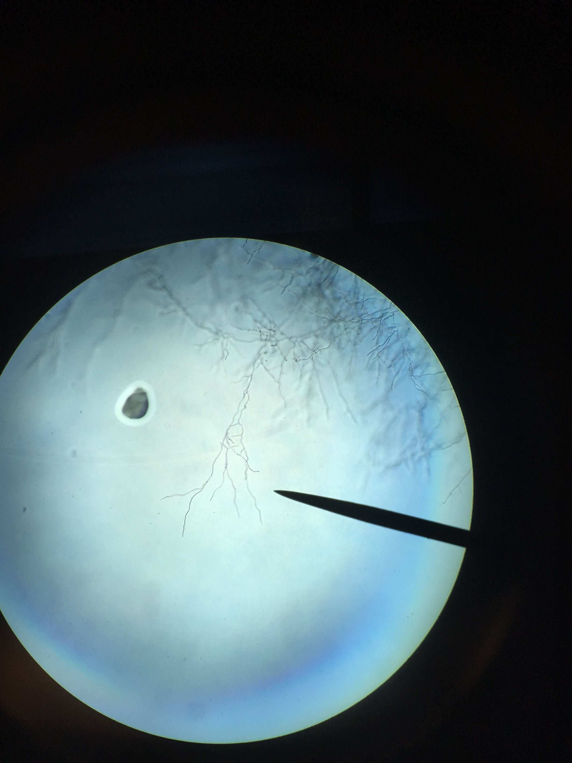
Hand drawn image of hyphal waviness (use reference images)

Slide 5
ANOVA Table Phenotype ~ Isolate + (Isolate*PlateBlock) + Date
Table #. ANOVA results of 97 Botrytis cinerea isolates measured for hyphal waviness.
Shown are Degrees of Freedom, Type III Sums-of-Squares, F-value and p-value for the linear modelling of hyphal waviness of 97 B. cinerea isolates. The terms are as follows: Isolate is the 97 B. cinerea isolates, PlateBlock is the randomization factor of the isolates per media, Date is the recorded date of phenotyping. Interactions of these factors were also tested (:).
 | % Variation | Df | Sum Sq | Mean Sq | F value | p
Isolate | 38.626 | 94 | 878.9 | 9.35 | 15.149 | < 2e-16
PlateBlock | 0.101 | 4 | 2.3 | 0.565 | 0.915 | 0.45421
Date | 5.603 | 5 | 127.5 | 25.506 | 41.325 | < 2e-16
Isolate:PlateBlock | 9.585 | 287 | 218.1 | 0.76 | 1.231 | 0.00855
Residuals | 46.084 | 1699 | 1048.6 | 0.617
 |  |  | 2275.4

Slide 6
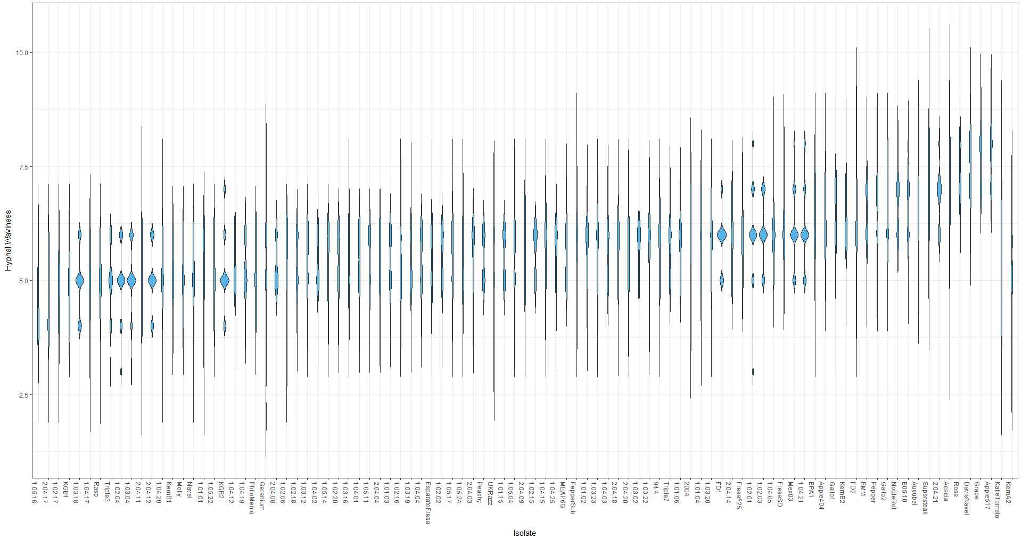
Figure #. Distribution of B. cinerea hyphal waviness of 97 genetically diverse isolates
The violin plots show the distribution of hyphal waviness of 97 B. cinerea isolates. The 75th percentile distribution are shown in each box and are ordered by increasing mean hyphal waviness.

Slide 7
Hyphal Waviness Distribution based on Isolate
Figure #:
Box plot of waviness distribution per isolate ..

Slide 8
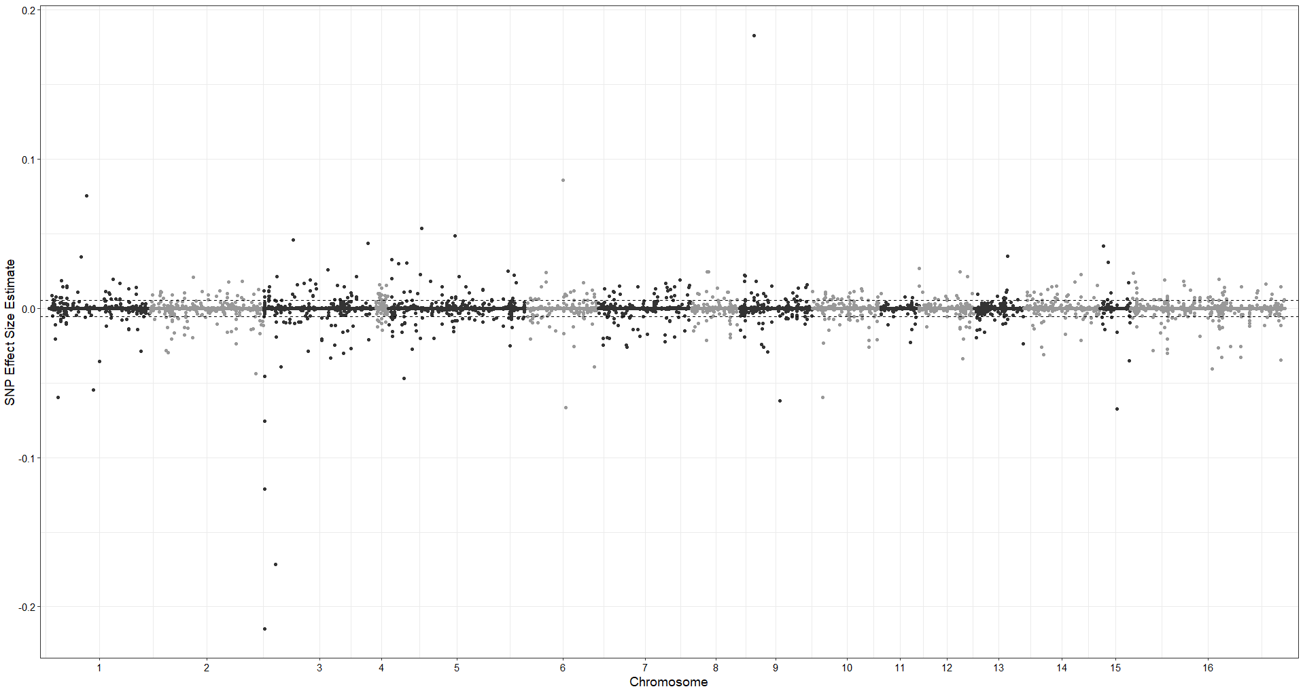
Figure #. GWA of B. cinerea hyphal waviness on potato dextrose agar.
A manhattan plot of estimated SNP effect size for Botrytis cinerea hyphal waviness with B. cinerea chromosomes as alternating black and white regions. 99.9% thresholds of effect size estimate from permutation analysis are displayed as horizontal dashed lines.

Slide 9
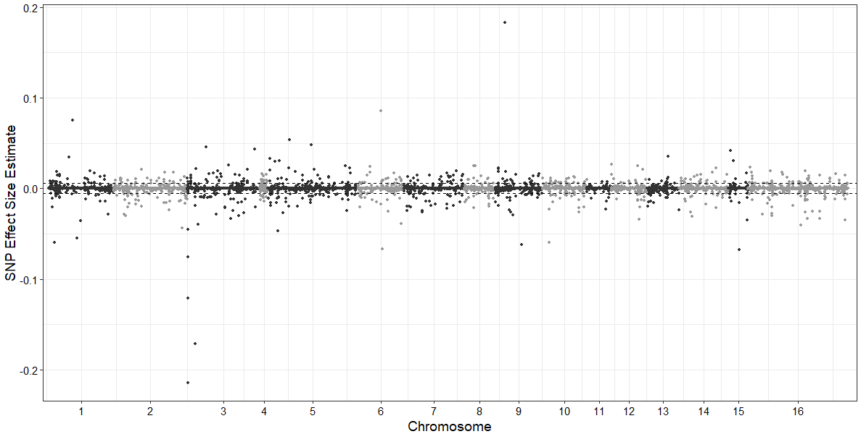
Smaller manhattan plot with scaled points

Slide 10
GWA analysis graphs

Slide 11
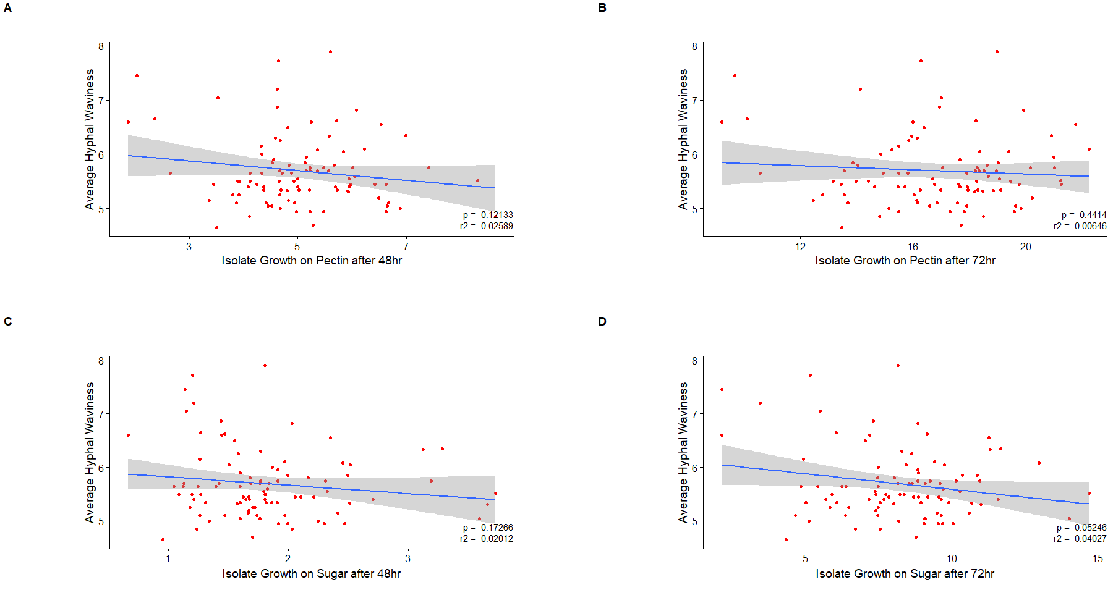
Figure # -
Average Hyphal Waviness plotted against Growth on Sugar/Pectin - pearson

Slide 12
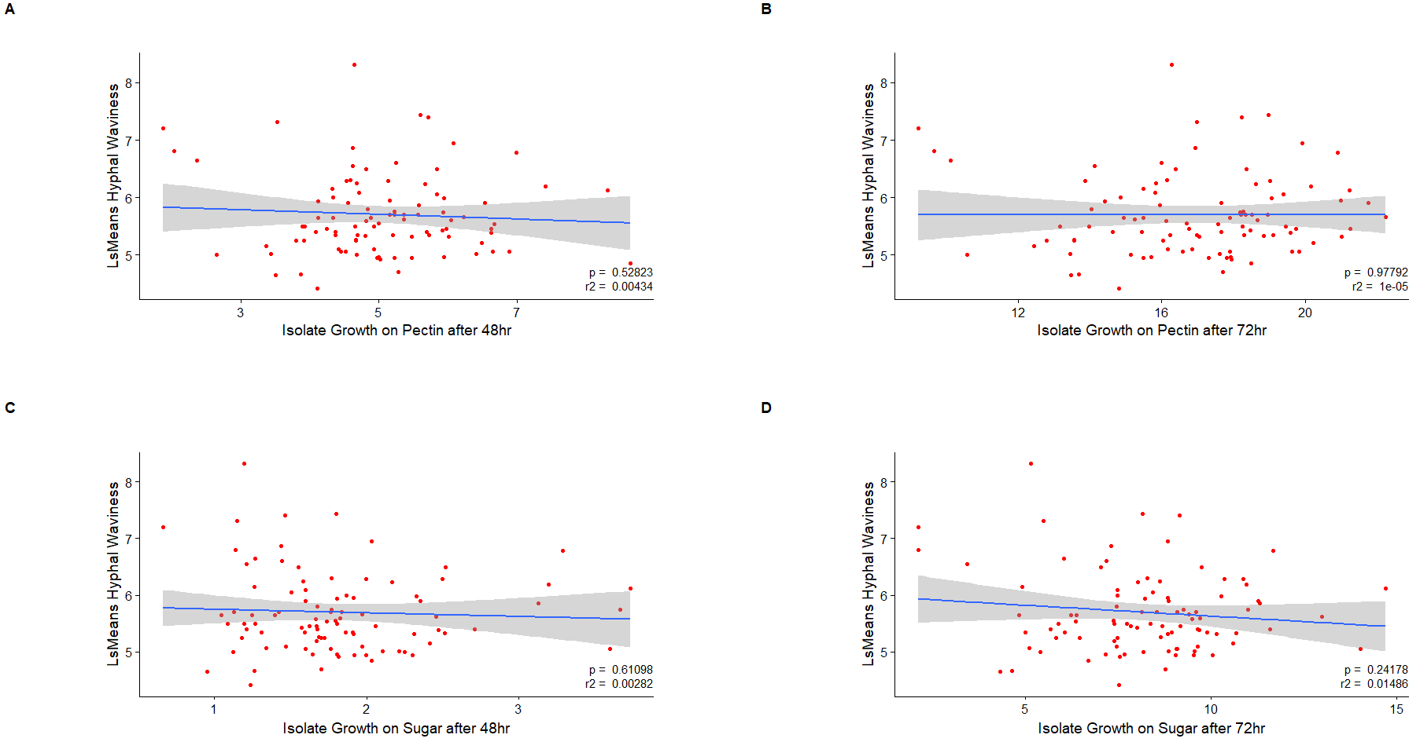
Figure # -
LsMeans Hyphal Waviness plotted against Growth on Sugar/Pectin - pearson

Slide 13
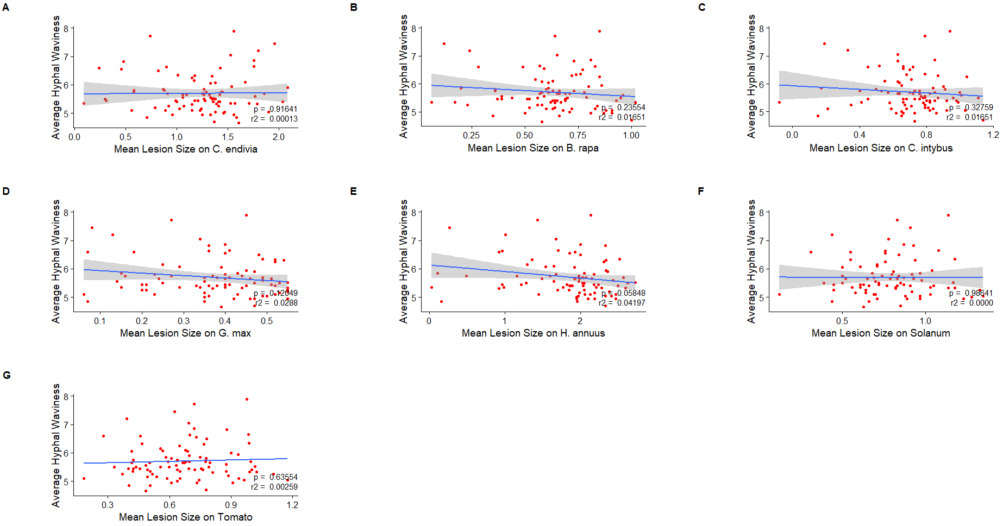
Figure # -
Average Hyphal Waviness plotted against Growth on Sugar/Pectin - pearson

Slide 14
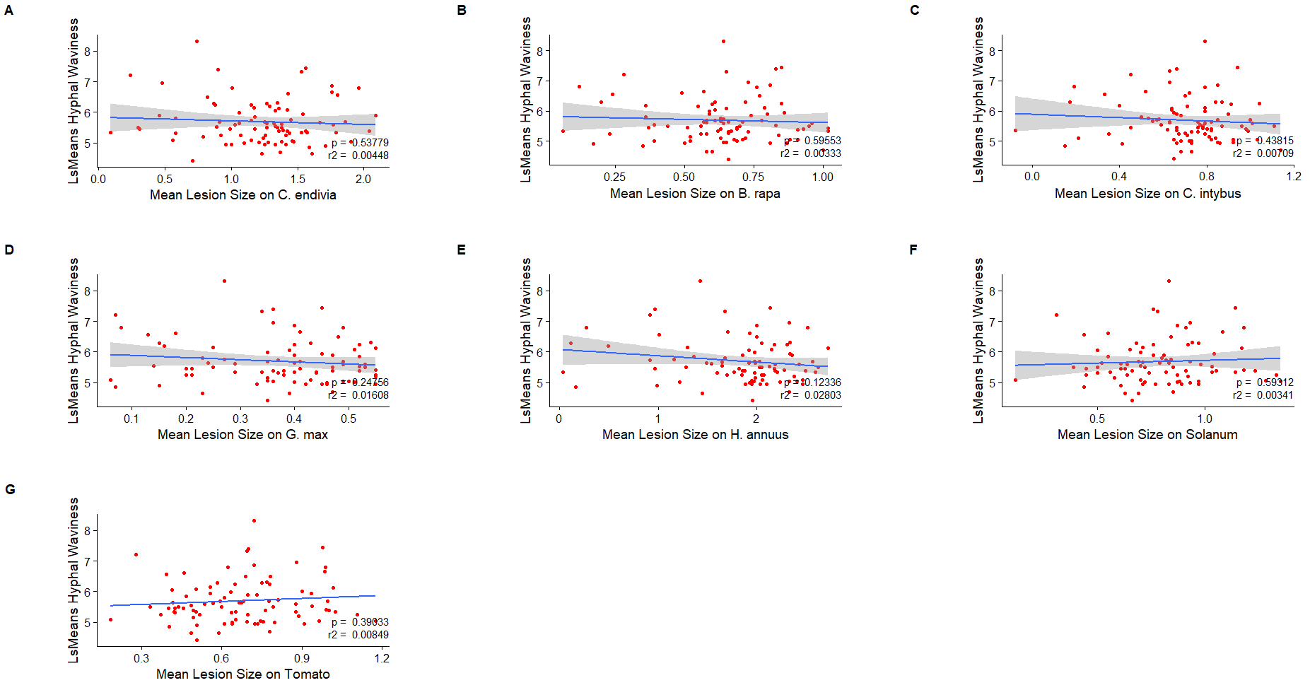
Figure #
See other slide and adopt accordingly - pearson

Slide 15
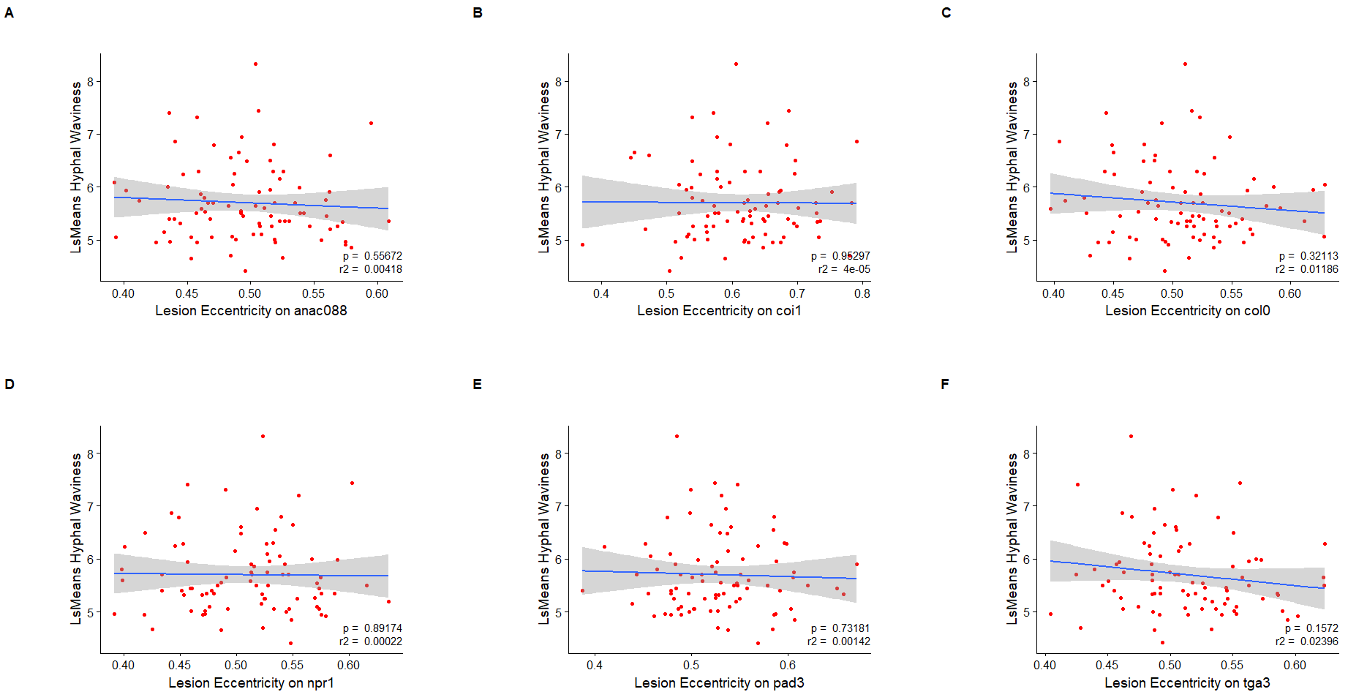
Figure #. Various interactions of B. cinerea lesions sizes on Eudicots with hyphal waviness of B. cinerea. - pearson
Scatter plots of various eudicot lesion sizes due to B. cinerea isolates compared against B. cinerea hyphal waviness based on 97 individual isolates. Each point is an isolate interaction of the marginal means of lesion size with marginal means of hyphal waviness.
A) Least Square Mean lesion size on Cichorium endivia
B) Least Square Mean lesion size on Brassica rapa
C) Least Square Mean lesion size on Cichorium intybus
D) Least Square Mean lesion size on Glycine max (soy bean)
E) Least Square Mean lesion size on Helianthus annuus
F) Least Square Mean lesion size on Solanum
G) Least Square Mean lesion size on Tomato

Slide 16
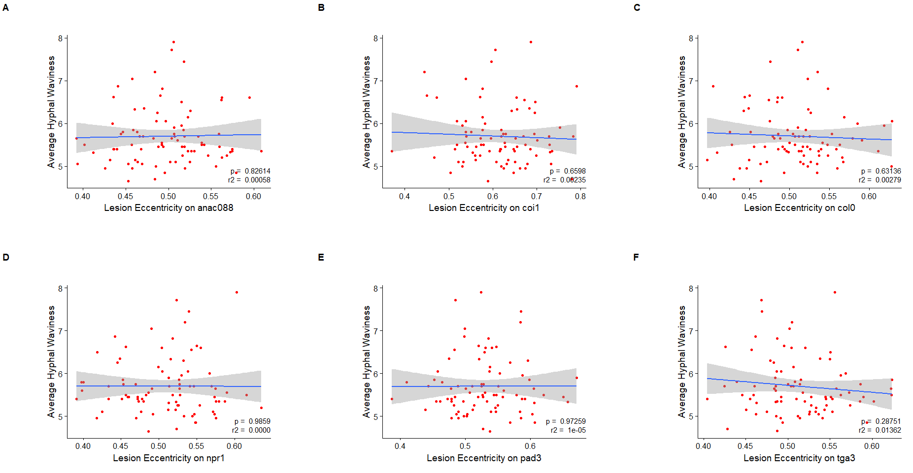
Figure#. B. cinerea Lesion Eccentricity on Multiple Hosts against Average Hyphal Waviness - Pearson

