Slide 1
Hyphal Waviness
Diagrams and Figures

Slide 2
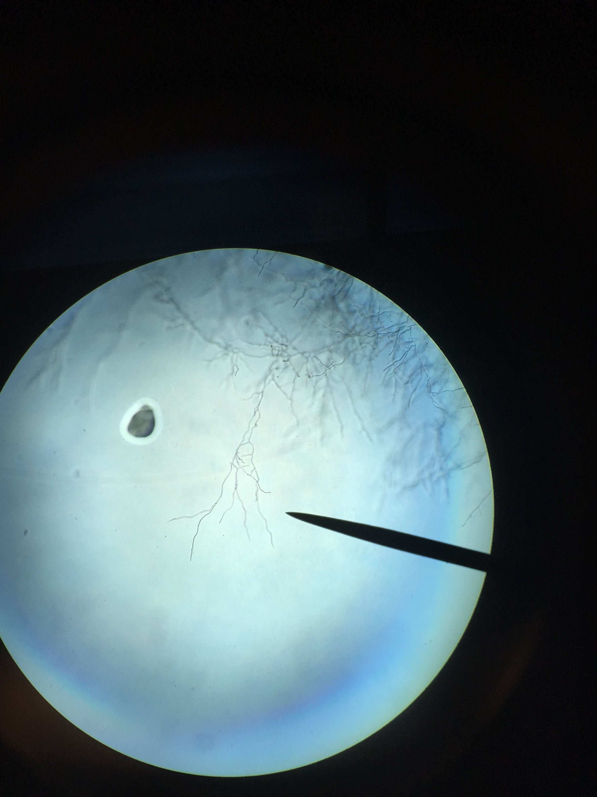
Hand drawn image of hyphal waviness (use reference images)

Slide 3
ANOVA Table Phenotype ~ Isolate + (Isolate*PlateBlock) + Date
Table #. ANOVA results of 97 Botrytis cinerea isolates measured for hyphal waviness.
Shown are Degrees of Freedom, Type III Sums-of-Squares, F-value and p-value for the linear modelling of hyphal waviness of 97 B. cinerea isolates. The terms are as follows: Isolate is the 97 B. cinerea isolates, PlateBlock is the randomization factor of the isolates per media, Date is the recorded date of phenotyping. Interactions of these factors were also tested (:).
 | % Variation | Df | Sum Sq | Mean Sq | F value | p
Isolate | 38.626 | 94 | 878.9 | 9.35 | 15.149 | < 2e-16
PlateBlock | 0.101 | 4 | 2.3 | 0.565 | 0.915 | 0.45421
Date | 5.603 | 5 | 127.5 | 25.506 | 41.325 | < 2e-16
Isolate:PlateBlock | 9.585 | 287 | 218.1 | 0.76 | 1.231 | 0.00855
Residuals | 46.084 | 1699 | 1048.6 | 0.617
 |  |  | 2275.4

Slide 4
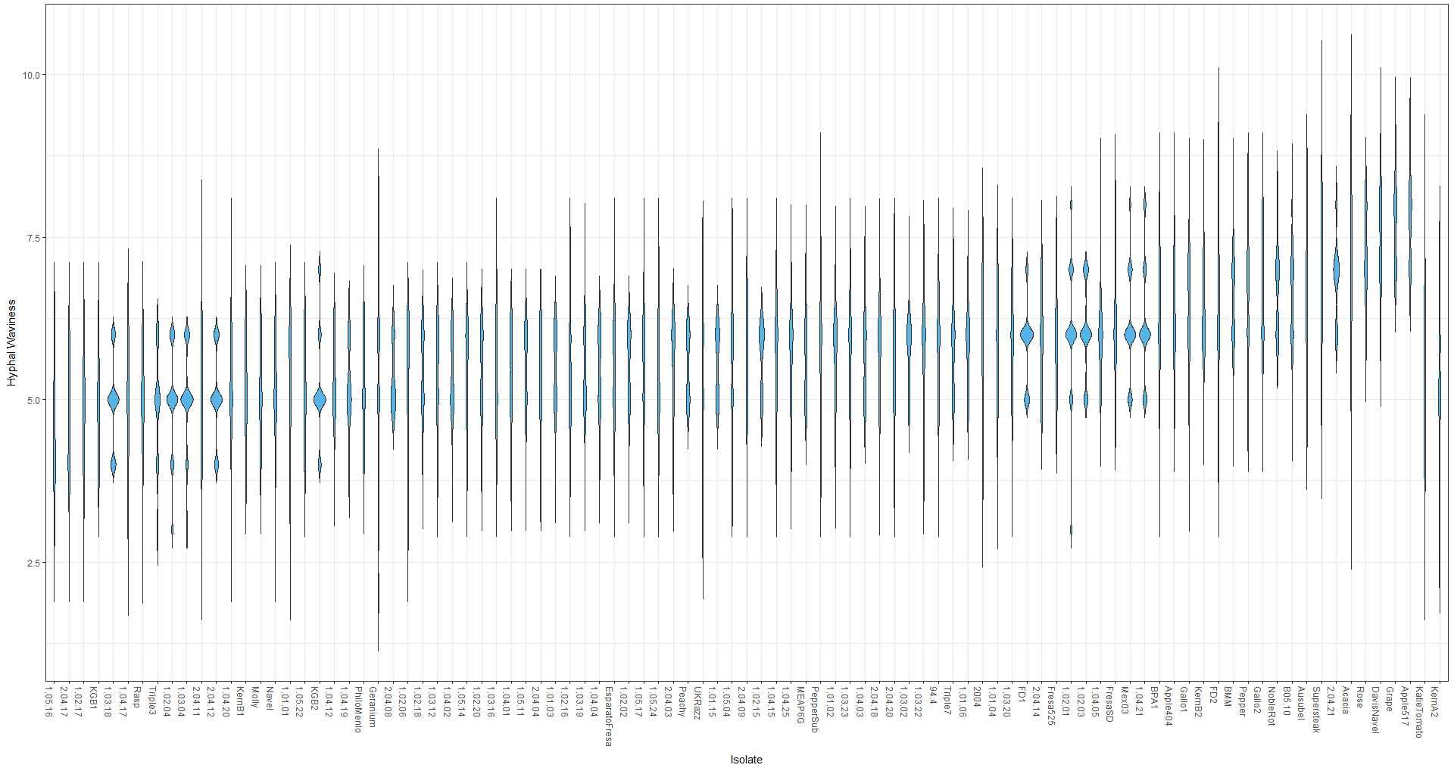
Figure #. Distribution of B. cinerea hyphal waviness of 97 genetically diverse isolates
The violin plots show the distribution of hyphal waviness of 97 B. cinerea isolates. The 75th percentile distribution are shown in each box and are ordered by increasing mean hyphal waviness.

Slide 5
Hyphal Waviness Distribution based on Isolate
Figure #:
Box plot of waviness distribution per isolate ..

Slide 6
Figure #. GWA of B. cinerea hyphal waviness on potato dextrose agar.
A manhattan plot of estimated SNP effect size for Botrytis cinerea hyphal waviness with B. cinerea chromosomes as alternating black and white regions. Thresholds of effect estimate from permutation analysis are displayed as horizontal dashed lines.

Slide 7
GWA analysis graphs

Slide 8
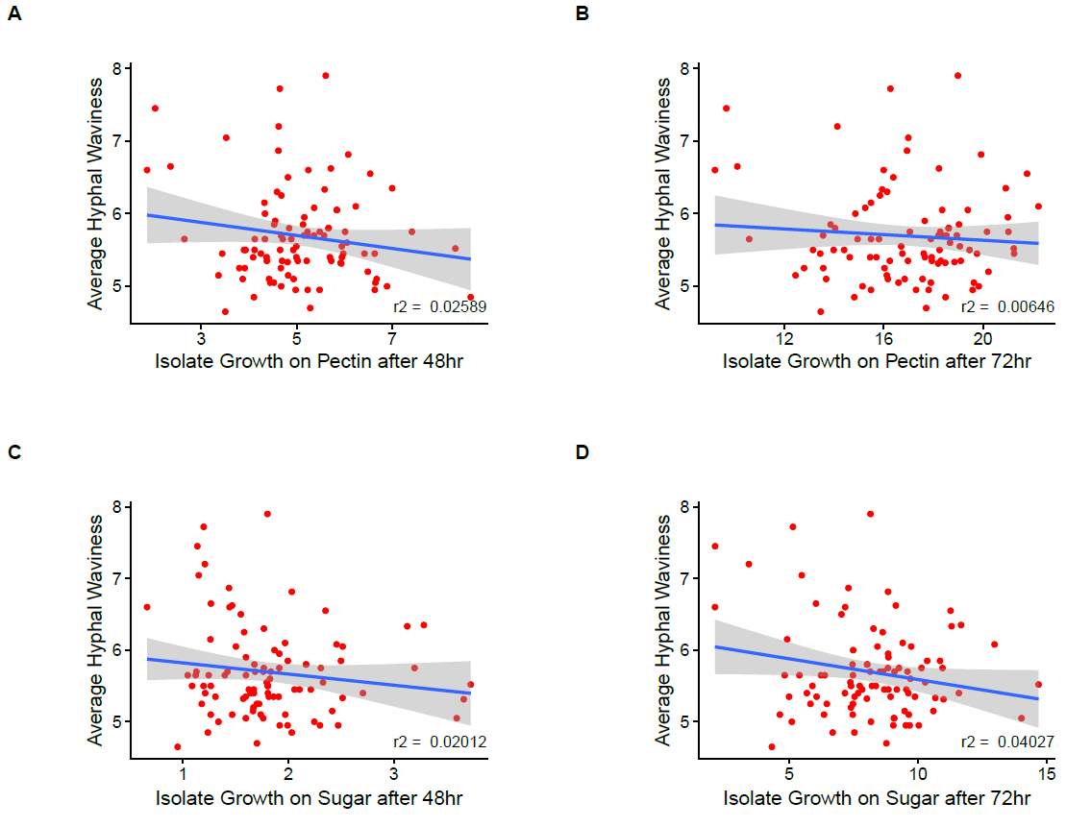
Figure # -
Average Hyphal Waviness plotted against Growth on Sugar/Pectin

Slide 9
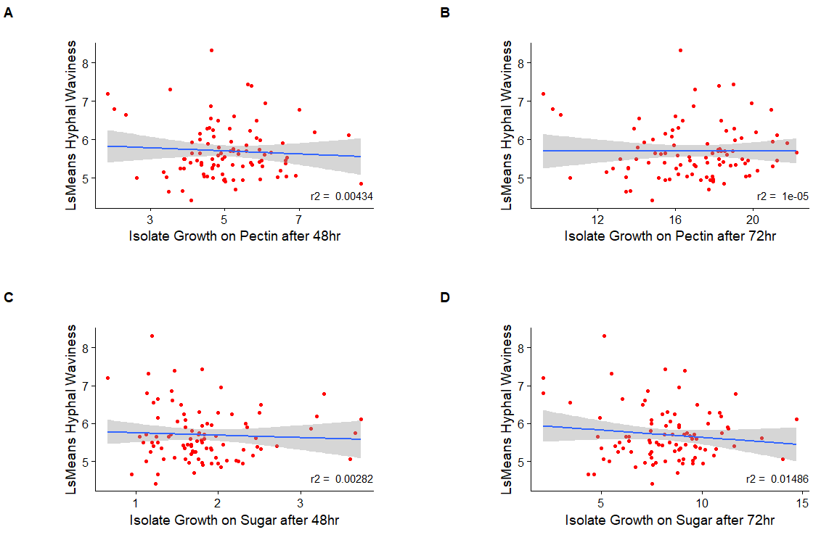
Figure # -
LsMeans Hyphal Waviness plotted against Growth on Sugar/Pectin

Slide 10
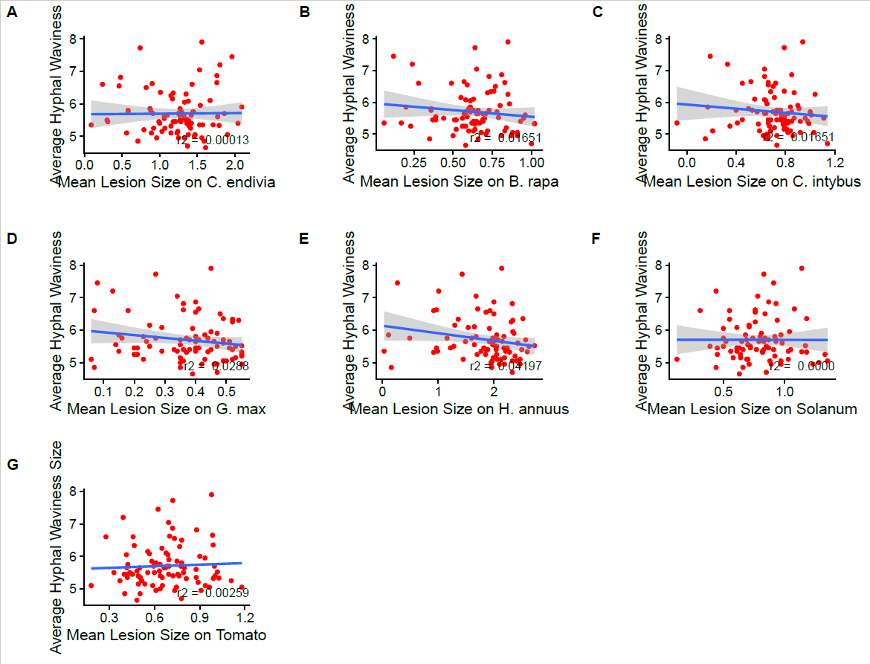
Figure #
See other slide and adopt accordingly

Slide 11
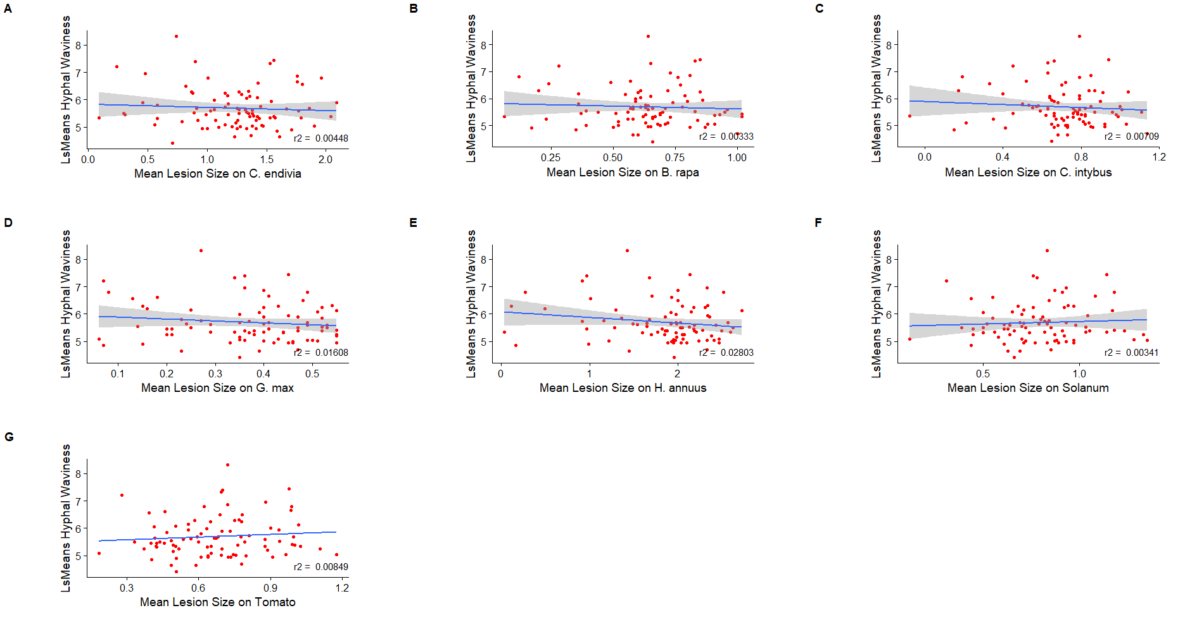
Figure #. Various interactions of B. cinerea lesions sizes on Eudicots with hyphal waviness of B. cinerea.
Scatter plots of various eudicot lesion sizes due to B. cinerea isolates compared against B. cinerea hyphal waviness based on 97 individual isolates. Each point is an isolate interaction of the marginal means of lesion size with marginal means of hyphal waviness.
A) Least Square Mean lesion size on Cichorium endivia
B) Least Square Mean lesion size on Brassica rapa
C) Least Square Mean lesion size on Cichorium intybus
D) Least Square Mean lesion size on Glycine max (soy bean)
E) Least Square Mean lesion size on Helianthus annuus
F) Least Square Mean lesion size on Solanum
G) Least Square Mean lesion size on Tomato

Slide 12
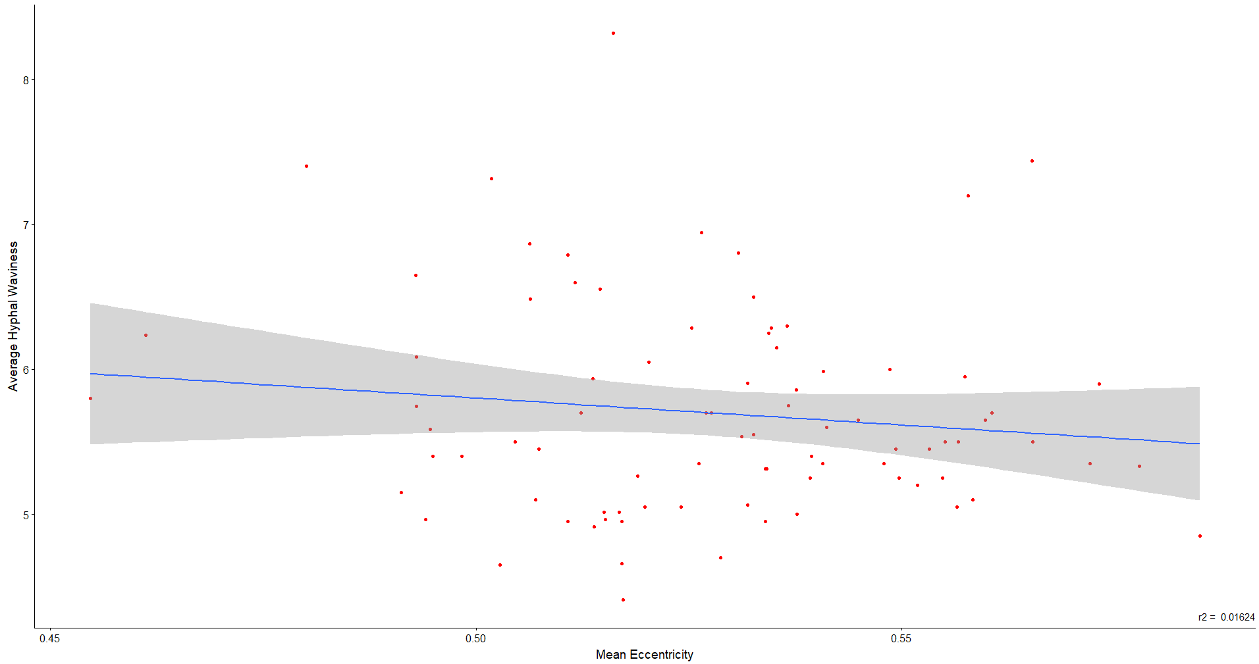
Figure #
Mean Eccentricity measured against LsMeans Hyphal Waviness

Slide 13
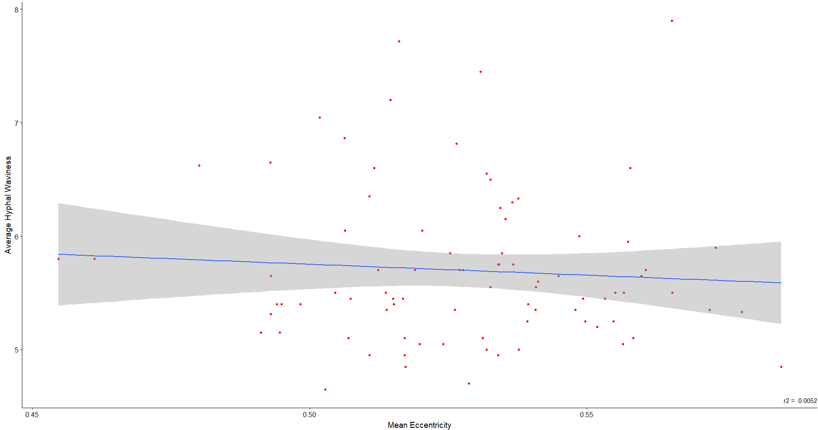
Figure #
Mean Eccentricity measured against Average Hyphal Waviness

Slide 14
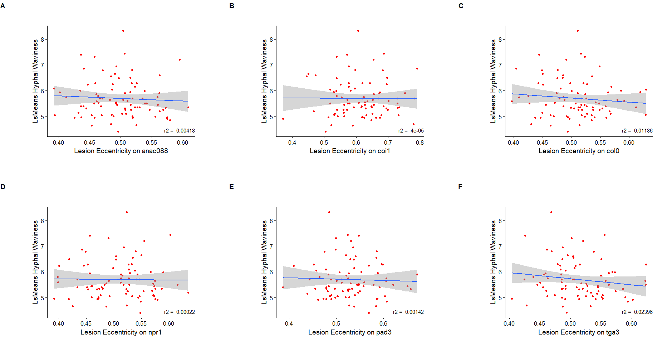
Figure#:
Lesion Eccentricity on Multiple Hosts against LsMeans Hyphal Waviness

Slide 15
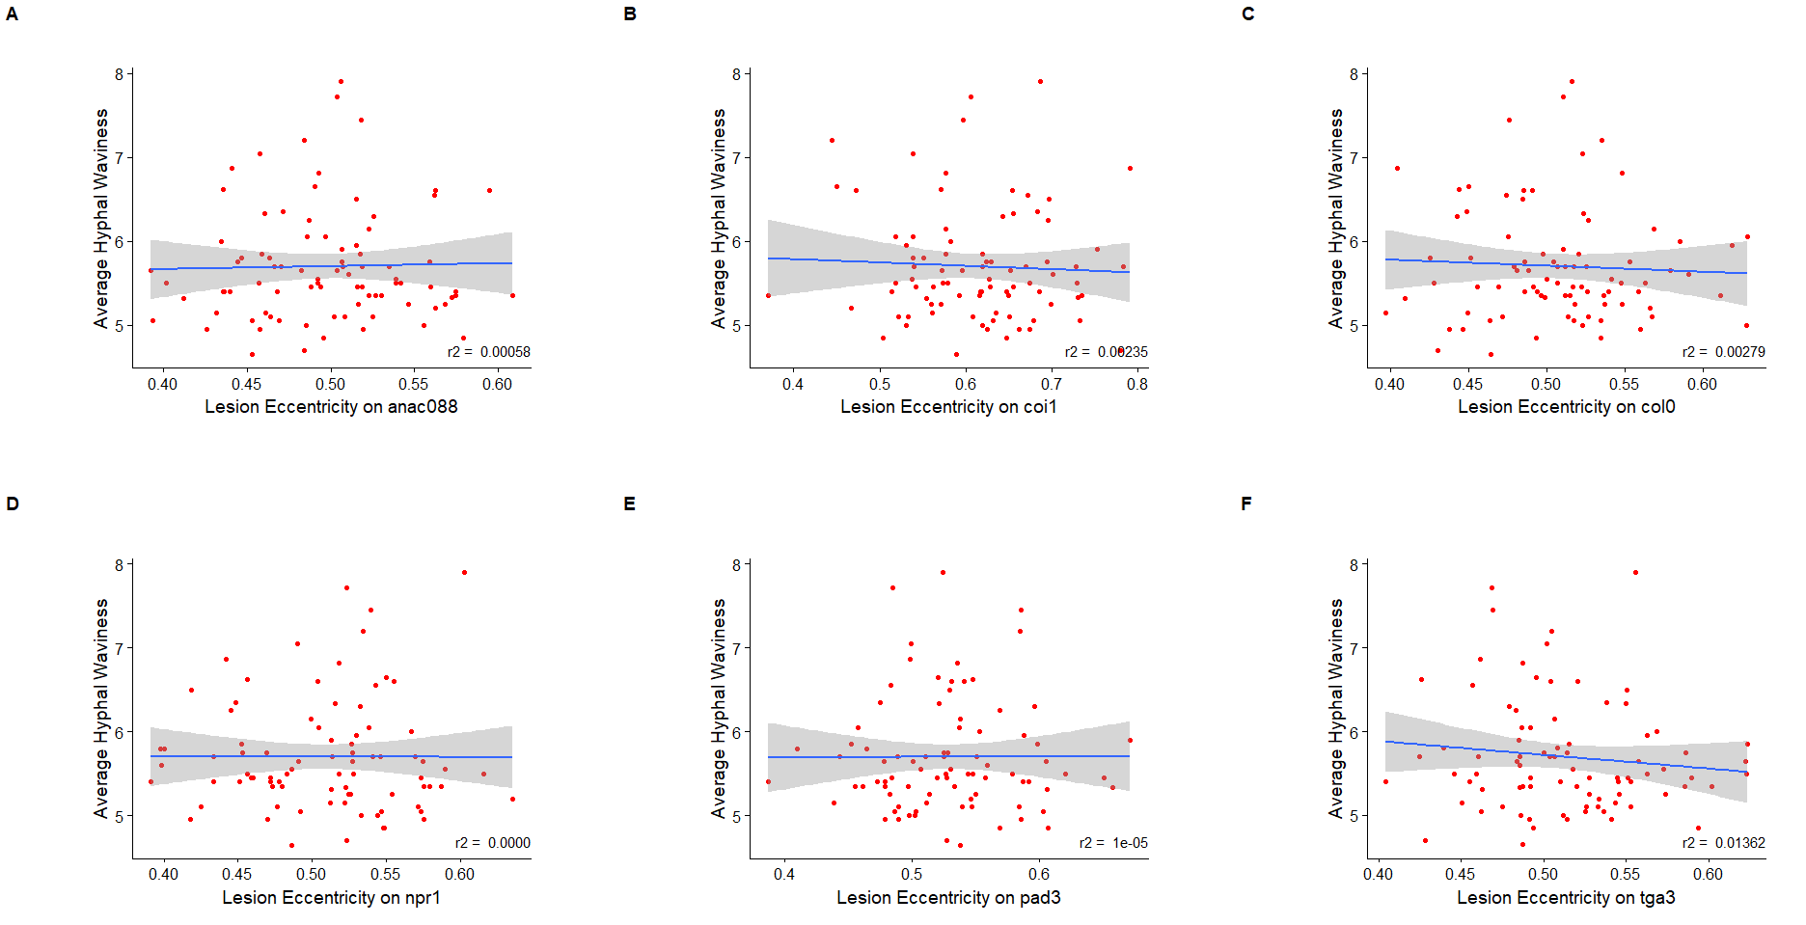
Figure#. B. cinerea Lesion Eccentricity on Multiple Hosts against Average Hyphal Waviness

