Slide 1
Predicting Fares

Slide 2
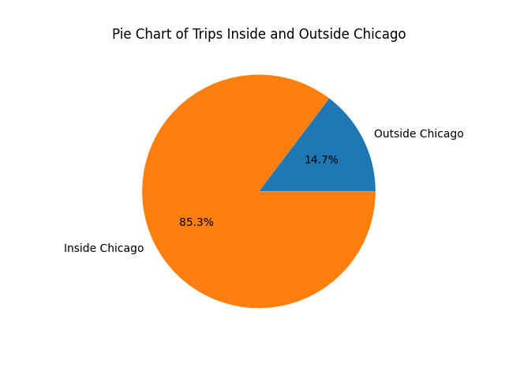
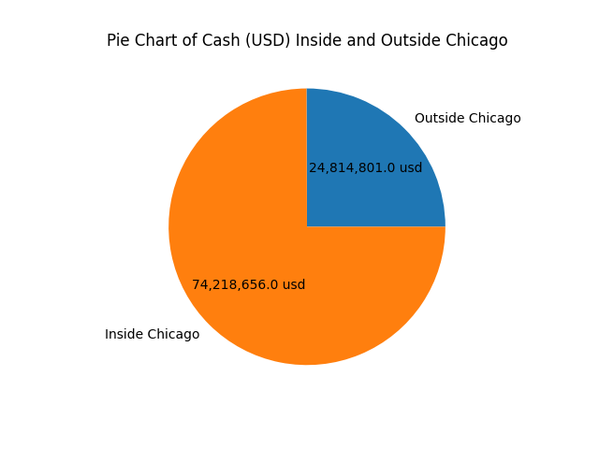
The opportunity
85% of rides are inside Chicago, which amounts to a net income of roughly 74.2 million USD

Slide 3
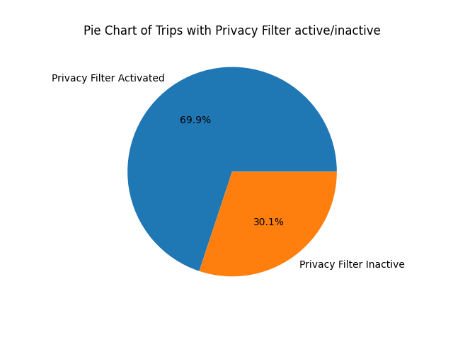
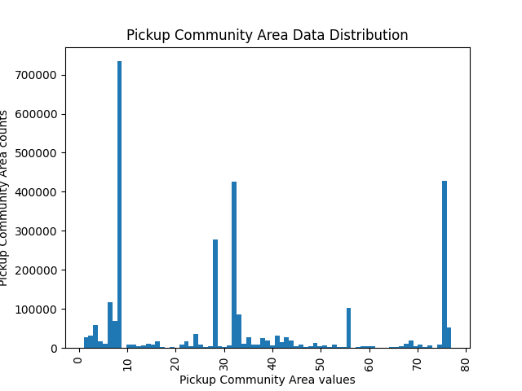
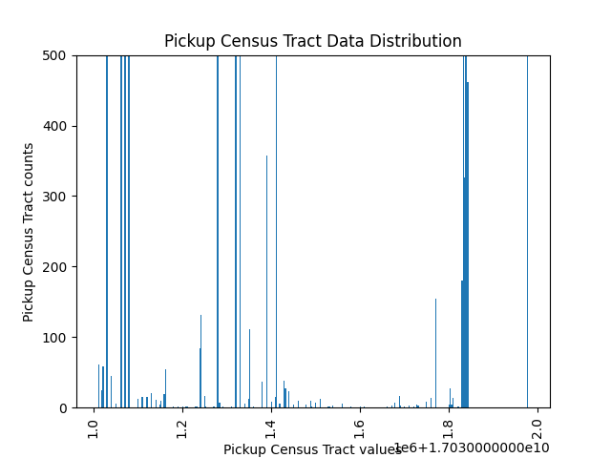
The value of the data collected (1/2)
More than 1 million rides do share all the information (privacy filter inactive).
Promotions target!
Promotions target!
Promotions target!

Slide 4
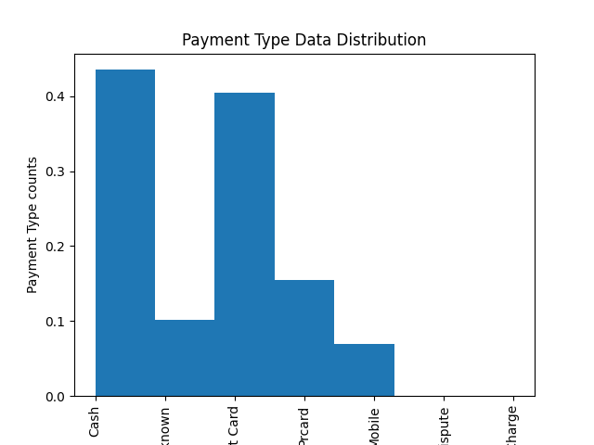
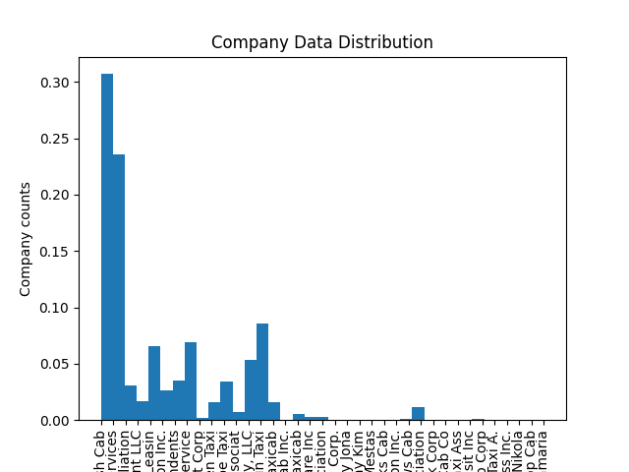
The value of the data collected (2/2)
Partnerships and deals can be done with credit card companies which amount to almost 40% of the payment methods used. Also with Taxicab companies.

Slide 5
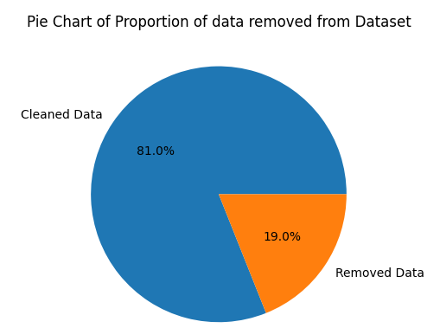
Fare Prediction: Data preprocessing
Removing missing fares (NaN/Null).
Removing missing fields (NaN/Null).
Removing outliers (IQR).
Fixing fields (values=0)
Removing unnecessary fields.

Slide 6
Fare Prediction: Data preparation
2 datasets were prepared:
Inside Chicago dataset: containing only samples inside Chicago, 851,154 samples (Table 4).
Whole dataset: all the samples combined inside/outside Chicago 3,199,179 samples (Table 4).

Slide 7
Fare Prediction: Benchmark models
Trained with all features/fields

Slide 8
Fare Prediction: Removing fields
All fields were removed except for [“Trip Miles”, “Trip Seconds”, “Company”, “Payment Type”]. The comparison with the retrained models is:
Conclusion: : in this analysis it was shown that most features in the dataset are not relevant in the estimation of the Fare. In the estimation of the Fare less than 0.5% accuracy loss is observed compared with benchmark models in the previous slide.

Slide 9
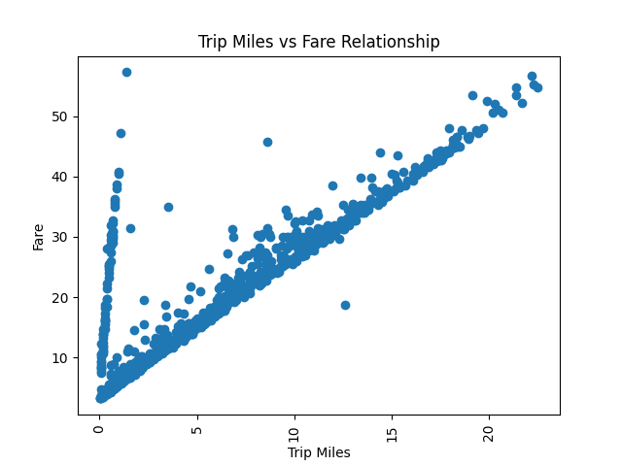
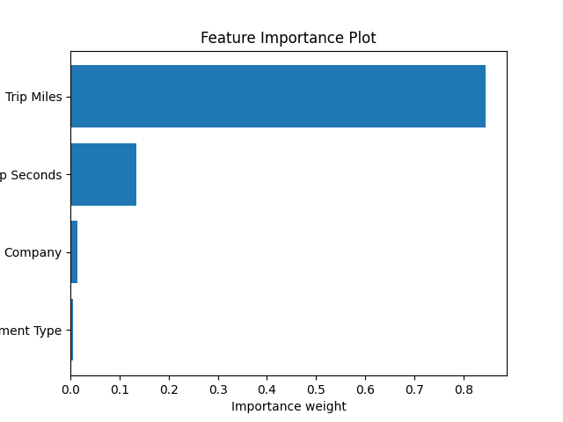
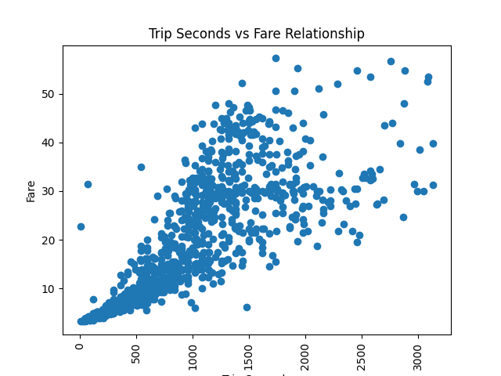
Fare Prediction: Final Model
XGBoost with all the data available but only considering [“Trip Miles”, “Trip Seconds”, “Company”, “Payment Type”].

