Slide 1
Vite
Next generation frontend tooling

Slide 2

Contents
What is Vite?
Why use Vite?
How does Vite work?
How do I deploy using Vite?

Slide 3
What is Vite and why use it?
Vite (French word for "quick", pronounced /vit/, like "veet") is a build tool that aims to provide a faster and leaner development experience for modern web projects.
https://vitejs.dev/

Slide 4
What is Vite and why use it?
A dev server that provides rich feature enhancements over native ES modules, for example extremely fast Hot Module Replacement (HMR).
A build command that bundles your code with Rollup, pre-configured to output highly optimized static assets for production.

Slide 5
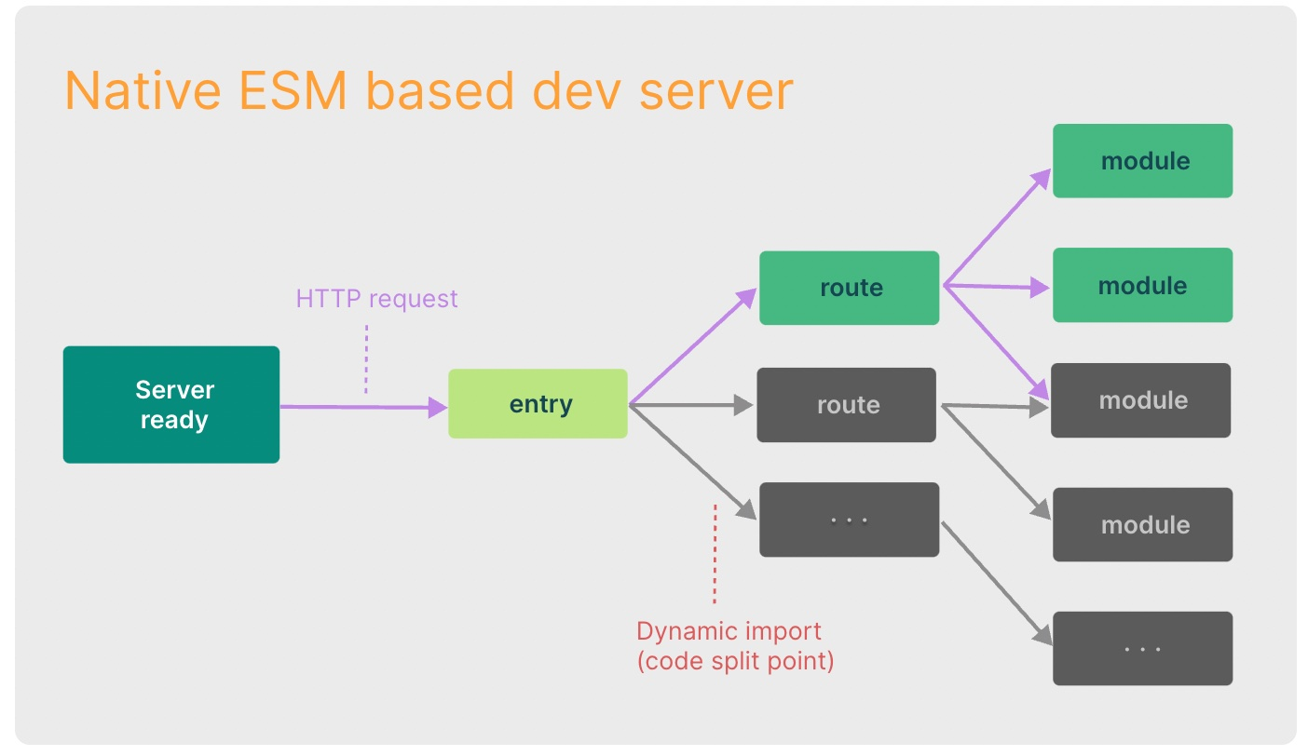
What problems does it solve
Using modules in javascript can be confusing
Multiple tools needed to start, debug, test & deploy a project
Debugging large projects can be slow

Slide 6

Supported presets
Both JavaScript & TypeScript
vanilla
vue
react
preact
lit
svelte
We will use this template for FEP2

Slide 7
Create your first Vite lit app
One npm command, a couple of settings and you have a working lit project.

Slide 8
Create a Vite project with npm
Open a terminal window and navigate to your dev folder
Issue the following command:
npm create vite@latest

Slide 9
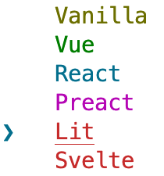

Create a Vite project with npm
For example:
lit-demo
Answer the following questions:
Project name:
Select a framework:
Select a variant:
Open Visual Studio Code in the folder that was just created.
Framework:
Select lit
variant:
Select JavaScript

Slide 10
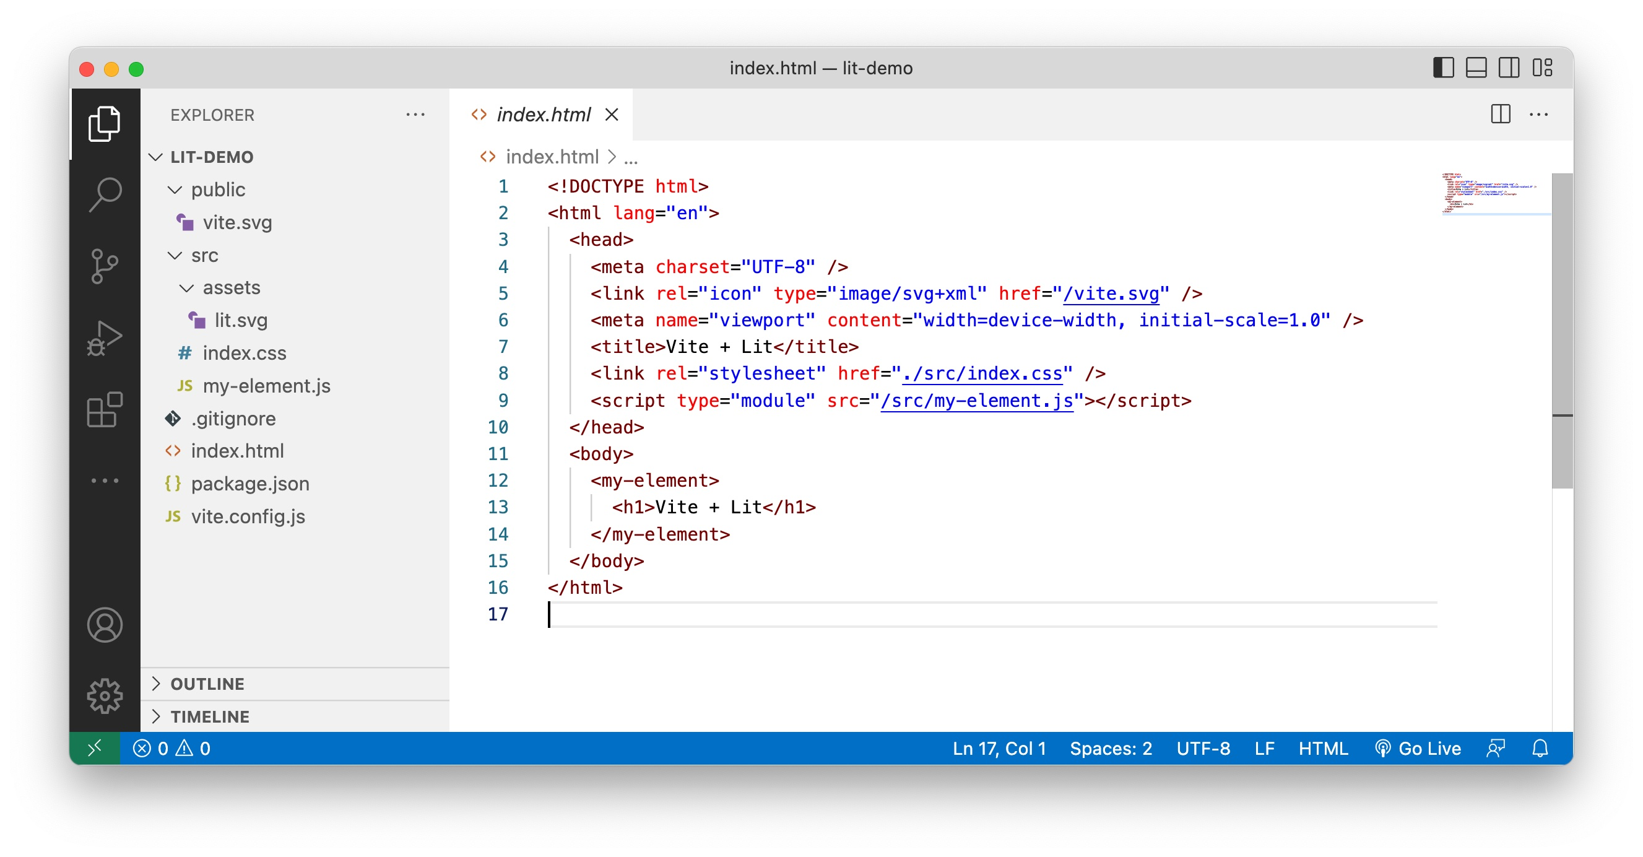
Project created

Slide 11
Run the application
To run the application you only need to run the npm install command and start the dev server:
npm install
npm run dev

Slide 12
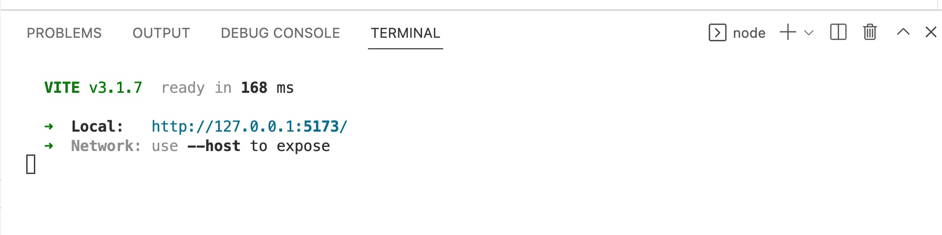
Run the application
The dev server will be started on port 5173

Slide 13
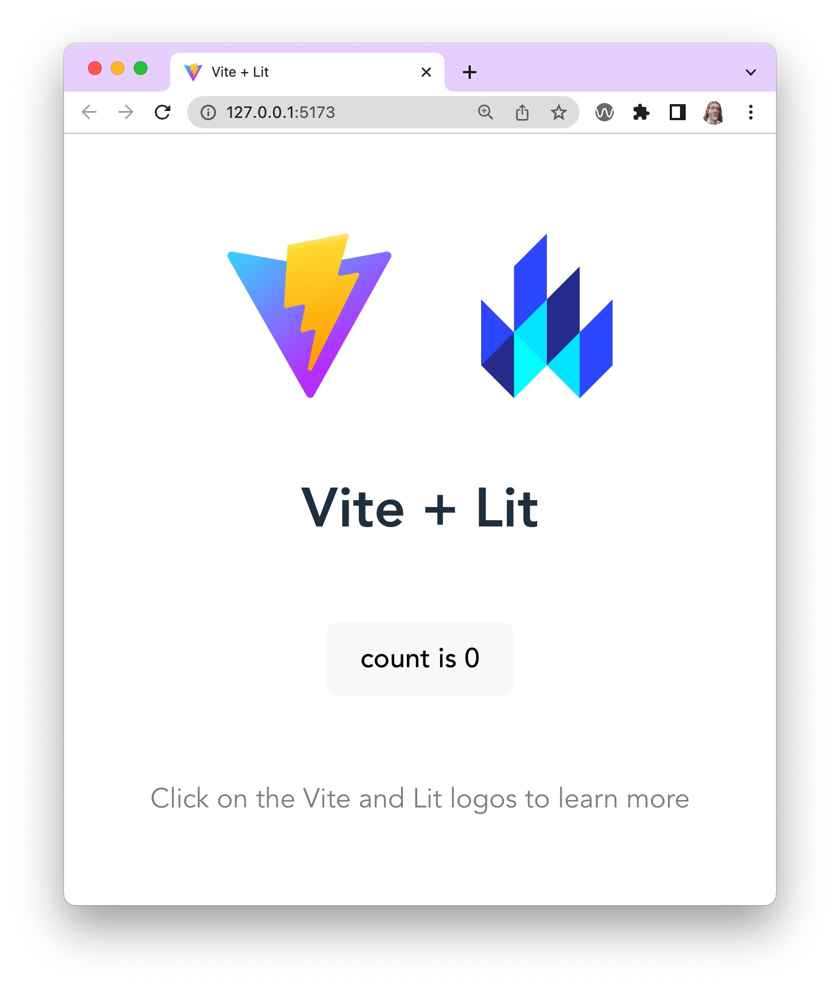

Slide 14
More information
You can find more information on:
https://vitejs.dev/guide/

Slide 15
Deploy your first vite lit app
When it is time to deploy your app for production, simply run the vite build command. By default, it uses <root>/index.html as the build entry point, and produces an application bundle that is suitable to be served over a static hosting service.
Moet dit uitgebreider?

Slide 16
Build for production
More information on the build process:
https://vitejs.dev/guide/build.html

Slide 17
Deploying to a Static Site
More information on the deploy process:
https://vitejs.dev/guide/static-deploy.html

