Slide 1
ENGG104 Electrical Systems
TEXTBOOK
Introductory Circuit Analysis, Boylestad, 12th Ed
Lecture 3
Attribution Nidhal Abdulaziz

Slide 2
Lecture 2 summary
Energy and Power P = W/t
Series Circuit – current is the same in the branch
Adding voltage sources
Resistors in series – you add them
Kirchhoff's Voltage Law – all voltages add to zero around a complete loop.
Voltage divider rule – voltages divide proportionally to resistance
Real Voltage source – internal resistance reduces output voltage

Slide 3
Lecture 3 Outline
Boylestad – Chapters (6,7 )
Parallel Circuits
Kirchhoff's Current Law (KCL) - all currents in and out of a node sum to zero.
Current Dividers – current splits in proportion to resistance

Slide 4

Parallel Circuits
With parallel circuits, components share two common connections
E.g. points A and B in the circuit shown opposite
With parallel circuits, all components experience the same voltage across them
E.g. the voltage E in the circuit shown
A good example of a parallel circuit is the house wiring system

Slide 5
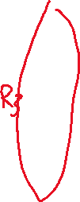

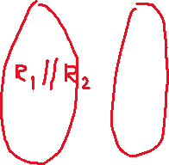

Example parallel circuits
Node
Node
Node
Node
FIG. 6.1 (a) Parallel resistors; (b) R₁ and R₂ are in parallel; (c) R₃ is in parallel with the series combination of R₁ and R₂.

Slide 6
More examples
Note all are the same circuit just drawn differently
FIG. 6.2 Schematic representations of three parallel resistors.

Slide 7
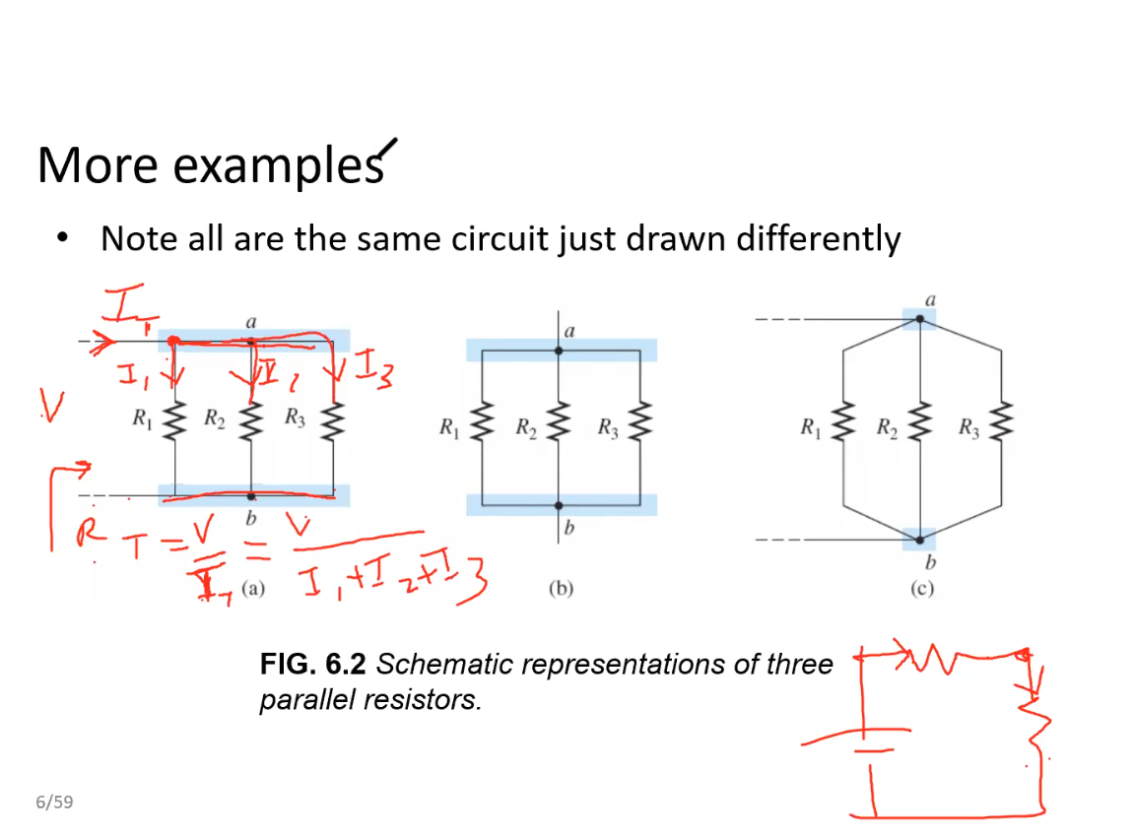

Slide 8
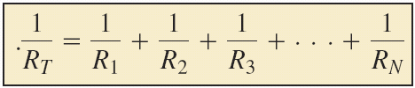
Total Resistance
For resistors in parallel as shown in Fig. 6.3, the total resistance is determined from the following equation:
FIG. 6.3 Parallel combination of resistors.

Slide 9
Rearranging the equation
The Total Resistance of parallel resistors is always less than the value of the smallest resistor

Slide 10
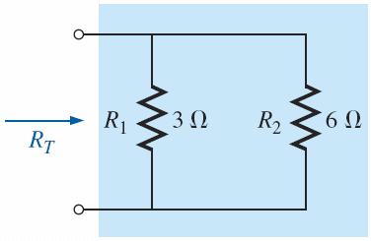
Examples: What is the total resistance?
FIG. 6.5 Parallel resistors for Example 6.2.
FIG. 6.4 Parallel resistors for Example 6.1.
R_{T} = R_{T} =

Slide 11
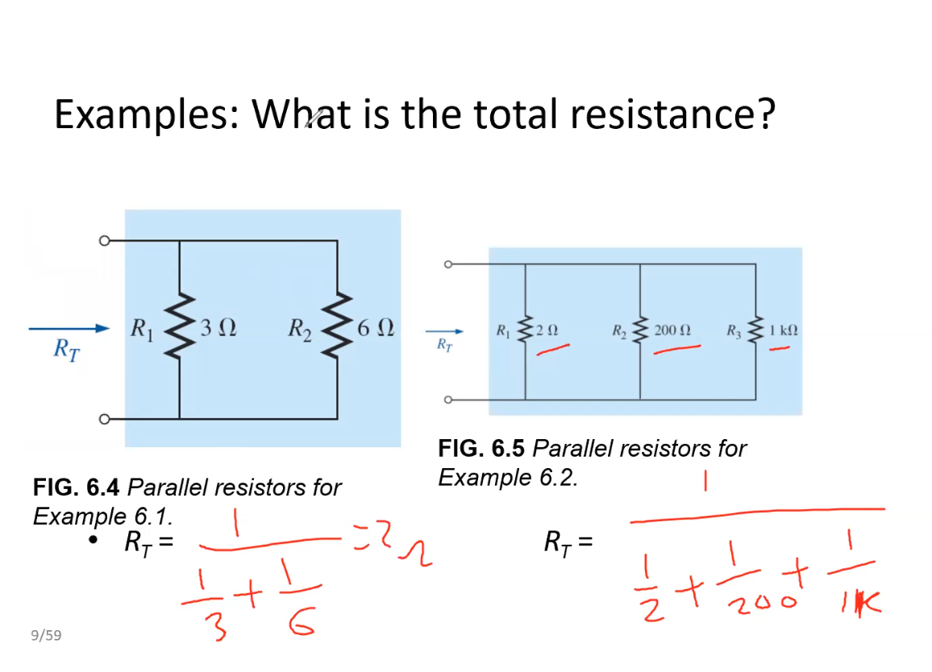

Slide 12

Example: What is the total resistance
FIG. 6.6 Network to be investigated in Example 6.3.
R_{T} =

Slide 13
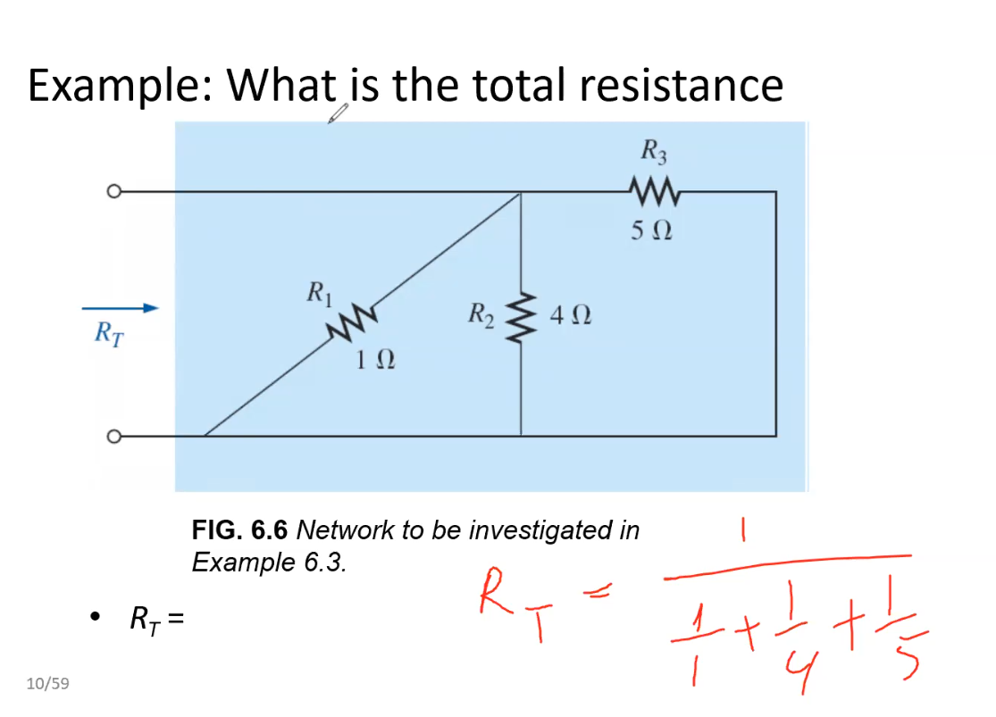

Slide 14
Note: Redrawing circuit
FIG. 6.7 Network in Fig. 6.6 redrawn.
Circuit from previous slide

Slide 15
Special cases: Two branches
Most of the time, we only have two branches in parallel
FIG. 6.4 Parallel resistors for Example 6.1.

Slide 16
Special case: All resistors are equal
FIG. 6.9 Three equal parallel resistors to be investigated in Example 6.5.

Slide 17
Measuring resistance
FIG. 6.17 Using an ohmmeter to measure the total resistance of a parallel network.
Remember always in parallel

Slide 18
Parallel Circuits
The Voltage across parallel elements is the same.
For Single Source Networks, The source current is equal to the sum of the individual branch currents.

Slide 19
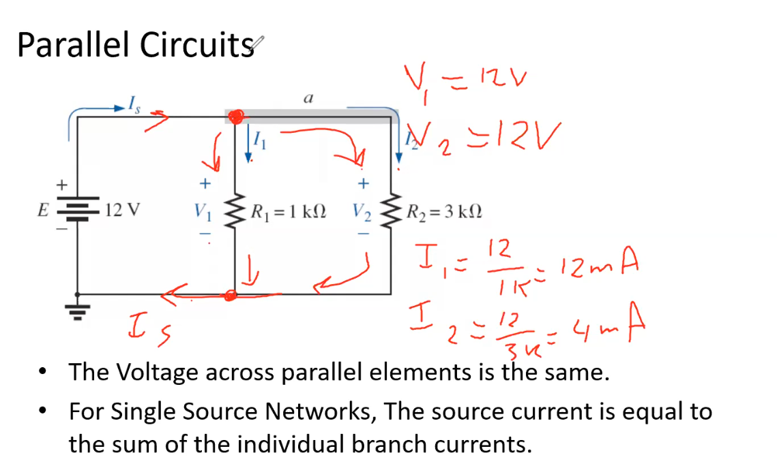

Slide 20
KIRCHHOFF’S CURRENT LAW
Kirchhoff’s current law (KCL):
The algebraic sum of the currents entering and leaving a junction (or region) of a network is zero.
FIG. 6.31 (a) Demonstrating Kirchhoff ’s current law; (b) the water analogy for the junction in (a).

Slide 21
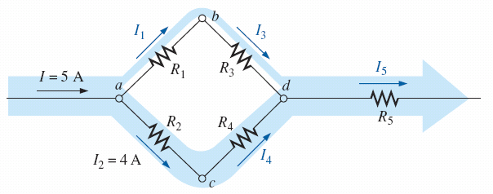
KIRCHHOFF’S CURRENT LAW
FIG. 6.33 Four-node configuration for Example 6.17.
I₁ =
I₃ =
I₄ = I₅ =

Slide 22
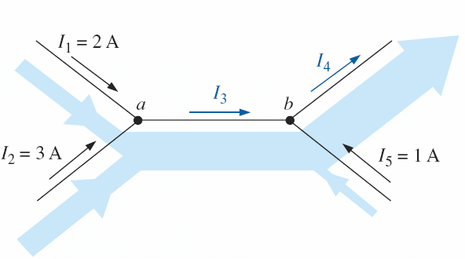
KIRCHHOFF’S CURRENT LAW
Note I₁ + I₂ = I₃ rewriting I₁+ I₂ – I₃ = 0 [KCL-sum of all currents in and out of node sum to zero]
At point b I₃ – I₄ + I₅ = 0
Notice all currents entering a node are positive and all currents exiting node are negative.

Slide 23
KCL example
I₃ = I₅=

Slide 24
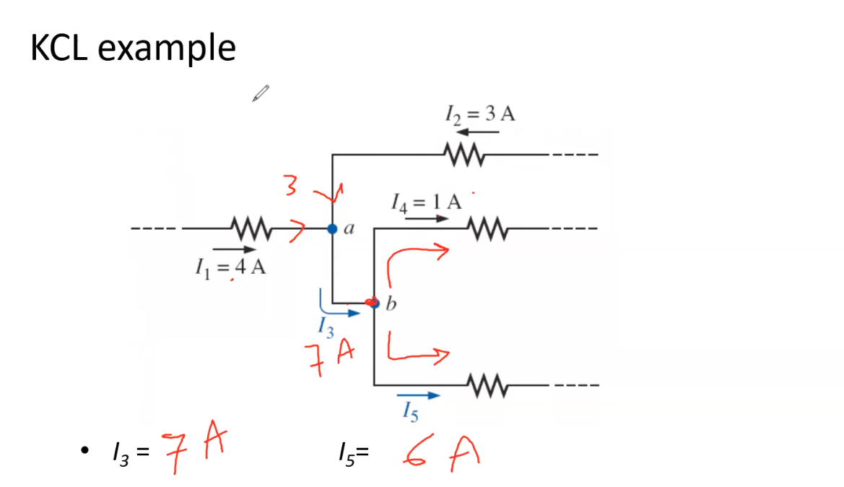

Slide 25
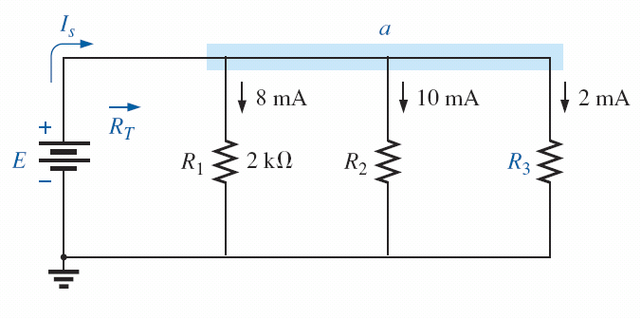
Another KCL example
I_{s} =

Slide 26
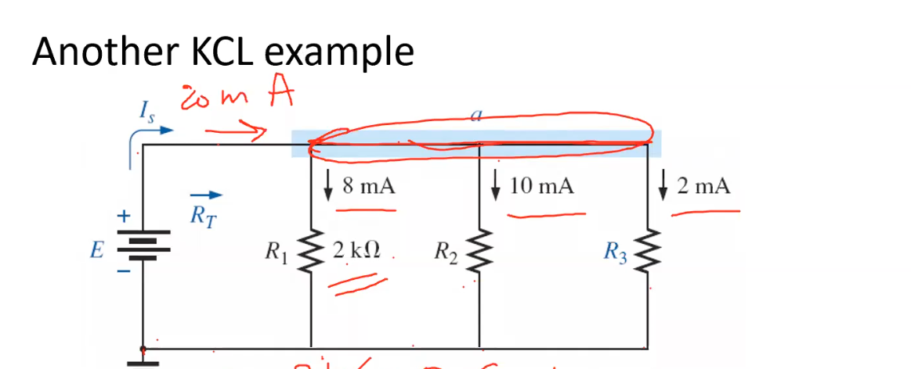
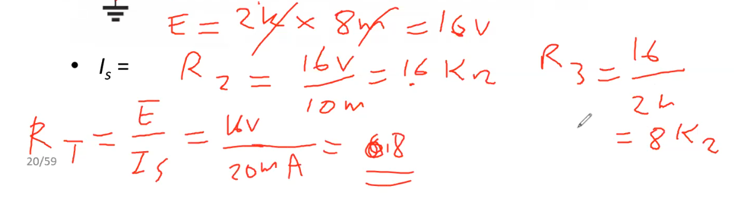

Slide 27
CURRENT DIVIDER RULE
For two parallel elements of equal value, the current will divide equally.
For parallel elements with different values, the smaller the resistance, the greater is the share of input current.
For parallel elements of different values, the current will split with a ratio equal to the inverse of their resistance values.

Slide 28
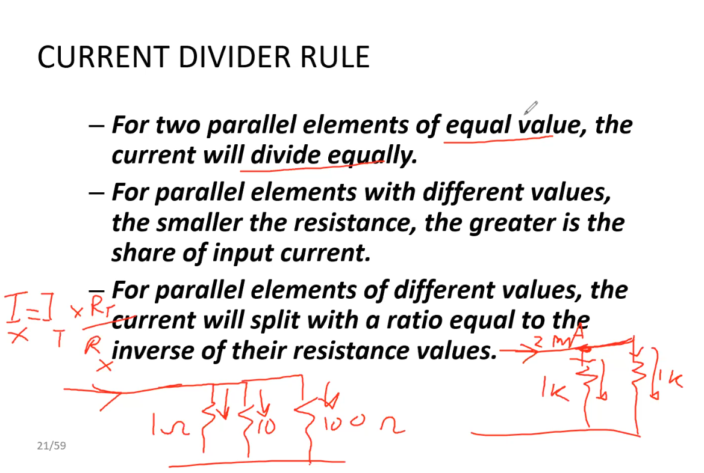

Slide 29
Current Divider example
10 times more current in 10 Ω resistor than in 100Ω resistor and 100 times more than 1000Ω resistor
Question: how will the 9 A split?

Slide 30
Current Divider Rule
Special Case: 2 resistors in parallel

Slide 31
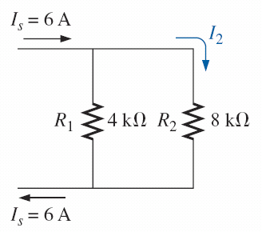
KCL example
Determine I₁ and I₂
Verify KCL

Slide 32
Lecture 3 summary
Parallel Circuits
Kirchhoff's Current Law (KCL) - all currents in and out of a node sum to zero.
Current Dividers – current splits in proportion to resistance

