Slide 1
ENGG104 Electrical Systems
Introductory Circuit Analysis, Boylestad, 12th Ed
Lecture 9 - 10

Slide 2
Basic Elements and Phasors
Chapter 14 – Boylestad
Sinusoidal response of resistor, inductor and capacitor
Low and high frequency response of inductors and capacitors
Average power and Power Factor

Slide 3

13.7 – Average Value
Understanding the average value using a sand analogy:
The average height of the sand is that height obtained if the distance form one end to the other is maintained while the sand is leveled off.
Notes:
20

Slide 4

Average Value
The algebraic sum of the areas must be determined, since some area contributions will be from below the horizontal axis.
Area above the axis is assigned a positive sign and area below the axis is assigned a negative sign.
The average value of any current or voltage is the value indicated on a dc meter – over a complete cycle the average value is the equivalent dc value.
Notes:
21

Slide 5
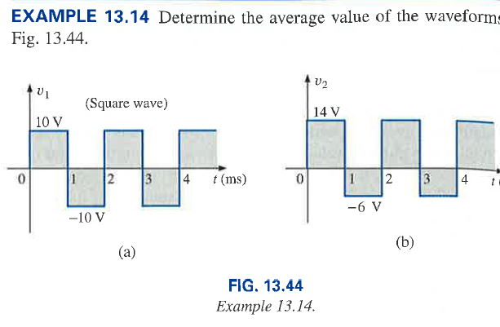
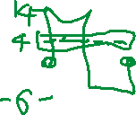
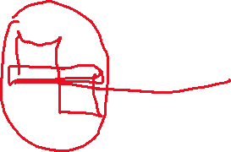
Example 5

Slide 6
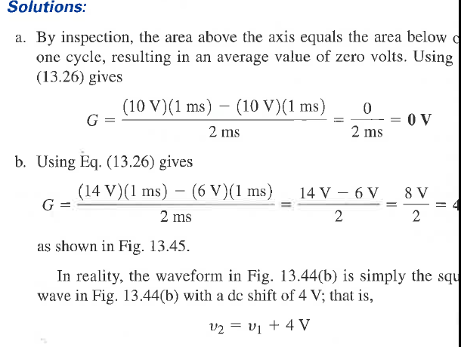
Example 5 solution

Slide 7
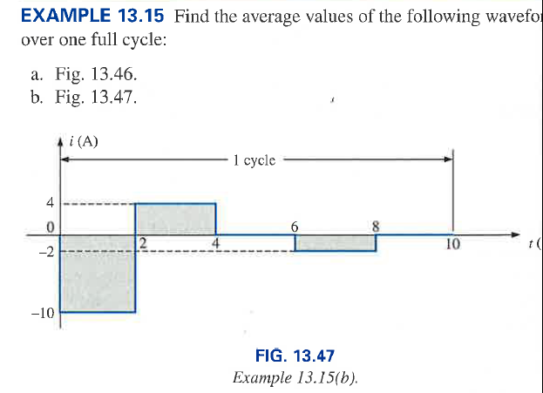


Example 6

Slide 8
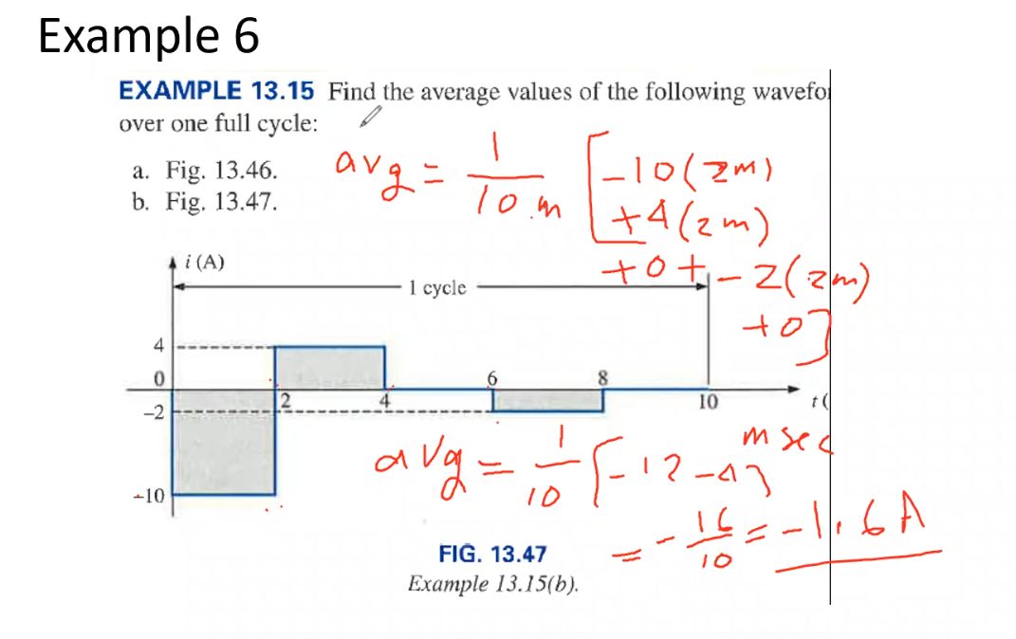

Slide 9



13.8 – Effective (rms) Values
How is it possible for a sinusoidal ac quantity to deliver a net power if, over a full cycle the net current in any one direction is zero (average value = 0).
Irrespective of direction, current of any magnitude through a resistor will deliver power to that resistor – during the positive and negative portions of a sinusoidal ac current, power is being delivered at each instant of time to the resistor.
The net power flow will equal twice that delivered by either the positive or the negative regions of sinusoidal quantity.
Notes:
22

Slide 10
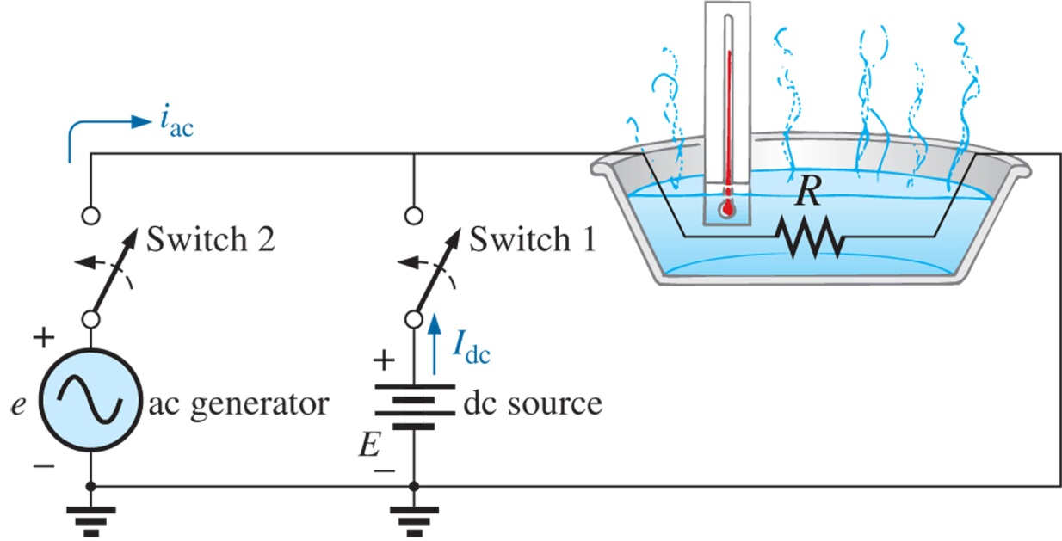
Effective or Root Mean Square (RMS) Value review
The average value of a sinusoidal waveform is zero. So how does a sinusoidal voltage provide power or produce heat in a resistor for example. Hint: power is given by i²R or v²/R or vi
For the two cases shown, for same average power find the relationship between the dc and ac sources
Boylestad, Prentice Hall 2007

Slide 11

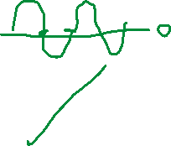
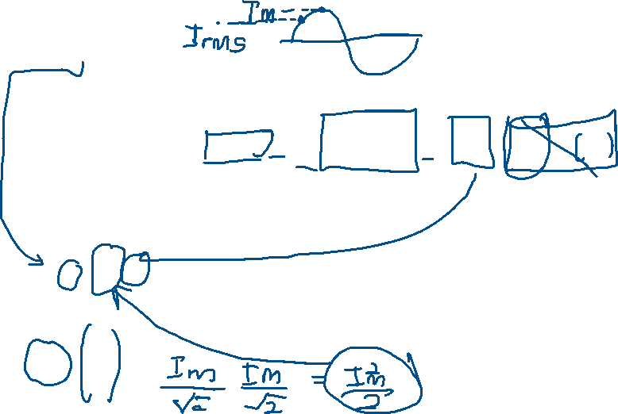
Effective or Root Mean Square (RMS) Value review
We can equate the average (mean) power due to the ac source over a cycle (0 - 2π) to P_{dc}. Noting that the average value of the cos2ωt is zero,
is called the effective value of the sinusoidal current

Slide 12
Effective (rms) Values
The formula for power delivered by the ac supply at any time is:
The average power delivered by the ac source is just the first term, since the average value of a cosine wave is zero even though the wave may have twice the frequency of the original input current waveform.
Notes:
23

Slide 13



Effective (rms) Values
The equivalent dc value is called the effective value of the sinusoidal quantity
or
and
or
Where: I_{m} and E_{m} are max (peak) values
Notes:
24

Slide 14

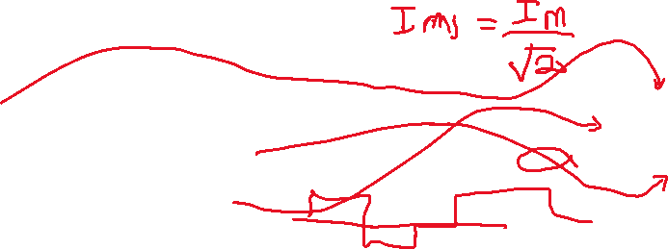
Effective or Root Mean Square (RMS) Value review
The mathematical process involved (in order)
Squaring the waveform
taking the Mean (average)
taking the square Root
The above process can be applied to any periodic waveform to obtain the RMS value

Slide 15
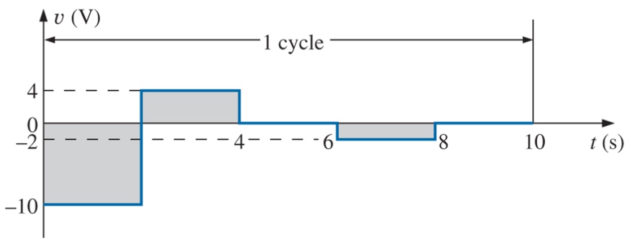
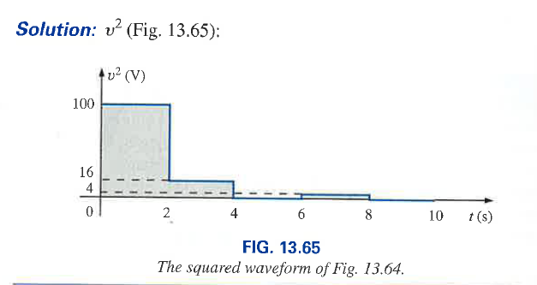
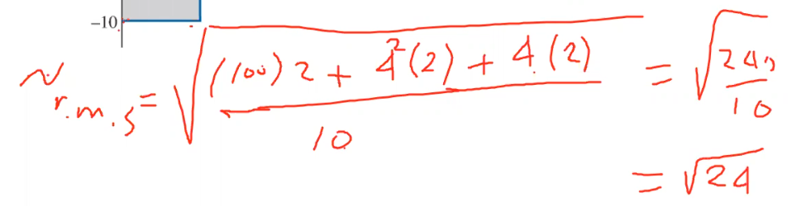

Effective or Root Mean Square (RMS) Value
Example 13.23 Boylestad (page 569)
Calculate the rms value of the voltage waveform in Fig. 13.62
Boylestad, Prentice Hall 2007

Slide 16
Effective (rms) Values
Instrumentation
A true rms meter will read the effective value of any waveform and is not limited to only sinusoidal waveforms.
You should make sure that your meter is a true rms meter, by checking the manual, if waveforms other than purely sinusoidal are to be encountered.
Notes:
25

Slide 17
Response of R, L and C
The response of the basic R, L, and C elements to a sinusoidal voltage and current will be examined with a special note of how frequency will affect the “opposing” characteristic of each element.
Phasor notation will then be introduced to establish a method of analysis.
Notes:
2

Slide 18
The Derivative
To understand the response of the basic R, L, and C elements to a sinusoidal signal, you need to examine the concept of the derivative.
The derivative dx/dt is defined as the rate of change of x with respect to time. If x fails to change at a particular instant, dx = 0, and the derivative is zero.
For the sinusoidal waveform, dx/dt is zero only at the positive and negative peaks (ωt = π/2 and 3π/2) since x fails to change at these instants of time.
Notes:
3

Slide 19
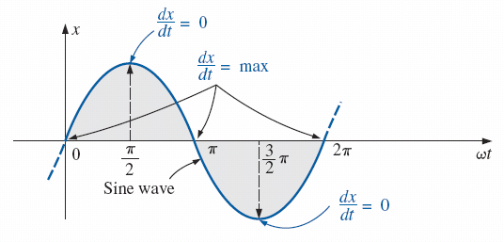




Slide 20
The Derivative
The derivative dx/dt is actually the slope of the graph at any instant of time.
The greatest change in x will occur at the instants ωt = 0, π, and 2π.
For various values of ωt between these maxima and minima, the derivative will exist and will have values from the minimum to the maximum inclusive.
The derivative of a sine wave is a cosine wave; it has the same period and frequency as the original sinusoidal waveform.
Notes:
4

Slide 21


Slide 22


Sinusoidal Response: Resistor
For a resistor the voltage and current are in phase and are related by Ohm’s law

Slide 23
The voltage and current of a resistive element are in phase.

Slide 24

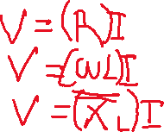

Sinusoidal Response: Inductors
For an inductor the current lags the voltage by 90 degrees
X_{L} = ωL is called the inductive reactance - unit Ω

Slide 25
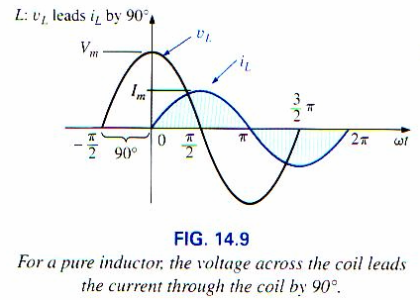
Sinusoidal Response: Waveforms
Inductor

Slide 26









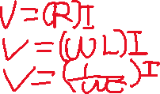
Sinusoidal Response: Capacitors
For a capacitor the current leads the voltage by 90 degrees
X_{c} = 1/ ωC is called the capacitive reactance – unit Ω

Slide 27
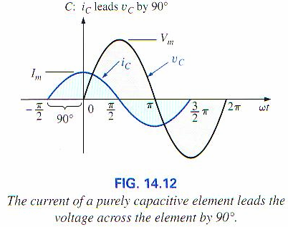
Sinusoidal Response: Waveforms
Capacitor

Slide 28
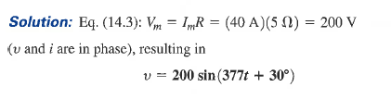
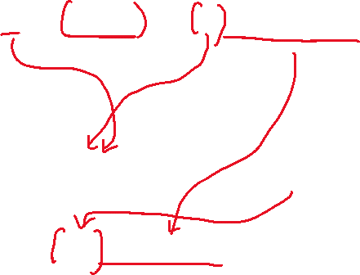
Sinusoidal Response
The current through a 5 ohm resistor is i = 40sin (377t + 30°) A. Find the expression for voltage across it.

Slide 29

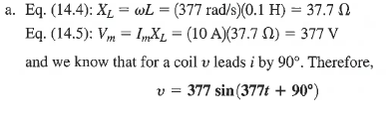


Sinusoidal Response
The current through a 0.1H coil is i = 10sin(377t) A. Find the voltage across it.

Slide 30
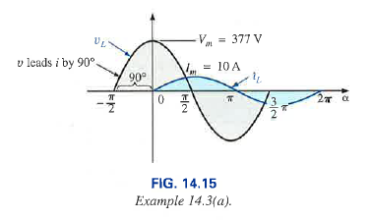
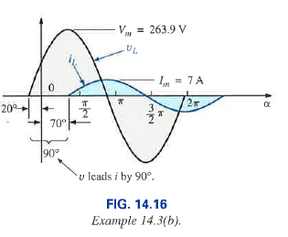
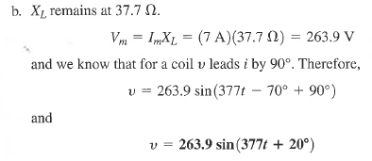

The current through a 0.1H coil is i = 7sin(377t – 70°) A. Find the voltage across it.

Slide 31

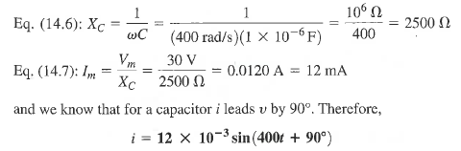

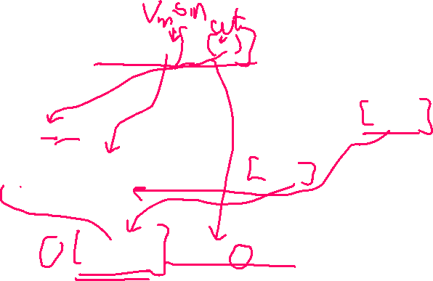
Capacitor Example

Slide 32
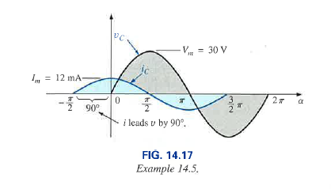

Slide 33
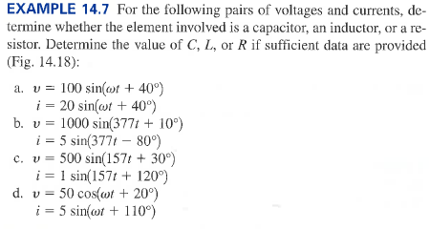

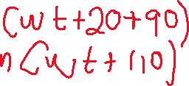
More questions

Slide 34
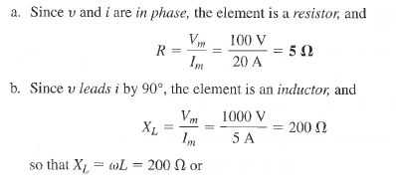

Slide 35
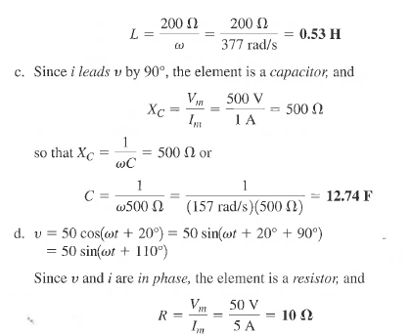

Slide 36
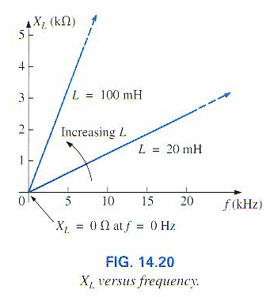

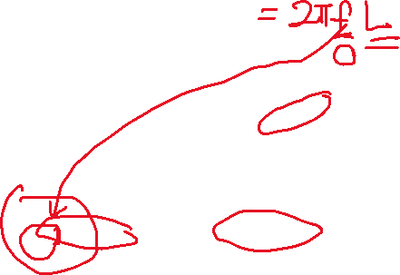


Low and High Frequency Response for Inductors
Inductors: X_{L} = ωL
At low frequencies, and especially DC, the reactance of a inductor is very low (zero for DC)
Hence at very low frequencies, an inductor may be considered as a short circuit
As input frequencies become very high, the reactance of an inductor approaches infinity
Hence at very high frequencies, an inductor may be considered as an open circuit
Boylestad, Prentice Hall 2007

Slide 37
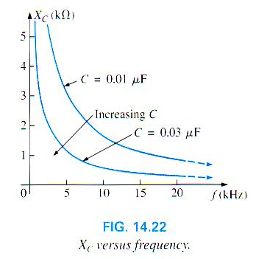






Low and High Frequency Response for Capacitors
Capacitors: X_{c} = 1/ωC
At low frequencies, and especially DC, the reactance of a capacitor is very high (infinite for DC)
Hence at very low frequencies, a capacitor may be considered as an open circuit
As input frequencies become very high, the reactance of a capacitor approaches 0Ω
Hence at very high frequencies, a capacitor may be considered as a short circuit

Slide 38

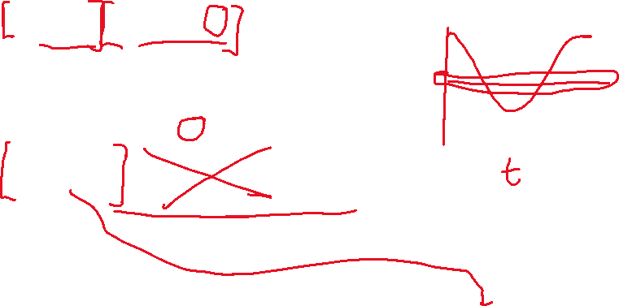
Average Power and Power Factor
In general v = V_{m} sinωt and I = I_{m} sin(ωt-θ)
Second term has a zero average value over a cycle and causes no average power
First term is independent of (a) time and is constant (b) whether v leads or lags i, and will be the Average Power or the Real Power

Slide 39
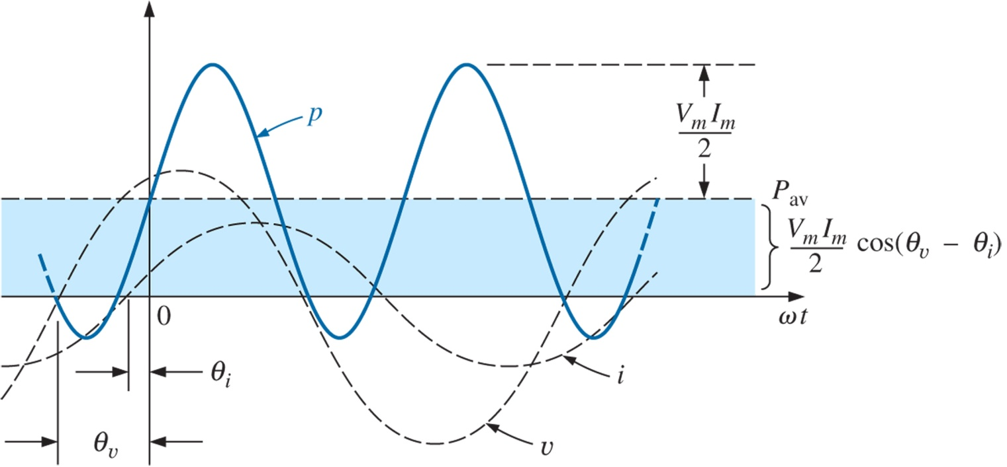
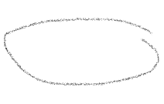

Average Power and Power Factor
θ
Boylestad, Prentice Hall 2007

Slide 40



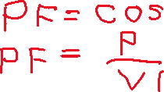

Average Power and Power Factor
where V and I are rms values of the sinusoidal voltage and current respectively
The factor (cos θ) which controls the average power flow is called the Power Factor.
For a resistor the Power Factor is unity
For an inductor or capacitor Power Factor is zero
Another way of finding the Power Factor is to use the expression

Slide 41
When you receive your electricity bill, by how much you spent on energy, in kWatthour
Usually the power transmitted to your home, most of the power generated at the power stations, they are made from generators.
The generators, they have coils.
What would be the power factor, would it be leading or lagging?
Leading or lagging, we are referring to the current with respect to the voltage.
If my circuit is made of many coils, obviously, the current will be lagging.
But you are paying for your electricity bills, are VI, in kWatthour
They don’t care about the power factor
Actually you are not getting all the money that you are paying for.
The power stations will try to improve the power factor
If the power factor is lagging, which is the usual case in most power generation stations, so they put capacitors to compensate for the effects of the coils, so that you have a power factor close to unity.
You can’t get a power factor of 1
If I have a purely resistive circuit, the power factor will be 1, because cos(0) = 1

Slide 42
Average Power and Power Factor
When the power factor is stated it is important to state whether it is leading or lagging in addition to its value (note that it lies between 0 and 1.0)

Slide 43

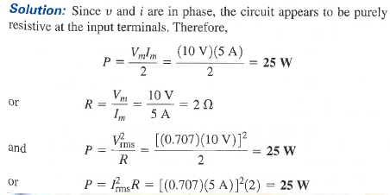
Average Power and Power Factor
Vrms = Vpeak/sqrt(2)
Irms = Ipeak/sqrt(2)

Slide 44
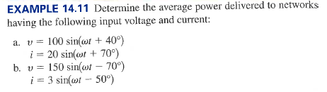
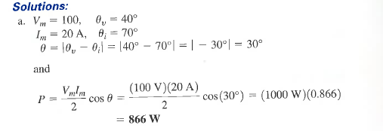
Average Power and Power Factor

Slide 45
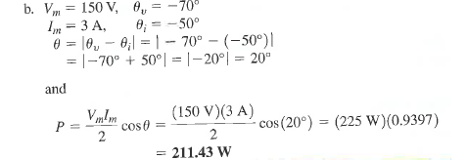

Slide 46







Power Factor F_{p}
Power Factor = F_{p} = cos θ
The term leading or lagging is often written in conjunction with the power factor.
They are defined by the current through the load.
If the current lead the voltage then its a leading power factor
If the current lags the voltage then its a lagging power factor
Capacitive circuits have leading power factors, while Inductive circuits have lagging power factors

Slide 47
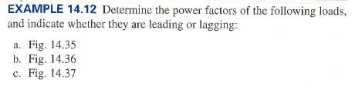
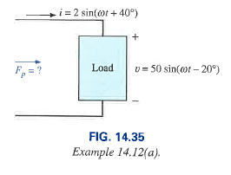
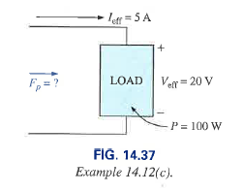
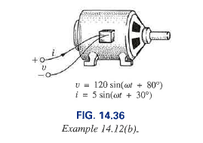
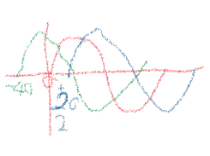
Example Power factor

Slide 48
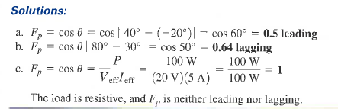

Slide 49
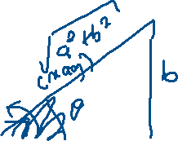
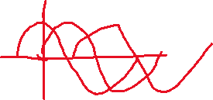
Complex Numbers
As an essential tool complex numbers will be used in solving ac circuits
Rectangular form Z = a + j b
where ‘j’ is an operator which turns the real number ‘b’ by 90° in the anti-clockwise direction on the complex plane
Polar form Z = Z /θ°
Addition is convenient in rectangular form
Division/multiplication is convenient in polar form
jb
a

Slide 50



Complex Numbers
Defining the rectangular form.

Slide 51


Polar form
Defining the polar form.
Demonstrating the effect of a negative sign on the polar form.

Slide 52




Slide 53


Complex Conjugate

Slide 54




Conversion Between Forms

Slide 55



Complex Numbers

Slide 56


Complex Numbers

Slide 57


Maths Operations

Slide 58






Slide 59







Polar form operations

Slide 60

Phasors and Phasor Diagrams
Often addition/subtraction of sinusoidal voltages and currents is required in ac circuit analysis.
For example consider the addition of two sinusoidal signals
v₁ = V_{m1} sin (ωt +θ) and v₂ = V_{m2} sin ωt
We can add the two waveforms on a point-by-point basis as shown (a tedious process!!) to obtain v_{T}.
Boylestad

Slide 61
Phasors and Phasor Diagrams
However it is very convenient to represent the two sinusoidal waveforms v₁ = V_{m1} sin (ωt +θ) and v₂ = V_{m2} sin ωt as vectors and then add the vectors. These vectors are called phasors.
V₁=V_{m1}/θ
V_{mT}
θ
V₂=V_{m2}/0
Phasor diagram of V₁, V₂ and V_{T}
Note the phasors with underscore – in the book shown in bold

Slide 62


Phasors and Phasor Diagrams
Phasors are characterised by a magnitude and a phase angle
It is common to represent the magnitude of a phasor as an rms quantity rather than a peak value
They represent a snap shots of the rotating vectors at t = 0
They do not carry information about the frequency
V₁=V₁/θ°
V_{T}
θ
V₂=V₂/0°

Slide 63





Phasor Addition

Slide 64











Slide 65




