Slide 1
ENGG104 Electrical Systems
TEXTBOOK
Introductory Circuit Analysis, Boylestad, 12th Ed
Attribution Nidhal Abdulaziz

Slide 2
Lecture 6 summary
(Boylestad – Chapter 10)
Capacitors and capacitance
Capacitor Types
Capacitors in Series and Parallel
Capacitor Charging and Discharging
Time Constants
Energy Storage

Slide 3
The Electric Field
In general, electric flux lines always extend from a positively charged body to a negatively charged body, always extend or terminate perpendicular to the charged surfaces, and never intersect.

Slide 4
The Electric field

Slide 5
Follow the electrons
The electrons will be stripped from atoms on the top plate and they will head to the positive terminal of the battery.
This creates a net positive charge on the top plate
The electrons are deposited on the bottom plate.

Slide 6
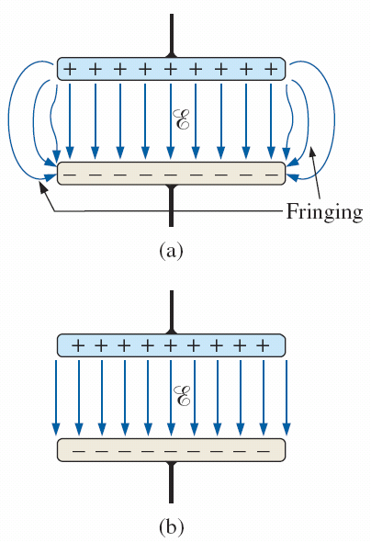
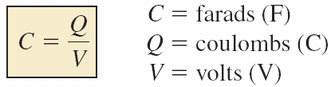
Capacitance
An electric field is setup between the plates
Capacitance is a measure of a capacitor’s ability to store charge on its plates—in other words, its storage capacity.
the higher the capacitance of a capacitor, the greater is the amount of charge stored on the plates for the same applied voltage.
Electric flux distribution between the plates of a capacitor: (a) including fringing; (b) ideal.

Slide 7
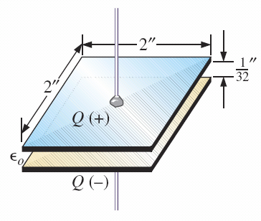
Capacitor
Directly proportional to Area (A), inversely proportional to separation (d) and directly proportional to permittivity (ε)

Slide 8
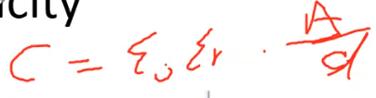
What’s the capacity
FIG. 10.9 Example 10.2.

Slide 9
Note:
The basic components of a capacitor are: conductive plates, separation, and dielectric.
Larger plates permit an increased area for the storage of charge, so the area of the plates should be in the numerator of the defining equation.
The smaller the distance between the plates, the larger is the capacitance, so this factor should appear in the numerator of the equation.
Finally, since higher levels of permittivity result in higher levels of capacitance, the factor should appear in the numerator of the defining equation

Slide 10
Effects of a Dielectric
FIG. 10.7 Effect of a dielectric on the field distribution between the plates of a capacitor: (a) alignment of dipoles in the dielectric; (b) electric field components between the plates of a capacitor with a dielectric present.

Slide 11
Effects of a Dielectric
Notice how charge is higher where dielectric is present
FIG. 10.8 Demonstrating the effect of inserting a dielectric between the plates of a capacitor: (a) air capacitor; (b) dielectric being inserted.

Slide 12
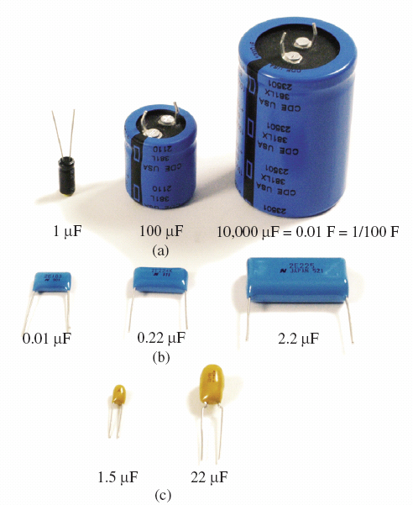
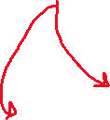
CAPACITORS Types of Capacitors
Negative side
FIG. 10.11 Symbols for the capacitor: (a) fixed; (b) variable.
The size of a capacitor increases with the capacitance value: (a) electrolytic; (b) polyester-film; (c) tantalum.

Slide 13
Increasing capacitance
FIG. 10.13 Three ways to increase the area of a capacitor: (a) rolling; (b) stacking; (c) insertion.

Slide 14
CAPACITORS IN SERIES AND IN PARALLEL
Capacitors, like resistors, can be placed in series and in parallel.
Increasing levels of capacitance can be obtained by placing capacitors in parallel, while decreasing levels can be obtained by placing capacitors in series.

Slide 15
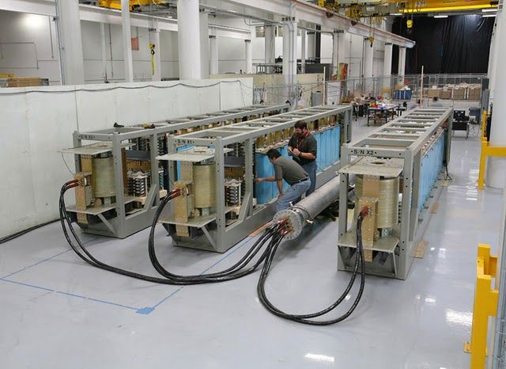
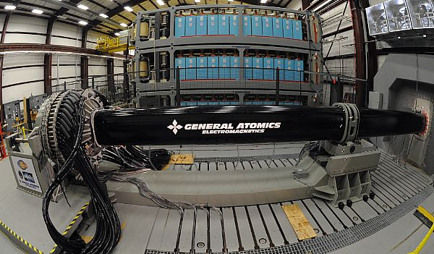
Capacitor banks

Slide 16
Series and Parallel
Parallel capacitors.
Series capacitors.

Slide 17
Example
What is the total capacitance of each circuit?

Slide 18





Example 2
Determine the unknowns: Everything is opposite to resistors: Voltage divides are current would for resistors and current
Q1=C1*V1
Q2=C2*V2
Q3=C3*V3

Slide 19
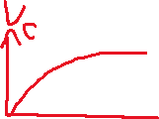


Capacitor in steady state
When completely charged, the capacitor is an open circuit, i=0. Below V_{C} is just the voltage across the 8Ω resistor once fully charged.

Slide 20

Capacitor is steady state
What is V_{C1} and V_{C2}?

Slide 21
Energy in a capacitor
An ideal capacitor does not dissipate any of the energy supplied to it.
It stores the energy in the form of an electric field between the conducting surfaces.
A plot of the voltage, current, and power to a capacitor during the charging phase is shown in Fig. 10.75.
The power curve can be obtained by finding the product of the voltage and current at selected instants of time and connecting the points obtained.
The energy stored is represented by the shaded area under the power curve.

Slide 22
Power Curve
Remember P=VI. At every instant multiply the two
FIG. 10.75 Plotting the power to a capacitive element during the transient phase.

Slide 23
TRANSIENTS IN CAPACITIVE NETWORKS: THE CHARGING PHASE
The placement of charge on the plates of a capacitor does not occur instantaneously.
Instead, it occurs over a period of time determined by the components of the network.
FIG. 10.26 Basic R-C charging network.

Slide 24
Charging phase
As the capacitor gathers charge, the voltage across it changes
As shown, the initial rate of voltage change across the capacitor is high
As the capacitor voltage becomes closer in magnitude to the source voltage E, the rate of change of capacitor voltage slows down
If the switch is kept closed long enough the capacitor gets fully charged and reaches a voltage of E
The above period during which changes take place is called a transient period
Once the transient period is over we reach
the steady state (or before the transient period began)

Slide 25


Transients in Capacitor Networks
Circuits which combine resistors and capacitors are called RC circuits (figure shows a series RC circuit)
When the Kirchoff’s voltage law is applied a first order differential equation (DE) is obtained
The solution to DE has the exponential form having the term e^{-t/RC} (note the minus sign)
e⁻⁰=1.0, e⁻¹=0.368, e⁻²=0.135,
e⁻⁵=0.007, e⁻¹⁰=0.000045,
e⁻¹⁰⁰=3.72x10⁻⁴⁴ (as time t increases the contribution made by the exponential term decreases)
The product RC is known as the time constant (τ), and has the unit of time
i
v_{c}

Slide 26
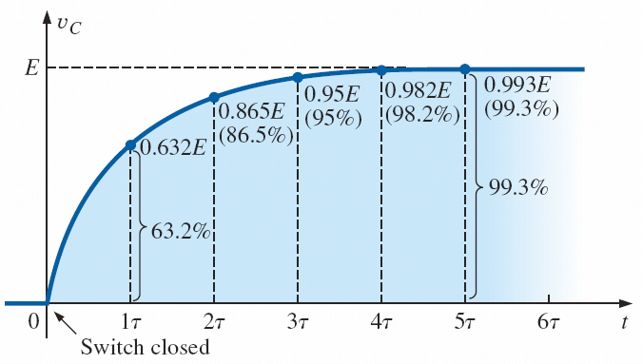


Current in the charging phase
Many electrons will flow quickly the instant the switch is closed then slow down as charge builds on the plates

Slide 27
Note the time constant τ = RC
The factor τ, called the time constant of the network, has the units of time

Slide 28
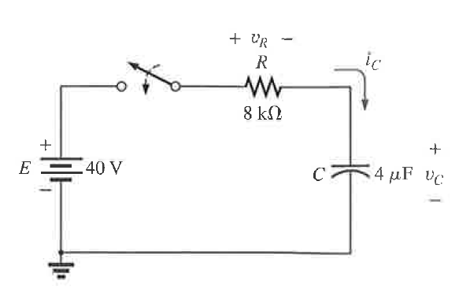
Example
Find v_{c} , i_{c} and v_{R} when after the switch is closed
Step 1: Find the final (steady state voltage across the capacitor). Remember this is the open circuit voltage E_{Th}
(in this case its equal to...)
Step 2: Find the time constant RC, The resistance is the Thevenin resistance R_{Th}.
Step 3: Substitute into equation

Slide 29
The discharge Phase
If the energy source is removed (The battery), then the capacitor will have the highest potential and hence will discharge its charge making a current flow.
This continues until there is no more charge and no potential on the capacitor.
Note the current will flow in the opposite direction and hence have a negative sign

Slide 30
Example Discharge Phase
Calculate v_{c} and i_{c} when the switch is placed in position 2. This is the discharge phase.
1
2

Slide 31
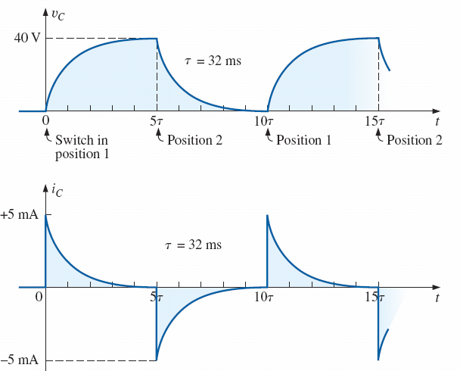
Charge/Discharge
FIG. 10.41 v_{C} and i_{C} for the network in Fig. 10.39(a) with the values in Example 10.6.

Slide 32
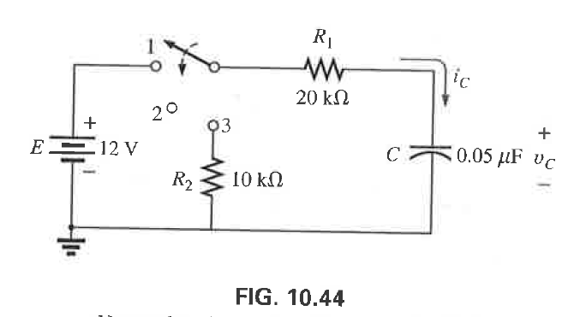
Example 3 Charge/Discharge
Find v_{c} and i_{c} when the switch is in position 1 at t=0.
Find v_{c} and i_{c} when the switch is in position 2 after t = 10ms

Slide 33
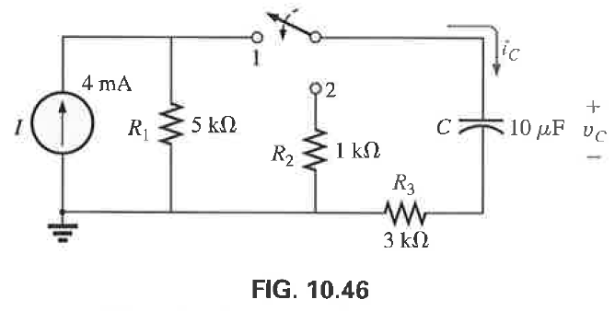
Example 4
Find v_{c} and i_{c} when the switch is closed at t=0
Find v_{c} and i_{c} when the switch is moved to position 2 at t=1τ

Slide 34
Lecture 6 summary
Boylestad – Chapters 10
Capacitors and capacitance
Capacitor Types
Capacitors in Series and Parallel
Capacitor Charging and Discharging
Time Constants
Energy Storage

