Slide 1
ENGG104 Electrical Systems
TEXTBOOK
Introductory Circuit Analysis, Boylestad, 12th Ed
Lecture 8

Slide 2
Lecture 8 summary
(Boylestad – Chapter 13)
Sinusoidal Alternating Waveforms
Phase relationships

Slide 3



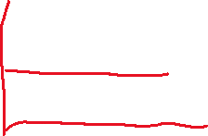
13.1 - Introduction
Alternating waveforms
The term alternating indicates only that the waveform alternates between two prescribed levels in a set time sequence.
Notes:
2

Slide 4
Generating AC
FIG. 13.2 Various sources of ac power: (a) generating plant; (b) portable ac generator; (c) wind-power station; (d) solar panel; (e) function generator

Slide 5
13.2 – Sinusoidal ac Voltage Characteristics and Definitions
Generation
An ac generator (or alternator) powered by water power, gas, or nuclear fusion is the primary component in the energy-conversion process.
The energy source turns a rotor (constructed of alternating magnetic poles) inside a set of windings housed in the stator (the stationary part of the dynamo) and will induce voltage across the windings of the stator.
Notes:
3

Slide 6
Sinusoidal ac Voltage Characteristics and Definitions
Generation
Wind power and solar power energy are receiving increased interest from various districts of the world.
The turning propellers of the wind-power station are connected directly to the shaft of an ac generator.
Light energy in the form of photons can be absorbed by solar cells. Solar cells produce dc, which can be electronically converted to ac with an inverter.
A function generator, as used in the lab, can generate and control alternating waveforms.
Notes:
4

Slide 7
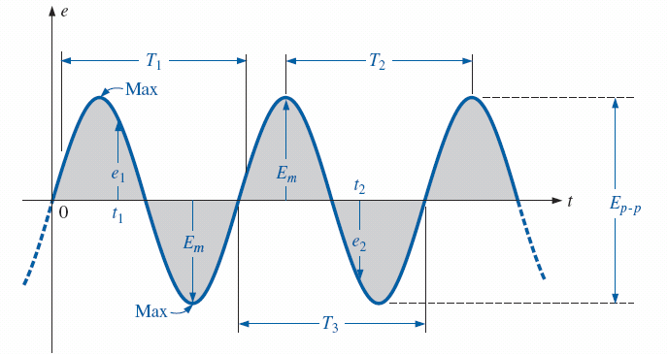
The Sine wave
FIG. 13.3 Important parameters for a sinusoidal voltage.

Slide 8
Sinusoidal ac Voltage Characteristics and Definitions
Definitions
Waveform: The path traced by a quantity, such as voltage, plotted as a function of some variable such as time, position, degree, radius, temperature and so on.
Instantaneous value: The magnitude of a waveform at any instant of time; denoted by the lowercase letters (e₁, e₂).
Peak amplitude: The maximum value of the waveform as measured from its average (or mean) value, denoted by the uppercase letters E_{m} (source of voltage) and V_{m} (voltage drop across a load).
Notes:
5

Slide 9
Sinusoidal ac Voltage Characteristics and Definitions
Definitions
Peak value: The maximum instantaneous value of a function as measured from zero-volt level.
Peak-to-peak value: Denoted by E_{p-p} or V_{p-p}, the full voltage between positive and negative peaks of the waveform, that is, the sum of the magnitude of the positive and negative peaks.
Periodic waveform: A waveform that continually repeats itself after the same time interval.
Notes:
6

Slide 10
Example
Determine V_{pp}, V_{p}, Period T, Frequency f
FIG. 13.7 Example 13.1.

Slide 11
Relationship between Sine wave and Circle
Generating a sinusoidal waveform through the vertical projection of a rotating vector – (video)

Slide 12





Sinusoidal ac Voltage Characteristics and Definitions
Defined polarities and direction
The polarity and current direction will be for an instant in time in the positive portion of the sinusoidal waveform.
In the figure, a lowercase letter is employed for polarity and current direction to indicate that the quantity is time dependent; that is, its magnitude will change with time.
Notes:
8

Slide 13
The angular Velocity and Sine wave
The sinusoidal wave form can be derived from the length of the vertical projection of a radius vector rotating in a uniform circular motion about a fixed point.
The velocity with which the radius vector rotates about the center, called the angular velocity, can be determined from the following equation:
Notes:
12

Slide 14
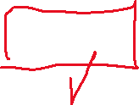


Angular velocity
Distance travelled on the circle
The angular velocity (ω) is:
Since (ω) is typically provided in radians per second, the angle α obtained using α = ωt is usually in radians.
For a full revolution or a complete period, the time required to complete one revolution is equal to the period (T) of the sinusoidal waveform. The radians subtended in this time interval are 2π.
or
Notes:
13

Slide 15
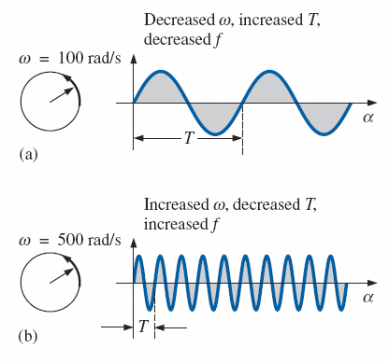


Angular velocity
100 circles in 1 second
500 circles in 1 second
Demonstrating the effect of ω on the frequency and period.

Slide 16
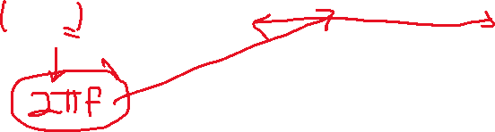
General Format for the Sinusoidal Voltage or Current
The basic mathematical format for the sinusoidal waveform is:
where:
A_{m} is the peak value of the waveform
α is the unit of measure for the horizontal axis
Notes:
14

Slide 17



General Format for the Sinusoidal Voltage or Current
For electrical quantities such as current and voltage, the general format is:
i = I_{m}sinωt = I_{m}sinα
e = E_{m}sinωt = E_{m}sinα
where: the capital letters with the subscript m represent the amplitude, and the lower case letters i and e represent the instantaneous value of current and voltage, respectively, at any time t.
Notes:
16

Slide 18
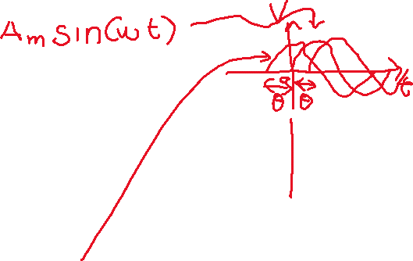

Phase Relations
If the waveform is shifted to the right or left of 0°:
where: θ is the angle (in degrees or radians) that the waveform has been shifted
Shifting left - If the wave form passes through the horizontal axis with a positive-going (increasing with the time) slope before 0°:
Shifting right - If the waveform passes through the horizontal axis with a positive-going slope after 0°:
Notes:
17

Slide 19

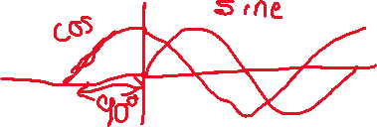

Phase Relations
The terms lead and lag are used to indicate the relationship between two sinusoidal waveforms of the same frequency plotted on the same set of axes.
The cosine curve is said to lead the sine curve by 90.
The sine curve is said to lag the cosine curve by 90.
90 is referred to as the phase angle between the two waveforms.
Notes:
18

Slide 20
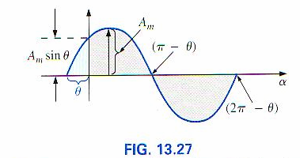
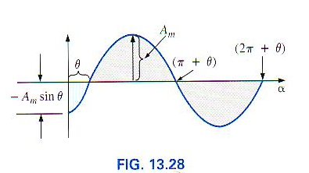
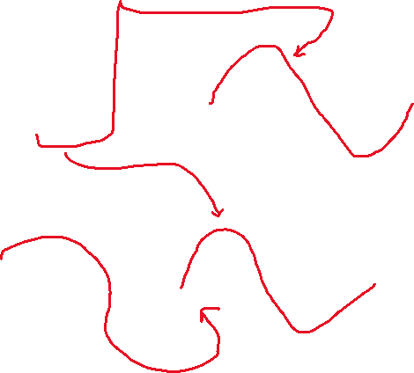
Phase Relationships
As sinusoidal voltages and currents pass through circuits they may exhibit a shift in time (we will learn this process soon)
This shifting in time can also be interpreted as a phase shift
The sinusoidal wave A_{m} sin (ωt + θ) is said to be leading the sinusoidal wave A_{m} sin (ωt)
The sinusoidal wave A_{m} sin (ωt - θ) is said to be lagging the sinusoidal wave A_{m} sin (ωt)
Boylestad, Prentice Hall 2007

Slide 21
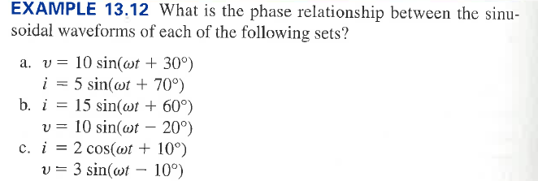





Example 4

Slide 22
Example (a)
FIG. 13.31 Example 13.12(a): i leads v by 40°.

Slide 23
Example (b)
Example 13.12(b): i leads v by 80°.

Slide 24
Example (c)
Example 13.12(c): i leads v by 110°.

Slide 25
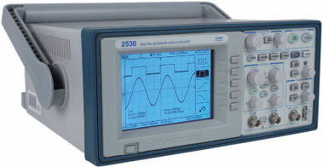
PHASE RELATIONS The Oscilloscope
The oscilloscope of is an instrument that will display the sinusoidal alternating waveform in a way that will permit the reviewing of all of the waveform’s characteristics.
Digital storage oscilloscope. (Courtesy BK Precision.)

Slide 26
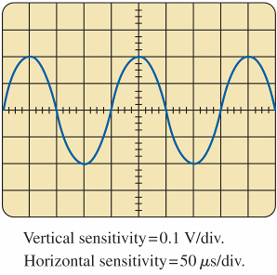
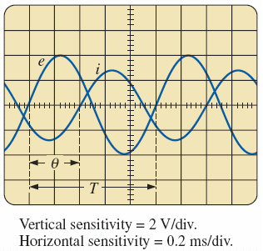
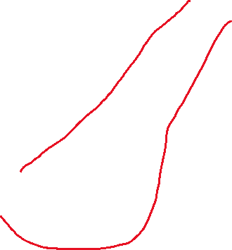
PHASE RELATIONS The Oscilloscope
FIG. 13.38 Example 13.13.
FIG. 13.39 Finding the phase angle between waveforms using a dual-trace oscilloscope.

Slide 27
Lecture 8 summary
Sinusoidal Alternating Waveforms
Phase relationships

