Slide 1
ENGG104 Electrical Systems
TEXTBOOK
Introductory Circuit Analysis, Boylestad, 12th Ed
Lecture 2
Attribution Nidhal Abdulaziz

Slide 2
Lecture 1 summary
Charge (Coulombs )
Separating positive and negative charges requires work to be done and creates a potential difference V (volts)= W(J)/Q(C)
Voltage difference ‘pushes’ electrons to move creating a current if a continuous path is present (a circuit) I(A)=Q(C)/t(sec)
Voltage source could be chemical or mechanical
Resistance is a measure of how easily electrons flow.
Relates voltage and current V=IR (ohms law)
No current flows in a branch of an open circuit

Slide 3
Lecture 2 Summary
Energy and Power P = W/t
Series Circuit
Adding voltage sources
Resistors in series
Kirchhoff's Voltage Law
Voltage divider rule
Real Voltage source

Slide 4
Power and Energy
Power is the rate at which energy is delivered (or used up) and is measured in units of Joules per second
i.e. 1 Watt (W) = 1 Joule/sec
Hence energy W = Power x time
i.e a power of 10 W, applied for 5 seconds = 10 x 5 = 50 Joules of energy
Rewriting this formula gives P = W/t

Slide 5
Power and Energy and Resistance
An electric current through a resistor delivers power, i.e.
Voltage (V) has units of Joules per coulomb (Q)
We have W = V x Q
Power P = W/t = VQ/t
However current (I) is expressed as Coulombs/s, i.e. I = Q/t
Hence P = VQ/t = VI
Substituting from Ohm’s Law,
P = VI = V(V/R) = V²/R = (IR)²/R = I²R

Slide 6
Example: Power and Energy
If a Kilowatt hour costs 25 cents, how much does it cost to light up a 20W low power light bulb continuously for 1 year?

Slide 7
Example: Power and Energy
A portable TV uses a 12V, 3A-h battery over a period of 5.5 hours when the battery is empty. What is the average current drawn during this period? What is energy expended by the battery during this period?

Slide 8
Another example
What is the power dissipated in a 5 Ω resistor is the current is 4 A?
P = I²R = (4)²(5) = 80 W
What is the current through a 5 kΩ resistor when the power dissipated by the element is 20mW?
P = I²R => I=√(P/R)= √(0.02/5000) = 2 mA

Slide 9
The basic Circuit on polarities
Note the polarity: current ’entering‘ a resistor makes that end positive.
FIG. 5.1 Introducing the basic components of an electric circuit.
A voltage source (energy) drives current (electron flow) around a circuit.
The value of the resistance R determines how much current can flow. The lower the resistance, the higher the current; the higher the resistance the lower the current.

Slide 10
A word about AC/DC
Two types of current are readily available to the consumer today.
One is direct current (DC), in which ideally the flow of charge (current) does not change in magnitude [value] (or direction) with time. [example: voltage from a mobile phone battery or charger]
The other is sinusoidal alternating current (AC), in which the flow of charge is continually changing in magnitude (and direction) with time. [example: household 240V]

Slide 11

Series Circuits
So far our circuits have had one resistor and one voltage source only
A common type of multi-resistor circuit features “series” connections as shown

Slide 12
Series Circuits
For circuit elements (i.e. resistors, voltage sources) to be in series, there must be
Two elements connected at one common point (e.g. point A in the circuit shown)
The current through each circuit element is the same
The total resistance of a series circuit is the sum of the individual resistances in it
e.g. for the circuit shown, total resistance = R₁ + R₂

Slide 13

Example:
Resistors NOT in series
FIG. 5.4 Series connection of resistors.
FIG. 5.5 Configuration in which none of the resistors are in series.
Resistors in series

Slide 14
Example:
R_{T}=?
FIG. 5.6 Series connection of resistors for Example 5.1.
R_{T} = 20+220+1200+5600 = 7.04 kΩ
FIG. 5.7 Series connection of four resistors of the same value (Example 5.2).

Slide 15
Series Resistors (Analogy)
One analogy that works well for the series combination of elements is connecting different lengths of rope together to make the rope longer.
Adjoining pieces of rope are connected at only one point, satisfying the definition of series elements.
Connecting a third rope to the common point would mean that the sections of rope are no longer in a series.

Slide 16
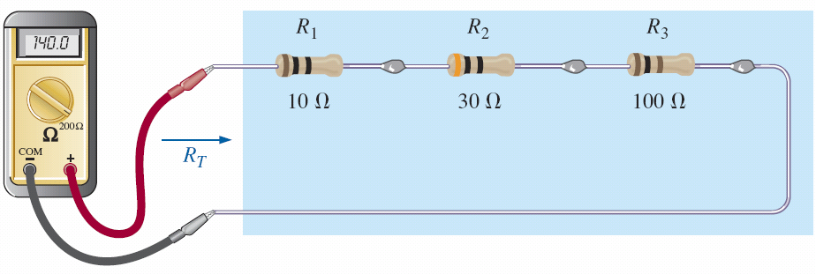
Measuring Resistance
FIG. 5.11 Using an ohmmeter to measure the total resistance of a series circuit.

Slide 17
A complete series circuit
If we now take an 8.4 V dc supply and connect it in series with the series resistors in Fig. 5.4, we have the series circuit in Fig. 5.12.
I_{s} = E/R_{T}
= 8.4/140
= 0.06 A
Ohm’s Law:
V=IR
FIG. 5.12 Schematic representation for a dc series circuit.

Slide 18
Voltages
Again its just Ohm’s law V=IR
V₁ = I_{s}R₁ = 0.06 x 10 = 0.6 V
V₂ = I_{s}R₂ = 0.06 x 30 = 1.8 V
V₃ = I_{s}R₃ = 0.06 x 100 = 6.0 V
Add up all the voltage ‘drops’ = 0.6+1.8+6 = 8.4 V
Notice this equal to the source voltage E.

Slide 19
A word about polarities
https://www.youtube.com/watch?v=ubnFqfYN3r
FIG. 5.14 Inserting the polarities across a resistor as determined by the direction of the current.

Slide 20
Example
Determine, R_{T}, I_{s}, V₁, V₂ and V₃.
Add all the voltages. Are they equal to the source E?
FIG. 5.15 Series circuit to be investigated in Example 5.4.

Slide 21
Definitions
A circuit: is any combination of elements that will result in a continuous flow of charge, or current, through the configuration.
Resistance: Total series resistance seen from a set of terminals
FIG. 5.13 Resistance “seen” at the terminals of a series circuit.

Slide 22
Measuring Voltage
FIG. 5.19 Using voltmeters to measure the voltages across the resistors in Fig. 5.12.

Slide 23
A note about instruments
Another important concept to remember is:
The insertion of any meter in a circuit will affect the circuit.
Furthermore, it is particularly helpful in the laboratory to realize that the voltages of a circuit can be measured without disturbing (breaking the connections in) the circuit.

Slide 24
Voltage Sources in Series
Voltage sources may be connected in series to obtain a higher voltage
The total resulting voltage is the sum of the individual ones
E.g. for the circuit shown, the total voltage is 1.5 + 1.5 = 3V

Slide 25
Voltage Sources in Series
FIG. 5.23 Reducing series dc voltage sources to a single source.

Slide 26
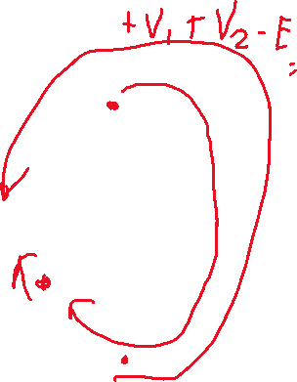
Kirchoff’s Voltage Law
An important circuit analysis tool is the use of “Kirchoff’s Voltage Law” (KVL)
Which states that the sum of the potential rises and falls (i.e. voltages) around a closed loop within a circuit is zero
Hence, for the circuit shown
E - V₁ - V₂ = 0
Note that it is important to consider the polarity of the potential difference across each circuit element, to ensure that the sum of the potential differences is zero
Either clockwise or anti clockwise direction can be considered in writing KVL

Slide 27



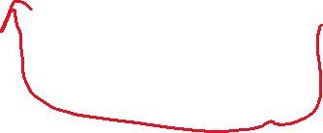

Kirchhoff’s Voltage Law (KVL)
E – V₁ – V₂ = 0 OR
E = V₁ + V₂
The law specifies that the algebraic sum of the potential rises and drops around a closed path (or closed loop) is zero.
FIG. 5.26 Applying Kirchhoff ’s voltage law to a series dc circuit.

Slide 28






KVL examples
Determine V_{x}
FIG. 5.31 Applying Kirchhoff ’s voltage law to a circuit in which the polarities have not been provided for one of the voltages (Example 5.12).
FIG. 5.30 Series configuration to be examined in Example 5.11.

Slide 29
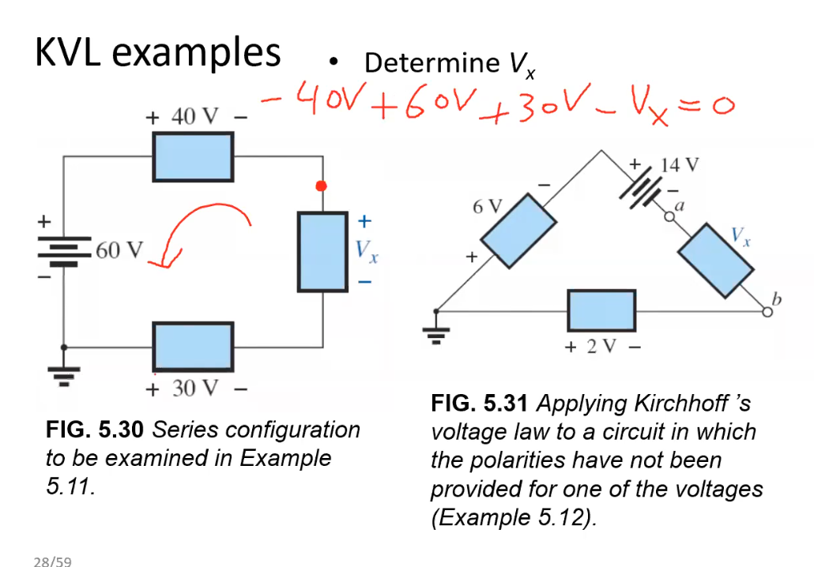
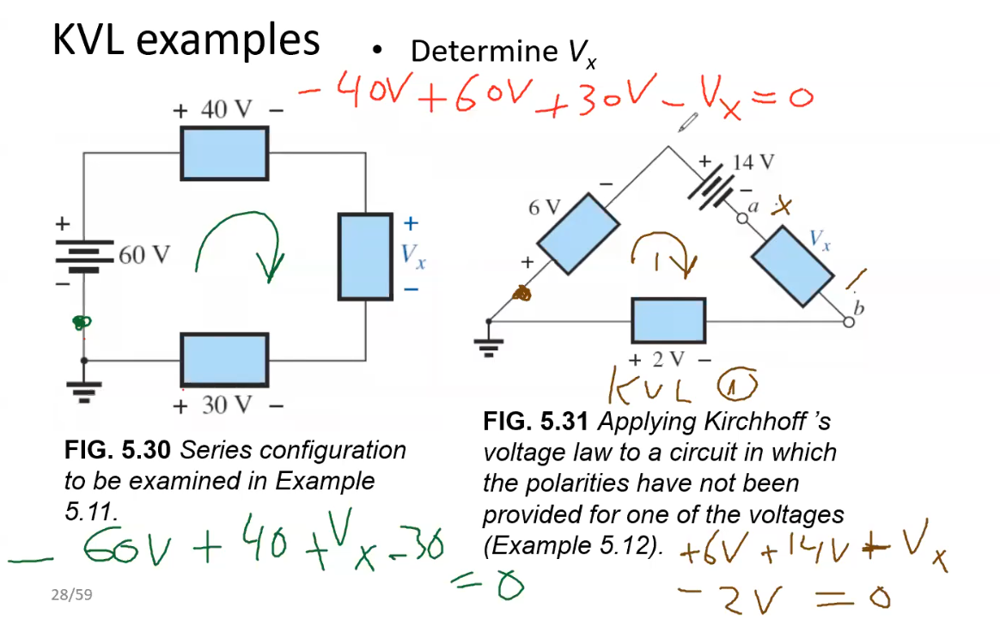
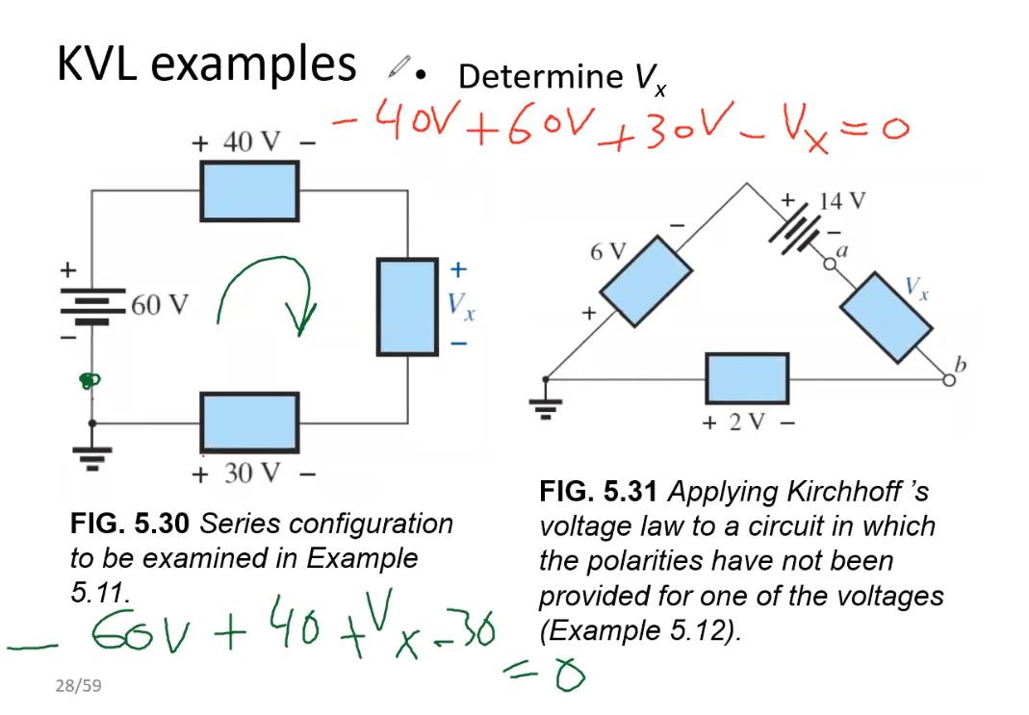



Slide 30
More KVL examples
Determine V₂.
Then determine I₂
Then determine R₁, R₂ and R₃.
FIG. 5.32 Series configuration to be examined in Example 5.13.

Slide 31
Voltage Divider Rule
Often circuit analysis requires finding the voltage across a single resistor within a series circuit
In other words, in a series resistive circuit, the larger the resistance, the more of the applied voltage it will capture.
In addition, the ratio of the voltages across series resistors will be the same as the ratio of their resistance levels.

Slide 32
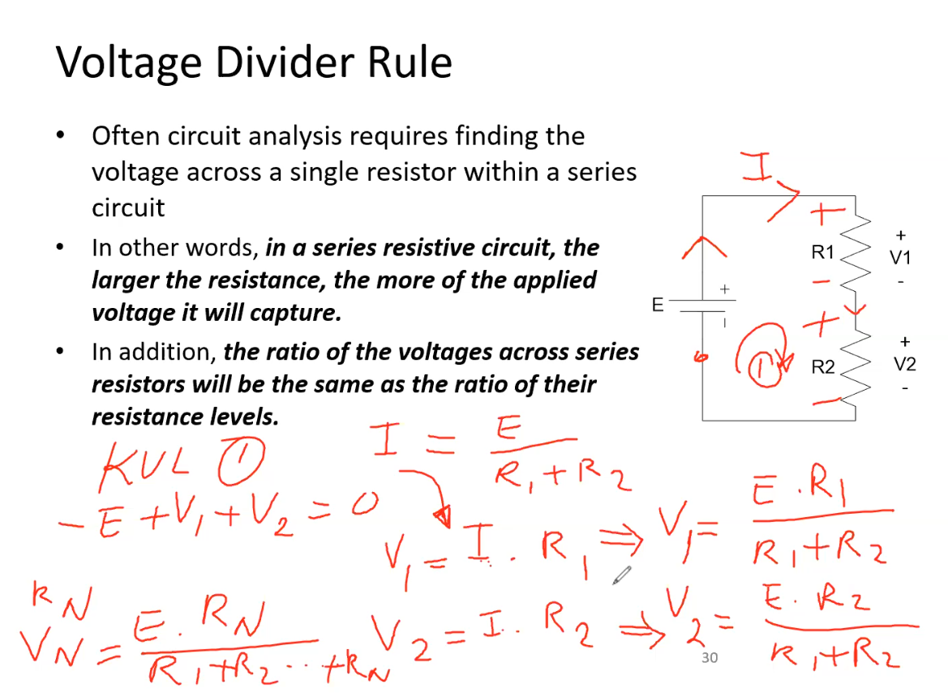

Slide 33
Voltage Divider Rule
The best way to understand this rule is consider the total voltage as being “shared” amongst the resistors, depending upon their respective values
Hence if all the resistors in the series connection have the same value, then they will each have the same voltage across them
E.g., for the example opposite, if R₁ = R₂, then V₁ = V₂

Slide 34
Voltage divider by example
Note voltages on each resistor proportional to resistor values.
FIG. 5.33 Revealing how the voltage will divide across series resistive elements.

Slide 35
Calculate the voltages across all resistors.
FIG. 5.42 Circuit in Fig. 5.41 with R₂ and R₃ interchanged.

Slide 36
Interchanging Elements in Series
FIG. 5.43 Example 5.20.
FIG. 5.44 Redrawing the circuit in Fig. 5.43.

Slide 37
Voltage Sources and ground
Except for a few special cases, electrical and electronic systems are grounded for reference and safety purposes.
The symbol for the ground connection appears in Fig. 5.45 with its defined potential level—zero volts.
FIG. 5.45 Ground potential.

Slide 38
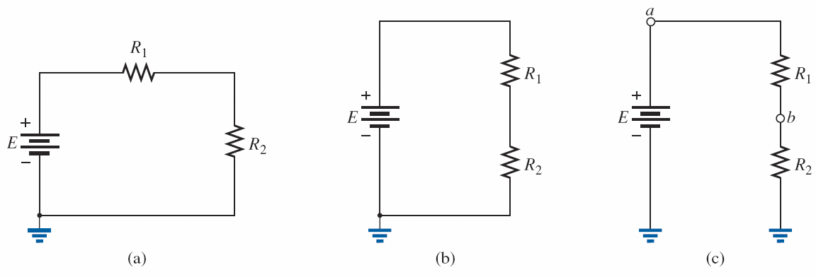
Voltage sources and ground
FIG. 5.46 Three ways to sketch the same series dc circuit.

Slide 39


Voltage Sources and ground
FIG. 5.48 Replacing the notation for a negative dc supply with the standard notation.
FIG. 5.47 Replacing the special notation for a dc voltage source with the standard symbol.

Slide 40
Voltage Double subscript notation
The fact that voltage is an across variable and exists between two points has resulted in a double-subscript notation that defines the first subscript as the higher potential.
FIG. 5.50 Defining the sign for double-subscript notation.

Slide 41
V_{ab}
The double-subscript notation V_{ab} specifies point a as the higher potential.
If this is not the case, a negative sign must be associated with the magnitude of V_{ab}.
In other words, the voltage V_{ab} is the voltage at point a with respect to (w.r.t.) point b.

Slide 42
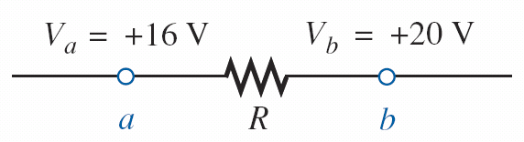
Examples: Calculate V_{ab}
FIG. 5.52 Example 5.21.
FIG. 5.53 Example 5.22.

Slide 43
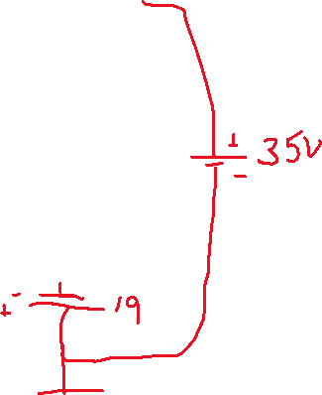
Example: Calculate V_{ac}, V_{ab}, V_{bc}, V_{cb}
FIG. 5.59 Example 5.25.
FIG. 5.60 Determining the total voltage drop across the resistive elements in Fig 5.59.

Slide 44
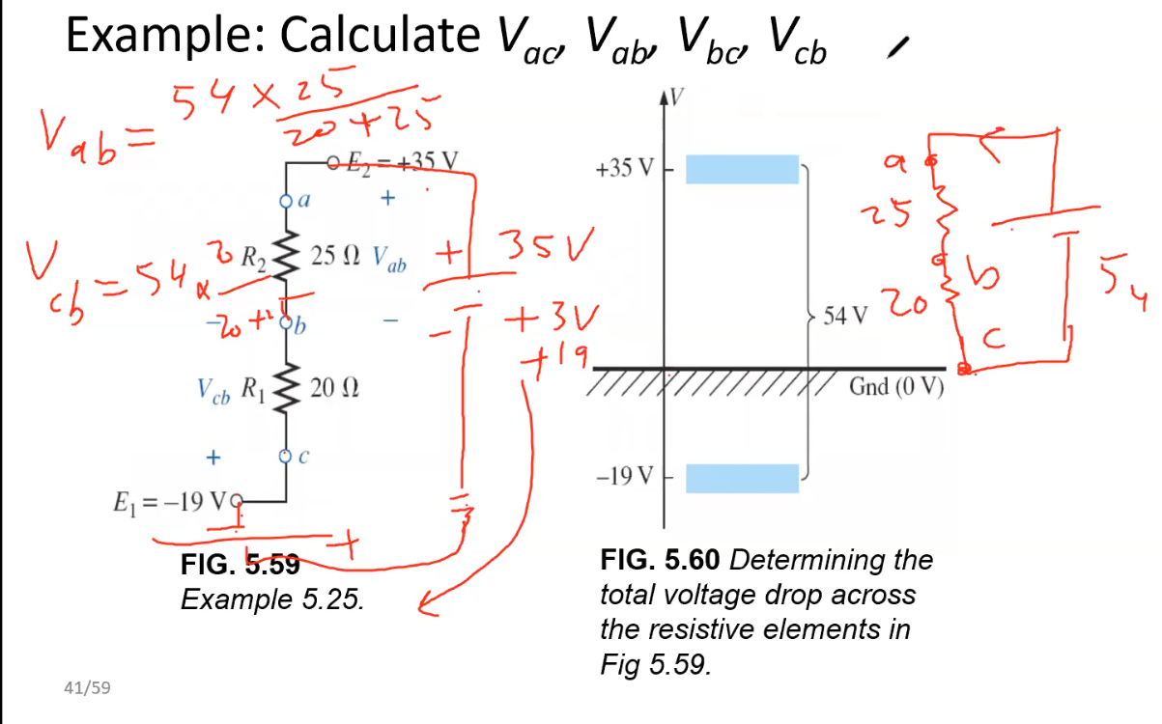

Slide 45
Real Voltage Sources
So far we have considered “ideal” voltage sources
A real voltage source, e.g. a battery, will have some internal resistance
Hence a real voltage source can be considered as an ideal source, connected in series with a resistor, whose value equals the internal resistance R_{int}

Slide 46
Real Voltage Sources
A battery is a common example of a real voltage source
A new battery has a small internal resistance
As the battery is used, its output voltage decreases
This is because the internal resistance increases, and hence, as explained by Ohm’s Law, any current drawn from the battery will produce a voltage drop across the battery internal resistance, thereby lowering the output voltage across the battery terminals

Slide 47
Lecture 2 summary
Energy and Power P = W/t
Series Circuit – current is the same in the branch
Adding voltage sources
Resistors in series – you add them
Kirchhoff's Voltage Law – all voltages add to zero around a complete loop.
Voltage divider rule – voltages divide proportionally to resistance
Real Voltage source – internal resistance reduces output voltage

