Slide 1
ENGG104 Electrical Systems
TEXTBOOK
Introductory Circuit Analysis, Boylestad, 12th Ed
Lecture 5

Slide 2
Lecture 5 summary
Boylestad – Chapters (7 and 8 )
Superposition
Thevenin Equivalent circuit

Slide 3
Superposition
The superposition theorem states the following:
The current through, or voltage across, any element of a network is equal to the algebraic sum of the currents or voltages produced independently by each source.

Slide 4
Superposition Steps
To apply the superposition theorem, the following steps must be followed
Select one source
Remove all other sources by
Replacing voltage sources with shorts circuits (be sure to maintain any internal resistance)
Replacing current sources with open circuits (also keep any internal resistances)
Determine the voltages and currents arising as a result of the selected source
Repeat this procedure for all the other sources
Add the resulting voltages/currents arising from each source
Again: Observe the polarities of the individual voltages, and the directions of the individual currents

Slide 5
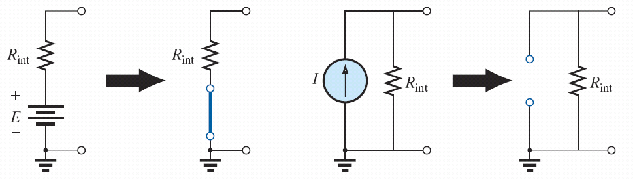
Superposition
FIG. 9.1 Removing a voltage source and a current source to permit the application of the superposition theorem.

Slide 6
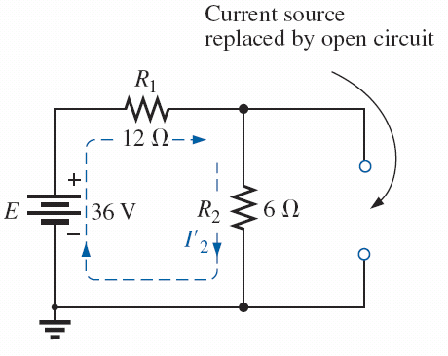
Superposition Example
Find Current I₂
FIG. 9.2 Network to be analyzed in Example 9.1 using the superposition theorem.
FIG. 9.3 Replacing the 9 A current source in Fig. 9.2 by an open circuit to determine the effect of the 36 V voltage source on current I₂.

Slide 7
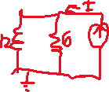
Superposition Example Continued
Now remove the voltage source and reinsert the current source and determine the current I₂ again
FIG. 9.4 Replacing the 36 V voltage source by a short-circuit equivalent to determine the effect of the 9 A current source on current I₂.
FIG. 9.5 Using the results of Figs. 9.3 and 9.4 to determine current I₂ for the network in Fig. 9.2.

Slide 8
Superposition-another example
Using the superposition theorem to determine the current through the 12Ω resistor (Example 9.2).

Slide 9

Superposition-another example
Replace 48 V source with a short. Calculate effect from 54 V source.
FIG. 9.9 Using the superposition theorem to determine the effect of the 54 V voltage source on current I2 in Fig. 9.8.

Slide 10
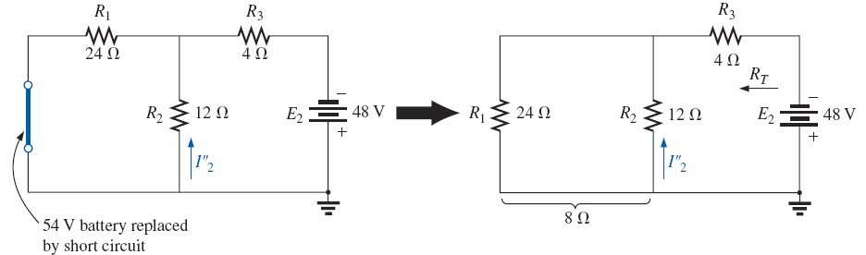
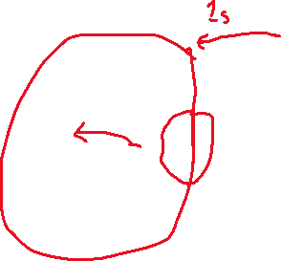
Now consider the current from the 48 V source. Note the difference in direction of current.
FIG. 9.10 Using the superposition theorem to determine the effect of the 48 V voltage source on current I₂ in Fig. 9.8.

Slide 11
Now adding the two currents
FIG. 9.11 Using the results of Figs. 9.9 and 9.10 to determine current I2 for the network in Fig. 9.8.

Slide 12
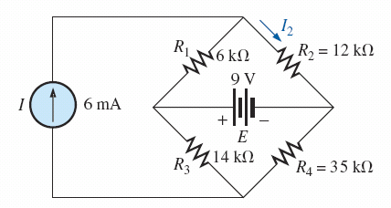
One more example
I₂
FIG. 9.15 Example 9.4.

Slide 13
Consider each source separately. Short the voltage and only consider the current source
FIG. 9.16 The effect of the current source I on the current I₂.

Slide 14
Now open the current source and consider the voltage
FIG. 9.17 The effect of the voltage source E on the current I₂.

Slide 15
THÉVENIN’S THEOREM
The next theorem to be introduced, Thévenin’s theorem, is probably one of the most interesting in that it permits the reduction of complex networks to a simpler form for analysis and design.

Slide 16
In general, the theorem can be used to do the following:
Analyze networks with sources that are not in series or parallel.
Reduce the number of components required to establish the same characteristics at the output terminals.
Investigate the effect of changing a particular component on the behavior of a network without having to analyze the entire network after each change

Slide 17
THÉVENIN’S THEOREM
Thévenin’s theorem states the following:
Any two-terminal dc network can be replaced by an equivalent circuit consisting solely of a voltage source and a series resistor as shown in Fig. 9.23.
FIG. 9.23 Thévenin equivalent circuit.

Slide 18
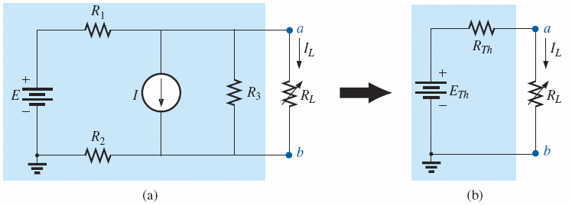
The circuit on the left can be replaced by the equivalent on the right.
FIG. 9.25 Substituting the Thévenin equivalent circuit for a complex network.

Slide 19
THÉVENIN’S THEOREM Thévenin’s Theorem Procedure
Remove that portion of the network where the Thévenin equivalent circuit is found. In Fig. 9.25(a), this requires that the load resistor RL be temporarily removed from the network.
Mark the terminals of the remaining two-terminal network. (The importance of this step will become obvious as we progress through some complex networks.)

Slide 20
Calculating the Thevenin resistance R_{Th}
R_{Th}:
3. Calculate R_{Th} by first setting all sources to zero (voltage sources are replaced by short circuits and current sources by open circuits) and then finding the resultant resistance between the two marked terminals. (If the internal resistance of the voltage and/or current sources is included in the original network, it must remain when the sources are set to zero.)

Slide 21
Calculate the Thevenin Voltage E_{Th}
E_{Th}:
4. Calculate E_{Th} by first returning all sources to their original position and finding the open-circuit voltage between the marked terminals. (This step is invariably the one that causes most confusion and errors. In all cases, keep in mind that it is the opencircuit potential between the two terminals marked in step 2.)

Slide 22
Last step:
5. Draw the Thévenin equivalent circuit with the portion of the circuit previously removed replaced between the terminals of the equivalent circuit. This step is indicated by the placement of the resistor R_{L} between the terminals of the Thévenin equivalent circuit as shown in Fig. 9.25(b).

Slide 23
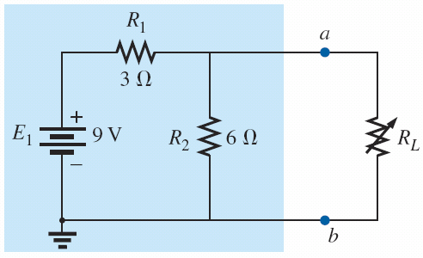
Thevenin Example
Note how the load is removed and an open circuit is formed
FIG. 9.27 Identifying the terminals of particular importance when applying Thévenin’s theorem.
FIG. 9.26 Example 9.6.

Slide 24
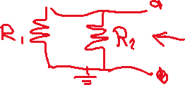
Determine the R_{Th}
Short all voltages and open all current sources
Note R₁ and R₂ are in parallel from viewpoint of the open circuit (Hence R_{Th}= 2 Ω)
FIG. 9.28 Determining R_{Th} for the network in Fig. 9.27.

Slide 25
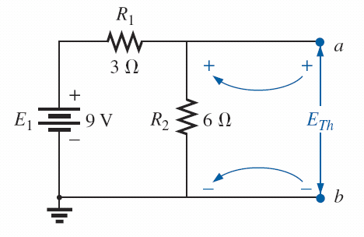
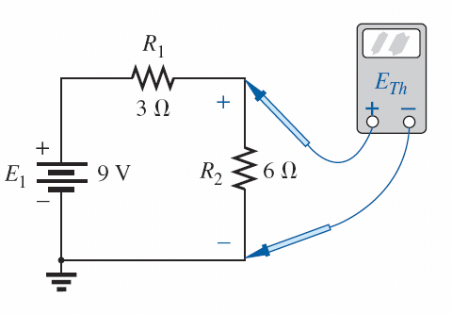


Determining E_{Th}
Measuring voltage across ab is the same as voltage across the 6Ω resistor (hence use voltage divider)
FIG. 9.29 Determining E_{Th} for the network in Fig. 9.27.
FIG. 9.30 Measuring E_{Th} for the network in Fig. 9.27.

Slide 26
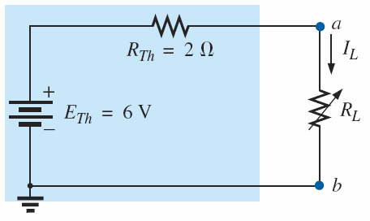
Final circuit
Place the load back in the circuit
FIG. 9.31 Substituting the Thévenin equivalent circuit for the network external to R_{L} in Fig. 9.26.

Slide 27
Another Example
FIG. 9.32 Example 9.7.

Slide 28
Find R_{Th} first...
R_{Th} = 6 Ω
FIG. 9.33 Establishing the terminals of particular interest for the network in Fig. 9.32.
FIG. 9.34 Determining R_{Th} for the network in Fig. 9.33.

Slide 29
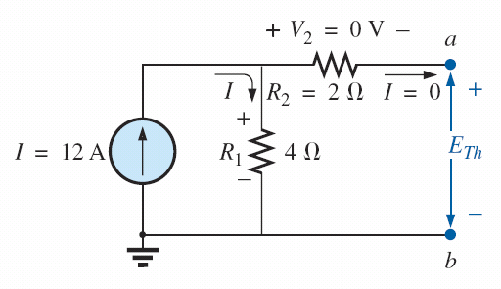

Find E_{Th}
Note no current flows in the open circuit. Hence the voltage is just what is across the 4Ω resistor
FIG. 9.35 Determining E_{Th} for the network in Fig. 9.33.
FIG. 9.36 Substituting the Thévenin equivalent circuit in the network external to the resistor R₃ in Fig. 9.32.

Slide 30
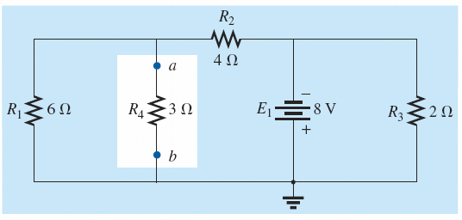
A third example
FIG. 9.37 Example 9.8.

Slide 31
FIG. 9.38 Identifying the terminals of particular interest for the network in Fig. 9.37.

Slide 32
R_{Th}
FIG. 9.39 Determining R_{Th} for the network in Fig. 9.38.

Slide 33
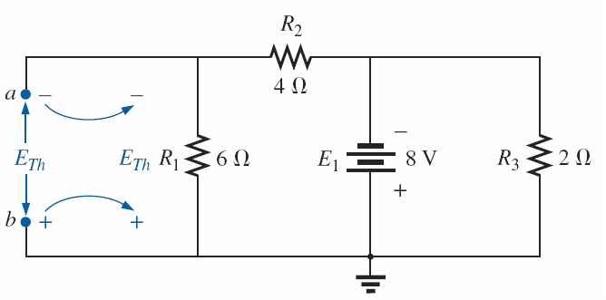
E_{Th}
FIG. 9.40 Determining E_{Th} for the network in Fig. 9.38.

Slide 34
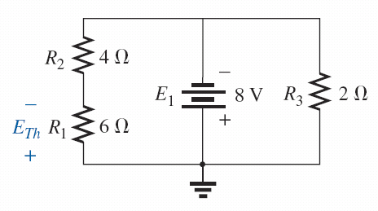
Final Result
FIG. 9.42 Substituting the Thévenin equivalent circuit for the network external to the resistor R₄ in Fig. 9.37.
FIG. 9.41 Network of Fig. 9.40 redrawn.

Slide 35
Challenge Example
Find Thevenin equivalent around R_{L}
FIG. 9.48 Example 9.10.

Slide 36
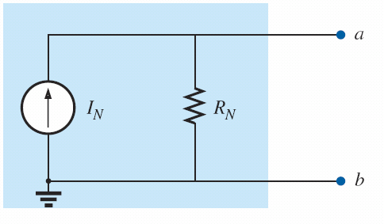
Norton Equivalent
Any two-terminal linear bilateral dc network can be replaced by an equivalent circuit consisting of a current source and a parallel resistor, as shown in Fig. 9.59
FIG. 9.59 Norton equivalent circuit.

Slide 37
Norton and Thevenin are equivalent
FIG. 9.60 Converting between Thévenin and Norton equivalent circuits.

Slide 38
Lecture 5 summary
Boylestad – Chapters 9
Superposition
Thevenin Equivalent circuit

