Slide 1
Lecture 13
Semiconductors, Diodes
Boylestad and Nashelsky, Prentice Hall, 2006 , Ch 1
Semiconductors
PN Junctions
Ideal Diodes
Attribution Nidhal Abdulaziz

Slide 2
Semiconductors
A Semiconductor has a conductivity that is between a conductor and insulator
Most used single crystal semiconductor materials are Germanium (Ge), Silicon (Si) and compound structure semiconductor is Gallium Aresenide (GaAs)

Slide 3
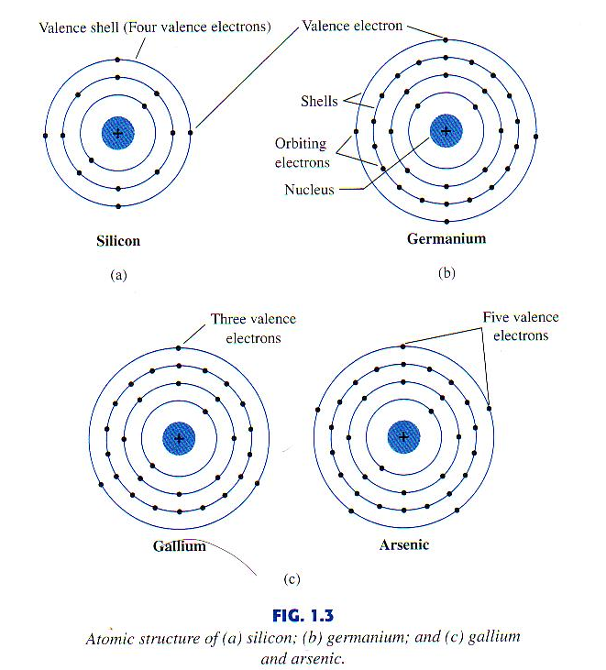
Semiconductors
We use the pure material of silicon, and then we add impurity from a different type of semiconductor material.
e.g. we add few atoms of gallium onto silicon to create a process called doping
Basic behaviour of a semiconductor can be explained using the atomic structure – note the number of valence electrons leading to covalent bonding between atoms making the atomic structure strong.
Copper (Cu) has 29 [2,8,8,8,3] electrons and Aluminium (Al) has 13 [2,8,3] electrons. The valence electrons can be dislodged easily making Al and Cu good conductors.
Boylestad and Nashelsky, page 3

Slide 4
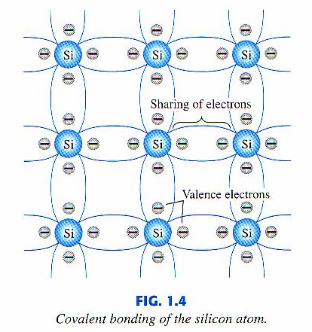
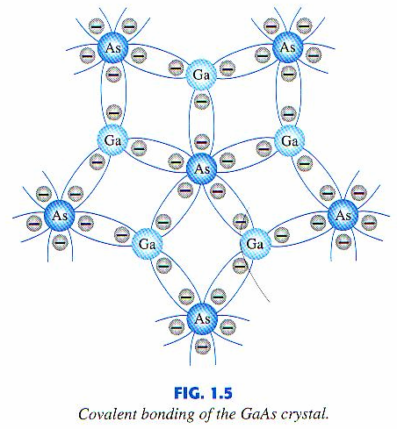
Semiconductors
The covalent bonding - sharing of the valence electrons makes the dislodgement of electrons more difficult
Boylestad and Nashelsky, page 3

Slide 5
Semiconductors
By applying sufficient energy from external sources the covalent bond can be broken and the electrons can be released (reaching a free state)
External sources include light energy, thermal energy
Pure semiconductor materials (intrinsic materials) can be subjected to a doping process leading to an extrinsic material
By introducing an impurity material (Antimony, Arsenic, Phosphorous) with 5 valence electrons to Si an n – type semiconductor material is formed (leaving one free electron per atom –negative charge)
By introducing an impurity material (Boron, Gallium, Indium) with 3 valence electrons to Si a p – type semiconductor material is formed (leaving one hole per atom – positive charge)

Slide 6
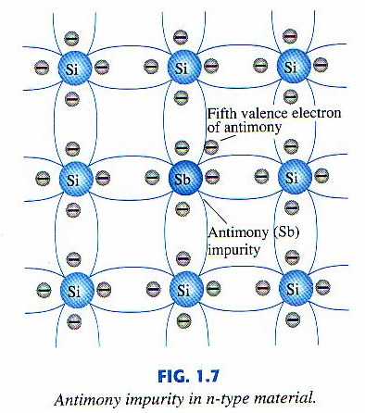
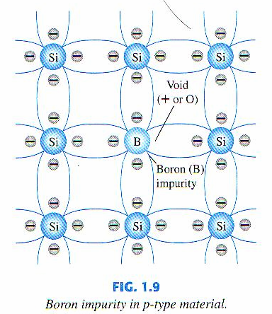
Semiconductors
n-type material
p-type material
Boylestad and Nashelsky, pages 7, 8

Slide 7
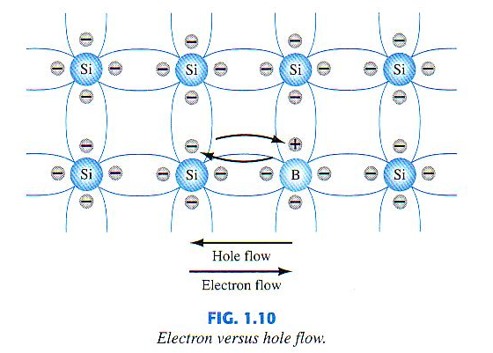
Semiconductors
Electron vs Hole flow
When an electron moves a hole will be created
When the electron is moving from 1 hole to
Another, is it as if the hole is moving in the opposite direction.
When electron moves, it will leave a hole.
When the electron is moving to the left, the hole is moving to the right.
The hole does not move. It is the electron who is moving.
Boylestad and Nashelsky, pages 9

Slide 8
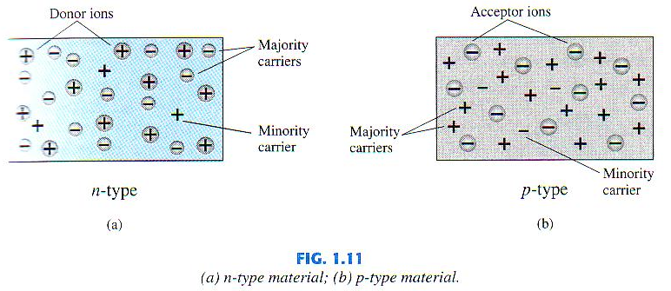
Semiconductors
In an n-type material majority carriers are electrons and the minority carries are holes
In a p-type material majority carriers are holes and the minority carries are electrons
Boylestad and Nashelsky, page 9

Slide 9
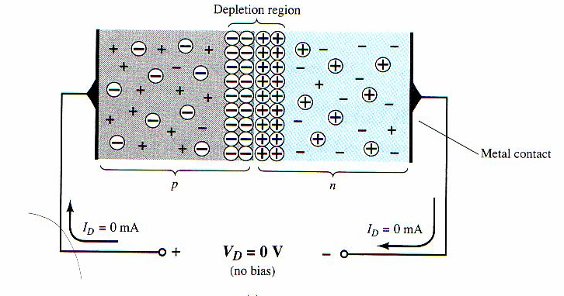
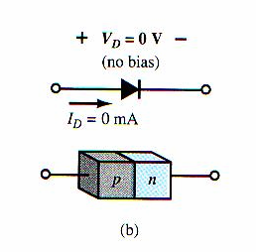
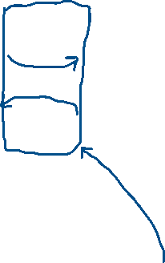
Semiconductor Diode
A key semiconductor component is the PN junction diode, formed by joining P and N type semiconductors (through a metallurgical process)
With no voltage (no bias) applied across the terminals a depletion region is created – electrons and the holes at the junction will combine developing a shortage of carriers
No Free electrons (or holes) to conduct
Holes try to jump from left to right
Symbol of diode
anode
cathode
Electrons try to jump from right to left
Boylestad and Nashelsky, page 9
All electrons and holes have stabilized with each other.
We don’t have free electrons or free holes to move. We call this the depletion region.

Slide 10
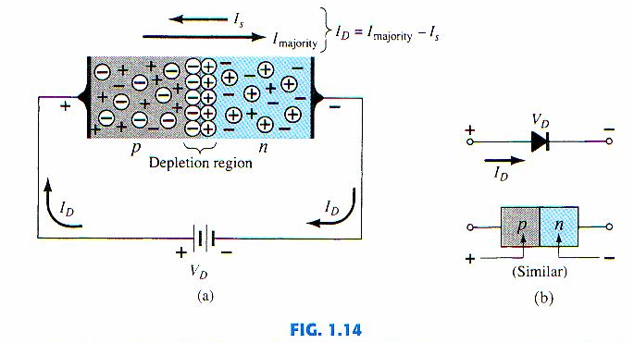



Semiconductor Diode
With forward bias across the terminals a depletion shrinks in its width thus making the current conduction easier
Holes attracted to negative side of battery
Electrons attracted to positive side of battery
Boylestad and Nashelsky, page 12

Slide 11
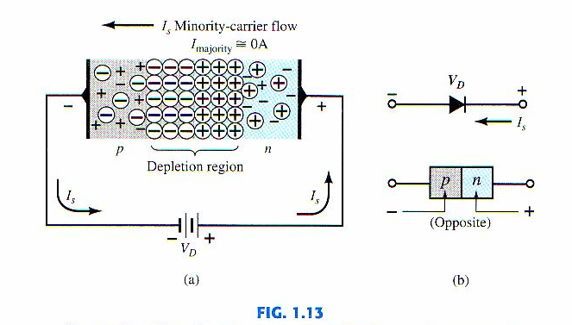
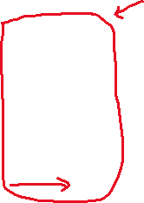
Semiconductor Diode
With reverse bias across the terminals a depletion is grown in its width thus making the current conduction more difficult
Depletion region becomes wider
Electron will try to go to positive side of battery. Hence
The depletion region will increase
Boylestad ad Nashelsky, page 12

Slide 12
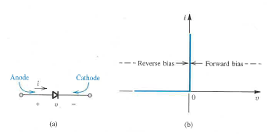
The ideal Diode
The ideal diode, only allows charge to flow in one direction.
This is known as ‘Forward bias’
No current flows in the negative direction
Known as ‘Reverse bias’
We can make use this diode characteristic to use the diode as a switch. When it is forward bias, the switch is on.
When it is reverse biased, the switch is off.

Slide 13
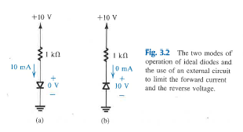
The two states of a Diode

Slide 14

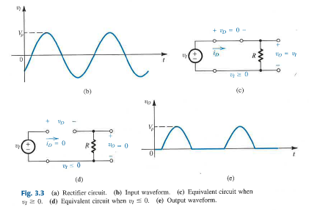
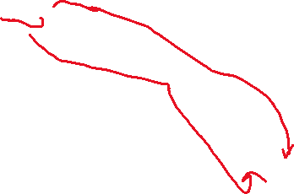
A Diode Rectifier Circuit

Slide 15
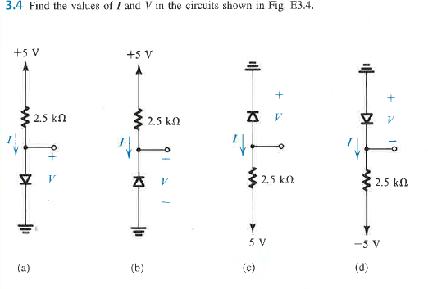
More Examples

Slide 16
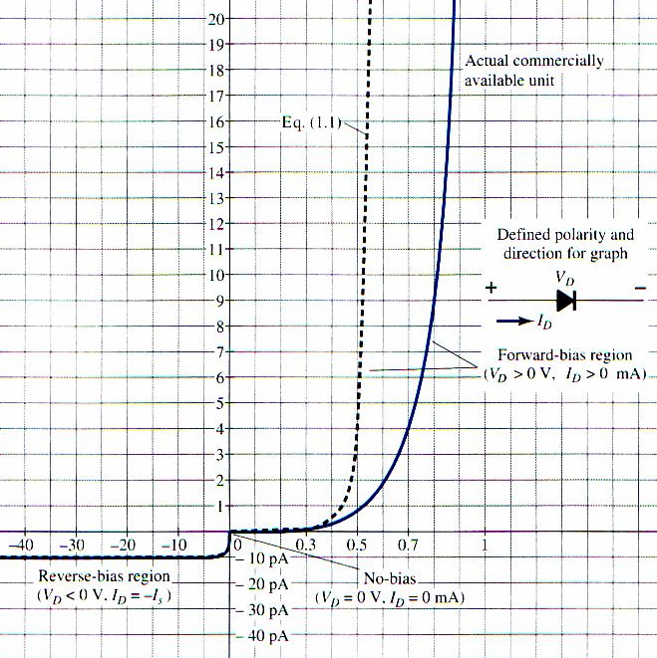
The Practical Diode
The practical diode v-I characteristics
Due to the potential drop that develops as a result of the depletion region about 0.7V of forward bias is required before current starts increasing when forward biased
A small leakage current does exist when reverse biased due to minority carriers
Boylestad and Nashelsky, page 14

Slide 17
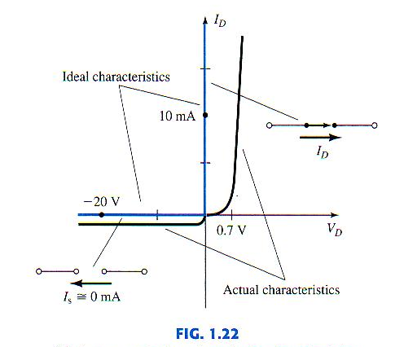
Semiconductor Diode
The practical vs ideal diode v-i characteristics
Boylestad and Nashelsky, page 21

Slide 18
Diode Circuits
Given the (nominal) zero resistance of a conducting diode, a series resistor must always be included in diode circuits, as shown opposite
A Light Emitting Diode (LED) is a diode which emits light when passing current
Common colours: red, green, yellow
The light intensity is proportional to the diode current
The battery needs to be more than 0.7 V for
the diode to start conducting

Slide 19
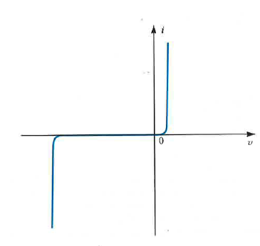
Practical Diode Continued
A Diode usually needs a 0.7V in the forward bias to get the current moving
If we keep increasing the voltage to a large number, there will be a breakdown.
The current will be very large in the opposite direction. Diode has been damaged. It is no longer a diode.
There is a continuous flow of current through the diode.

Slide 20
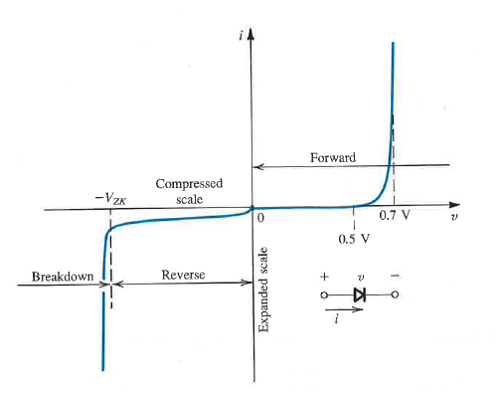
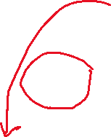

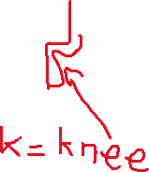
Practical Diode Continued

Slide 21
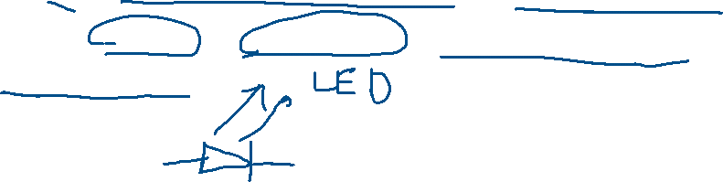
Wave-shaping Circuits
Necessary to shape waveforms
Many examples can be found in transmitters and receivers in TV or radar or equipment control and protection circuits
Uses diodes and zener diodes for clipping and clamping (shaping) input

Slide 22
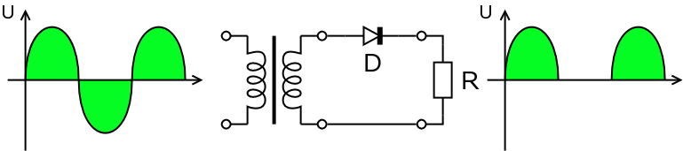
Rectifiers Overview
Half Wave rectifier
a. What is the use of the transformer?
To step down the voltage
220V -> 12 V

Slide 23
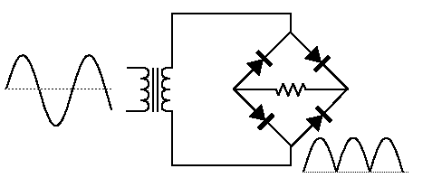
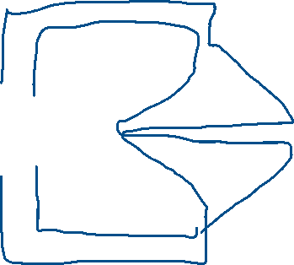
Bridge Rectifier

Slide 24
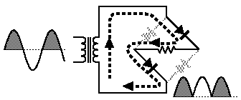
Current Flow in the Bridge Rectifier

Slide 25
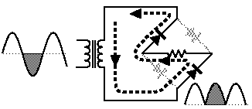
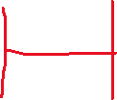
Current Flow in the Bridge Rectifier

Slide 26
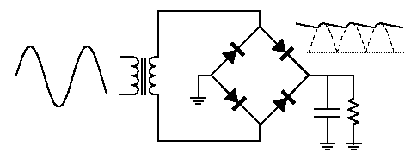
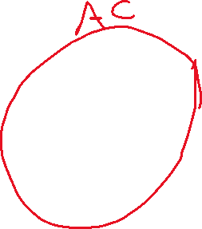
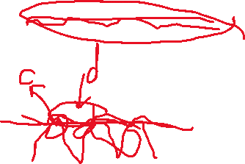
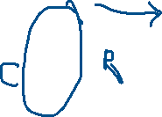
Bridge Rectifier, RC Filter
To improve the DC waveform that is generated at the output we use additional RC circuit.
The capacitor will charge and discharge.
We will choose time constant RC so that the capacitor cannot discharge quickly. It will take
A long time to discharge the capacitor, until the second halve will come and it will charge again.
We still have ripples at the output. We will use the regulator circuit to regulate the voltage at the output.

Slide 27
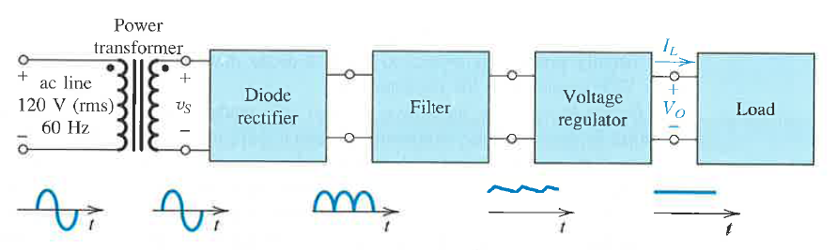
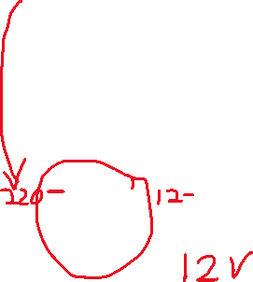


Example: DC power supply circuit
220 V in UAE and Europe

