Slide 1
Lecture 12
Series- Parallel AC Networks
Chapter 16 – Boylestad
Series- Parallel AC Networks Analysis
Attribution Nidhal Abdulaziz

Slide 2
16.1 – Introduction
In general, when working with series-parallel AC networks, consider the following approach:
Redraw the network employing block impedances to combine obvious series and parallel elements,
which will reduce the network to one that clearly reveals the fundamental structure of the system.
Notes:
2

Slide 3
Introduction
Study the problem and make a brief sketch of the overall approach you plan to use.
Doing this may result in time- and energy-saving shortcuts. In some cases a lengthy, drawn-out analysis may not be necessary.
A single application of a fundamental law of circuit analysis may result in the desired solution.
Notes:
3

Slide 4
Introduction
After the overall approach has been determined, consider each branch involved in your method independently before tying them together in series-parallel combinations.
In most cases, work back from the obvious series and parallel combinations to the source to determine the total impedance of the network.
The source current can then be determined, and the path back to specific unknowns can be defined
Notes:
4

Slide 5
Introduction
When you have arrived at a solution check to see that it is reasonable by considering the magnitudes of the energy source and the elements in the circuit. If not, either solve the network using another approach, or check over your work very carefully. At this point a computer solution can be an invaluable asset in the validation process.
Notes:
5

Slide 6


16.2 – Illustrative Examples
Example 16.1
Calculate Z_{T}.
Determine I_{S}.
Calculate V_{R} and V_{c}.
Find I_{C}.
Computer the power
delivered.
Find F_{p} of the network.
Notes:
6

Slide 7
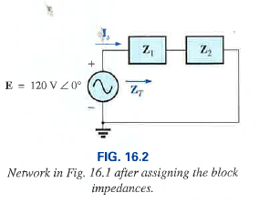
Example solution

Slide 8
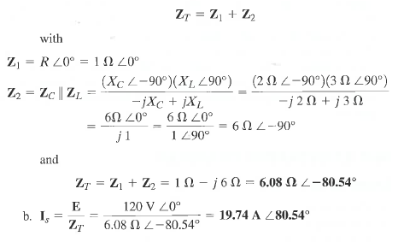

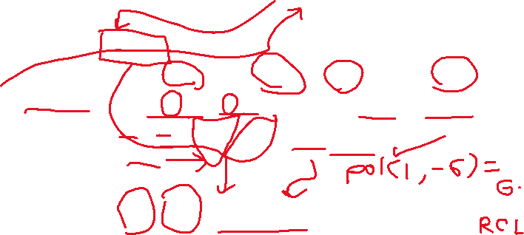

Example continued

Slide 9
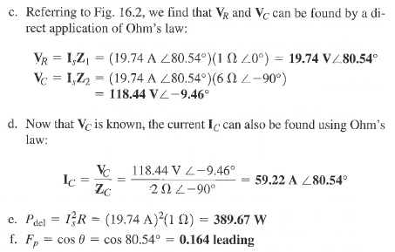




Example Continued

Slide 10
Illustrative Examples
Example 16.2
Solution
Redraw the circuit
Use the current divider rule, determine I, I₁ and I₂
Notes:
7

Slide 11
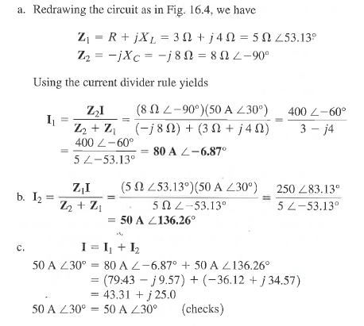
Example 16.2 solution

Slide 12

Illustrative Examples
Example 16.4
Solution
Redraw the circuit
Use the current divider rule, determine I₁ and I₂ and V_{ab}
a. What is ZT
b. What is YT
Notes:
8

Slide 13
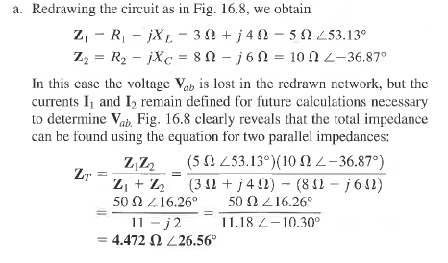
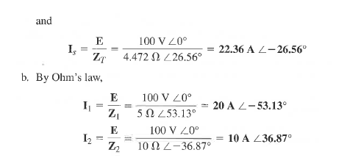
Solution to example 16.4

Slide 14
Illustrative Examples
To find V_{ab}, Kirchhoff’s voltage law must be applied around the loop.
Notes:
9

Slide 15
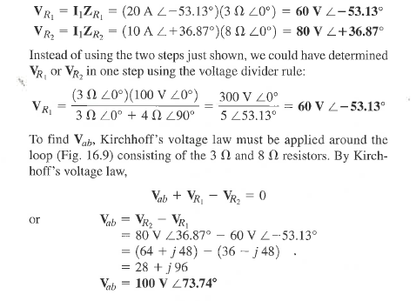







Solution to 16.4 continued

Slide 16
16.3 – Ladder Networks
Here we will calculate the total resistance and resulting source current, and then work back through the ladder until the desired current, I₆ , (or voltage) is obtained.
Notes:
10

Slide 17
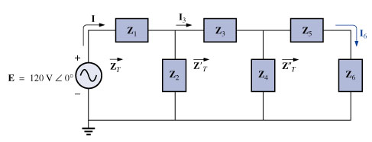

Ladder Networks
Impedance Z_{T} , Z_{T}' and Z_{T}'' and the currents I₁ and I₃ are defined:
Notes:
11

Slide 18
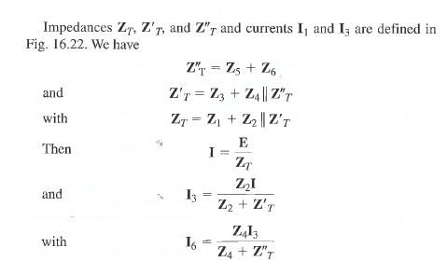



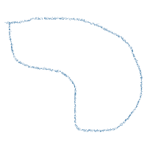


Slide 19
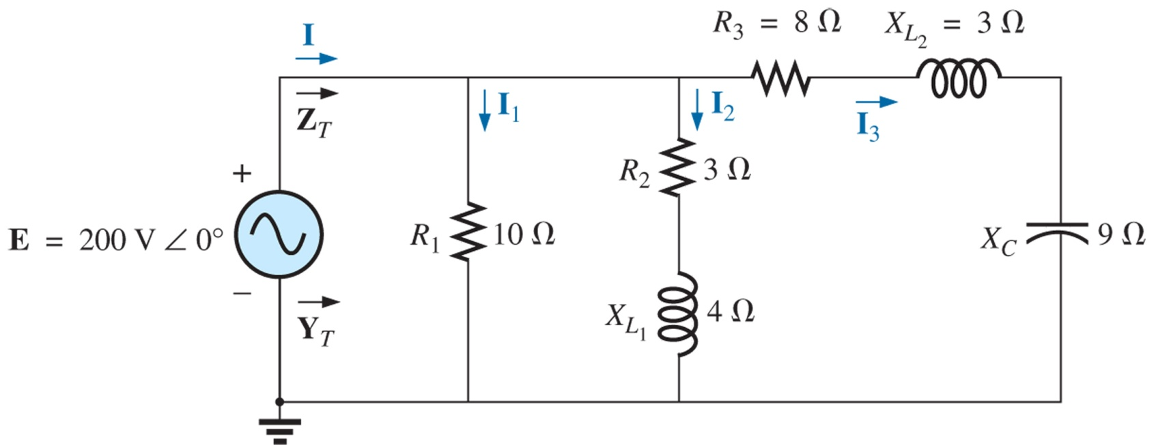
Series-Parallel Circuits
Boylestad, p 719 Fig 16.14
Compute I
Find I₁, I₂ and I₃
Verify Kirchhoff’s current law by showing that I=I₁+ I₂ +I₃

Slide 20
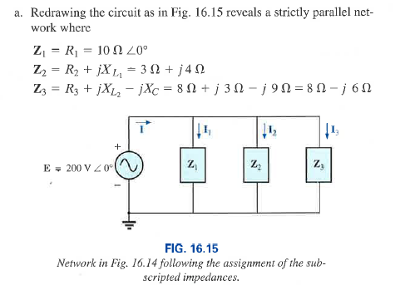
Solution to 16.14

Slide 21
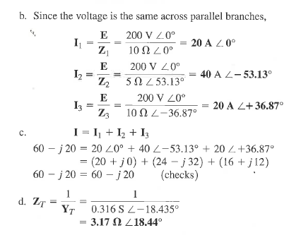

Solution continued

Slide 22
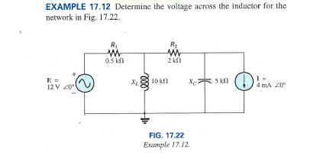



A word about nodal and mesh analysis
Same as DC, but need to do it will all the phases in AC, otherwise the same
Lets do a Nodal analysis example

Slide 23
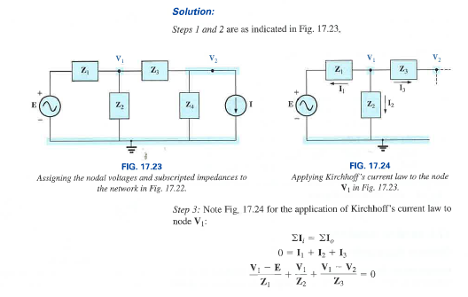



Slide 24
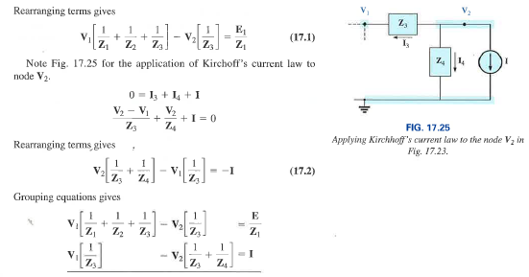



Solution continued

Slide 25
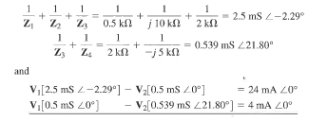







Solution continued

Slide 26
16.5 – Applications
GFCI (Ground Fault Circuit Interrupter)
GFCI outlets are to be used in areas where water and dampness could result in serious injury, such as bathrooms, kitchens, pools, outdoor receptacles.
A protection circuit separates the power source from the outlet.
The protection circuit must be connected to the central ground.
Notes:
12

Slide 27
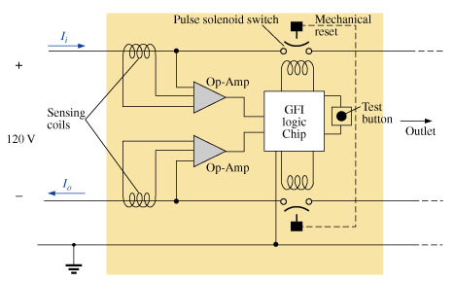
Applications
The network senses both current entering ( I_{i} ) and current leaving ( I_{o}), and provides a direct connection to the outlet when they are equal.
If a fault develops, the protection circuit will sense the difference, between feed and return currents, and cut off power to the outlet.
Notes:
13

Slide 28
Applications
The test button will place a large-value resistor between the line and ground to “unbalance” the line and cause a fault condition.
When the test button is released, it will remove the resistor from the line, removing the fault condition.
The reset button is used to reconnect the outlet to the supply after a fault (from an external device or the “test button”) has been removed .
Notes:
14

