Slide 1
Automatic Cell Counting
Team members:
Jorge Tapias Gomez: Product Owner
Sriram Ramesh: Developer
Aaron Swoiskin: Developer
Dhruv Tummala: Final Scrum Master
6/1/21
Notes:
Jorge
Jorge: 1-7
Sri: 8-11
Ishki: 12-15
Dhruv: 16-19

Slide 2
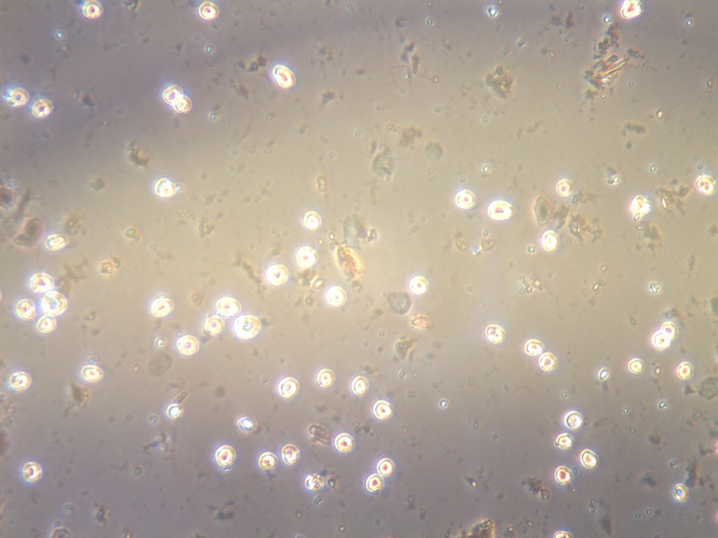
The problem:
Lab researchers have to spend many hours of their time manually counting cells in samples that they obtain. This takes away time from their more important research and employers must pay for the time that they spend counting. This task is also heavily error-prone.
Notes:
Eye cancer Lab researchers (but really all scientist that need any sort of cell counting) have to spend many hours of their time manually counting cells in samples that they obtain. This takes away time from their more important research and employers must pay for the time that they spend counting. This task is also heavily error-prone.
Motivation:
Learn about machine learning
Fun project that had an actual real world application

Slide 3


Goals we planned to achieve
Be able to count cells correctly (ignore dirt specks)
Be able to identify dead cells
Be able to only count cells in a certain area
Have a simple interface that the user can interact with
Notes:
Sriram

Slide 4

Challenges
Lack of experience
Researching models
Failure of 3rd party code
Trial and error
Outdated code
Underestimating completion time
Outside commitments
Notes:
Sriram

Slide 5
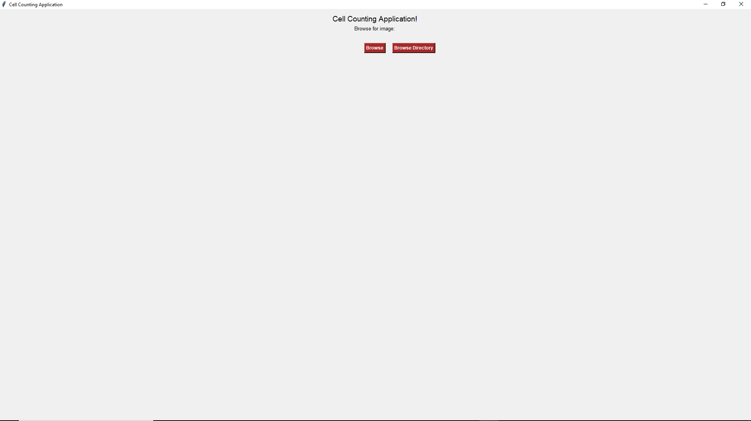
Demo/Screenshots
TEMP easy to do
Notes:
Sriram

Slide 6
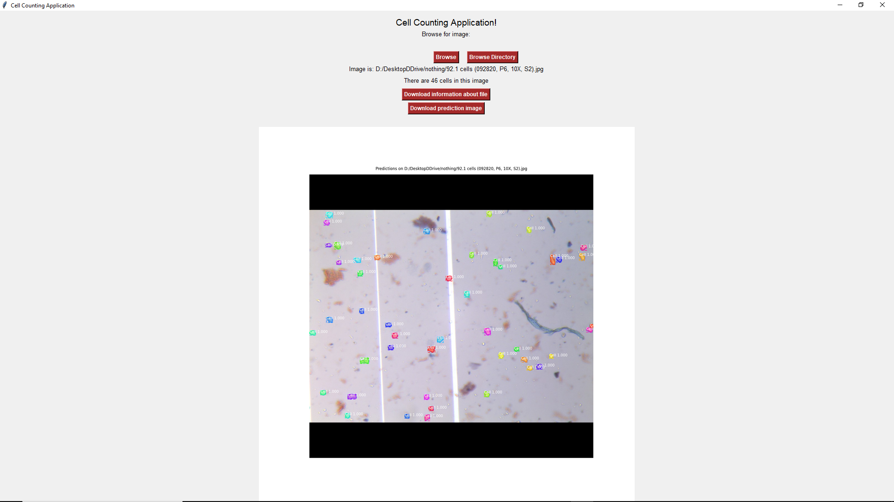
Demo/Screenshots
TEMP easy to do
Notes:
Sriram

Slide 7
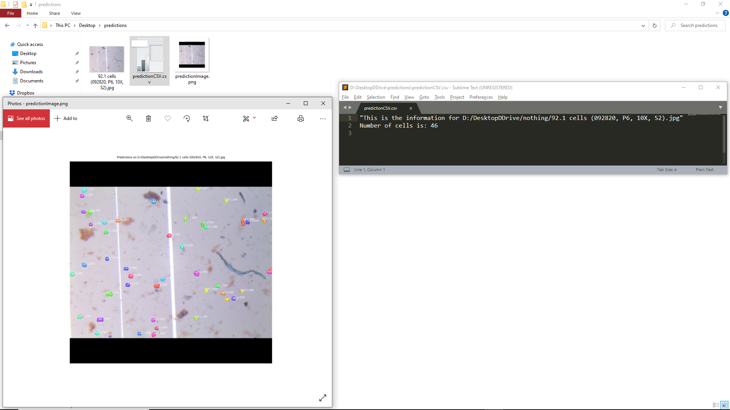
Demo/Screenshots
TEMP easy to do
Notes:
Sriram

Slide 8
Architecture (while running)
1
UI
Takes images from
Start here
User File system
Download Results
5
2
Outputs
count and
other results
Supplies Images
4
Model weights
Predictor
3
Reads in parameters from
Notes:
Green is ours, brown is users’, and purple is external code.
Beveled square is component code,
Folded corner is a static file,
Bunch of layered squares is a file system

Slide 9
Technologies (while running)
Tkinter
Start here
OS
.h5
Mask RCNN
(Built on Keras)
Notes:
Green is ours, brown is users’, and purple is external code.
Beveled square is component code,
Folded corner is a static file,
Bunch of layered squares is a file system

Slide 10
Architecture (while training)
Dataset
Evaluates
Training Notebook
Modifies the files in
Outputs
Markup Converter
Model weights
Notes:
Green is ours, brown is users’, and purple is external code.
Beveled square is component code,
Folded corner is a static file,
Bunch of layered squares is a file system

Slide 11
Technologies (while training)
LabelMe,
JSON
Google
Collab
Custom .py script
.h5
Notes:
Green is ours, brown is users’, and purple is external code.
Beveled square is component code,
Folded corner is a static file,
Bunch of layered squares is a file system

Slide 12
Project Management
Meeting only 3 times a week was not enough so we met very often to discuss about the state of our respective tasks.
Tools:
Trello
Github
Google Drive
Discord
Notes:
Aaron

Slide 13
Accomplishments
MVP
Learned about various ML models
Learned a lot about how to assess whether a model is viable during selection
Very effective communication
Everyone was very good about attending the regular meetings despite uncontrollable outside factors
Notes:
Sriram

Slide 14
Fun
Working as a group and collaboratively problem solving
The project was really fun and we learned a lot about the models even in failure
When all the debugging paid off
Except DO-UNET, that one crushed our hopes and dreams
Redesigning our code base to follow the 5 principles
Notes:
Aaron

Slide 15
Not Fun
DO-UNET
Managing outdated requirements (wrong keras/tensorflow versions, etc.)
Many contributions and many work hours didn’t end up in the final product
Using Google collab to train
Notes:
Aaron

Slide 16
Lessons Learned: What went well
Ask for help from each other earlier rather than later.
We communicated concerns we had as they came up and addressed them as soon as we could.
Having regular meetings kept us all updated on progress and let us know what we needed to work on next.
Notes:
Aaron

Slide 17
Lessons Learned: What didn’t go well
If you don’t see issues raised in a Github’s history, it means no one is using the repo. It does not mean that it’s just high quality code.
Turns out machine learning progresses really fast, and so things get outdated extremely fast. A 2 year old package is old.
Creating users stories following the agile guidelines for this project was really tough and painful.
The scrum board did not work very well as we tended to forget about it specially in sprint 2 and 3 where we were stuck on the same tasks.
The perfect is the enemy of the good.
Notes:
Aaron

Slide 18
Lessons Learned: What we wish we did
Doing less stuff through Jupyter notebooks. It makes synchronising and collaborating difficult.
We could have trained in chunks rather than doing the whole thing at once.
Dedicate a part of your notebook to be a setup script.
Don’t work on code that depends on the result of a research spike.
Notes:
Aaron

Slide 19
Thank You
Any questions?

