Slide 1
Values, names and types
What kind of thing is each part of a sale?
Python for Data Analysis | Session 2 of 24 | Week 1, Meet the data
Holiday Data and AI Camp | The National ICT Innovation Hub, Nakawa
Notes:
Good to see you. Today is session 2 and our topic is values, names and types.
By the end of today you will be able to store numbers and text under names, and say what type each one is.
We will answer one question: What kind of thing is each part of a sale?

Slide 2
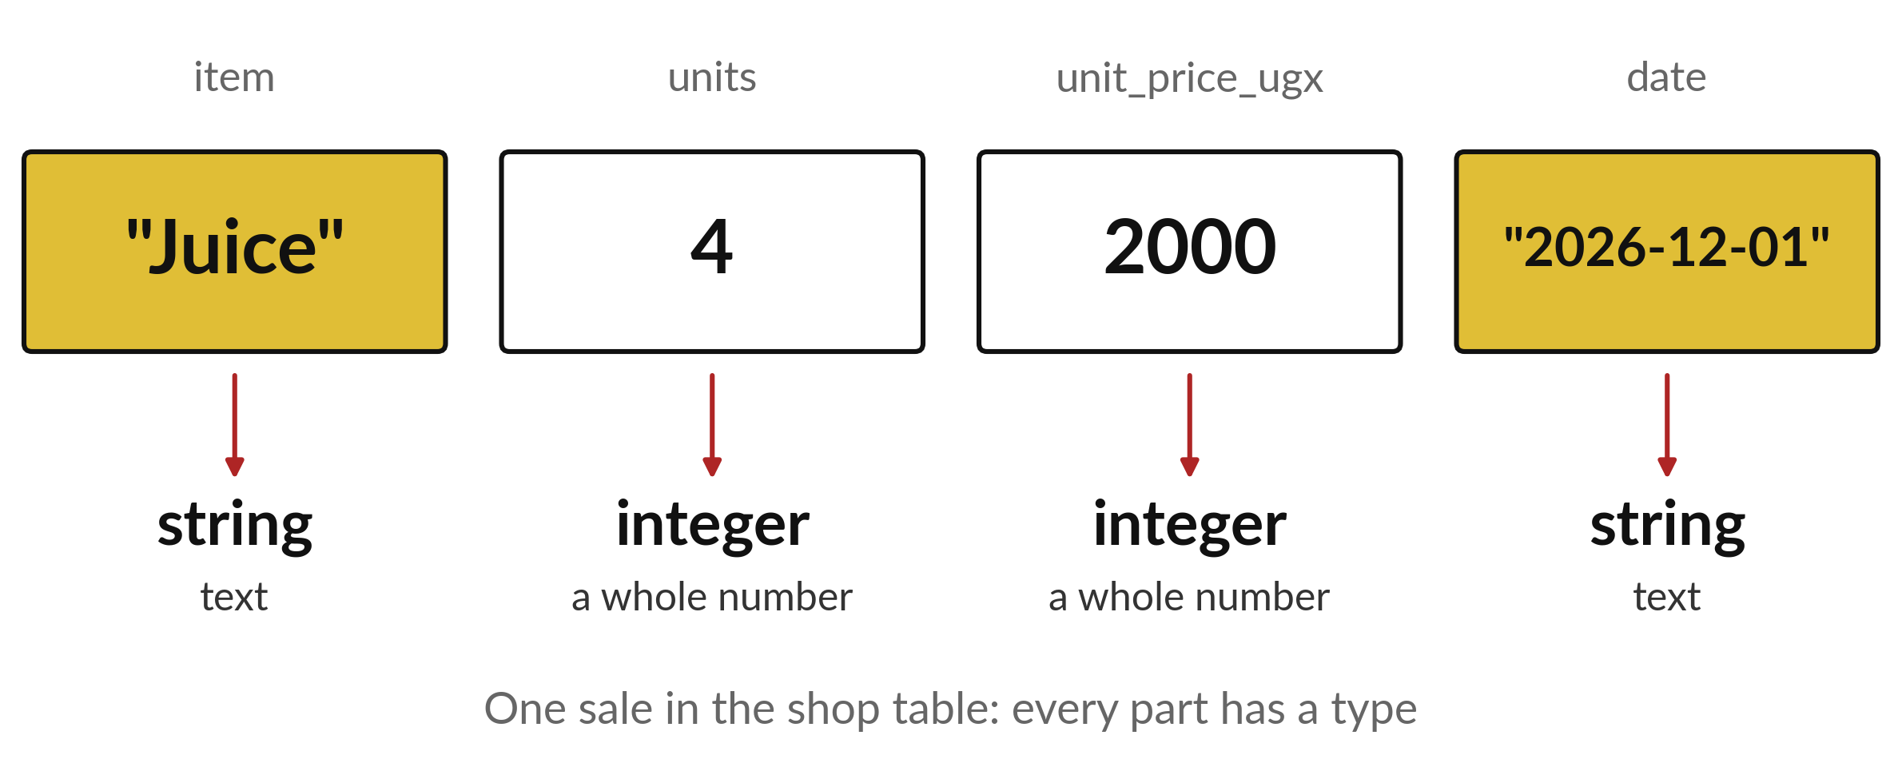
What kind of thing is each part of a sale?
Notes:
Here is one sale from the shop table: a bottle of juice, four units, two thousand shillings each, sold on the first of December. Each part is a different kind of thing. The name Juice and the date are text. The number four is a count and two thousand is an amount of money. Python needs to know which kind it is dealing with, because each kind behaves in its own way. That is what we are sorting out today.

Slide 3

Three hours, mostly doing
Most of our time is spent doing, in small steps, with a guess before every run.
Notes:
Here is how the 3 hours go. Each bar is as long as the time we spend on that part.
First, 10 minutes. Recall. Then, 50 minutes. Block A. After that, 15 minutes. Break away from screens. Next, 50 minutes. Block B. Then, 40 minutes. Make. Then, 15 minutes. Exit ticket, save, and an individual check with each learner.
Notice how much of the time is yours. You listen for a short while and then you do. That is on purpose, because you learn this by doing it.

Slide 4


Words for today (1 of 2)
value
One piece of information, such as 2000 or Juice.
One entry on a receipt.
integer
A whole number with no decimal part.
Counting 3 books.
float
A number with a decimal part.
A price of 2500.5 shillings.
Notes:
We need a few words today. For each one I will say what it means and give you something to picture.
value. One piece of information, such as 2000 or Juice. An example from everyday life. One entry on a receipt.
integer. A whole number with no decimal part. Here is a way to see it. Counting 3 books.
float. A number with a decimal part. A small example. A price of 2500.5 shillings.

Slide 5
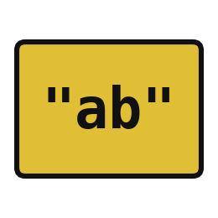


Words for today (2 of 2)
string
Text inside quotation marks.
A name written on a label.
variable
A name that points to a value.
A label on a box of stock.
type
The kind of value: integer, float or string.
Knowing whether a box holds pens or juice.
Notes:
More words for today.
string. Text inside quotation marks. Picture this. A name written on a label.
variable. A name that points to a value. You have seen this before. A label on a box of stock.
type. The kind of value: integer, float or string. Knowing whether a box holds pens or juice.

Slide 6
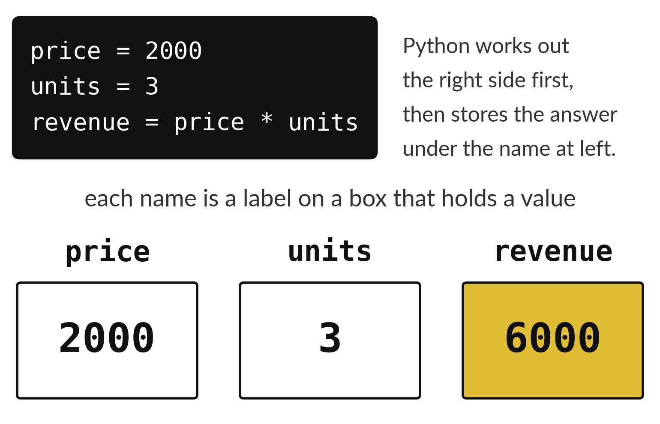
A variable is a labelled box that holds a value
The name goes on the label.
The value sits inside the box.
The equals sign stores it there.
Notes:
Think of the stock boxes in a shop storeroom. Each box has a label, and inside is what you counted. A variable works the same way. The label is the name, such as price. The thing inside is the value, such as two thousand. The equals sign is the instruction that puts a value into a labelled box.
Look at the third line. Python works out the right side first, price times units, and then stores the answer in a new box called revenue. What will be inside that box?

Slide 7
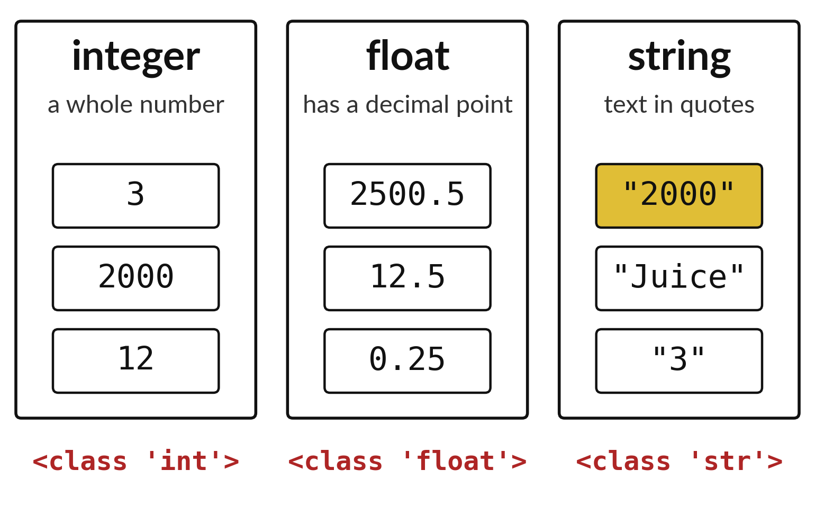
A value's type decides what you can do with it
A whole number is an integer.
A number with a decimal point is a float.
Text in quotation marks is a string.
Notes:
Python sorts every value into a type. A whole number with no decimal point is an integer. A number with a decimal point, like twenty five hundred and a half, is a float. Anything written between quotation marks is a string, which means text. Look at the three bins and notice that the string bin has the number three in it, but with quotation marks around it.
If we ask Python for the type, it tells us which bin a value belongs to. Try it on your own laptop in a minute.

Slide 8
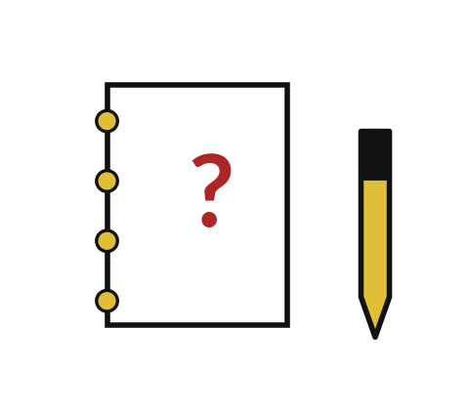
Predict: Names point to values
price = 2000
units = 3
revenue = price * units
print(revenue)
print(type(price))
print(type("2000"))
Predict the three lines the cell will print.
Write your guess on paper before we run it.
Notes:
A shop sells 3 Juice bottles at 2000 shillings each. The equals sign stores a value under a name.
This is the part where you decide. Predict the three lines the cell will print. Guess on paper first. Surprises are useful.

Slide 9
Run it: Names point to values
6000
<class 'int'>
<class 'str'>
The cell prints 6000, then <class 'int'>, then <class 'str'>.
price and units are variables.
2000 is an integer.
The quoted "2000" is a string, which is text.
The equals sign stores the value on its right under the name on its left.
Notes:
Let us see what happens. Match each line of the output with the line of code that made it.
The cell prints 6000, then <class 'int'>, then <class 'str'>. price and units are variables. 2000 is an integer. The quoted "2000" is a string, which is text. The equals sign stores the value on its right under the name on its left.
Which line of the output matches which line of the code? Point to each pair.

Slide 10
Investigate: Names point to values
1. Why is type("2000") a string?
2. What does the equals sign do in revenue = price * units?
price = 2000
units = 3
revenue = price * units
print(revenue)
print(type(price))
print(type("2000"))
Notes:
Now we look closely at names point to values. I have two questions for you.
Question one. Why is type("2000") a string? Say it quietly to yourself before anyone answers.
What I would say is this. Quotation marks make it text. Python cannot multiply it like an amount of money.
Question two. What does the equals sign do in revenue = price * units? Give it thirty seconds and then we will hear a few answers.
Let me answer it. It works out the right side first and then stores the answer under the name revenue.

Slide 11
Modify: change one thing
Change units to 5 and run the whole cell again.
Then tell your neighbour what changed and how you know.
price = 2000
units = 3
revenue = price * units
print(revenue)
print(type(price))
print(type("2000"))
Notes:
Change one thing and watch what happens. Change units to 5 and run the whole cell again. When you have run it, tell your neighbour what changed and how you know.
Here is what happens. revenue becomes 10000.

Slide 12

Break
15 minutes away from your screen
Stand up. Drink some water. Tell someone what you guessed in the first half.
Notes:
Break time. 15 minutes away from your screens. Stand up, drink some water and tell someone what you guessed in the first half.
When we come back we start the second idea.

Slide 13
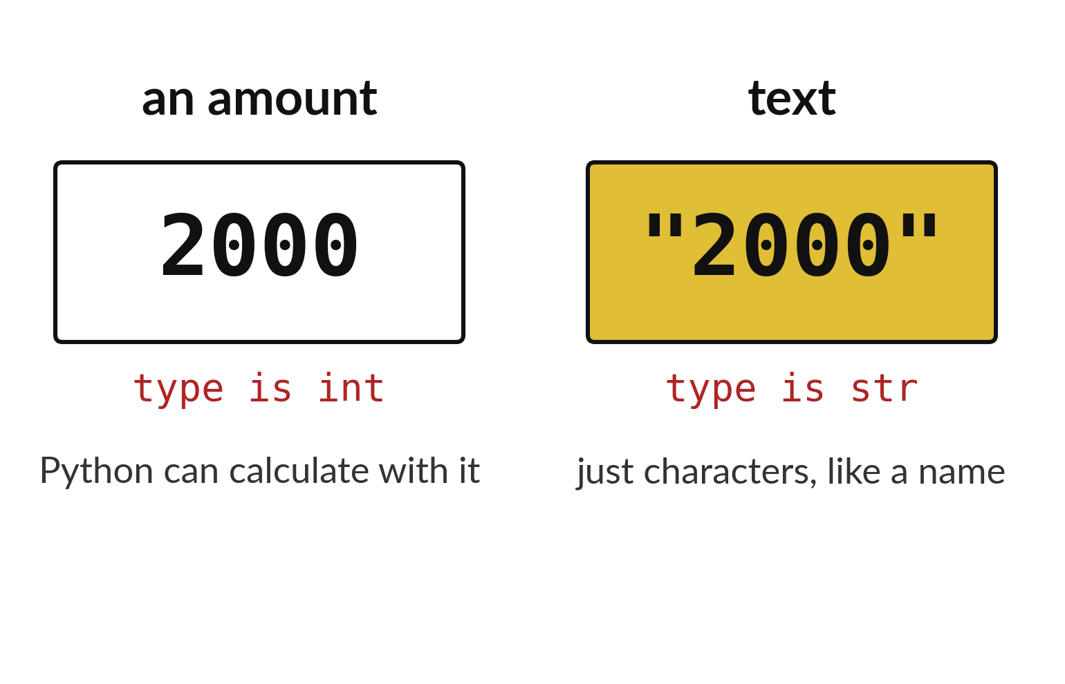
Quotation marks turn an amount into text
2000 is an amount Python can calculate with.
"2000" is only characters, like a name.
The type tells you which one you have.
Notes:
These two look almost the same, but Python treats them very differently. Two thousand without quotation marks is an amount. You can multiply it, add it and compare it. Two thousand with quotation marks is just four characters in a row, the way a name is a few letters in a row.
Why does this matter in a shop table? Because data often arrives as text, and a price that is text cannot be added up until we change it. We fix that next.

Slide 14
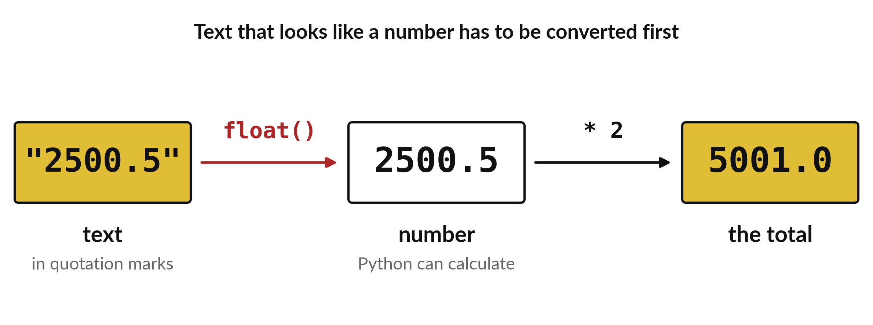
float() turns number-like text into a number
Convert first, then calculate.
Notes:
Here the price arrived as text, with quotation marks. Python cannot multiply text. The word float, followed by brackets, converts it into a real number with a decimal point. After that we can multiply by two and get five thousand and one.
Follow the arrows from left to right. Where do the quotation marks disappear?

Slide 15
Predict: Decimals and converting text
price = 2500.5
text_price = "2500.5"
print(type(price))
print(type(text_price))
print(price * 2)
print(float(text_price) * 2)
Predict what each of the first three prints shows, and whether the last line will work.
Write your guess on paper before we run it.
Notes:
Prices can have decimals. Text that looks like a number has to be converted before Python can calculate with it.
Make a prediction. Predict what each of the first three prints shows, and whether the last line will work. Write it on paper. It does not have to be right.

Slide 16
Run it: Decimals and converting text
<class 'float'>
<class 'str'>
5001.0
5001.0
The cell prints <class 'float'>, <class 'str'>, 5001.0 and 5001.0.
The quoted price is text.
float() turns it into a number that can be multiplied.
Notes:
Running it now. Match each line of the output with the line of code that made it.
The cell prints <class 'float'>, <class 'str'>, 5001.0 and 5001.0. The quoted price is text. float() turns it into a number that can be multiplied.
Keep your guess. We use it in the next step.

Slide 17

Investigate: Decimals and converting text
1. Why does the answer 5001.0 keep a decimal point even though 2 is a whole number?
2. What would happen with float("two")?
Notes:
Now we look closely at decimals and converting text. I have two questions for you.
Question one. Why does the answer 5001.0 keep a decimal point even though 2 is a whole number? Give it thirty seconds and then we will hear a few answers.
Let me answer it. Multiplying a float by 2 gives a float. Python keeps the decimal point.
Question two. What would happen with float("two")? Talk it over with your neighbour for a minute.
The answer is this. An error. Only text that looks like a number can be converted.

Slide 18
Modify: change one thing
Convert the text "2500.5" to a number with float() and multiply it by 4.
Then tell your neighbour what changed and how you know.
price = 2500.5
text_price = "2500.5"
print(type(price))
print(type(text_price))
print(price * 2)
print(float(text_price) * 2)
Notes:
Make one small change. Convert the text "2500.5" to a number with float() and multiply it by 4. Run it, then tell someone what you saw.
What you should find: 10002.0.

Slide 19
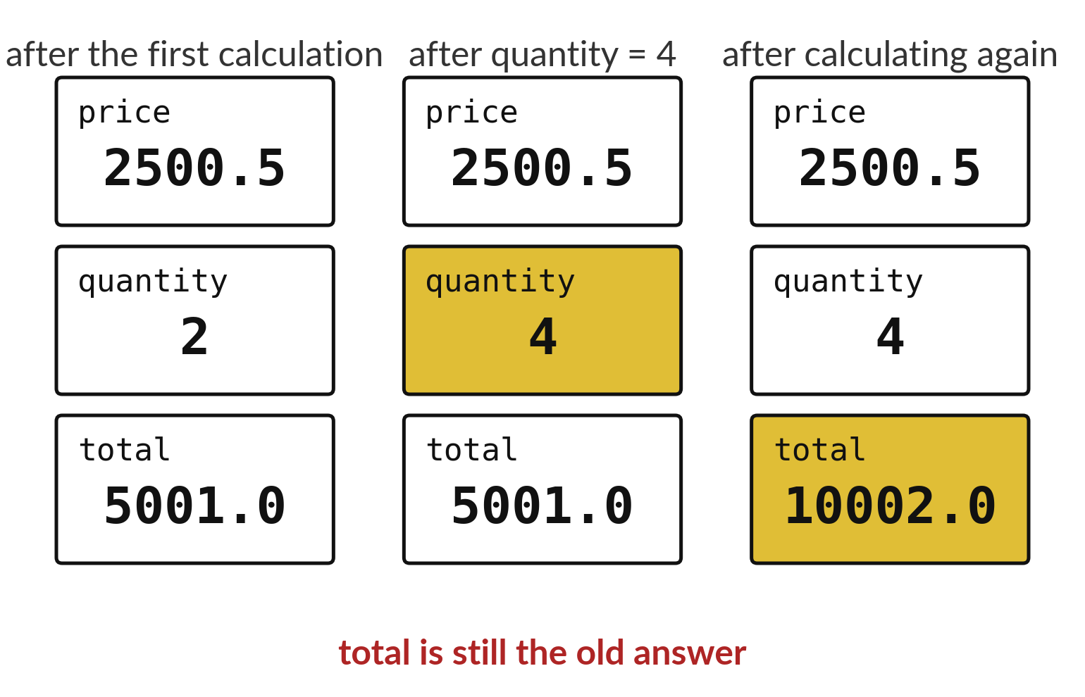
A calculated value waits until you calculate again
Changing quantity does not change total.
The line that calculates total must run again.
Python reads from the top down.
Notes:
This is a trap for almost every beginner. In the first column total is five thousand and one. In the second column we changed quantity to four, but total still says five thousand and one. Python does not update an earlier answer behind your back. Only when we run the line that calculates total again does it become ten thousand and two.
Remember this when your numbers look wrong after an edit. Ask yourself which line you forgot to run again.

Slide 20

Make: your own version
Create a decimal price of 2500.5 and a quantity of 2.
Print the total.
Write one sentence on why "2500.5" with quotation marks behaves differently.
Save it as DA02. Write two sentences: what you changed and how you checked it.
Notes:
This is your own task for today. Take it one step at a time. If you get stuck for a few minutes, read your error message, check the error card, and then ask me.
Save it as DA02. I will come round to each of you and ask what you changed and how you checked it.

Slide 21

Two errors you may meet today
It means: Python has not run a line that creates that name in this session.
Fix: Run the cell that creates the name first, and check the spelling and capital letters.
NameError: name 'price' is not defined
It means: You tried to multiply text by a decimal.
Fix: Convert the text with float() or remove the quotation marks.
TypeError: can't multiply sequence by non-int of type 'float'
Notes:
Everyone meets errors, including me. Two are likely today, so let us meet them now.
This is the first one. You will see: NameError: name 'price' is not defined. It means this: Python has not run a line that creates that name in this session. To fix it, Run the cell that creates the name first, and check the spelling and capital letters.
The next one. You will see: TypeError: can't multiply sequence by non-int of type 'float'. It means this: you tried to multiply text by a decimal. To fix it, convert the text with float() or remove the quotation marks.
Keep this slide in mind when something stops working.

Slide 22

Finish this sentence in your notebook
A variable is a name that points to a value, and the value stays until I store a new one.
Then save your notebook, close it and open it again to check it saved.
Notes:
We are nearly done. Remember the question from the start of the session: What kind of thing is each part of a sale?
Write this sentence in your notebook and finish it your own way. A variable is a name that points to a value, and the value stays until I store a new one.
Then save your notebook, close it and open it again to check it saved.

