Slide 1
Arithmetic, revenue
and reading errors
How much money did the first three sales bring in?
Python for Data Analysis | Session 3 of 24 | Week 1, Meet the data
Holiday Data and AI Camp | The National ICT Innovation Hub, Nakawa
Notes:
Laptops open, please. Today is session 3 and our topic is arithmetic, revenue and reading errors.
By the end of today you will be able to calculate revenue for a sale, check it by hand, and read an error message to find the line to fix.
We will answer one question: How much money did the first three sales bring in?

Slide 2
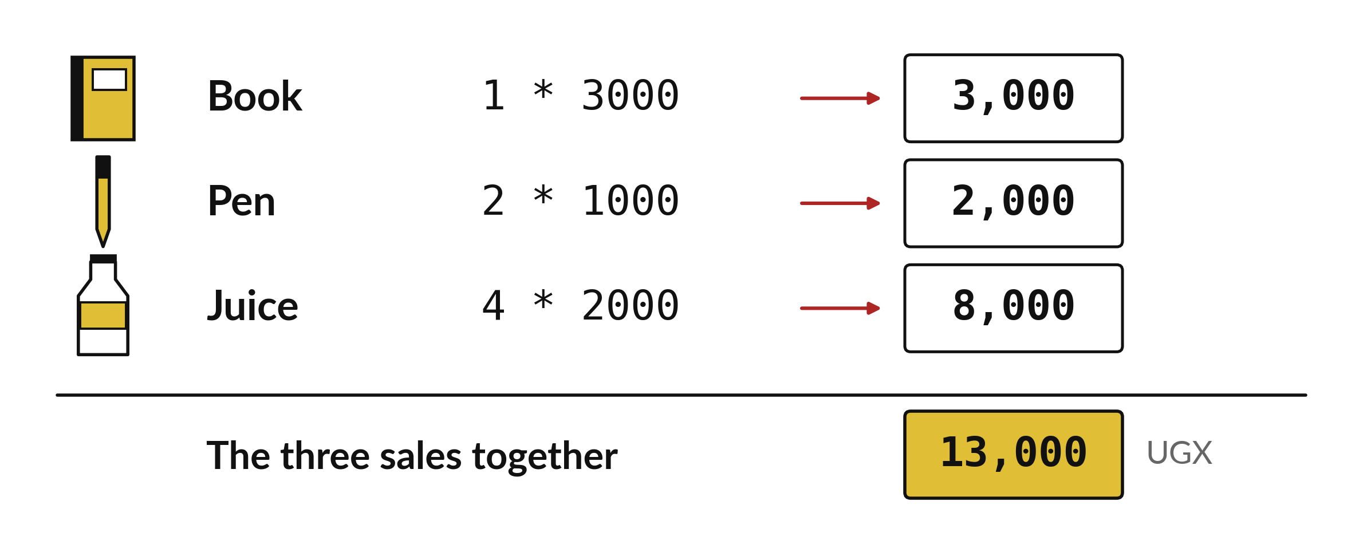
How much money did the
first three sales bring in?
Notes:
Here are the first three sales in the shop table. A book, a pen and a bottle of juice. Revenue for each sale is the number of units times the price of one unit. You can work these out on paper in under a minute. Today we teach Python to do the same sums, and then we check that its answers agree with our paper answers.

Slide 3

Three hours, mostly doing
Most of our time is spent doing, in small steps, with a guess before every run.
Notes:
Here is how the 3 hours go. Each bar is as long as the time we spend on that part.
First, 10 minutes. Recall. Then, 50 minutes. Block A. After that, 15 minutes. Break away from screens. Next, 50 minutes. Block B. Then, 40 minutes. Make. Then, 15 minutes. Exit ticket, save, and an individual check with each learner.
Notice how much of the time is yours. You listen for a short while and then you do. That is on purpose, because you learn this by doing it.

Slide 4
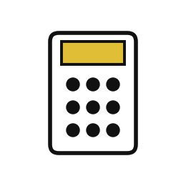

Words for today (1 of 2)
operator
A symbol that calculates: + - * / and **.
The buttons on a calculator.
expression
A calculation Python can work out, such as 3 * 2000.
One line of working in a maths exercise.
order of operations
Brackets first, then powers, then multiply and divide, then add and subtract.
The rule that makes 2 + 3 * 4 equal 14.
Notes:
Here are the words for today. Listen for the picture that goes with each one.
operator. A symbol that calculates: + - * / and **. Picture this. The buttons on a calculator.
expression. A calculation Python can work out, such as 3 * 2000. You have seen this before. One line of working in a maths exercise.
order of operations. Brackets first, then powers, then multiply and divide, then add and subtract. The rule that makes 2 + 3 * 4 equal 14.

Slide 5

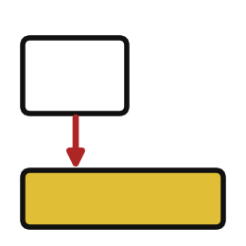

Words for today (2 of 2)
comment
A note for people that starts with # and is ignored by Python.
A pencil note in the margin.
error message
Python explaining why it stopped. Read the last line first.
A teacher's comment on what went wrong.
line number
The place in the cell where Python found the problem.
The page and line in a book.
Notes:
Two more words to know before we start.
comment. A note for people that starts with # and is ignored by Python. Think of a shop. A pencil note in the margin.
error message. Python explaining why it stopped. Read the last line first. Imagine it like this. A teacher's comment on what went wrong.
line number. The place in the cell where Python found the problem. An example from everyday life. The page and line in a book.

Slide 6
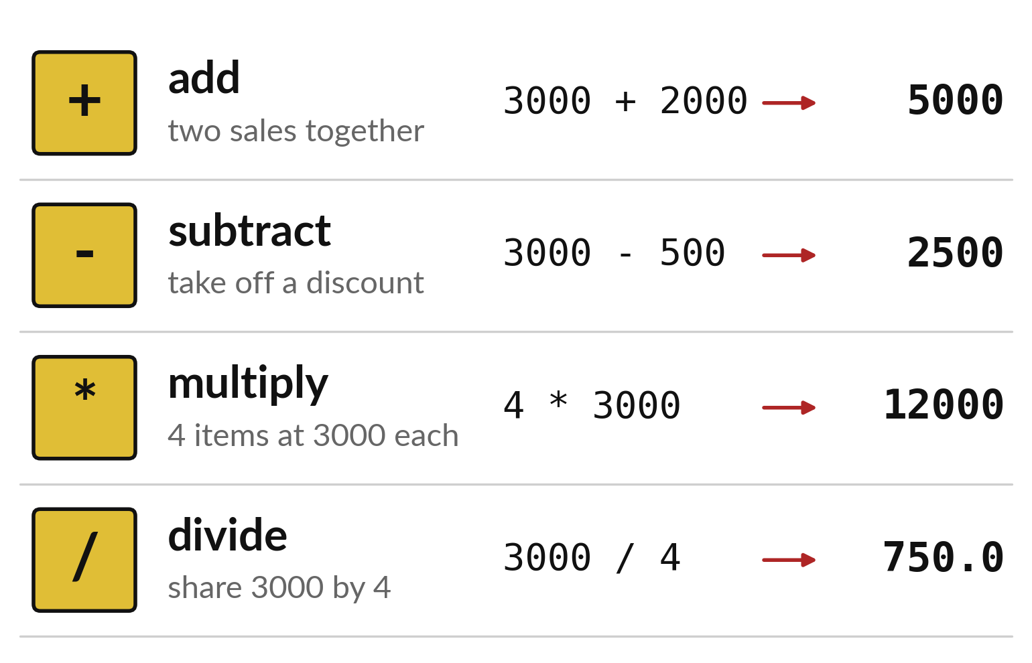
Four symbols do the arithmetic
Plus adds and minus subtracts.
The star multiplies.
The slash divides.
Notes:
Python uses the same four sums you know from school, but two of the symbols look different. Plus and minus are the same. Multiplication is written with a star, because a cross would be confused with the letter x. Division is written with a slash.
Look at the last column. Every answer is worked out by Python the moment the cell runs. Which answer has a decimal point, and why do you think it does?

Slide 7
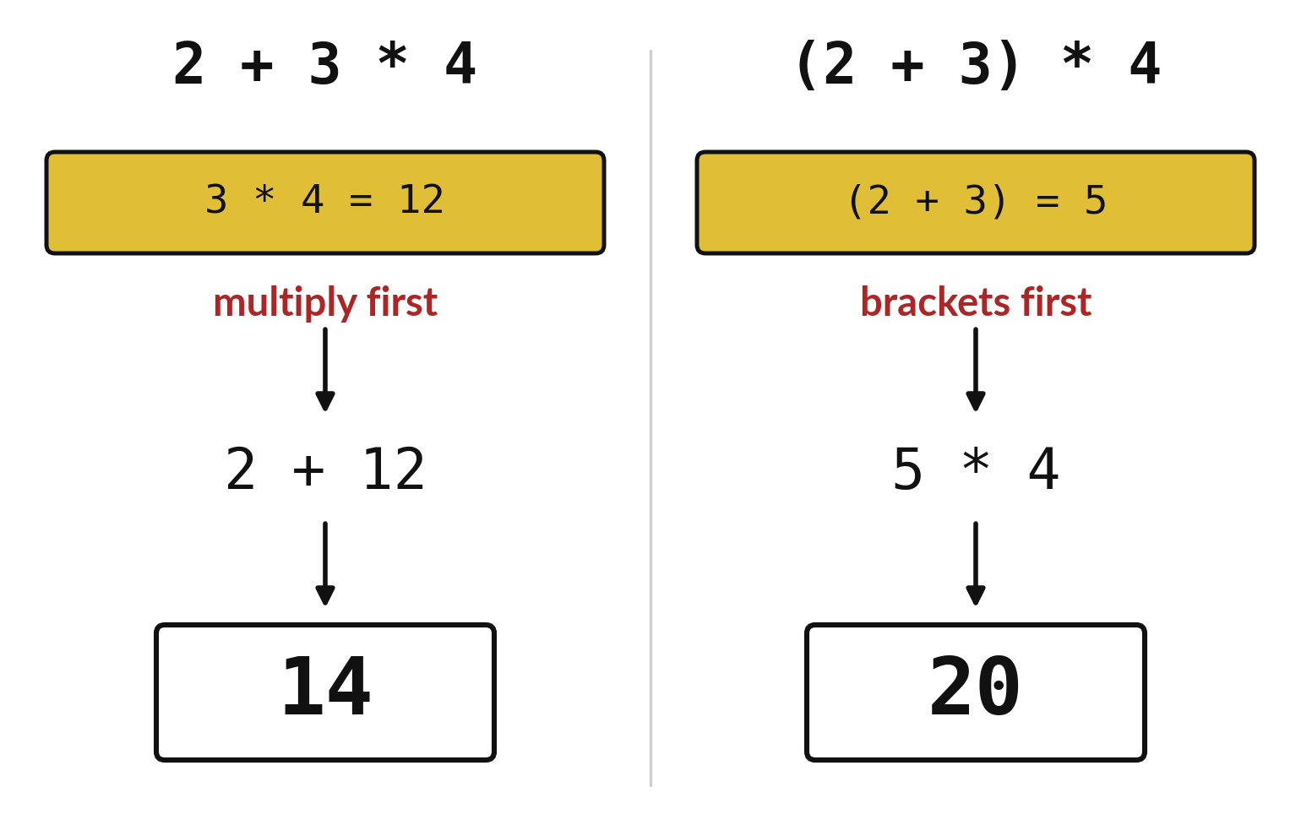
Multiplication goes before
addition, brackets go first
Python multiplies and divides first.
Brackets always go first.
Check by hand before you trust a long sum.
Notes:
The same numbers can give two different answers. On the left there are no brackets, so Python multiplies three times four first and then adds two. The answer is fourteen. On the right the brackets force the addition to happen first. Five times four gives twenty.
When you write a long sum in your notebook, use brackets to say exactly what you mean. Then check the answer on paper.

Slide 8

Predict: Revenue by hand and by Python
# revenue = units * price
book = 1 * 3000
pen = 2 * 1000
juice = 4 * 2000
total = book + pen + juice
print(book, pen, juice)
print(total)
print(2 + 3 * 4)
print((2 + 3) * 4)
Predict the three revenues and their total, using paper.
Write your guess on paper before we run it.
Notes:
Revenue is units times unit price. The first three sales in the shop table are 1 Book at 3000, 2 Pens at 1000 and 4 Juice at 2000.
Your turn to guess. Predict the three revenues and their total, using paper. Write it on paper. It does not have to be right.

Slide 9
Run it: Revenue by hand and by Python
3000 2000 8000
13000
14
20
The cell prints 3000 2000 8000, then 13000, then 14 and 20.
Multiplication happens before addition.
Brackets change the order.
Notes:
I will run it, and you compare with your guess. Match each line of the output with the line of code that made it.
The cell prints 3000 2000 8000, then 13000, then 14 and 20. Multiplication happens before addition. Brackets change the order.
Check your paper. Were you close?

Slide 10
Investigate: Revenue by hand and by Python
1. Why does 2 + 3 * 4 give 14 and not 20?
2. Why do we say revenue and not profit?
# revenue = units * price
book = 1 * 3000
pen = 2 * 1000
juice = 4 * 2000
total = book + pen + juice
print(book, pen, juice)
print(total)
print(2 + 3 * 4)
print((2 + 3) * 4)
Notes:
Now we look closely at revenue by hand and by Python. I have two questions for you.
Question one. Why does 2 + 3 * 4 give 14 and not 20? Give it thirty seconds and then we will hear a few answers.
Python multiplies first, so it works out 3 * 4 = 12 and then adds 2. Brackets are needed to add first.
Question two. Why do we say revenue and not profit? Talk it over with your neighbour for a minute.
Here is how I would answer it. Revenue is the money received. Profit would need the cost of the stock, which the table does not have.

Slide 11
Modify: change one thing
Change the Pen to 5 units and find the new total.
Then tell your neighbour what changed and how you know.
# revenue = units * price
book = 1 * 3000
pen = 2 * 1000
juice = 4 * 2000
total = book + pen + juice
print(book, pen, juice)
print(total)
print(2 + 3 * 4)
print((2 + 3) * 4)
Notes:
Time to experiment. Change the Pen to 5 units and find the new total. Then explain to your neighbour what the change did.
The result: 16000.

Slide 12

Break
15 minutes away from your screen
Stand up. Drink some water. Tell someone what you guessed in the first half.
Notes:
Break time. 15 minutes away from your screens. Stand up, drink some water and tell someone what you guessed in the first half.
When we come back we start the second idea.

Slide 13
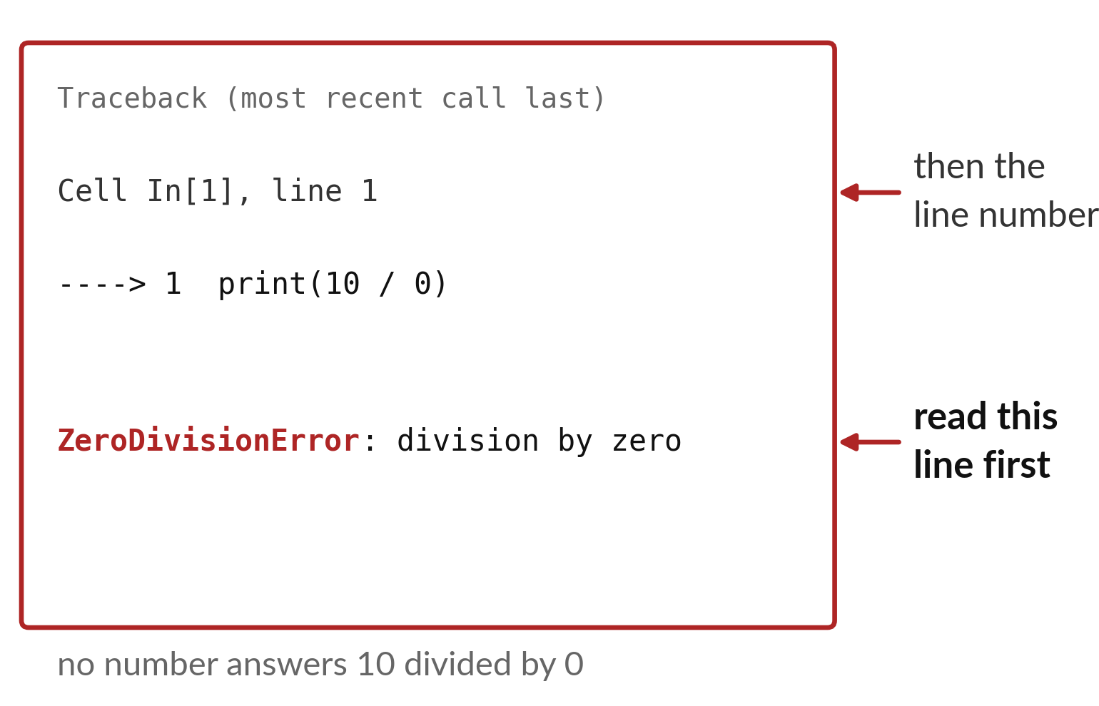
The last line of an error
message names the problem
Read the last line first.
It names the error and says what happened.
The line number tells you where to look.
Notes:
Errors are not a sign that you are bad at this. They are Python telling you what it could not do. An error message has a clear shape. At the top is a long heading that you can ignore for now. Near the middle is the line number and the instruction that failed. At the bottom is the part that matters most, the name of the error and a few words about what went wrong.
Always read the bottom line first. What is the name of the error in this picture?

Slide 14
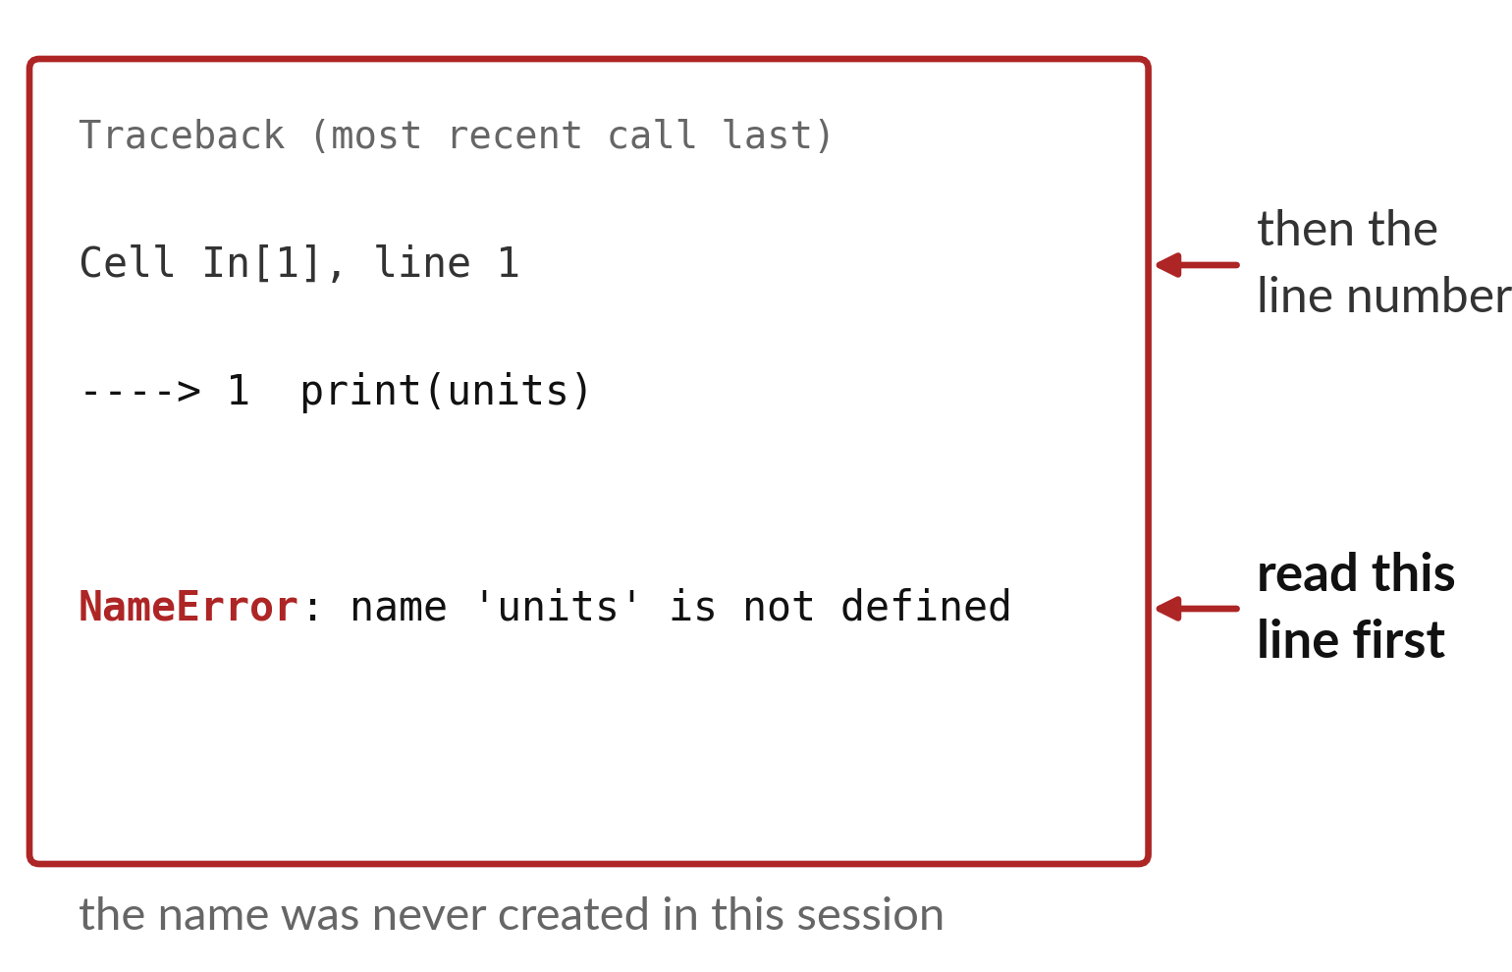
A NameError means Python
has never met that name
The name was spelled differently, or never created.
Run the cell that creates it first.
Check capital letters and spelling.
Notes:
This is the error you will see most often. NameError says that Python has never been told what units means. Either you never ran the cell that creates it, or you spelled it a little differently, perhaps with a capital letter.
Python is strict about spelling. Units with a capital U is a different name from units. Can you think of two quick things to check when you see this message?

Slide 15
Predict: Reading an error message
print(10 / 0)
print(units)
Predict the name of each error before you run the lines.
Write your guess on paper before we run it.
Notes:
An error is feedback about an instruction. It is not a judgement about you.
Now your guess. Predict the name of each error before you run the lines. Put it on paper first. We will check it together in a moment.

Slide 16

Run it: Reading an error message
The first line stops with ZeroDivisionError: division by zero, because no number answers 10 divided by 0.
The second stops with NameError: name 'units' is not defined, because Python has not met a line that creates units.
Notes:
Watch the output as it appears. Match each line of the output with the line of code that made it.
The first line stops with ZeroDivisionError: division by zero, because no number answers 10 divided by 0. The second stops with NameError: name 'units' is not defined, because Python has not met a line that creates units. In both cases the last line of the message says what went wrong.
Tell the person next to you whether your guess matched.

Slide 17
Investigate: Reading an error message
1. Which line of the message do you read first, and why?
2. How do you fix a NameError?
print(10 / 0)
print(units)
Notes:
Now we look closely at reading an error message. I have two questions for you.
Question one. Which line of the message do you read first, and why? Talk it over with your neighbour for a minute.
Here is how I would answer it. The last one. It names the error and says what happened.
Question two. How do you fix a NameError? Think about it for a moment, then tell the person next to you.
What I would say is this. Run the cell that creates the name, or correct its spelling and capital letters.

Slide 18
Modify: change one thing
Fix the NameError by creating units = 4 first and then printing units * 2000.
Then tell your neighbour what changed and how you know.
print(10 / 0)
print(units)
Notes:
Your hands on the keyboard now. Fix the NameError by creating units = 4 first and then printing units * 2000. When you have run it, tell your neighbour what changed and how you know.
Here is what happens. 8000.

Slide 19
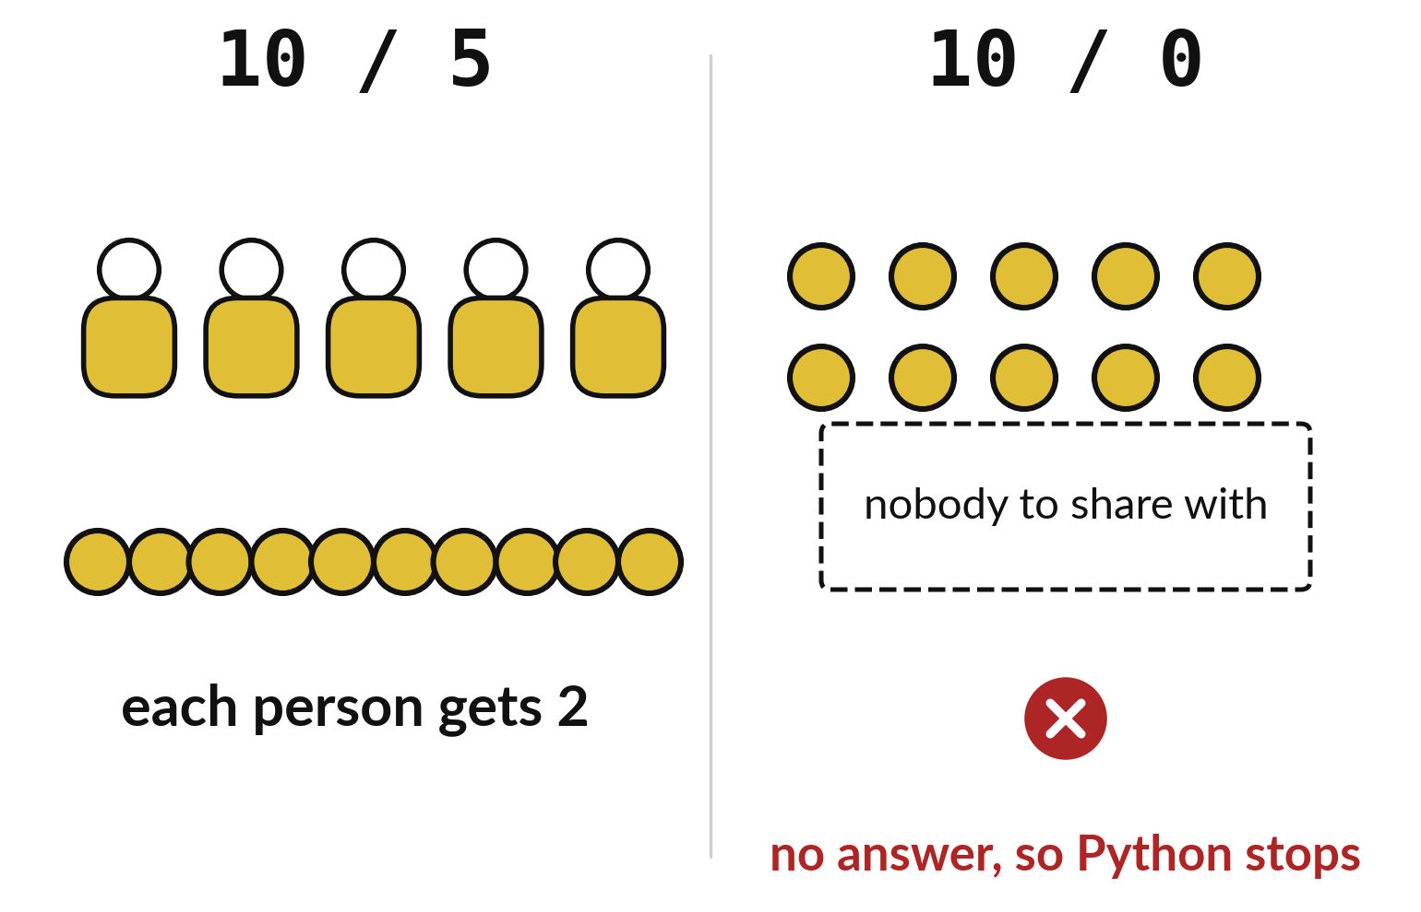
Nothing can be shared among zero people
Ten coins among five people gives two each.
Ten coins among nobody has no answer.
Python stops with a ZeroDivisionError.
Notes:
On the left, ten coins are shared among five people and everyone gets two. On the right, ten coins are shared among nobody. Who gets the coins? There is no answer, so there is nothing for Python to calculate.
That is why Python stops with a ZeroDivisionError instead of guessing. In the practice task you explain this in your own words, so think of your own picture for it.

Slide 20

Make: your own version
Convert the text "12.5" to a number and calculate the price of four items at that price.
Predict the result before you run it.
Write one sentence on why division by zero cannot be answered.
Save it as DA03. Write two sentences: what you changed and how you checked it.
Notes:
Now you do the real work yourself. Start with the first step. If you get stuck for a few minutes, read your error message, check the error card, and then ask me.
Save it as DA03. I will come round to each of you and ask what you changed and how you checked it.

Slide 21

Two errors you may meet today
It means: You divided by zero, which has no answer.
Fix: Check the number you divide by. Change it or guard against zero in a later session.
ZeroDivisionError: division by zero
It means: The name was never created in this session or is spelled differently.
Fix: Run the cell that creates it and compare the spelling letter by letter.
NameError: name 'units' is not defined
Notes:
Two things are likely to go wrong today. It helps to know them before they happen.
This is the first one. You will see: ZeroDivisionError: division by zero. It means this: you divided by zero, which has no answer. To fix it, check the number you divide by. Change it or guard against zero in a later session.
The next one. You will see: NameError: name 'units' is not defined. It means this: the name was never created in this session or is spelled differently. To fix it, Run the cell that creates it and compare the spelling letter by letter.
If you meet one of these, fix it and carry on. It happens to everyone.

Slide 22

Finish this sentence in your notebook
I read the last line of an error first, find its line number, and fix one thing at a time.
Then save your notebook, close it and open it again to check it saved.
Notes:
Before we finish, go back to the question we began with: How much money did the first three sales bring in?
Copy this sentence into your notebook and make it yours. I read the last line of an error first, find its line number, and fix one thing at a time.
Then save your notebook, close it and open it again to check it saved.

