Slide 1
Lists, dictionaries and loops
How many units did the first six sales sell in total?
Python for Data Analysis | Session 5 of 24 | Week 2, Python you need
Holiday Data and AI Camp | The National ICT Innovation Hub, Nakawa
Notes:
Here we go. Today is session 5 and our topic is lists, dictionaries and loops.
By the end of today you will be able to store several values in a list, look one up by position, and use a loop to add them up.
We will answer one question: How many units did the first six sales sell in total?

Slide 2
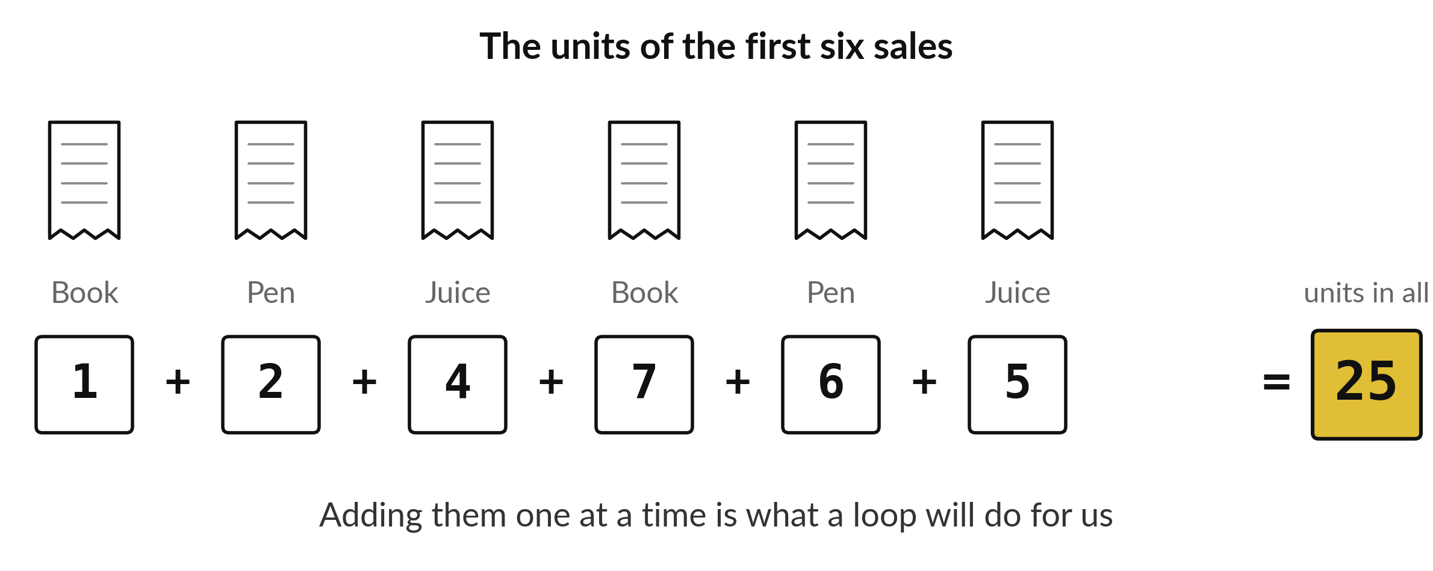
How many units did the first six sales sell in total?
Notes:
Here are the first six sales, each with its number of units. Adding six numbers by hand is easy. But imagine sixty sales, or six thousand. Nobody wants to type a plus sign six thousand times. Today we learn how to store many values together and how to make Python add them up for us.

Slide 3

Three hours, mostly doing
Most of our time is spent doing, in small steps, with a guess before every run.
Notes:
Here is how the 3 hours go. Each bar is as long as the time we spend on that part.
First, 10 minutes. Recall. Then, 50 minutes. Block A. After that, 15 minutes. Break away from screens. Next, 50 minutes. Block B. Then, 40 minutes. Make. Then, 15 minutes. Exit ticket, save, and an individual check with each learner.
Notice how much of the time is yours. You listen for a short while and then you do. That is on purpose, because you learn this by doing it.

Slide 4
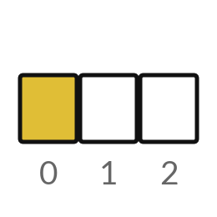
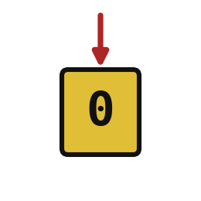

Words for today (1 of 2)
list
Several values in order inside square brackets.
A shopping list.
index
The position of a value in a list. Counting starts at 0.
The numbered seats in a bus, with the driver as seat 0.
dictionary
Named pairs inside braces. A key finds its value.
A price board: the name of the item gives its price.
Notes:
We need a few words today. For each one I will say what it means and give you something to picture.
list. Several values in order inside square brackets. Here is a way to see it. A shopping list.
index. The position of a value in a list. Counting starts at 0. A small example. The numbered seats in a bus, with the driver as seat 0.
dictionary. Named pairs inside braces. A key finds its value. Picture this. A price board: the name of the item gives its price.

Slide 5


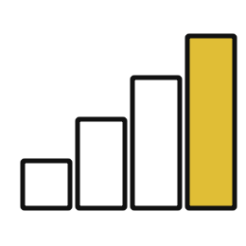
Words for today (2 of 2)
key
The name used to look up a value in a dictionary.
The name on a price board.
loop
Repeat the indented lines once for each value.
Counting stock shelf by shelf.
running total
A number that grows as each value is added.
The cash tin during the day.
Notes:
More words for today.
key. The name used to look up a value in a dictionary. You have seen this before. The name on a price board.
loop. Repeat the indented lines once for each value. Counting stock shelf by shelf.
running total. A number that grows as each value is added. Think of a shop. The cash tin during the day.

Slide 6
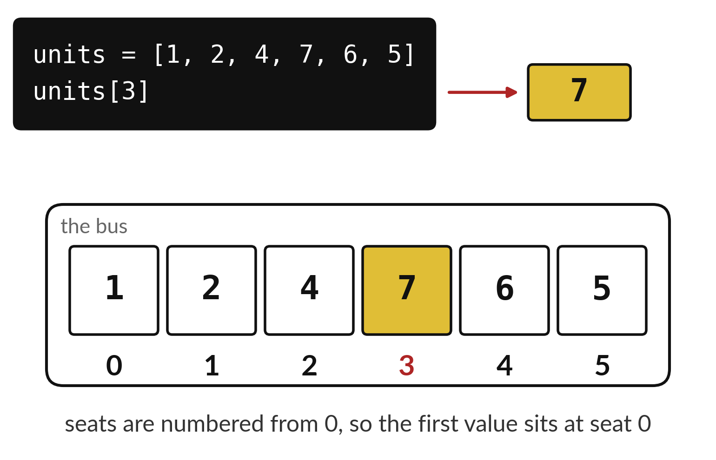
A list numbers its seats from zero
A list keeps values in order.
The first seat is number 0.
Square brackets pick one seat.
Notes:
Imagine a bus where each seat has a number painted on it. A list is like that. The values sit in order, and each seat has a number called an index. The surprise is that counting starts at zero. The first seat is seat zero, the second is seat one, and so on.
In the picture we ask for units with a three in brackets. Which value comes back? Count the seats from zero, and watch out, because most people say four.

Slide 7
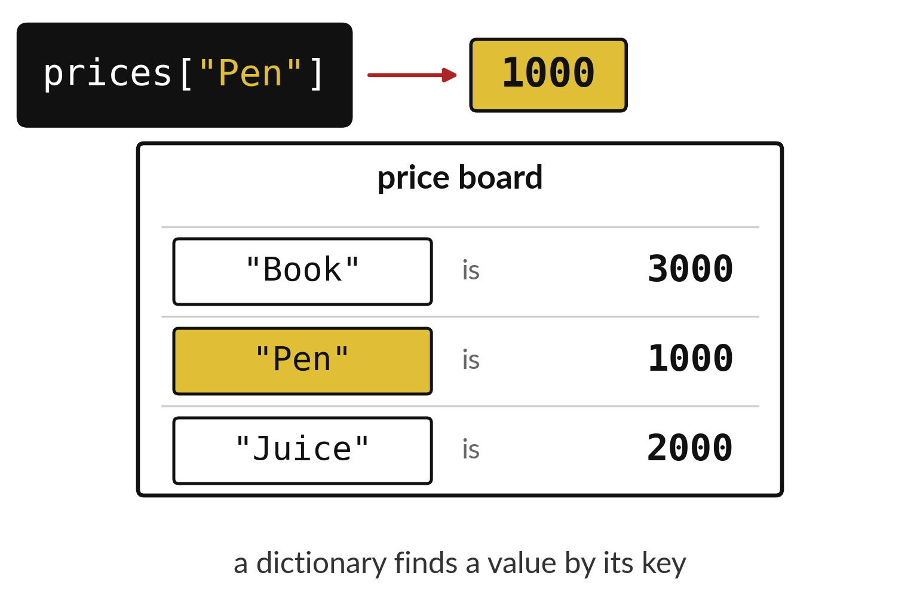
A dictionary finds a value by its key
Each key has a value beside it.
Ask for the key to get its value.
A list uses numbers, a dictionary uses names.
Notes:
A dictionary works like the price board outside a shop. You do not ask for the second row. You ask for Pen, and the board tells you one thousand. The name you ask for is called the key. The answer is the value.
If you write a key that is not on the board, Python stops with a KeyError. Which spelling mistake would cause that?

Slide 8

Predict: Lists and positions
units = [1, 2, 4, 7, 6, 5]
print(units[0])
print(units[3])
print(len(units))
print(max(units))
Predict what each print shows.
Write your guess on paper before we run it.
Notes:
The units of the first six sales in the shop table are 1, 2, 4, 7, 6 and 5. A list keeps them in order inside square brackets.
Now your guess. Predict what each print shows. Put your guess on paper now, even if you are unsure.

Slide 9
Run it: Lists and positions
1
7
6
7
The cell prints 1, 7, 6 and 7.
Position 0 holds the first value and position 3 holds the fourth.
len counts the values and max finds the largest.
Notes:
Watch the output as it appears. Match each line of the output with the line of code that made it.
The cell prints 1, 7, 6 and 7. Position 0 holds the first value and position 3 holds the fourth. len counts the values and max finds the largest.
Tell the person next to you whether your guess matched.

Slide 10
Investigate: Lists and positions
1. Why does units[3] show 7 and not 4?
2. Which position holds the last value?
units = [1, 2, 4, 7, 6, 5]
print(units[0])
print(units[3])
print(len(units))
print(max(units))
Notes:
Now we look closely at lists and positions. I have two questions for you.
Question one. Why does units[3] show 7 and not 4? Think about it for a moment, then tell the person next to you.
Here is how I would answer it. Counting starts at 0, so position 3 is the fourth value.
Question two. Which position holds the last value? Have a go in your head first.
What I would say is this. Position 5, which is len(units) - 1.

Slide 11
Modify: change one thing
Print the value at position 4.
Then tell your neighbour what changed and how you know.
units = [1, 2, 4, 7, 6, 5]
print(units[0])
print(units[3])
print(len(units))
print(max(units))
Notes:
Your hands on the keyboard now. Print the value at position 4. Run it, then tell someone what you saw.
What you should find: 6.

Slide 12

Break
15 minutes away from your screen
Stand up. Drink some water. Tell someone what you guessed in the first half.
Notes:
Break time. 15 minutes away from your screens. Stand up, drink some water and tell someone what you guessed in the first half.
When we come back we start the second idea.

Slide 13
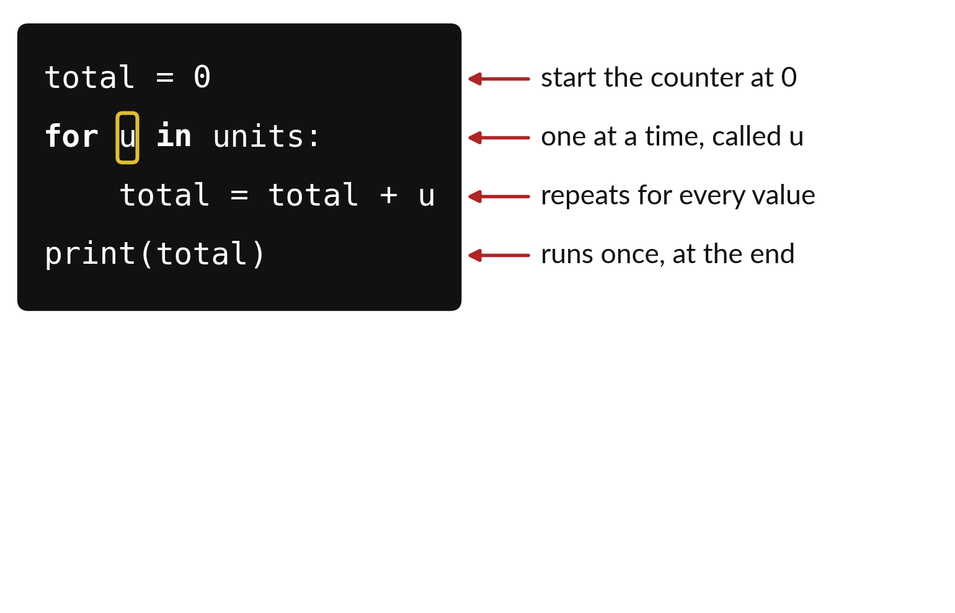
A loop repeats the same lines for every value
u stands for one value at a time.
The indented line repeats for every value.
The last line runs once, after the loop.
Notes:
A loop is a way of saying do this for each one. The first line sets a counter to zero. The second line says take the values one at a time and call the current one u. The indented line below it is the work that repeats. The last line has no indent, so it waits until the loop is finished.
Read the code aloud, in plain English, as if you were telling a friend. Can you do it without looking at the notes on the right?

Slide 14
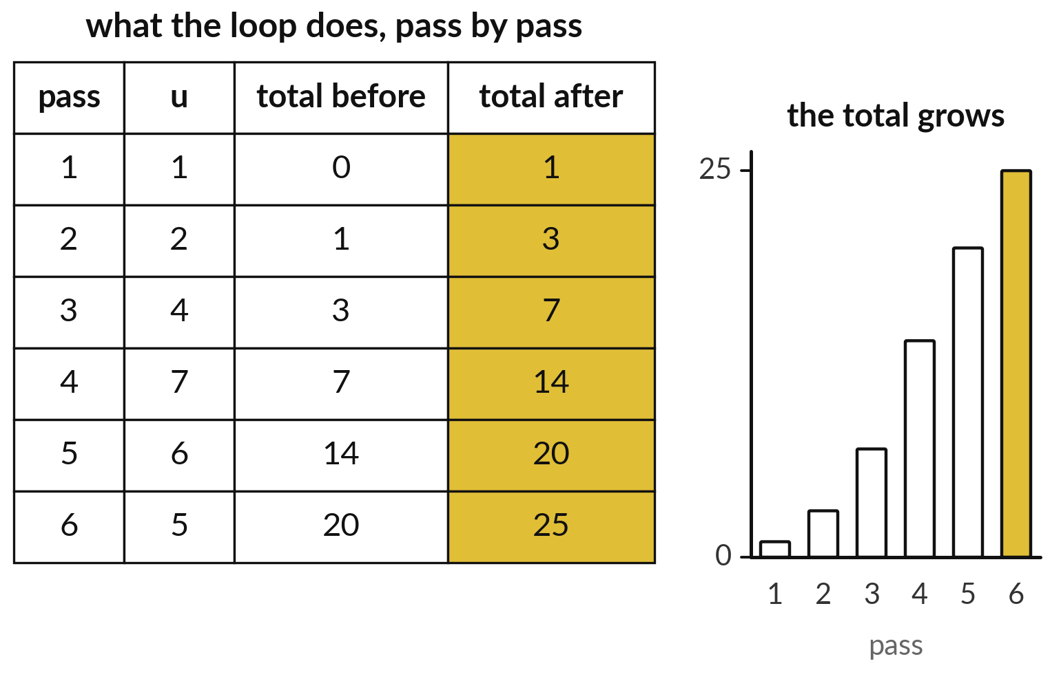
The running total grows one value at a time
Each pass adds the current value.
The total after one pass is the total before the next.
The last total is the answer.
Notes:
Here is what the loop actually does, pass by pass. On pass one the total is zero and we add one. On pass two it is one and we add two. The total after each pass becomes the total before the next. The bars on the right show it growing until it reaches twenty five, the same answer we got by adding the six numbers by hand.
Cover the last column and predict pass five. Then uncover it.

Slide 15

Predict: Dictionaries and
a loop with a running total
units = [1, 2, 4, 7, 6, 5]
prices = {"Book": 3000, "Pen": 1000, "Juice": 2000}
print(prices["Pen"])
total_units = 0
for u in units:
total_units = total_units + u
print(total_units)
Predict the final total and the price of Pen.
Write your guess on paper before we run it.
Notes:
A dictionary stores named pairs. A for loop repeats its indented lines for each value in a list.
This is the part where you decide. Predict the final total and the price of Pen. Write one line on paper. I will give you a minute.

Slide 16
Run it: Dictionaries and a loop with a running total
1000
25
The cell prints 1000 and then 25.
The loop starts the running total at 0 and adds each of the six values in turn: 1, 3, 7, 14, 20, 25.
Notes:
Let us see what happens. Match each line of the output with the line of code that made it.
The cell prints 1000 and then 25. The loop starts the running total at 0 and adds each of the six values in turn: 1, 3, 7, 14, 20, 25.
Which line of the output matches which line of the code? Point to each pair.

Slide 17

Investigate: Dictionaries and
a loop with a running total
1. What does the line total_units = total_units + u do?
2. What would happen if total_units = 0 sat inside the loop?
Notes:
Now we look closely at dictionaries and a loop with a running total. I have two questions for you.
Question one. What does the line total_units = total_units + u do? Have a go in your head first.
What I would say is this. It reads the current total, adds u and stores the answer back under the same name.
Question two. What would happen if total_units = 0 sat inside the loop? Write your answer in one line before we compare.
Let me answer it. The total would restart for each value and end as the last value only, which is 5.

Slide 18

Modify: change one thing
Change the loop to print each value plus 1 and then print the final total.
Then tell your neighbour what changed and how you know.
Notes:
Change one thing and watch what happens. Change the loop to print each value plus 1 and then print the final total. After you run it, say in one sentence what changed and how you checked.
You should see this. The loop prints 2, 3, 5, 8, 7, 6.

Slide 19
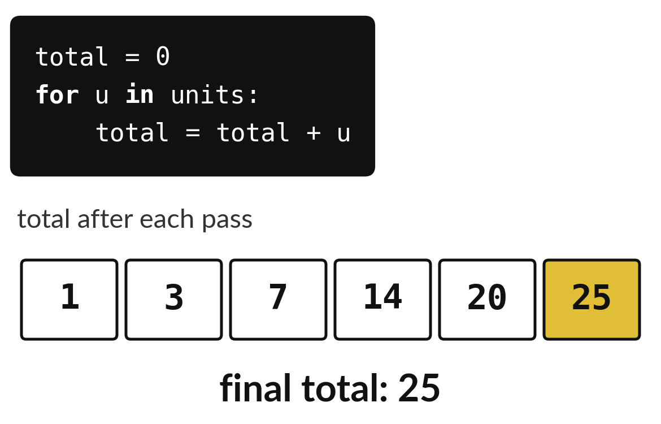
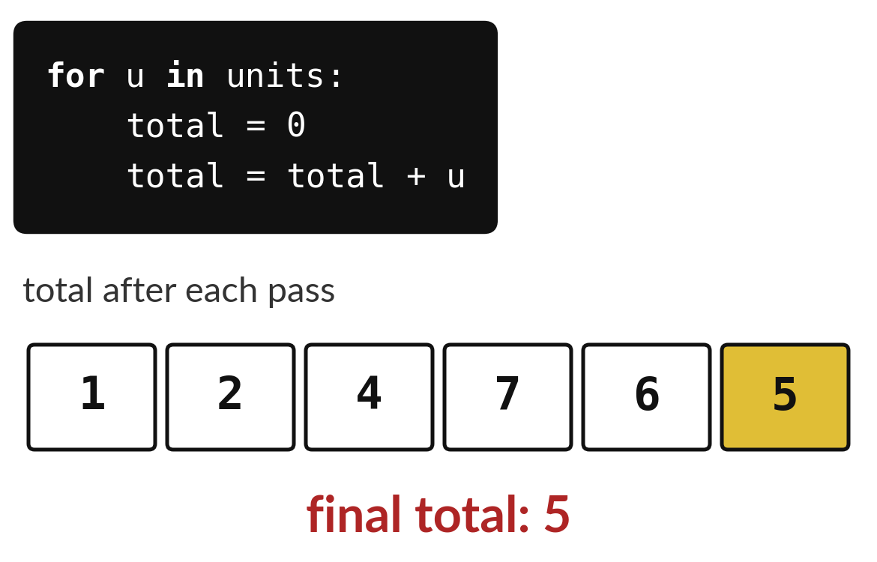
Where the counter starts decides the answer
Counter set to 0 once, before the loop: the total keeps growing.
Counter set to 0 inside the loop: it restarts every pass.
Notes:
The two programs differ by one line, and the answers are very different. On the left the counter is set to zero once, before the loop starts, and it grows to twenty five. On the right the line total equals zero sits inside the loop, so the counter restarts on every pass and finishes with only the last value.
If your total is the same as your last value, look for a line that resets it inside the loop.

Slide 20

Make: your own version
Make a list [2, 4, 6].
Print each value plus 1 with a loop.
Make a dictionary with the keys name and stock and print the stock.
Explain why position 0 is the first.
Save it as DA05. Write two sentences: what you changed and how you checked it.
Notes:
This is your own task for today. Take it one step at a time. If you get stuck for a few minutes, read your error message, check the error card, and then ask me.
Save it as DA05. I will come round to each of you and ask what you changed and how you checked it.

Slide 21

Two errors you may meet today
It means: You asked for a position beyond the end of the list.
Fix: A list of six values has positions 0 to 5. Check len().
IndexError: list index out of range
It means: The key is not in the dictionary, often because of a capital letter.
Fix: Check the exact spelling and capitals of the key.
KeyError: 'Price'
Notes:
Everyone meets errors, including me. Two are likely today, so let us meet them now.
This is the first one. You will see: IndexError: list index out of range. It means this: you asked for a position beyond the end of the list. To fix it, A list of six values has positions 0 to 5. Check len().
The next one. You will see: KeyError: 'Price'. It means this: the key is not in the dictionary, often because of a capital letter. To fix it, check the exact spelling and capitals of the key.
Keep this slide in mind when something stops working.

Slide 22

Finish this sentence in your notebook
A list keeps values in order starting at position 0, and a loop repeats the same steps for each value.
Then save your notebook, close it and open it again to check it saved.
Notes:
We are nearly done. Remember the question from the start of the session: How many units did the first six sales sell in total?
Write this sentence in your notebook and finish it your own way. A list keeps values in order starting at position 0, and a loop repeats the same steps for each value.
Then save your notebook, close it and open it again to check it saved.

