Slide 1
Functions and checks
that fail loudly
Can we trust our revenue calculation on cases we already know the answer to?
Python for Data Analysis | Session 6 of 24 | Week 2, Python you need
Holiday Data and AI Camp | The National ICT Innovation Hub, Nakawa
Notes:
Welcome back. Today is session 6 and our topic is functions and checks that fail loudly.
By the end of today you will be able to write a function that returns a result, and use assert to check it on known cases.
We will answer one question: Can we trust our revenue calculation on cases we already know the answer to?

Slide 2
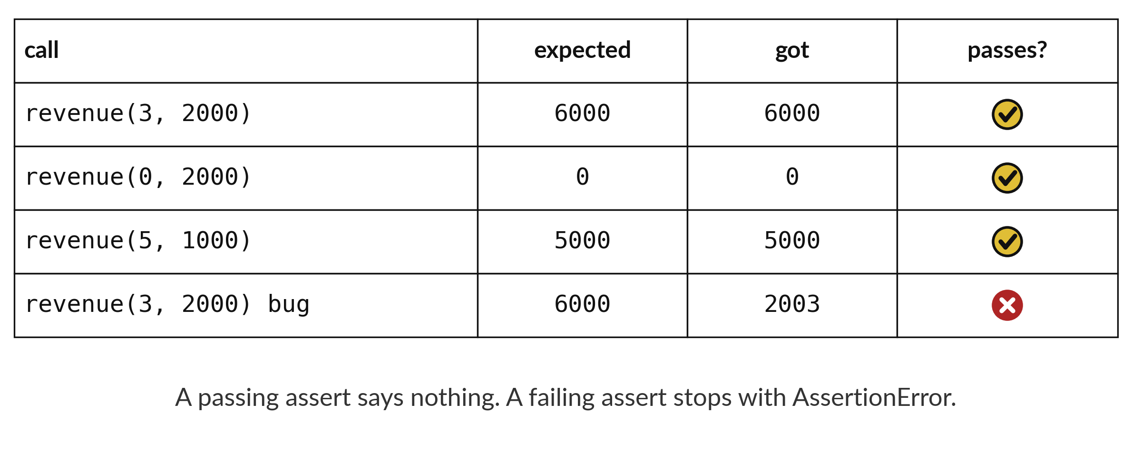
Can we trust our revenue calculation on
cases we already know the answer to?
Notes:
Before you trust a calculation, check it on cases where you already know the answer. Three units at two thousand is six thousand. No units is zero. Five units at one thousand is five thousand. If your code agrees with all three, you can trust it more. If it disagrees with one, you have found a bug before it cost anyone money. Today we package a calculation into a reusable machine and write the checks that test it.

Slide 3

Three hours, mostly doing
Most of our time is spent doing, in small steps, with a guess before every run.
Notes:
Here is how the 3 hours go. Each bar is as long as the time we spend on that part.
First, 10 minutes. Recall. Then, 50 minutes. Block A. After that, 15 minutes. Break away from screens. Next, 50 minutes. Block B. Then, 40 minutes. Make. Then, 15 minutes. Exit ticket, save, and an individual check with each learner.
Notice how much of the time is yours. You listen for a short while and then you do. That is on purpose, because you learn this by doing it.

Slide 4
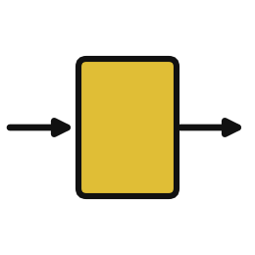


Words for today (1 of 2)
function
A named set of instructions you can use again.
A recipe with a name.
parameter
The name for an input inside a function.
The blank in a form.
argument
The actual value you give a function when you call it.
The answer you write in the blank.
Notes:
Here are the words for today. Listen for the picture that goes with each one.
function. A named set of instructions you can use again. You have seen this before. A recipe with a name.
parameter. The name for an input inside a function. The blank in a form.
argument. The actual value you give a function when you call it. Think of a shop. The answer you write in the blank.

Slide 5



Words for today (2 of 2)
return
Send the result back to where the function was called.
The cashier handing you the change.
assert
Stop with an error if a statement is False. Say nothing if it is True.
A teacher checking the answer without saying well done.
edge case
A value at the boundary where a rule might break, such as zero.
A customer who buys nothing.
Notes:
Two more words to know before we start.
return. Send the result back to where the function was called. Imagine it like this. The cashier handing you the change.
assert. Stop with an error if a statement is False. Say nothing if it is True. An example from everyday life. A teacher checking the answer without saying well done.
edge case. A value at the boundary where a rule might break, such as zero. Here is a way to see it. A customer who buys nothing.

Slide 6
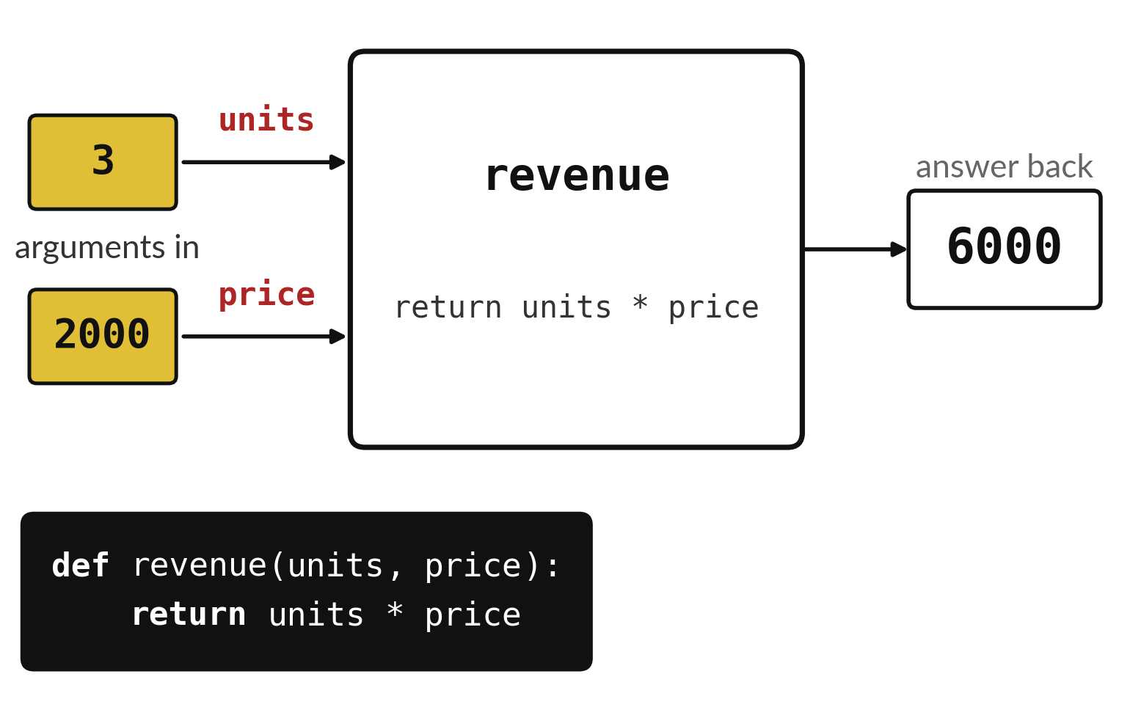
A function turns arguments into an answer
The machine has a name.
Each input has a name, such as units.
The answer comes back out.
Notes:
A function is a machine you build once and use as often as you like. Our machine is called revenue. It has two slots for inputs, called units and price. You drop in the numbers three and two thousand, the machine multiplies them, and out comes six thousand. The code at the bottom describes the machine in two lines.
What would come out if you dropped in five and one thousand?

Slide 7
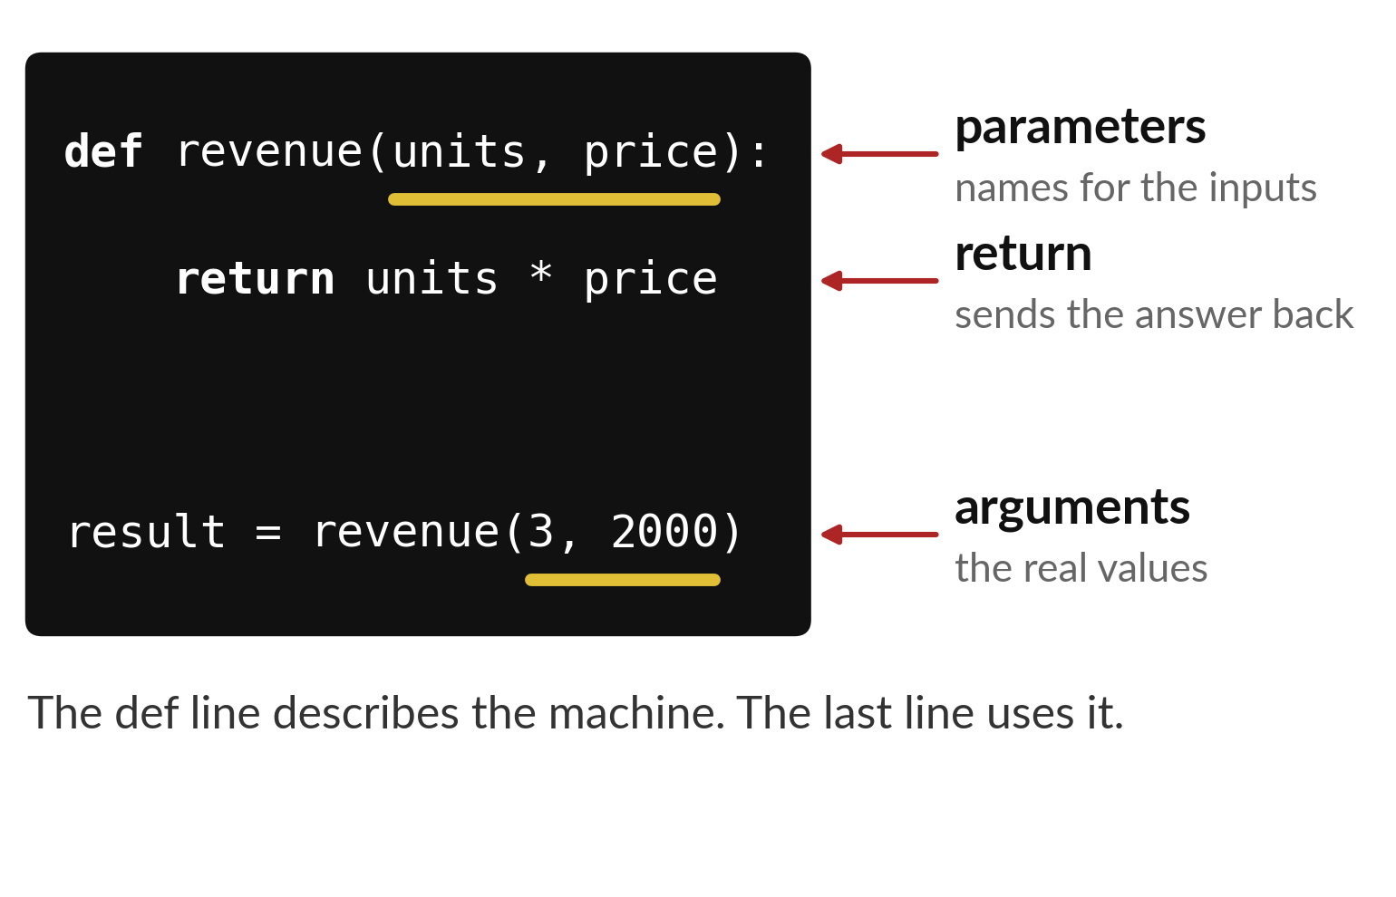
Each word in a function has its own job
Parameters are the names inside the machine.
Arguments are the real values you give it.
return sends the answer back.
Notes:
Four words matter here. The word def starts the description of the machine. The names in brackets on that line, units and price, are the parameters. They are the labels on the input slots. The word return says what comes out. Later, when we use the machine, the real numbers we give it, three and two thousand, are called arguments.
A parameter is the label on the slot and an argument is what you put in the slot. Say that sentence once to your neighbour.

Slide 8
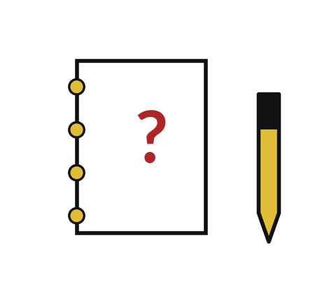
Predict: A function and a check
def revenue(units, price):
return units * price
print(revenue(3, 2000))
assert revenue(3, 2000) == 6000
assert revenue(0, 2000) == 0
Predict what the function returns for 3 units at 2000 shillings, and what a passing assert prints.
Write your guess on paper before we run it.
Notes:
A function starts with def. print only shows something on the screen.
Time to commit to an answer. Predict what the function returns for 3 units at 2000 shillings, and what a passing assert prints. Write one line on paper. I will give you a minute.

Slide 9
Run it: A function and a check
6000
The cell prints 6000.
The two asserts print nothing, which means both pass.
units and price are the parameters.
3 and 2000 are the arguments.
Notes:
Now we run it. Match each line of the output with the line of code that made it.
The cell prints 6000. The two asserts print nothing, which means both pass. units and price are the parameters. 3 and 2000 are the arguments.
If your guess was off, find the line that surprised you.

Slide 10

Investigate: A function and a check
1. What is the difference between return and print?
2. What does it mean that the asserts print nothing?
Notes:
Now we look closely at A function and a check. I have two questions for you.
Question one. What is the difference between return and print? Have a go in your head first.
The answer is this. return gives the value to the rest of the program. print only shows it.
Question two. What does it mean that the asserts print nothing? Write your answer in one line before we compare.
The statements are True. Silence means the check passed.

Slide 11

Modify: change one thing
Add a third assert that checks revenue(5, 1000) equals 5000.
Then tell your neighbour what changed and how you know.
Notes:
Now it is your turn to change something. Add a third assert that checks revenue(5, 1000) equals 5000. When you have run it, tell your neighbour what changed and how you know.
Here is what happens. It passes silently.

Slide 12

Break
15 minutes away from your screen
Stand up. Drink some water. Tell someone what you guessed in the first half.
Notes:
Break time. 15 minutes away from your screens. Stand up, drink some water and tell someone what you guessed in the first half.
When we come back we start the second idea.

Slide 13
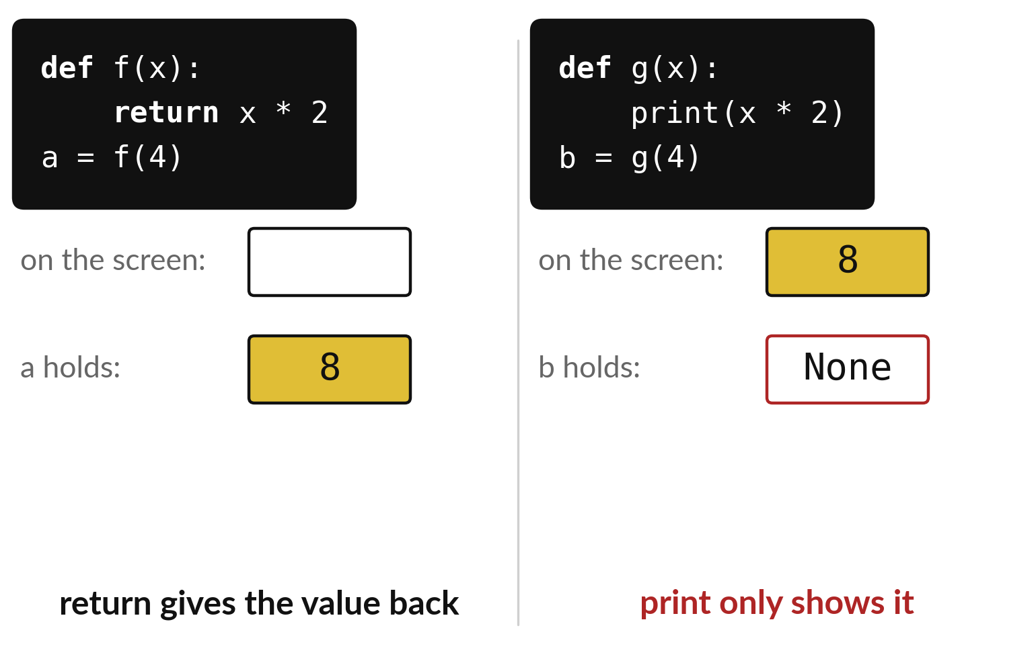
return hands the answer back, print only shows it
return gives the value to the rest of the program.
print writes on the screen and gives back nothing.
A function with no return holds None.
Notes:
These two functions look similar and behave very differently. On the left, the function returns the answer, so the variable a holds eight and we can use it later. On the right, the function prints the answer. Eight appears on the screen, but nothing is handed back, so the variable b holds None.
If your function shows None where you expected a number, look for a missing return.

Slide 14
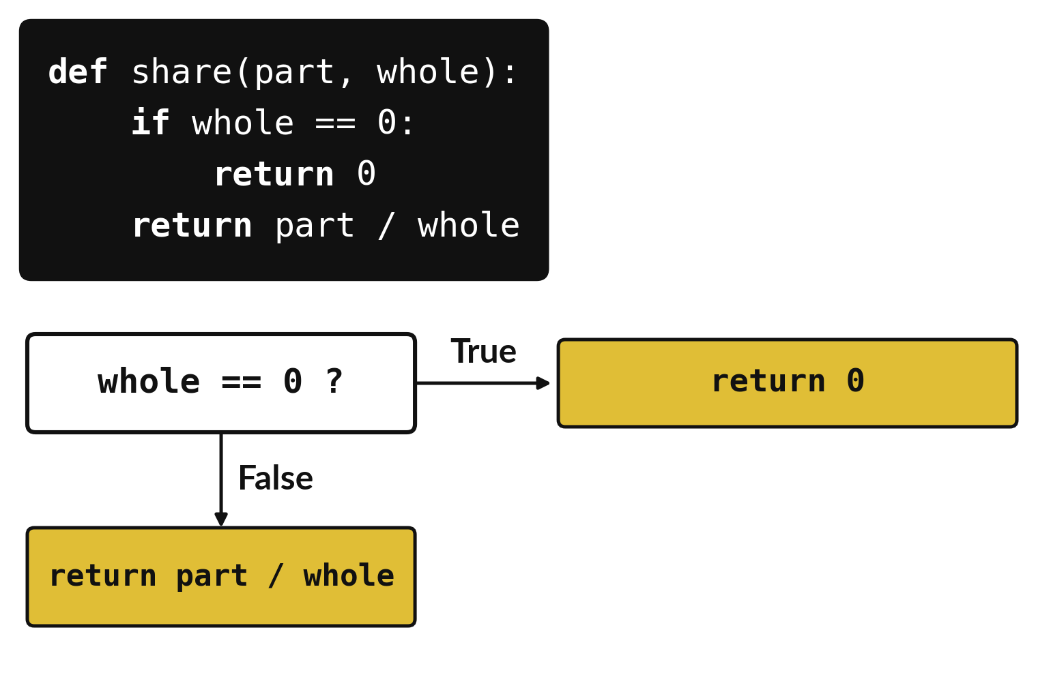
A guard stops the program dividing by zero
Ask the risky question first.
Return early when the answer is True.
Only divide when it is safe.
Notes:
We learned that dividing by zero stops the program. A function can protect itself with a guard. Before dividing, it asks whether the whole is zero. If it is, the function returns zero straight away and never reaches the division. If it is not, the function goes on and divides.
Is returning zero always the right answer for a share of nothing? Think about it, because a guard is a choice and you should be able to explain it.

Slide 15
Predict: Edge cases and a guard
def share(part, whole):
if whole == 0:
return 0
return part / whole
print(share(12, 20))
print(share(5, 0))
assert share(12, 20) == 0.6
assert share(5, 0) == 0
Predict the result of share(12, 20) and of share(5, 0).
Write your guess on paper before we run it.
Notes:
A share is a part divided by a whole. Dividing by zero is an edge case.
Your turn to guess. Predict the result of share(12, 20) and of share(5, 0). Jot it on paper before anyone speaks.

Slide 16
Run it: Edge cases and a guard
0.6
0
The cell prints 0.6 and then 0.
When the whole is zero the function returns before it divides, so no error appears.
Notes:
I will run it, and you compare with your guess. Match each line of the output with the line of code that made it.
The cell prints 0.6 and then 0. When the whole is zero the function returns before it divides, so no error appears.
Check your paper. Were you close?

Slide 17
Investigate: Edge cases and a guard
1. Why does the function check the whole before it divides?
2. Is returning 0 for share(5, 0) always the right answer?
def share(part, whole):
if whole == 0:
return 0
return part / whole
print(share(12, 20))
print(share(5, 0))
assert share(12, 20) == 0.6
assert share(5, 0) == 0
Notes:
Now we look closely at edge cases and a guard. I have two questions for you.
Question one. Why does the function check the whole before it divides? Write your answer in one line before we compare.
Dividing by zero stops the program with an error. The check avoids it.
Question two. Is returning 0 for share(5, 0) always the right answer? Say it quietly to yourself before anyone answers.
Here is how I would answer it. Not always. It is a choice that must be stated, because a share of nothing is undefined.

Slide 18
Modify: change one thing
Add an assert that share(1, 4) equals 0.25.
Then tell your neighbour what changed and how you know.
def share(part, whole):
if whole == 0:
return 0
return part / whole
print(share(12, 20))
print(share(5, 0))
assert share(12, 20) == 0.6
assert share(5, 0) == 0
Notes:
Time to experiment. Add an assert that share(1, 4) equals 0.25. Run it, then tell someone what you saw.
What you should find: It passes silently.

Slide 19
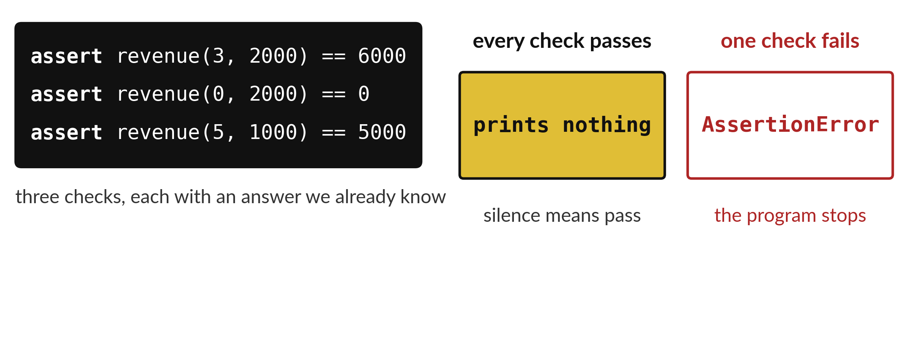
assert checks the machine on known answers
Silence is the sign that every check passed.
Notes:
The table lists three checks and a faulty version of the function. For each call we write the answer we expect, run the function, and compare. The assert instruction does the comparing for us. When the answer matches it stays silent, and silence means pass. When it does not match, Python stops and tells you.
In the last row the faulty function added instead of multiplying. Which numbers would have shown that problem straight away?

Slide 20

Make: your own version
Write price_after_discount(price, percent) that returns the price after a percentage discount.
Check it with assert for 0 percent, 10 percent and 100 percent on a price of 2000.
Save the notebook and run all cells from the top.
Write two sentences: what you changed and how you checked it.
Notes:
Now you do the real work yourself. Start with the first step. If you get stuck for a few minutes, read your error message, check the error card, and then ask me.
Save it as DA06. I will come round to each of you and ask what you changed and how you checked it.

Slide 21

Two errors you may meet today
It means: The statement after assert was False, so the function gave a different answer from the one you expected.
Fix: Print the function result for that input and compare it with your hand calculation.
AssertionError
It means: The function has no return line, so it gives nothing back.
Fix: Add return in front of the value you want back.
The function shows None
Notes:
Two things are likely to go wrong today. It helps to know them before they happen.
This is the first one. You will see: AssertionError. It means this: the statement after assert was False, so the function gave a different answer from the one you expected. To fix it, print the function result for that input and compare it with your hand calculation.
The next one. You will see: The function shows None. It means this: the function has no return line, so it gives nothing back. To fix it, add return in front of the value you want back.
If you meet one of these, fix it and carry on. It happens to everyone.

Slide 22
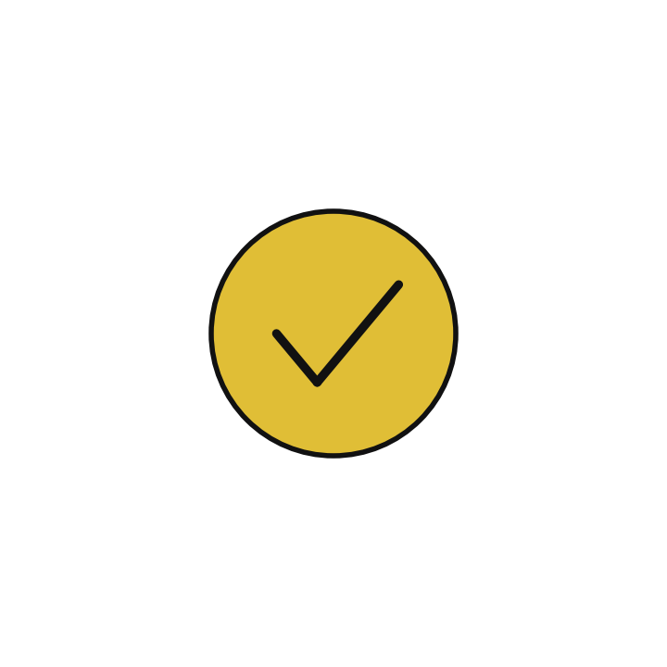
Finish this sentence in your notebook
A function returns a result, and an assert checks that result on cases I already know.
Then save your notebook, close it and open it again to check it saved.
Notes:
Before we finish, go back to the question we began with: Can we trust our revenue calculation on cases we already know the answer to?
Copy this sentence into your notebook and make it yours. A function returns a result, and an assert checks that result on cases I already know.
Then save your notebook, close it and open it again to check it saved.

