Slide 1
A table in Python: DataFrame,
columns and reading a CSV
What is in each table we have been given?
Python for Data Analysis | Session 7 of 24 | Week 3, Tables in pandas
Holiday Data and AI Camp | The National ICT Innovation Hub, Nakawa
Notes:
Good to see you. Today is session 7 and our topic is A table in Python: DataFrame, columns and reading a CSV.
By the end of today you will be able to build a small table, read a CSV file into one, and say how many rows and columns it has and what each column holds.
We will answer one question: What is in each table we have been given?

Slide 2
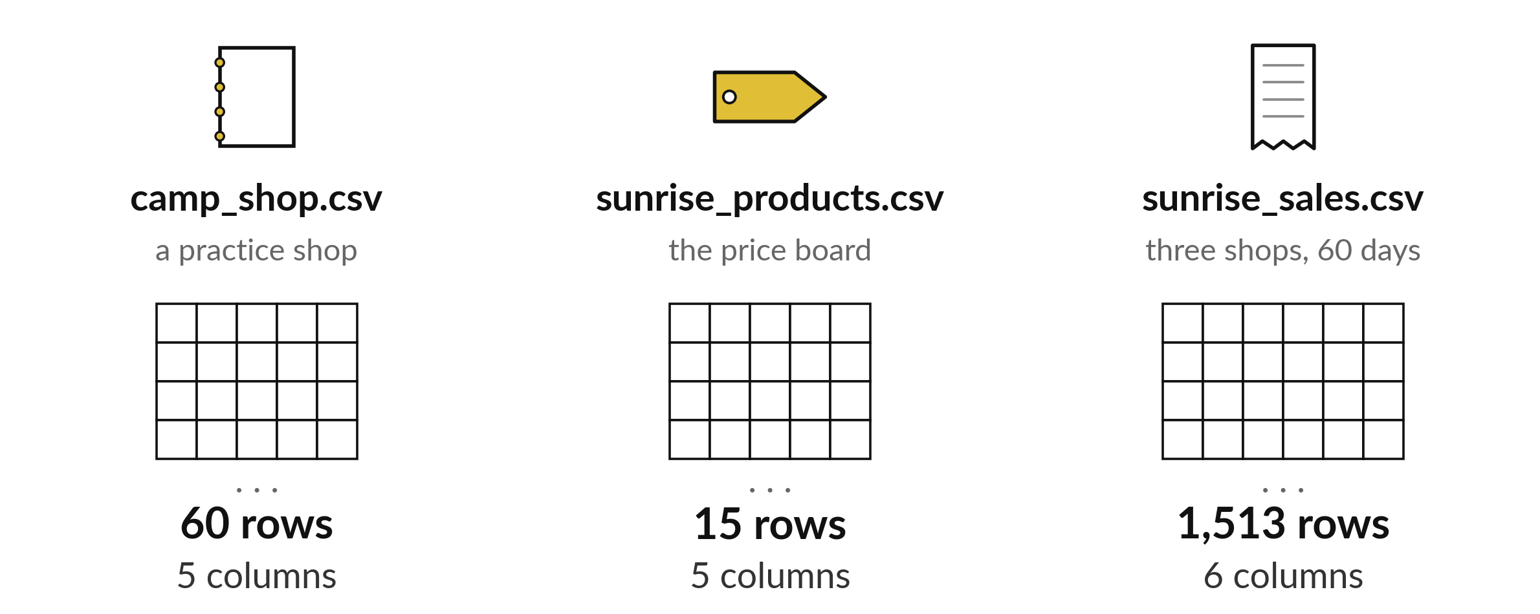
What is in each table we have been given?
Notes:
Open the camp folder and you will find several files. Each one holds a table. A table is the most common shape that data takes, and every question we ask this term starts by looking inside one. Look at the three tables on the screen. One has sixty rows, one has fifteen and the biggest has more than fifteen hundred. Today we learn to open a table in Python and say what is in it: how many rows, which columns and what kind of fact each column holds.

Slide 3

Three hours, mostly doing
Most of our time is spent doing, in small steps, with a guess before every run.
Notes:
Here is how the 3 hours go. Each bar is as long as the time we spend on that part.
First, 10 minutes. Recall. Then, 50 minutes. Block A. After that, 15 minutes. Break away from screens. Next, 50 minutes. Block B. Then, 40 minutes. Make. Then, 15 minutes. Exit ticket, save, and an individual check with each learner.
Notice how much of the time is yours. You listen for a short while and then you do. That is on purpose, because you learn this by doing it.

Slide 4



Words for today (1 of 2)
row
One record in a table, such as one sale.
One line in the shop register.
column
One kind of information in a table, such as units.
One vertical strip of the register.
header
The name written at the top of a column.
The title of a column in the register.
Notes:
First the words, because every one of them is used in the code later.
row. One record in a table, such as one sale. Imagine it like this. One line in the shop register.
column. One kind of information in a table, such as units. An example from everyday life. One vertical strip of the register.
header. The name written at the top of a column. Here is a way to see it. The title of a column in the register.

Slide 5



Words for today (2 of 2)
CSV
Comma-separated values: a plain-text file that holds a table.
A register copied by hand with commas between the boxes.
DataFrame
The table object in pandas, with rows and named columns.
The register after it has been opened in Python.
library
Code written by other people that you load with import.
A toolbox you borrow.
Notes:
Here are the rest of today's words.
CSV. Comma-separated values: a plain-text file that holds a table. A small example. A register copied by hand with commas between the boxes.
DataFrame. The table object in pandas, with rows and named columns. Picture this. The register after it has been opened in Python.
library. Code written by other people that you load with import. You have seen this before. A toolbox you borrow.

Slide 6
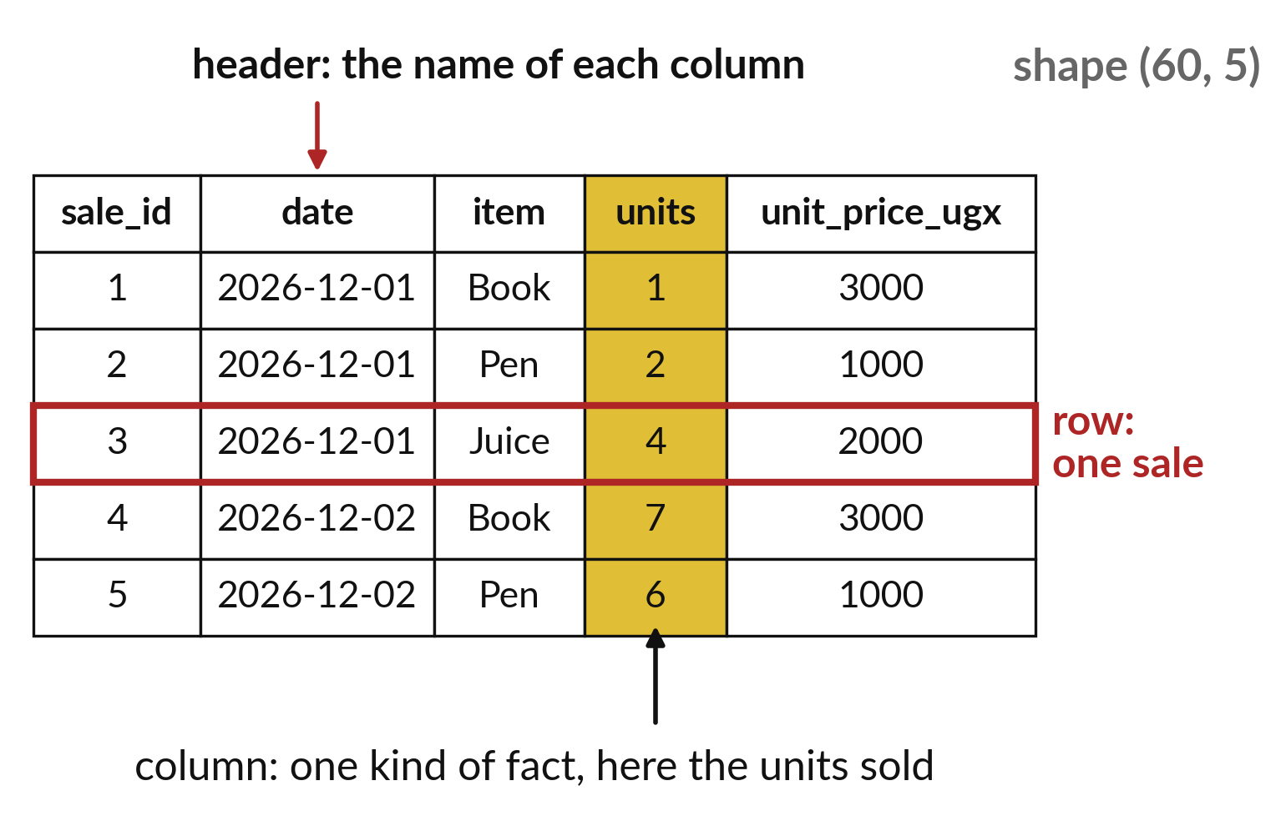
A table has rows across,
columns down and a header
One row is one record, such as one sale.
One column holds one kind of fact.
The header names each column.
Notes:
Here is a table with the parts named. A row runs across the page, and each row is one record. In our shop data one row is one sale. A column runs down the page, and each column holds one kind of fact, such as the number of units or the price of one unit. The names along the top are called the header. They are how we ask for a column later.
Point to one row and one column on your own sheet. Which fact sits where they cross?

Slide 7
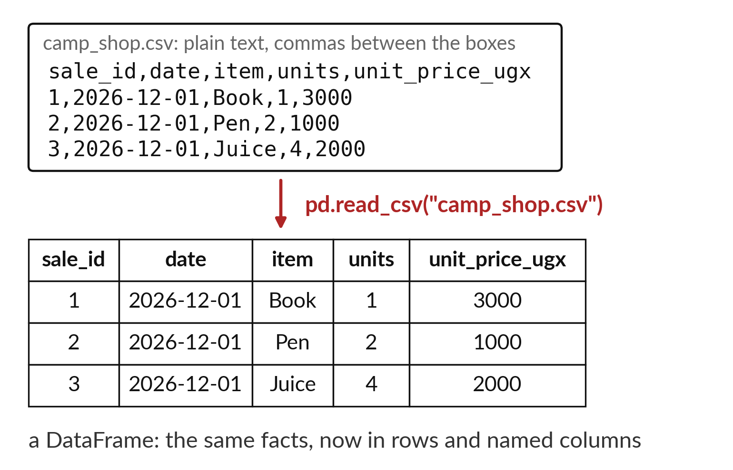
read_csv turns a text file into a DataFrame
A CSV file is plain text with commas between values.
pandas is the library that reads it.
The result is a DataFrame.
Notes:
On the left is a CSV file. CSV stands for comma separated values, which means the table is stored as plain text with a comma between each value. On the right is what we get after one line of Python. The instruction read_csv, from a library called pandas, reads the text and builds a table object called a DataFrame. The first line of the file becomes the header. Every other line becomes a row.
Match one line of text on the left with one row of the table on the right.

Slide 8

Predict: Build a tiny table
import pandas as pd
sales = pd.DataFrame({"item": ["Book", "Pen", "Book"], "units": [2, 5, 3]})
print(sales)
print(sales.shape)
print(list(sales.columns))
Predict the shape of the table before you run the cell.
Write your guess on paper before we run it.
Notes:
pandas is a library for tables. import pandas as pd loads it and gives it the short name pd.
This is the part where you decide. Predict the shape of the table before you run the cell. Jot it on paper before anyone speaks.

Slide 9
Run it: Build a tiny table
item units
0 Book 2
1 Pen 5
2 Book 3
(3, 2)
['item', 'units']
The cell prints a table of three rows and two columns, then (3, 2), then ['item', 'units'].
The first column holds the item sold and the second holds the units.
Notes:
Let us see what happens. Match each line of the output with the line of code that made it.
The cell prints a table of three rows and two columns, then (3, 2), then ['item', 'units']. The first column holds the item sold and the second holds the units.
Which line of the output matches which line of the code? Point to each pair.

Slide 10

Investigate: Build a tiny table
1. Which number in (3, 2) counts rows?
2. Where do the column headers come from?
Notes:
Now we look closely at build a tiny table. I have two questions for you.
Question one. Which number in (3, 2) counts rows? Write your answer in one line before we compare.
What I would say is this. The first one. The shape is rows first and then columns.
Question two. Where do the column headers come from? Say it quietly to yourself before anyone answers.
Let me answer it. From the keys of the dictionary we gave pandas.

Slide 11

Modify: change one thing
Add a third column called price_ugx with the values 3000, 1000 and 3000, then print the shape.
Then tell your neighbour what changed and how you know.
Notes:
Change one thing and watch what happens. Add a third column called price_ugx with the values 3000, 1000 and 3000, then print the shape. Then explain to your neighbour what the change did.
The result: The shape becomes (3, 3).

Slide 12

Break
15 minutes away from your screen
Stand up. Drink some water. Tell someone what you guessed in the first half.
Notes:
Break time. 15 minutes away from your screens. Stand up, drink some water and tell someone what you guessed in the first half.
When we come back we start the second idea.

Slide 13
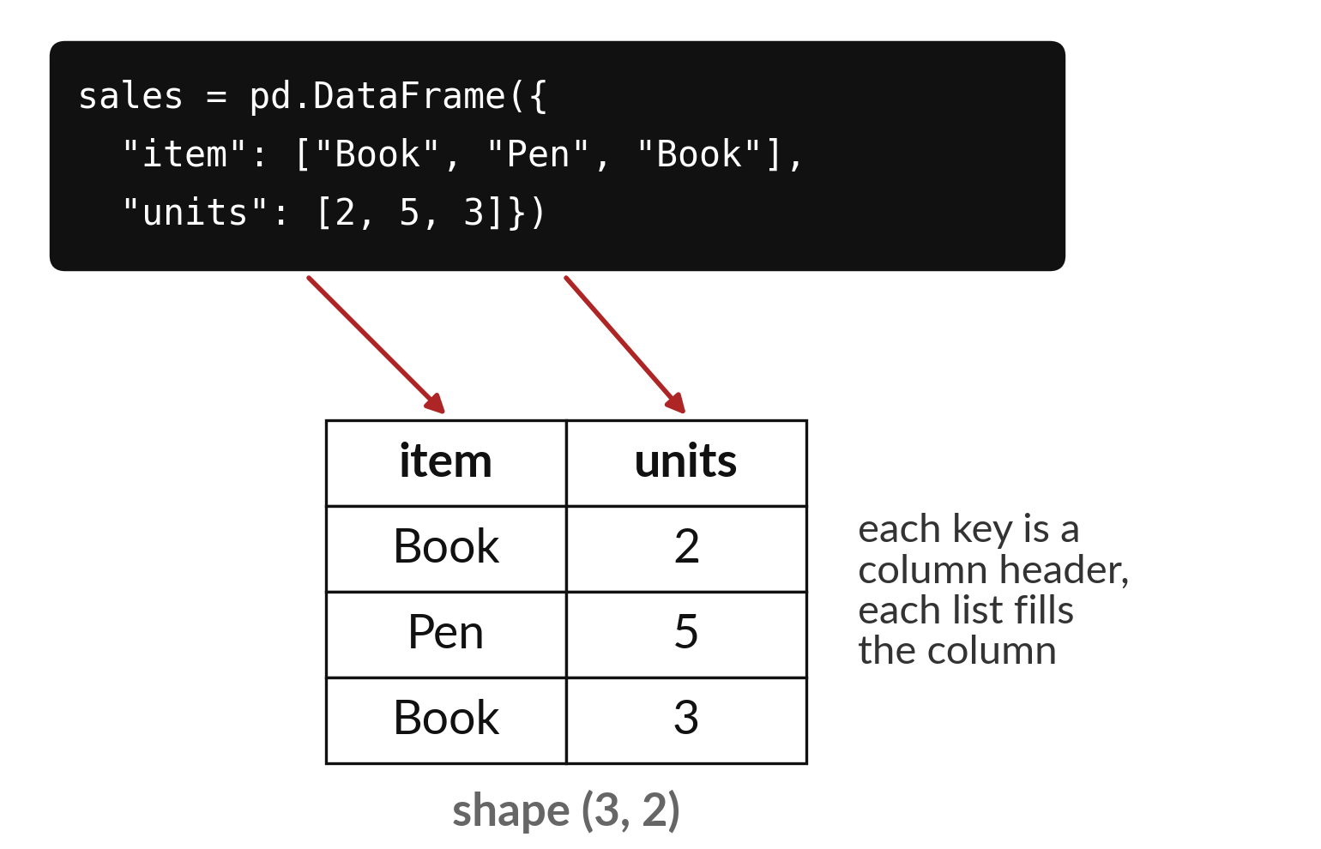
A dictionary of columns
builds a DataFrame by hand
Each key is a column name.
Each list holds that column's values.
The lists must be the same length.
Notes:
We can also build a small table ourselves. In Python a dictionary pairs a name with a list of values. If each name is a column and each list is the values in that column, pandas stitches them into a DataFrame.
There is one rule. Every list has to be the same length, because each row needs a value in every column. If one list is shorter, pandas will stop and tell you. Check the picture and count the values in each list before we run it.

Slide 14
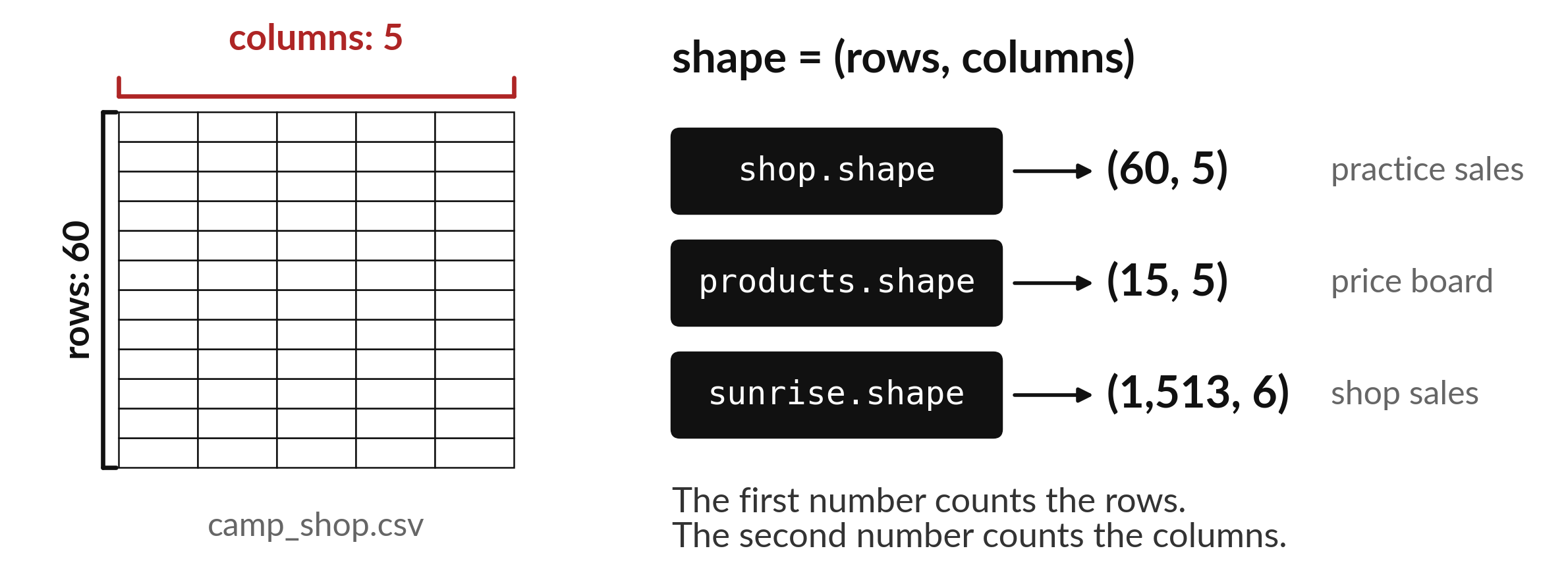
shape gives rows first and columns second
The Sunrise sales table has 1,513 rows and 6 columns.
Notes:
The attribute called shape tells you the size of a table in one go. It always reports two numbers, and the rows come first. For the Sunrise sales file the answer is one thousand five hundred and thirteen rows and six columns. That means one thousand five hundred and thirteen sales, with six facts about each.
Notice there are no brackets after shape. It is a fact about the table, so we only read it. Rows first, columns second.

Slide 15
Predict: Read a CSV file
shop = pd.read_csv("camp_shop.csv")
print(shop.shape)
print(shop.dtypes)
products = pd.read_csv("sunrise_products.csv")
print(products.shape)
print(products.head(3))
Predict how many rows and columns camp_shop.csv has, and which columns hold text.
Write your guess on paper before we run it.
Notes:
pd.read_csv reads a CSV file and returns a DataFrame. The path is where the file is.
Make a prediction. Predict how many rows and columns camp_shop.csv has, and which columns hold text. Guess on paper first. Surprises are useful.

Slide 16

Run it: Read a CSV file
The shop table has shape (60, 5).
date and item hold text.
The other three columns are whole numbers.
The Sunrise products table has shape (15, 5): fifteen products, each with an id, a name, a category and two prices.
Notes:
Running it now. Match each line of the output with the line of code that made it.
The shop table has shape (60, 5). date and item hold text. The other three columns are whole numbers. The Sunrise products table has shape (15, 5): fifteen products, each with an id, a name, a category and two prices.
Keep your guess. We use it in the next step.

Slide 17
Investigate: Read a CSV file
1. Which columns would you use to work out revenue?
2. Why is date a text column here?
Notes:
Now we look closely at read a CSV file. I have two questions for you.
Question one. Which columns would you use to work out revenue? Say it quietly to yourself before anyone answers.
Let me answer it. units and unit_price_ugx. Revenue is units times unit price.
Question two. Why is date a text column here? Give it thirty seconds and then we will hear a few answers.
The answer is this. pandas reads it as text until we ask it to treat it as a date, which is a later session.

Slide 18
Modify: change one thing
Show the last three rows of the shop table with tail(3).
Then tell your neighbour what changed and how you know.
Notes:
Make one small change. Show the last three rows of the shop table with tail(3). When you have run it, tell your neighbour what changed and how you know.
Here is what happens. Sales 58, 59 and 60.

Slide 19
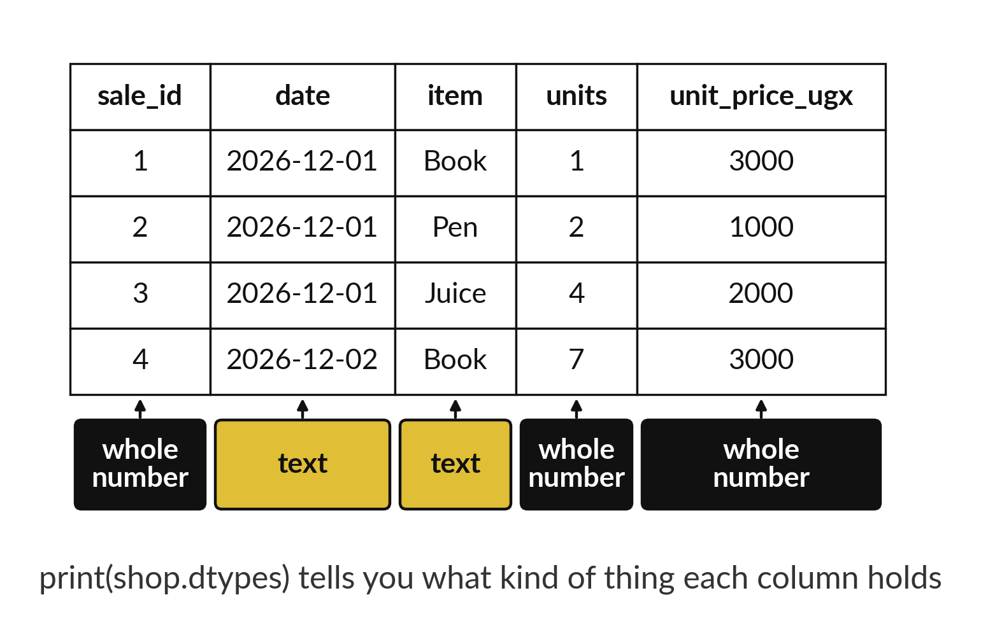
Every column has a dtype
that decides what it can do
int64 holds whole numbers.
float64 holds numbers with decimals.
object holds text.
Notes:
When pandas reads a file it guesses what kind of value each column holds, and the guess is called the dtype. Whole numbers become int64. Numbers with a decimal point become float64. Text becomes object. The dtype matters because it decides what we may do. You can add up a column of numbers, and you cannot add up a column of names.
Look at the units column and the item column. Which dtype does each one have, and why?

Slide 20

Make: your own version
Read sunrise_sales.csv, the Sunrise Shops sales.
Print its shape and its column names.
Write which column holds the date and which holds the price of one unit.
Save it as DA07. Write two sentences: what you changed and how you checked it.
Notes:
This task is yours. Run your code after every step so you can see where a problem begins. If you get stuck for a few minutes, read your error message, check the error card, and then ask me.
Save it as DA07. I will come round to each of you and ask what you changed and how you checked it.

Slide 21

Two errors you may meet today
It means: Python cannot find the file where it looks.
Fix: Put the notebook and the CSV in the same folder, and check the spelling of the file name.
FileNotFoundError: [Errno 2] No such file: 'sunrise_sales.csv'
It means: This laptop is not using the prepared environment.
Fix: Ask the instructor. Do not install random packages.
ModuleNotFoundError: No module named 'pandas'
Notes:
Here are two errors from this session, so you recognise them when they appear.
This is the first one. You will see: FileNotFoundError: [Errno 2] No such file: 'sunrise_sales.csv'. It means this: Python cannot find the file where it looks. To fix it, put the notebook and the CSV in the same folder, and check the spelling of the file name.
The next one. You will see: ModuleNotFoundError: No module named 'pandas'. It means this: this laptop is not using the prepared environment. To fix it, ask the instructor. Do not install random packages.
When you are stuck, read the last line of the message first.

Slide 22

Finish this sentence in your notebook
A DataFrame is a table with rows and named columns, and read_csv turns a CSV file into one.
Then save your notebook, close it and open it again to check it saved.
Notes:
Last step. Our question for today was: What is in each table we have been given?
Finish this sentence in your notebook, in your own words. A DataFrame is a table with rows and named columns, and read_csv turns a CSV file into one.
Then save your notebook, close it and open it again to check it saved.

