Slide 1
Exploring relationships: scatter
plots, correlation and cause
Do busier days bring in more money, and does rain keep customers away?
Python for Data Analysis | Session 15 of 24 | Week 5, Explore with NumPy and seaborn
Holiday Data and AI Camp | The National ICT Innovation Hub, Nakawa
Notes:
Welcome back. Today is session 15 and our topic is exploring relationships: scatter plots, correlation and cause.
By the end of today you will be able to draw a scatter plot coloured by group, read a correlation number, and say why a correlation does not prove one thing causes another.
We will answer one question: Do busier days bring in more money, and does rain keep customers away?

Slide 2
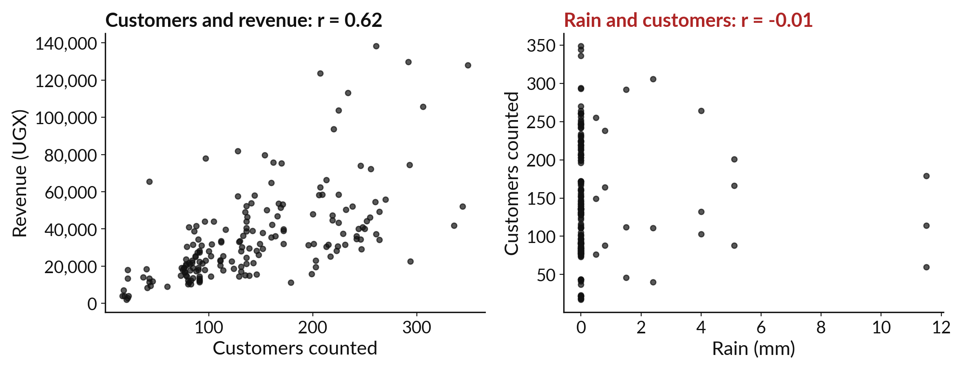
Do busier days bring in more money,
and does rain keep customers away?
Notes:
Do busier days bring in more money, and does rain keep customers away? Both questions ask whether two columns move together. Today we measure how strongly they move together with a number called the correlation. We will find that busier days do bring in more money, and rain barely matters at all. And we will learn why a link between two columns never proves that one causes the other.

Slide 3

Three hours, mostly doing
Most of our time is spent doing, in small steps, with a guess before every run.
Notes:
Here is how the 3 hours go. Each bar is as long as the time we spend on that part.
First, 10 minutes. Recall. Then, 50 minutes. Block A. After that, 15 minutes. Break away from screens. Next, 50 minutes. Block B. Then, 40 minutes. Make. Then, 15 minutes. Exit ticket, save, and an individual check with each learner.
Notice how much of the time is yours. You listen for a short while and then you do. That is on purpose, because you learn this by doing it.

Slide 4
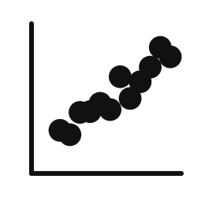


Words for today (1 of 2)
correlation
A number from -1 to 1 for how closely two columns move together.
Taller pupils usually have longer feet.
strength
How close the correlation is to 1 or -1. Near 0 means weak.
How tightly the dots hug a line.
heatmap
A table of numbers coloured by size.
A map shaded by rainfall.
Notes:
Here are the words for today. Listen for the picture that goes with each one.
correlation. A number from -1 to 1 for how closely two columns move together. You have seen this before. Taller pupils usually have longer feet.
strength. How close the correlation is to 1 or -1. Near 0 means weak. How tightly the dots hug a line.
heatmap. A table of numbers coloured by size. Think of a shop. A map shaded by rainfall.

Slide 5


Words for today (2 of 2)
hue
A colour that shows which group each dot belongs to.
A different coloured pen for each shop.
cause
One thing makes another happen. A correlation alone does not show it.
Rain makes the ground wet. Wet ground does not make rain.
Notes:
Two more words to know before we start.
hue. A colour that shows which group each dot belongs to. Imagine it like this. A different coloured pen for each shop.
cause. One thing makes another happen. A correlation alone does not show it. An example from everyday life. Rain makes the ground wet. Wet ground does not make rain.

Slide 6
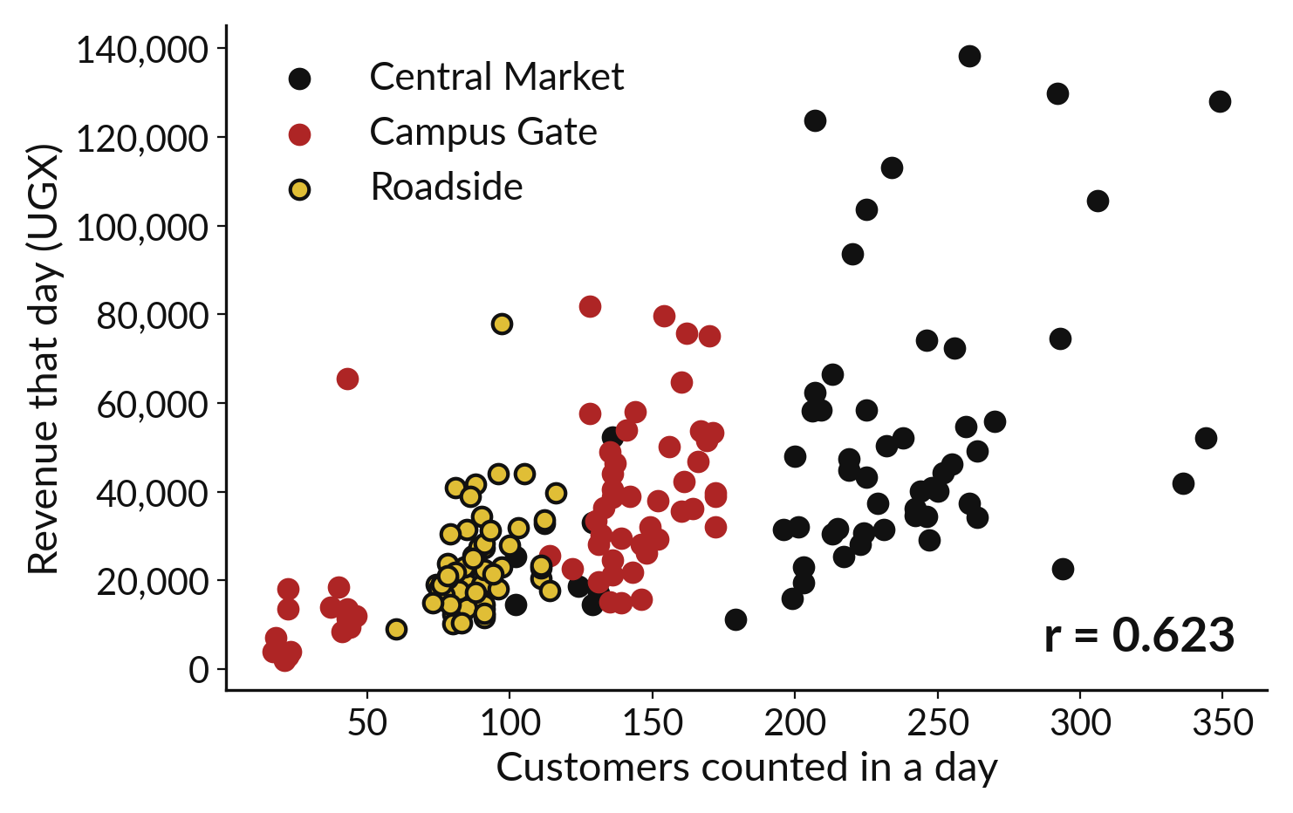
Colour adds a third fact to a scatter plot
Across is one column, up is another.
The hue is a third column.
Each shop gets its own colour.
Notes:
We can add a third fact to a scatter plot without a third axis. We give each dot a colour that depends on a column, and seaborn calls that the hue. Here each dot is a day, and the colour says which shop it belongs to. Central Market is black, Campus Gate is red and Roadside is gold, and we keep those three colours for the rest of the course.
Does each shop show the same upward drift? Look for a colour whose dots sit away from the others.

Slide 7
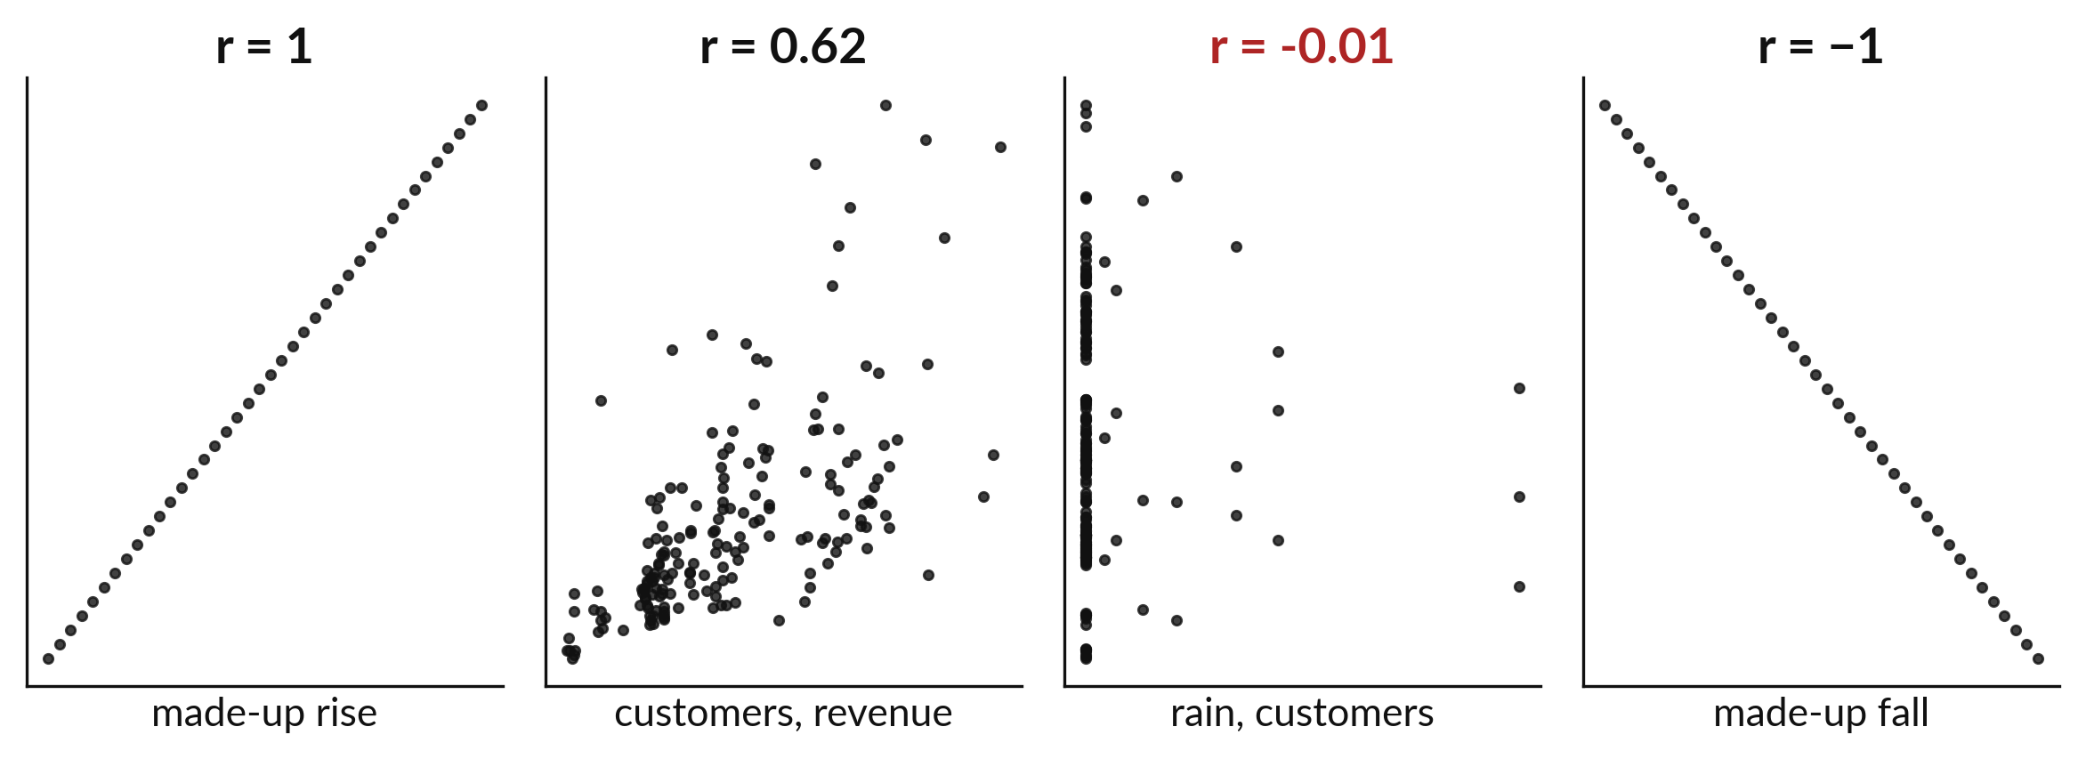
Correlation runs from minus one to plus one
Plus one rises together, zero shows no link, minus one moves opposite.
Notes:
The correlation squeezes the link between two columns into one number between minus one and plus one. Close to plus one, the two rise together. Close to zero, there is no straight line link. Close to minus one, one rises while the other falls.
For customers and revenue in the daily summary, the correlation is zero point six two three. That is a fairly strong upward link, though the dots do not all fall on one line.

Slide 8

Predict: A scatter plot and one correlation
import pandas as pd
import seaborn as sns
import matplotlib.pyplot as plt
daily = pd.read_csv("sunrise_daily_summary.csv")
sns.scatterplot(
data=daily, x="customers_counted", y="revenue_ugx",
hue="branch"
)
plt.show()
r = daily["customers_counted"].corr(daily["revenue_ugx"])
print(round(r, 3))
Predict whether the correlation between customers and revenue is close to 0, close to 1 or close to -1.
Write your guess on paper before we run it.
Notes:
sns.scatterplot puts one column on each axis. hue= colours the dots by group.
Time to commit to an answer. Predict whether the correlation between customers and revenue is close to 0, close to 1 or close to -1. Write one line on paper. I will give you a minute.

Slide 9
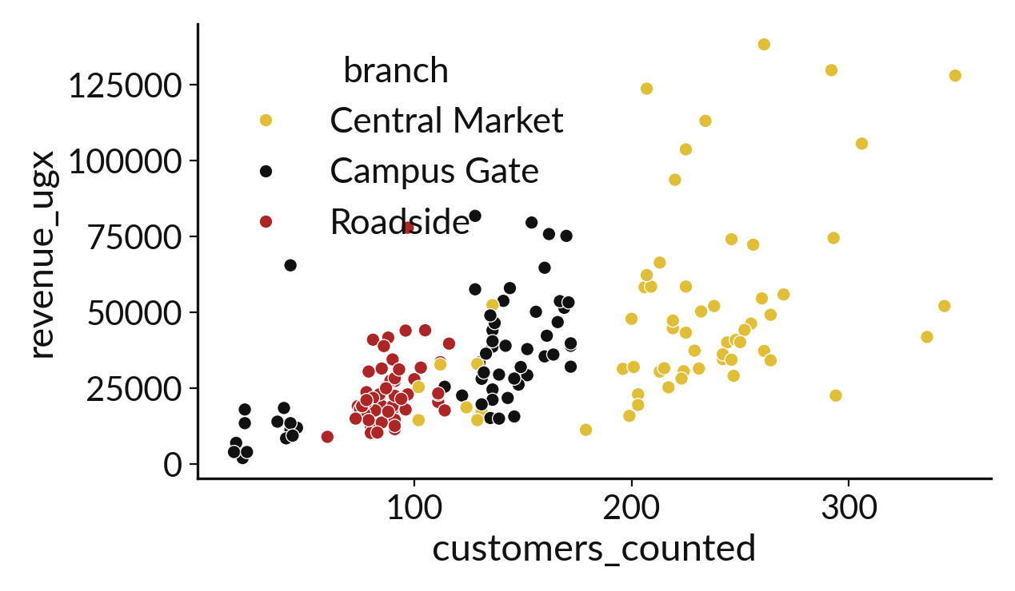
Run it: A scatter plot and one correlation
The dots rise from left to right, so more customers usually mean more revenue.
The correlation is 0.623: positive and moderately strong.
The dots are scattered, so a customer count does not fix the revenue.
Notes:
Now we run it. Match each line of the output with the line of code that made it.
The dots rise from left to right, so more customers usually mean more revenue. The correlation is 0.623: positive and moderately strong. The dots are scattered, so a customer count does not fix the revenue.
If your guess was off, find the line that surprised you.

Slide 10

Investigate: A scatter plot and one correlation
1. What would a correlation of 1 look like on the chart?
2. Why do the colours help?
Notes:
Now we look closely at A scatter plot and one correlation. I have two questions for you.
Question one. What would a correlation of 1 look like on the chart? Have a go in your head first.
The answer is this. All the dots would lie exactly on one rising line.
Question two. Why do the colours help? Write your answer in one line before we compare.
They show that the three shops sit in different parts of the chart. Central Market is at the busy end.

Slide 11

Modify: change one thing
Find the correlation between customers and the number of sale lines (sale_lines).
Then tell your neighbour what changed and how you know.
Notes:
Now it is your turn to change something. Find the correlation between customers and the number of sale lines (sale_lines). When you have run it, tell your neighbour what changed and how you know.
Here is what happens. 0.744, stronger.

Slide 12

Break
15 minutes away from your screen
Stand up. Drink some water. Tell someone what you guessed in the first half.
Notes:
Break time. 15 minutes away from your screens. Stand up, drink some water and tell someone what you guessed in the first half.
When we come back we start the second idea.

Slide 13
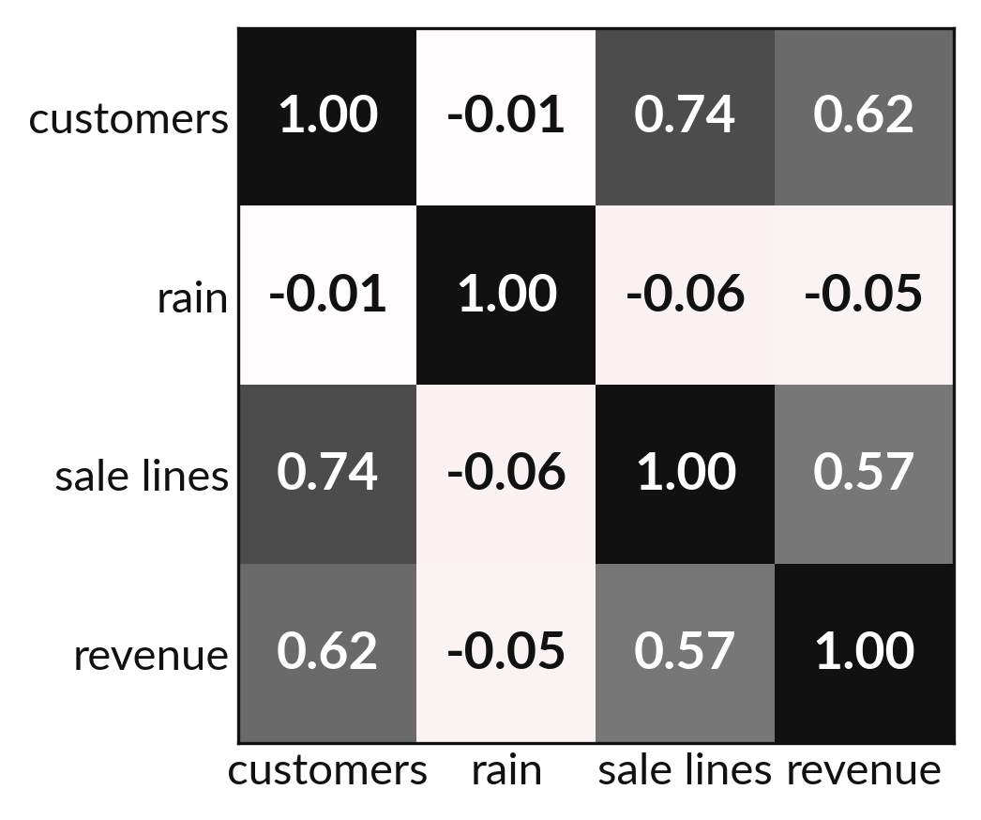
A heatmap colours every pair of columns
Each square is one pair of columns.
Darker means a stronger link.
The diagonal is always one.
Notes:
When we have many columns, a heatmap shows all the correlations at once. Each square is one pair of columns, and the colour says how strong the link is. The diagonal is each column compared with itself, so it is always one.
Scan for the darkest squares away from the diagonal. Those are the pairs worth a closer look with a scatter plot.

Slide 14
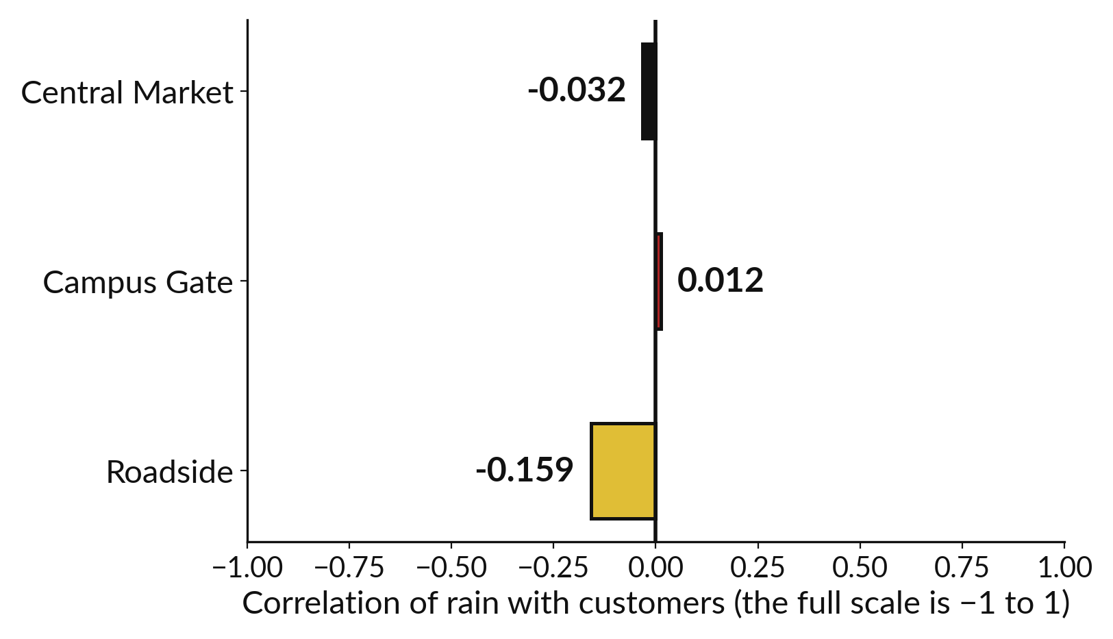
Rain is weakly linked to customers (−0.16 at most)
Overall, rain and customers correlate at −0.013.
Roadside is the strongest, at −0.159, and still weak.
Central Market and Campus Gate are close to zero.
Notes:
Do customers stay home when it rains? Across all the days the correlation between rainfall and customers counted is minus zero point zero one three. That is almost exactly zero. The bars show the same check shop by shop. Roadside is the strongest at minus zero point one five nine, and the other two sit near zero. None of them is a strong link in either direction.
So in this data, rain did little to keep customers away. In your own words, say that and nothing more.

Slide 15
Predict: A heatmap of every
pair, and the rain question
cols = ["customers_counted", "rain_mm", "sale_lines", "revenue_ugx"]
table = daily[cols].corr()
sns.heatmap(table, annot=True, vmin=-1, vmax=1)
plt.show()
print(round(table.loc["rain_mm", "customers_counted"], 3))
print(round(table.loc["sale_lines", "revenue_ugx"], 3))
Predict whether rain_mm is strongly related to customers.
Write your guess on paper before we run it.
Notes:
A heatmap of .corr() shows every pair at once. annot=True writes the numbers in the squares.
Your turn to guess. Predict whether rain_mm is strongly related to customers. Jot it on paper before anyone speaks.

Slide 16
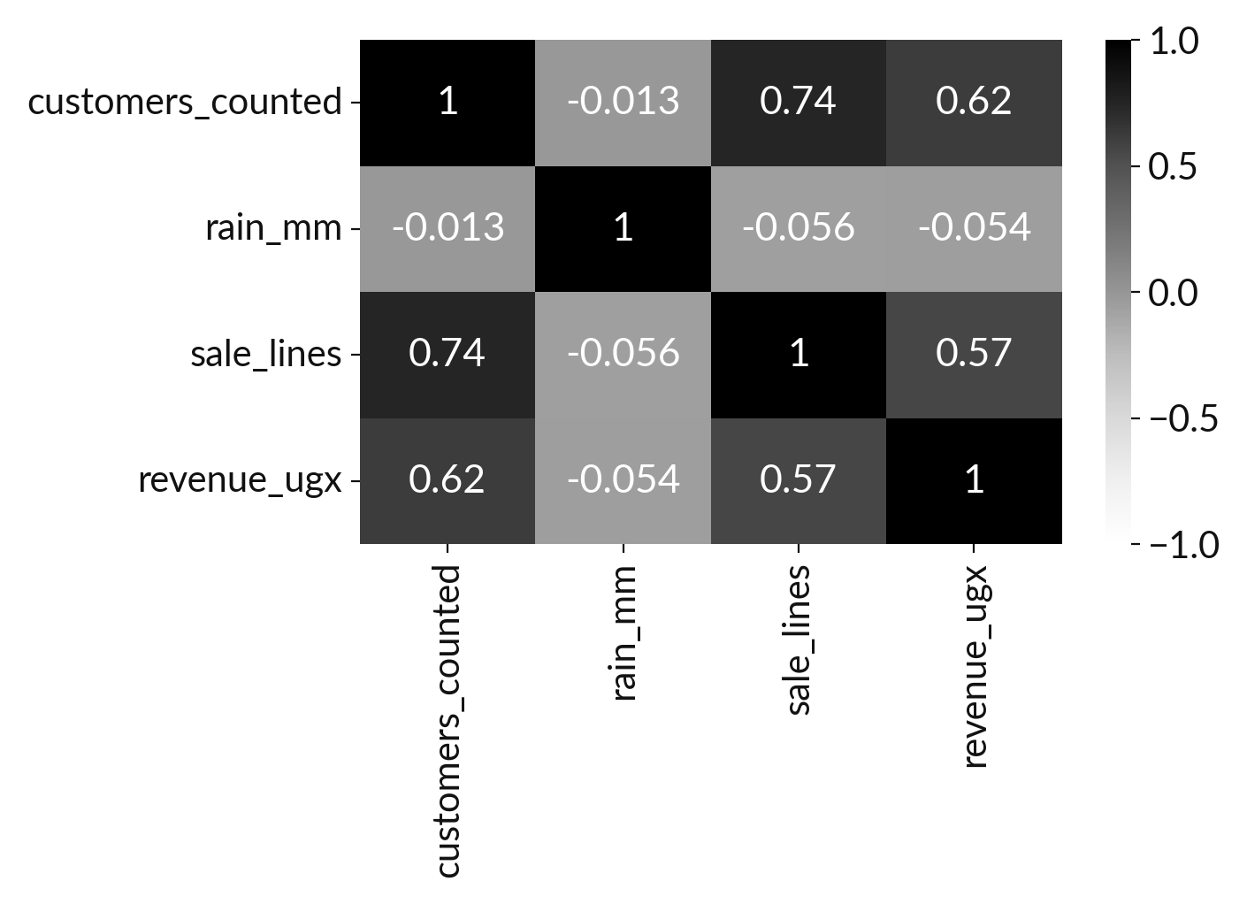
Run it: A heatmap of every
pair, and the rain question
Rain and customers have a correlation of -0.013, which is essentially zero.
Sale lines and revenue have 0.565.
In this data the weather barely matters.
A weak correlation is a finding too.
Notes:
I will run it, and you compare with your guess. Match each line of the output with the line of code that made it.
Rain and customers have a correlation of -0.013, which is essentially zero. Sale lines and revenue have 0.565. In this data the weather barely matters. A weak correlation is a finding too.
Check your paper. Were you close?

Slide 17
Investigate: A heatmap of every
pair, and the rain question
1. What does -0.013 tell us about rain?
2. Could a strong correlation still be a coincidence?
Notes:
Now we look closely at A heatmap of every pair, and the rain question. I have two questions for you.
Question one. What does -0.013 tell us about rain? Write your answer in one line before we compare.
Almost nothing links them in this data. Wet days and dry days look alike.
Question two. Could a strong correlation still be a coincidence? Say it quietly to yourself before anyone answers.
Here is how I would answer it. Yes. Two things can move together without one causing the other, so we look for a reason as well.

Slide 18
Modify: change one thing
Find the correlation of rain_mm with revenue_ugx.
Then tell your neighbour what changed and how you know.
Notes:
Time to experiment. Find the correlation of rain_mm with revenue_ugx. Run it, then tell someone what you saw.
What you should find: -0.054, also close to zero.

Slide 19
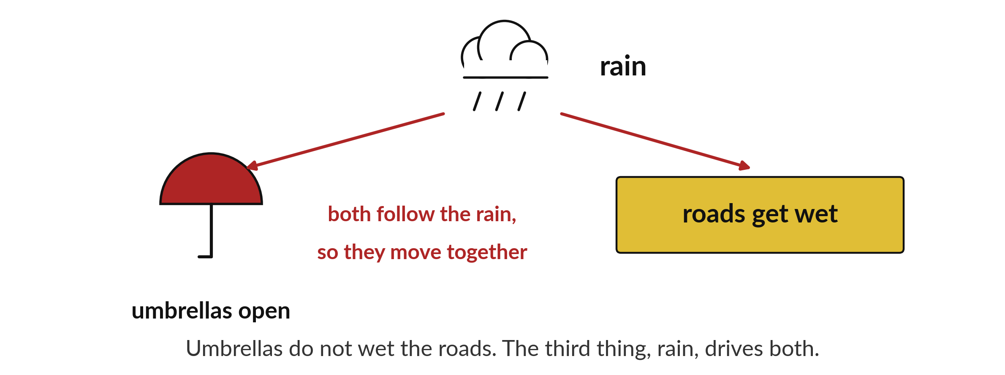
Moving together does not
prove one causes the other
Umbrellas and wet roads both follow the rain.
Notes:
Here is a famous example. On rainy days more people open umbrellas, and the roads get wet. If we only looked at the umbrellas and the wet roads, they would move together. But umbrellas do not wet the roads. The rain does both.
A correlation tells you that two columns move together. It cannot tell you why. In your report, write that the columns are linked, and leave the cause for a better experiment.

Slide 20

Make: your own version
Check the rain question for each shop separately.
For each branch find the correlation between rain_mm and customers_counted.
Say whether rain matters at any shop and why a correlation could not prove that it does.
Save it as DA15. Write two sentences: what you changed and how you checked it.
Notes:
Now you do the real work yourself. Start with the first step. If you get stuck for a few minutes, read your error message, check the error card, and then ask me.
Save it as DA15. I will come round to each of you and ask what you changed and how you checked it.

Slide 21

Two errors you may meet today
It means: The hue column name is not in the table.
Fix: Print list(daily.columns) and use the exact name.
KeyError: "hue"
It means: vmin and vmax were not set, or only one column was used.
Fix: Pass the four numeric columns and set vmin=-1 and vmax=1.
The heatmap shows all one colour
Notes:
Two things are likely to go wrong today. It helps to know them before they happen.
This is the first one. You will see: KeyError: "hue". It means this: the hue column name is not in the table. To fix it, print list(daily.columns) and use the exact name.
The next one. You will see: The heatmap shows all one colour. It means this: vmin and vmax were not set, or only one column was used. To fix it, pass the four numeric columns and set vmin=-1 and vmax=1.
If you meet one of these, fix it and carry on. It happens to everyone.

Slide 22

Finish this sentence in your notebook
A correlation tells me how closely two columns move together, and it does not tell me why.
Then save your notebook, close it and open it again to check it saved.
Notes:
Before we finish, go back to the question we began with: Do busier days bring in more money, and does rain keep customers away?
Copy this sentence into your notebook and make it yours. A correlation tells me how closely two columns move together, and it does not tell me why.
Then save your notebook, close it and open it again to check it saved.

