Slide 1
Cleaning the raw export
If we clean the raw export carefully, does it give back the true revenue?
Python for Data Analysis | Session 16 of 24 | Week 6, Messy data and two tables
Holiday Data and AI Camp | The National ICT Innovation Hub, Nakawa
Notes:
Good to see you. Today is session 16 and our topic is cleaning the raw export.
By the end of today you will be able to turn a messy export into a clean table with a pipeline that reruns, and explain why its total is lower than the true total.
We will answer one question: If we clean the raw export carefully, does it give back the true revenue?

Slide 2
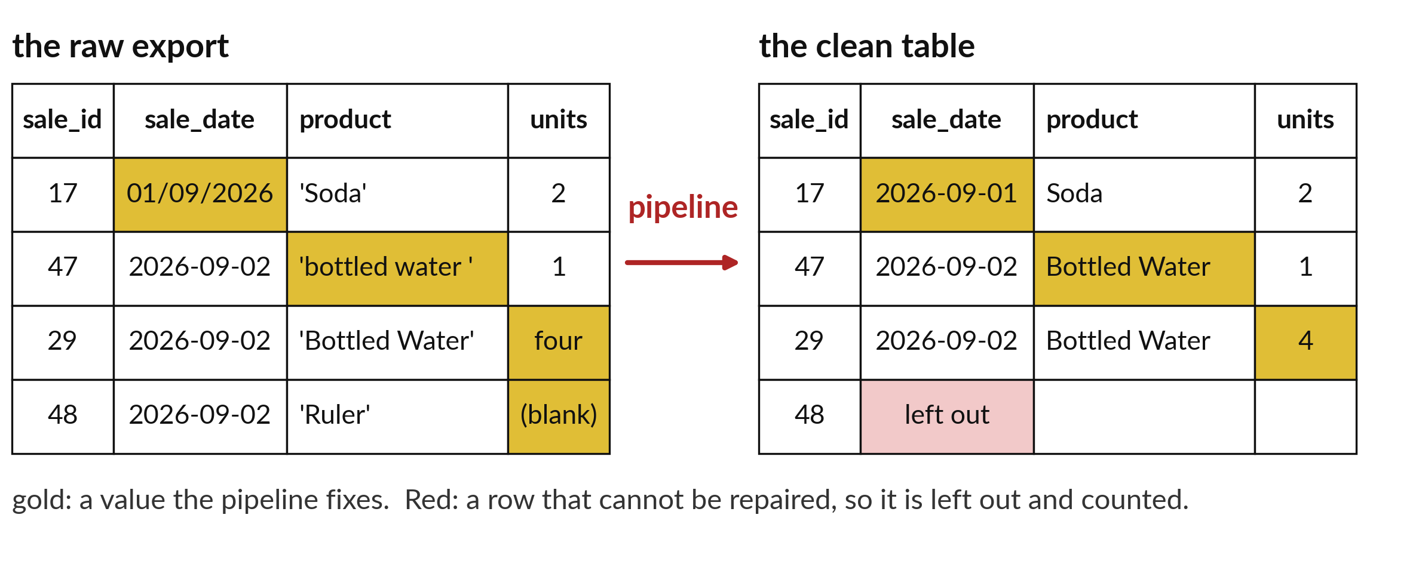
If we clean the raw export carefully,
does it give back the true revenue?
Notes:
If we clean the raw export carefully, does it give back the true revenue? The true revenue is six million three hundred and seventy five thousand nine hundred shillings. We know it because we built this data ourselves. The raw file has one thousand five hundred and thirty eight rows, with repeats, mixed dates, messy names and blanks. Today we clean it step by step and see how close we get.

Slide 3

Three hours, mostly doing
Most of our time is spent doing, in small steps, with a guess before every run.
Notes:
Here is how the 3 hours go. Each bar is as long as the time we spend on that part.
First, 10 minutes. Recall. Then, 50 minutes. Block A. After that, 15 minutes. Break away from screens. Next, 50 minutes. Block B. Then, 40 minutes. Make. Then, 15 minutes. Exit ticket, save, and an individual check with each learner.
Notice how much of the time is yours. You listen for a short while and then you do. That is on purpose, because you learn this by doing it.

Slide 4



Words for today (1 of 2)
parse
Read text and turn it into a proper date or number.
Reading a handwritten date and writing it as a real date.
normalise
Make the same thing look the same everywhere, such as one spelling and one case.
Writing every name with a capital first letter.
lookup
A dictionary that turns one value into another.
The price board.
Notes:
First the words, because every one of them is used in the code later.
parse. Read text and turn it into a proper date or number. Imagine it like this. Reading a handwritten date and writing it as a real date.
normalise. Make the same thing look the same everywhere, such as one spelling and one case. An example from everyday life. Writing every name with a capital first letter.
lookup. A dictionary that turns one value into another. Here is a way to see it. The price board.

Slide 5


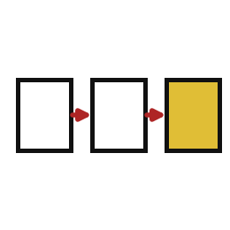
Words for today (2 of 2)
exclude
Leave a row out and count it, because it cannot be repaired.
Setting aside the damaged goods and counting them.
residual
The difference that is left after you have done everything right.
The small change nobody can account for.
pipeline
A series of cleaning steps that always run in the same order.
A production line.
Notes:
Here are the rest of today's words.
exclude. Leave a row out and count it, because it cannot be repaired. A small example. Setting aside the damaged goods and counting them.
residual. The difference that is left after you have done everything right. Picture this. The small change nobody can account for.
pipeline. A series of cleaning steps that always run in the same order. You have seen this before. A production line.

Slide 6
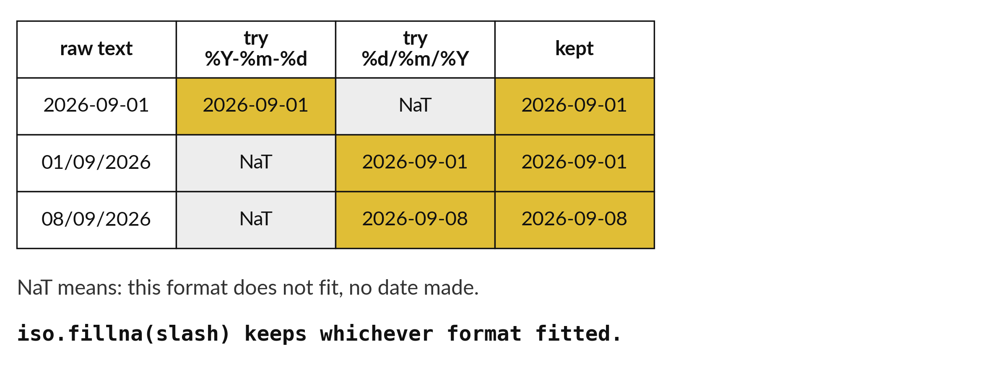
Two date styles are parsed one at a time
60 dates use slashes. The rest use year, month and day.
Notes:
The date column has two styles. Most dates are written year, month, day with dashes. Sixty are written day, month, year with slashes. To parse a date is to read the text and turn it into a real date. A single format cannot read both styles.
So we parse with the first format and let the failures come back as empty. Then we parse those with the second format. Every date ends up a real date.

Slide 7
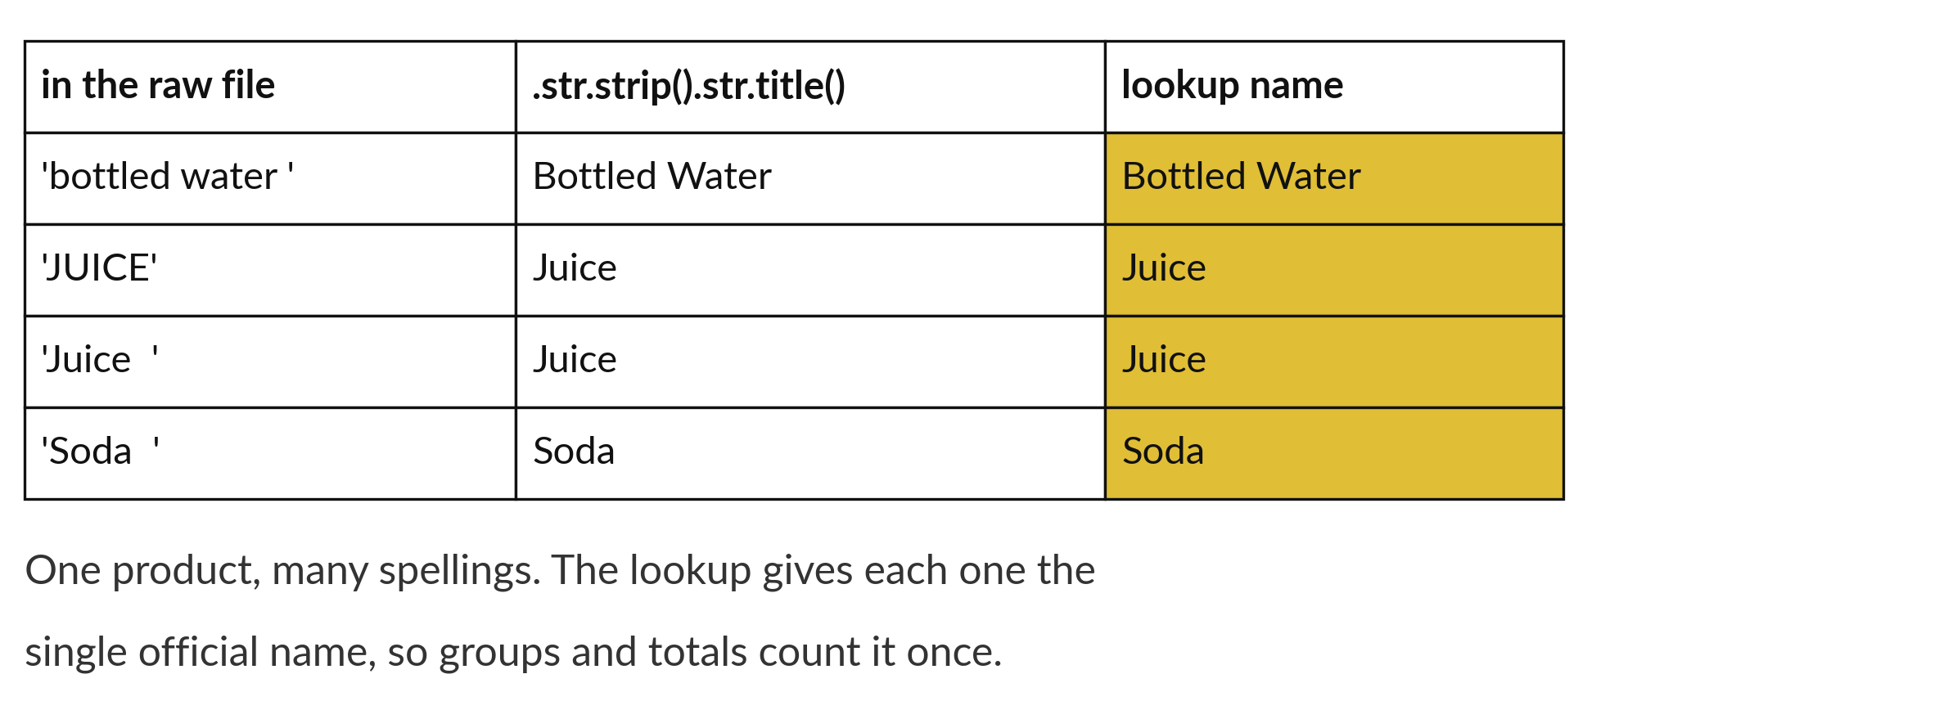
Normalised names let one lookup match them all
Strip spaces and fix capital letters, then look the name up.
Notes:
The product names are messy. Some have extra spaces, and some have capital letters in the wrong places. To the computer, pen and Pen are different words. Normalising means putting every name into one agreed shape, here with spaces trimmed and the first letters capitalised. Then a lookup against the products table finds each one.
Compare the names before and after on the picture. How many different spellings turned into one?

Slide 8

Predict: Dates and names (1 of 2)
import pandas as pd
raw = pd.read_csv("sunrise_sales_raw.csv")
work = raw.drop_duplicates().copy()
iso = pd.to_datetime(work["sale_date"], format="%Y-%m-%d", errors="coerce")
slash = pd.to_datetime(work["sale_date"], format="%d/%m/%Y", errors="coerce")
work["sale_date"] = iso.fillna(slash)
Predict how many dates cannot be parsed after both formats have been tried.
The rest of the code is on the next slide.
Notes:
The raw export has two date formats in one column: 2026-09-01 and 01/09/2026. Parse each format on its own, and keep the date that worked.
This is the part where you decide. Predict how many dates cannot be parsed after both formats have been tried. Jot it on paper before anyone speaks.

Slide 9
Predict: Dates and names (2 of 2)
print(work["sale_date"].isna().sum())
print(work["sale_date"].min().date(), work["sale_date"].max().date())
products = pd.read_csv("sunrise_products.csv")
lookup = {n.title(): n for n in products["name"]}
work["product"] = work["product"].str.strip().str.title().map(lookup)
print(work["product"].isna().sum(), work["product"].nunique())
This is the rest of the code. Keep your guess in mind.
Write your guess on paper before we run it.
Notes:
Here is the rest of the code. Read it through once. Then write your guess on paper before we run anything.

Slide 10
Run it: Dates and names
0
2026-09-01 2026-10-30
0 15
The cell prints 0 dates that cannot be parsed, then the range 2026-09-01 to 2026-10-30.
The names step prints 0 names left unmatched and 15 different products.
Every date and product name is now one consistent form.
Notes:
Let us see what happens. Match each line of the output with the line of code that made it.
The cell prints 0 dates that cannot be parsed, then the range 2026-09-01 to 2026-10-30. The names step prints 0 names left unmatched and 15 different products. Every date and product name is now one consistent form.
Which line of the output matches which line of the code? Point to each pair.

Slide 11

Investigate: Dates and names
1. Why parse the two formats separately and join the results?
2. What does errors="coerce" do?
Notes:
Now we look closely at dates and names. I have two questions for you.
Question one. Why parse the two formats separately and join the results? Write your answer in one line before we compare.
What I would say is this. Python cannot tell whether 03/09/2026 is 3 September or 9 March. We know the second format is day first, so we say so.
Question two. What does errors="coerce" do? Say it quietly to yourself before anyone answers.
Let me answer it. It turns a date that does not fit the format into a missing value instead of stopping with an error.

Slide 12

Modify: change one thing
Count how many rows used the slash format.
Then tell your neighbour what changed and how you know.
Notes:
Change one thing and watch what happens. Count how many rows used the slash format. Then explain to your neighbour what the change did.
The result: 60.

Slide 13

Break
15 minutes away from your screen
Stand up. Drink some water. Tell someone what you guessed in the first half.
Notes:
Break time. 15 minutes away from your screens. Stand up, drink some water and tell someone what you guessed in the first half.
When we come back we start the second idea.

Slide 14
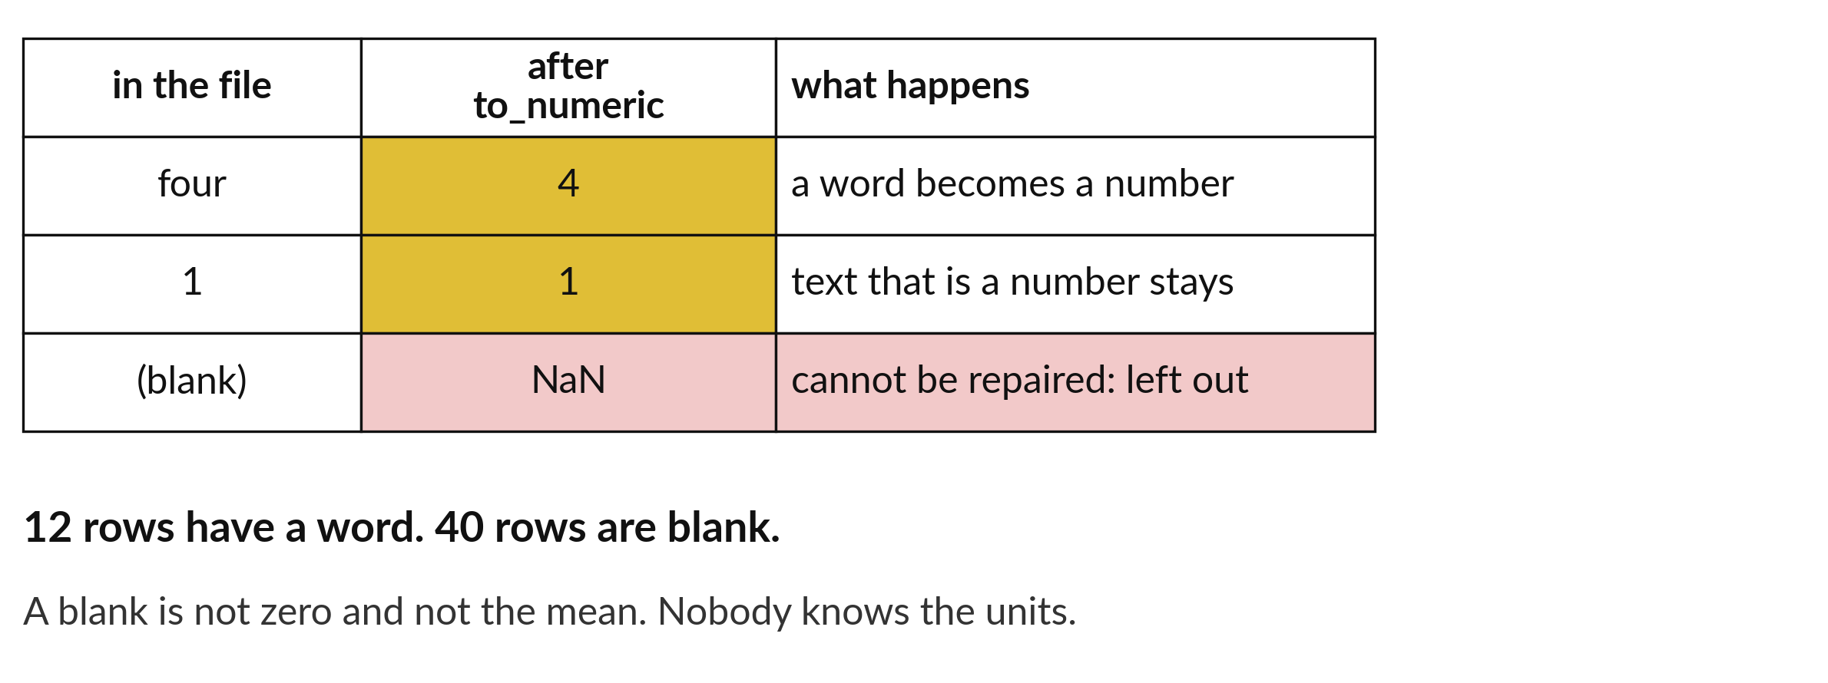
Words become numbers; blank units are left out
12 units written as words are converted. 40 blank units are excluded and counted.
Notes:
Twelve units are written as words, like two or three. We convert them using a small lookup, so two becomes the number two. Forty units are blank. We cannot guess how many were sold, so we exclude those rows from the clean table and keep them in a separate table.
The excluded rows stay available, so we can report how many there were.

Slide 15
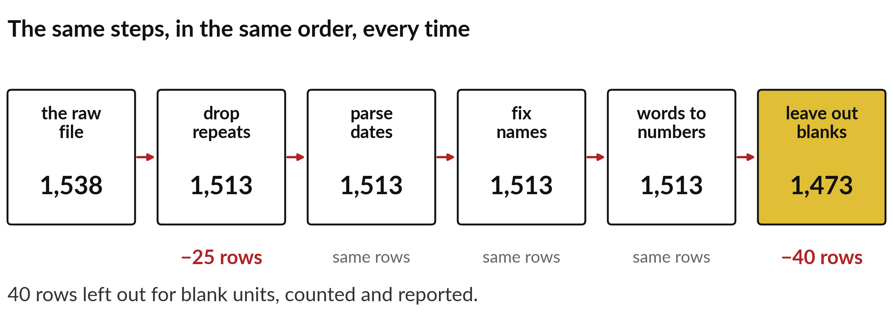
A pipeline shows the row count after every step
The raw file has 1,538 rows. The clean table keeps 1,473.
Notes:
A pipeline is the cleaning steps in order. After each step we print the number of rows. The raw file starts at one thousand five hundred and thirty eight. Dropping the twenty five repeats gives one thousand five hundred and thirteen. Leaving out the forty blank units leaves one thousand four hundred and seventy three.
Each count in the pipeline can be checked against the fault counts from session ten. If a number surprises you, the step before it is where to look.

Slide 16
Predict: Units, blanks and the residual (1 of 2)
words = {"one": 1, "two": 2, "three": 3, "four": 4, "five": 5}
work["units"] = pd.to_numeric(work["units"].replace(words), errors="coerce")
excluded = work[work["units"].isna()]
clean = work.dropna(subset=["units"]).copy()
clean["units"] = clean["units"].astype(int)
clean["line_value"] = clean["units"] * clean["unit_price_ugx"]
Predict whether the cleaned revenue will be above, equal to or below the true revenue of 6375900.
The rest of the code is on the next slide.
Notes:
Some units are written as words, such as two. A lookup turns them into numbers.
Make a prediction. Predict whether the cleaned revenue will be above, equal to or below the true revenue of 6375900. Guess on paper first. Surprises are useful.

Slide 17
Predict: Units, blanks and the residual (2 of 2)
print(len(excluded), len(clean))
print(clean["line_value"].sum())
true_sales = pd.read_csv("sunrise_sales.csv")
true_total = (true_sales["units"] * true_sales["unit_price_ugx"]).sum()
residual = true_total - clean["line_value"].sum()
print(residual)
This is the rest of the code. Keep your guess in mind.
Write your guess on paper before we run it.
Notes:
Here is the rest of the code. Read it through once. Then write your guess on paper before we run anything.

Slide 18
Run it: Units, blanks and the residual
40 1473
6250500
125400
40 rows are excluded and 1473 rows are clean.
The cleaned revenue is 6250500, which is 125400 below the true 6375900.
The residual of 125400 is the value of the 40 excluded sales.
It is not a mistake in the pipeline.
Notes:
Running it now. Match each line of the output with the line of code that made it.
40 rows are excluded and 1473 rows are clean. The cleaned revenue is 6250500, which is 125400 below the true 6375900. The residual of 125400 is the value of the 40 excluded sales. It is not a mistake in the pipeline. It is the cost of rows that cannot be recovered.
Keep your guess. We use it in the next step.

Slide 19
Investigate: Units, blanks and the residual
1. Why is the cleaned total below the true total?
2. Would it be honest to report that the two totals match?
Notes:
Now we look closely at units, blanks and the residual. I have two questions for you.
Question one. Why is the cleaned total below the true total? Say it quietly to yourself before anyone answers.
Let me answer it. The 40 blank-unit sales are missing from the clean table, and their value is what is left over.
Question two. Would it be honest to report that the two totals match? Give it thirty seconds and then we will hear a few answers.
The answer is this. No. They differ by 125400, and the report says so and says why.

Slide 20
Modify: change one thing
Prove that the residual equals the value of the 40 excluded sales, using the true sales table.
Then tell your neighbour what changed and how you know.
Notes:
Make one small change. Prove that the residual equals the value of the 40 excluded sales, using the true sales table. When you have run it, tell your neighbour what changed and how you know.
Here is what happens. Both are 125400.

Slide 21
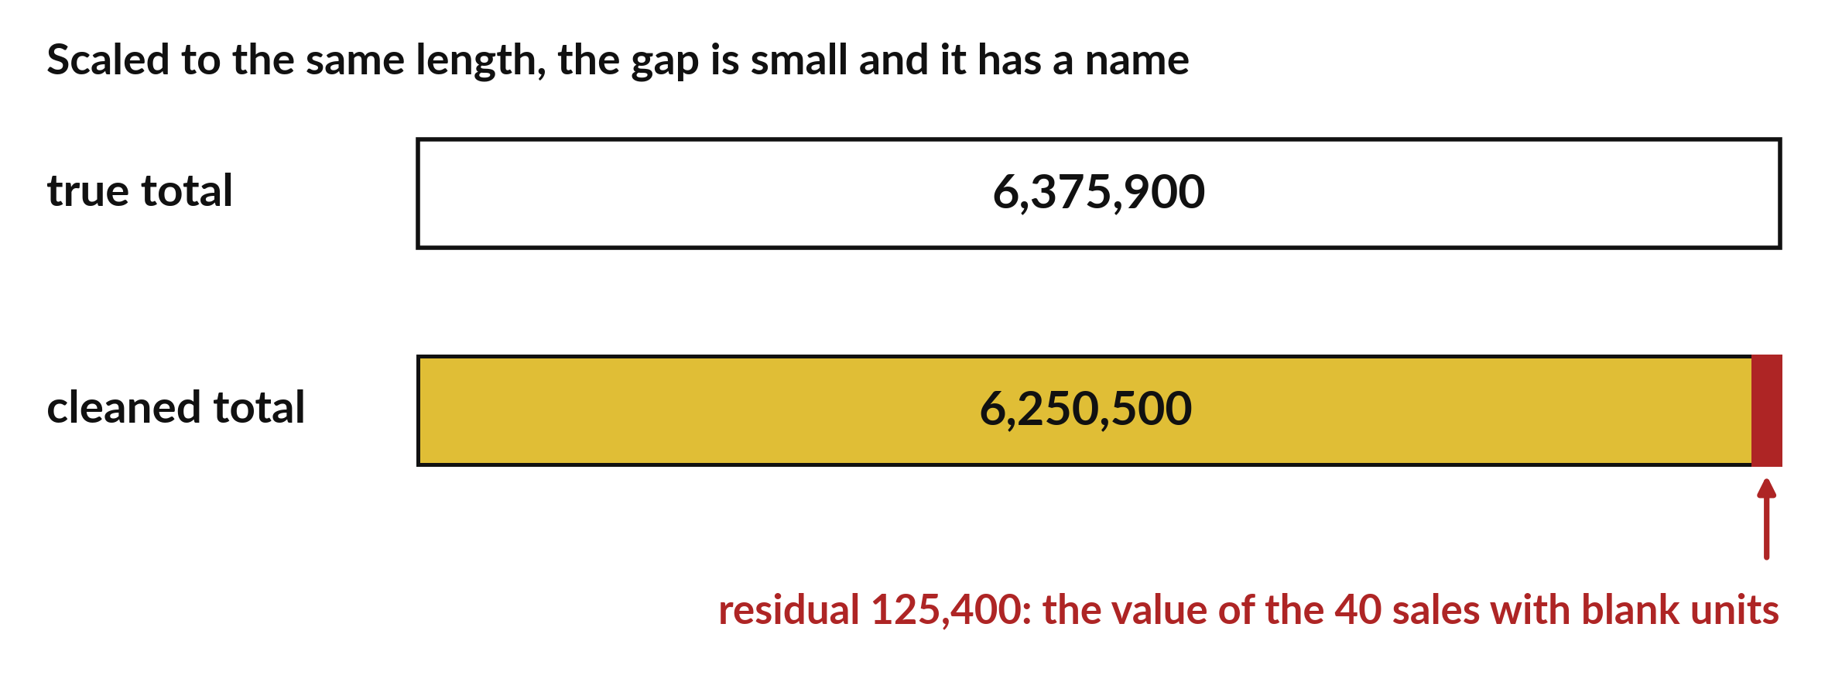
The clean total is 125,400 short of the truth
Clean: 6,250,500. True: 6,375,900. Residual: 125,400.
Notes:
After cleaning, the revenue totals six million two hundred and fifty thousand five hundred. The true figure is six million three hundred and seventy five thousand nine hundred. The gap is one hundred and twenty five thousand four hundred shillings, and it is called the residual.
The residual is the revenue of the forty rows that had blank units. We left them out on purpose, so a small gap is the honest result. Report the gap in your findings.

Slide 22
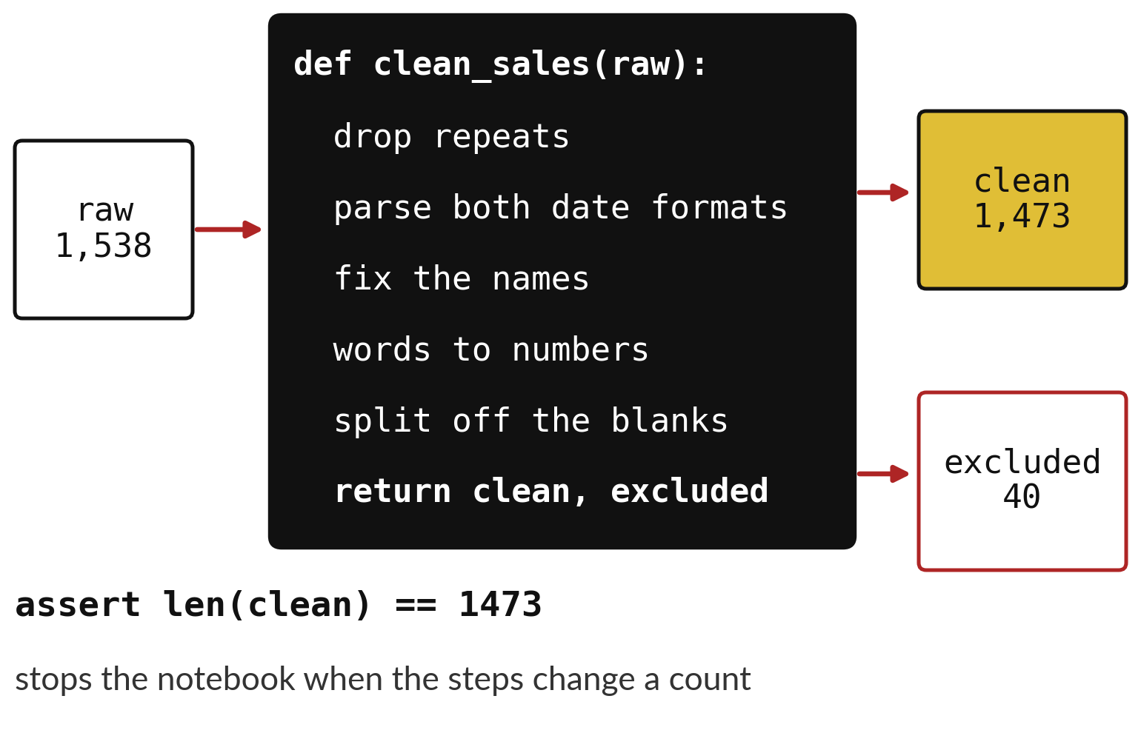
A function lets anyone rerun the cleaning steps
The function takes the raw table in.
It returns the clean table and the excluded rows.
Calling it twice gives the same answer.
Notes:
We wrap the whole pipeline in a function called clean sales. It takes the raw table, runs every step in order, and hands back two tables: the clean rows and the excluded rows.
Now cleaning is one line. A partner can run it on the same file and get the same one thousand four hundred and seventy three rows. We check that with an assert, which stops the notebook if the number is wrong.

Slide 23

Make: your own version
Put the cleaning steps in one function called clean_sales(raw) that returns the clean table and the excluded rows.
Run it on the raw export and check with assert that the clean table has 1473 rows and the clean revenue is 6250500.
Write one sentence naming the residual and its cause.
Save it as DA16. Write two sentences: what you changed and how you checked it.
Notes:
This task is yours. Run your code after every step so you can see where a problem begins. If you get stuck for a few minutes, read your error message, check the error card, and then ask me.
Save it as DA16. I will come round to each of you and ask what you changed and how you checked it.

Slide 24

Two errors you may meet today
It means: A date is written in a form the format string does not describe.
Fix: Use errors="coerce" for one format and fill the gaps with the other format.
ValueError: time data does not match format
It means: The duplicates were not removed before the other steps.
Fix: Call drop_duplicates() first and print len() after every step.
The clean table has 1538 rows, not 1513 or 1473
Notes:
Here are two errors from this session, so you recognise them when they appear.
This is the first one. You will see: ValueError: time data does not match format. It means this: A date is written in a form the format string does not describe. To fix it, use errors="coerce" for one format and fill the gaps with the other format.
The next one. You will see: The clean table has 1538 rows, not 1513 or 1473. It means this: the duplicates were not removed before the other steps. To fix it, call drop_duplicates() first and print len() after every step.
When you are stuck, read the last line of the message first.

Slide 25

Finish this sentence in your notebook
A careful clean can still leave a gap, and I report the gap and its cause.
Then save your notebook, close it and open it again to check it saved.
Notes:
Last step. Our question for today was: If we clean the raw export carefully, does it give back the true revenue?
Finish this sentence in your notebook, in your own words. A careful clean can still leave a gap, and I report the gap and its cause.
Then save your notebook, close it and open it again to check it saved.

