Slide 1
Checkpoint two: clean,
merge and reconcile
Which category earns the most in the cleaned data, and by how much do our totals fall short of the truth?
Python for Data Analysis | Session 18 of 24 | Week 6, Messy data and two tables
Holiday Data and AI Camp | The National ICT Innovation Hub, Nakawa
Notes:
Let us begin. Today is session 18 and our topic is checkpoint two: clean, merge and reconcile.
By the end of today you will be able to clean a raw export, merge it with a lookup table, and report a total together with its named difference from the true total.
We will answer one question: Which category earns the most in the cleaned data, and by how much do our totals fall short of the truth?

Slide 2
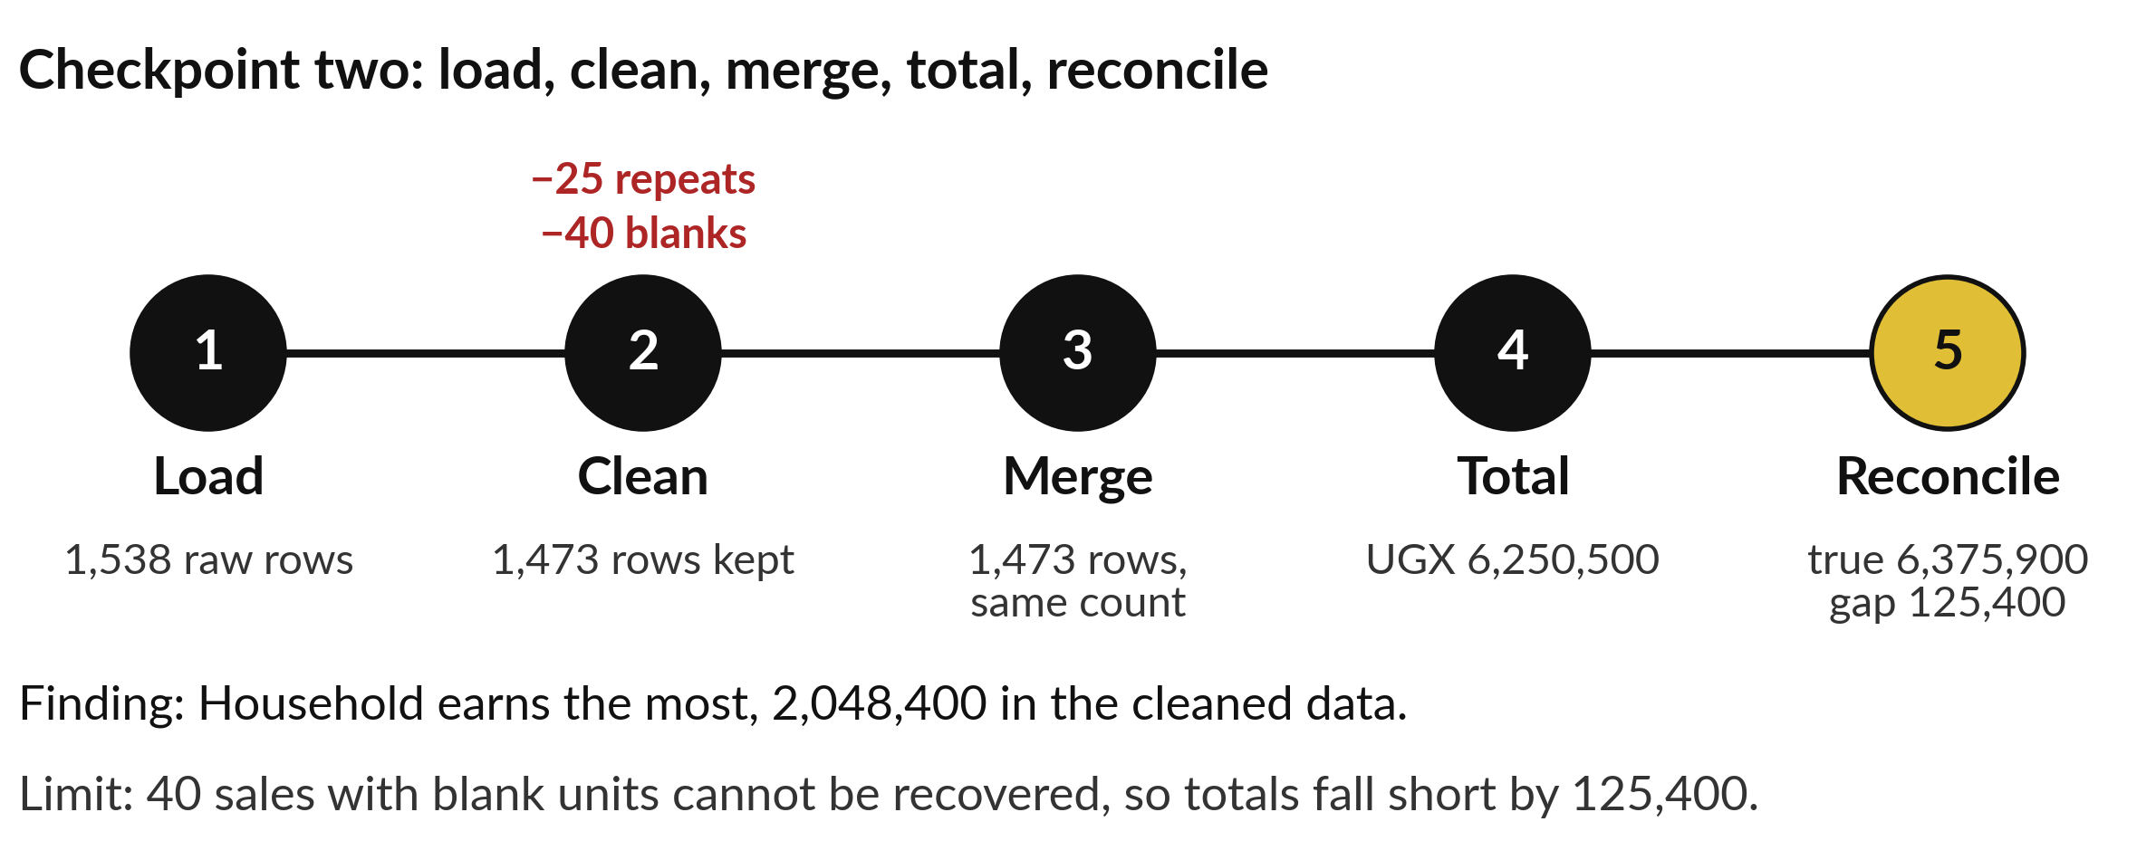
Which category earns the most in the cleaned data,
and by how much do our totals fall short of the truth?
Notes:
Second checkpoint. Which category earns the most in the cleaned data, and by how much do our totals fall short of the truth? You clean the raw export, merge it with the products table, and add up the categories. Then you reconcile. You already know the pieces. Today you put them in one notebook and show that every number agrees.

Slide 3
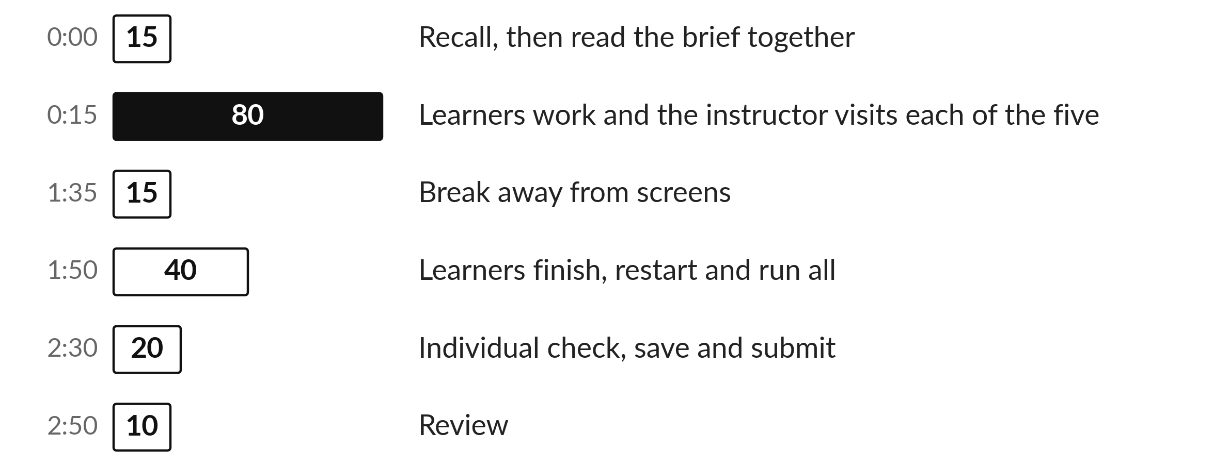
Today's plan in minutes
Today is your own work. I visit each of you and answer questions on the brief.
Notes:
Here is how the 3 hours go. Each bar is as long as the time we spend on that part.
First, 15 minutes. Recall, then read the brief together. Then, 80 minutes. Learners work and the instructor visits each of the five. After that, 15 minutes. Break away from screens. Next, 40 minutes. Learners finish, restart and run all. Then, 20 minutes. Individual check, save and submit. Then, 10 minutes. Review.
Today is your own work. I visit each of you and answer questions on the brief. Ask me now if any part of the plan is unclear.

Slide 4
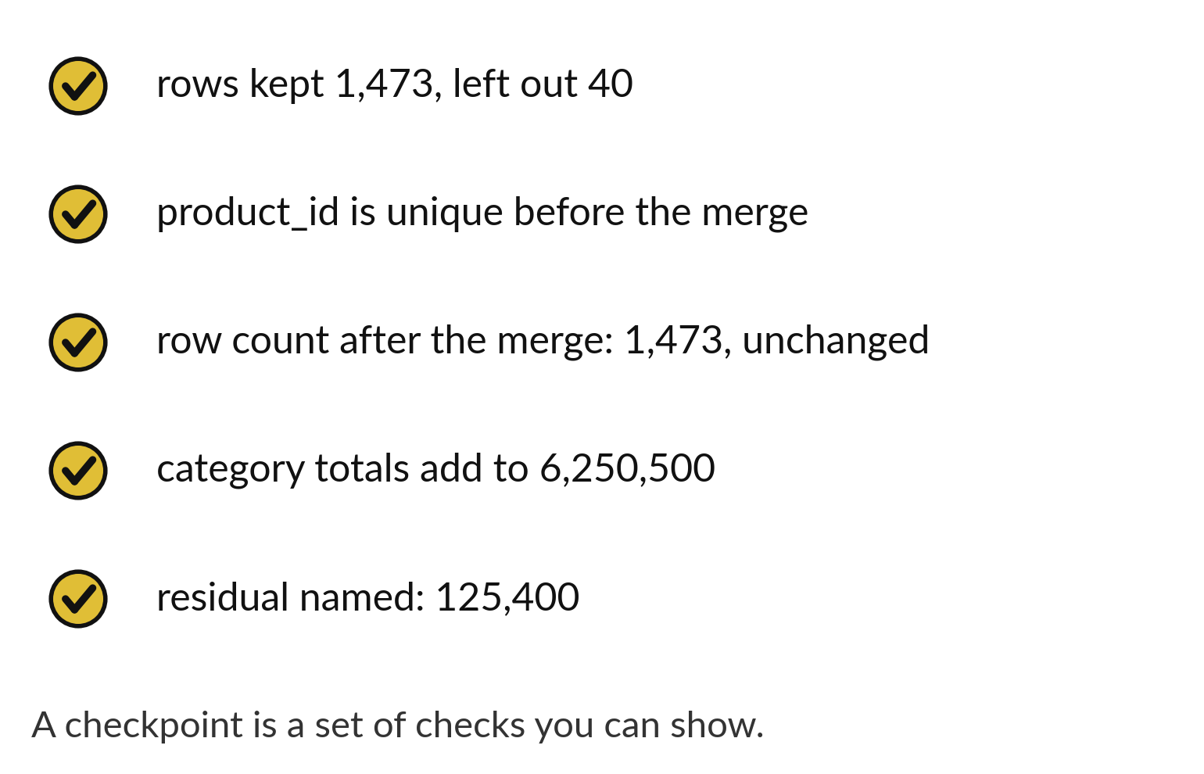
Checkpoint two ends with five checks that all pass
Count the rows kept and the rows left out.
Check the key and the merged row count.
Check the totals and name the gap.
Notes:
There are five checks, and they are the same kind of checks you would use at work. The key in the products table must be unique. The rows kept and the rows left out must be counted. The merge must keep the same number of rows. The category totals must add up to the clean total. And the gap to the true total must have a name, which is the revenue of the excluded rows.
Write each check as an assert so the notebook stops if one fails.

Slide 5
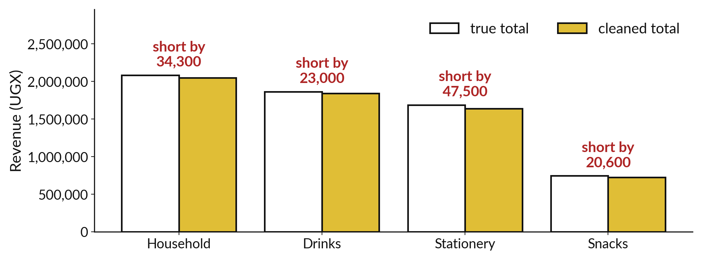
Clean category totals fall short of the true ones
Clean total 6,250,500 against a true total of 6,375,900.
Notes:
This chart compares each category in the cleaned data with the true value. The clean bars are a little lower, and the whole gap is one hundred and twenty five thousand four hundred shillings.
If your category totals add to six million three hundred and seventy five thousand nine hundred, the merge has probably gone wrong. If they add to six million two hundred and fifty thousand five hundred, you cleaned correctly.

Slide 6
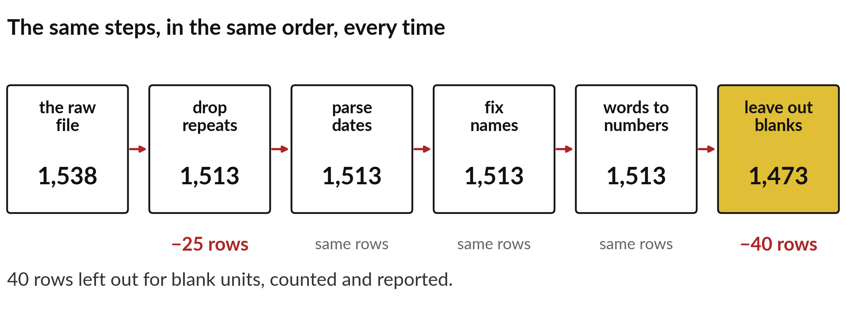
Every step has a row count that you can explain
Raw 1,538, repeats removed 1,513, blanks excluded 1,473.
Notes:
Finish by reading your pipeline from top to bottom. Each row count has a reason. We start with one thousand five hundred and thirty eight raw rows. Twenty five repeats come out, which leaves one thousand five hundred and thirteen. Forty blank rows are excluded, which leaves one thousand four hundred and seventy three, and the merge changes nothing.
If you can explain every number in that list, you have understood the checkpoint, and you are ready to start your own project next session.

Slide 7

Make: your own version (1 of 2)
In DA18.ipynb start from sunrise_sales_raw.csv.
1) Clean it with a function and report the rows kept, rows excluded and the cleaning steps.
2) Merge the clean table with the products table on product_id.
Check that the key is unique and that the row count is unchanged.
3) Total the revenue by category.
Notes:
Now you do the real work yourself. Start with the first step. If you get stuck for a few minutes, read your error message, check the error card, and then ask me.
Save it as DA18. I will come round to each of you and ask what you changed and how you checked it.
The rest of the brief is on the next slide.

Slide 8
Make: your own version (2 of 2)
4) Compare the cleaned total with the true total in sunrise_sales.csv.
Name the residual and its cause.
5) Write two limitations.
Run from a restarted kernel, save and submit DA18.ipynb and a short explanation of your checks through the route in START_HERE.md.
Write two sentences: what you changed and how you checked it.
Notes:
Here is the rest of the brief. Take your time, and save your work as you go, because a saved file is the only thing I can mark.

Slide 9

Two errors you may meet today
It means: The clean table was not used, or the excluded rows were put back by a merge.
Fix: Total from the cleaned table and compare with len() at each step.
The category totals add to 6375900, not 6250500
It means: The key is repeated in the products table.
Fix: Check is_unique on the lookup table before you merge.
MergeError or a larger row count after the merge
Notes:
Two things are likely to go wrong today. It helps to know them before they happen.
This is the first one. You will see: The category totals add to 6375900, not 6250500. It means this: the clean table was not used, or the excluded rows were put back by a merge. To fix it, total from the cleaned table and compare with len() at each step.
The next one. You will see: MergeError or a larger row count after the merge. It means this: the key is repeated in the products table. To fix it, check is_unique on the lookup table before you merge.
If you meet one of these, fix it and carry on. It happens to everyone.

Slide 10

Finish this sentence in your notebook
I can show my steps, my checks and the named reason my total is not the true total.
Then save your notebook, close it and open it again to check it saved.
Notes:
Before we finish, go back to the question we began with: Which category earns the most in the cleaned data, and by how much do our totals fall short of the truth?
Copy this sentence into your notebook and make it yours. I can show my steps, my checks and the named reason my total is not the true total.
Then save your notebook, close it and open it again to check it saved.

