Slide 1
Build a reliable analysis
Can a stranger follow my steps from the raw file to my numbers?
Python for Data Analysis | Session 20 of 24 | Week 7, Show it
Holiday Data and AI Camp | The National ICT Innovation Hub, Nakawa
Notes:
Good to see you. Today is session 20 and our topic is build a reliable analysis.
By the end of today you will be able to build the calculations for your project so that each one is checked by hand and by a second route, and a partner can rerun them.
We will answer one question: Can a stranger follow my steps from the raw file to my numbers?

Slide 2
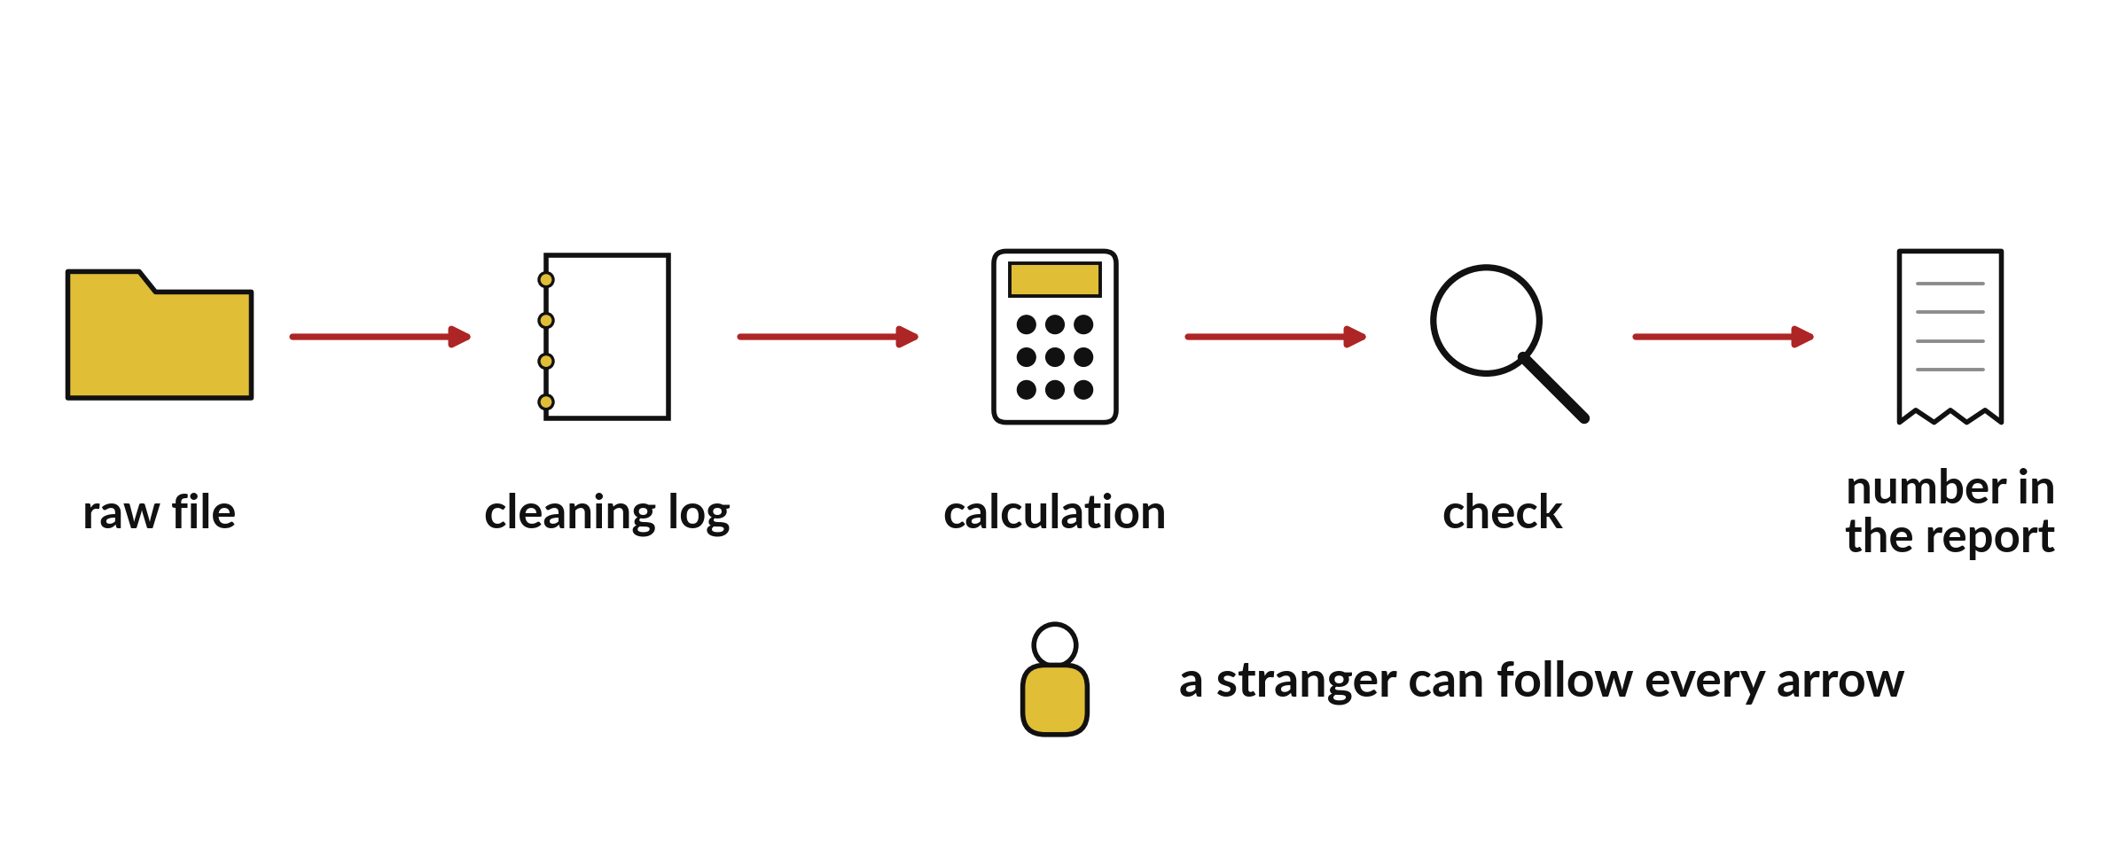
Can a stranger follow my steps
from the raw file to my numbers?
Notes:
Can a stranger follow my steps from the raw file to my numbers? Look at the path. A raw file goes in. A cleaning log records what changed. A calculation produces a number, and a check confirms it. Only then does the number go in the report. If any arrow is missing, a reader has to take your word for it. Today we build the analysis so that every arrow is visible.

Slide 3
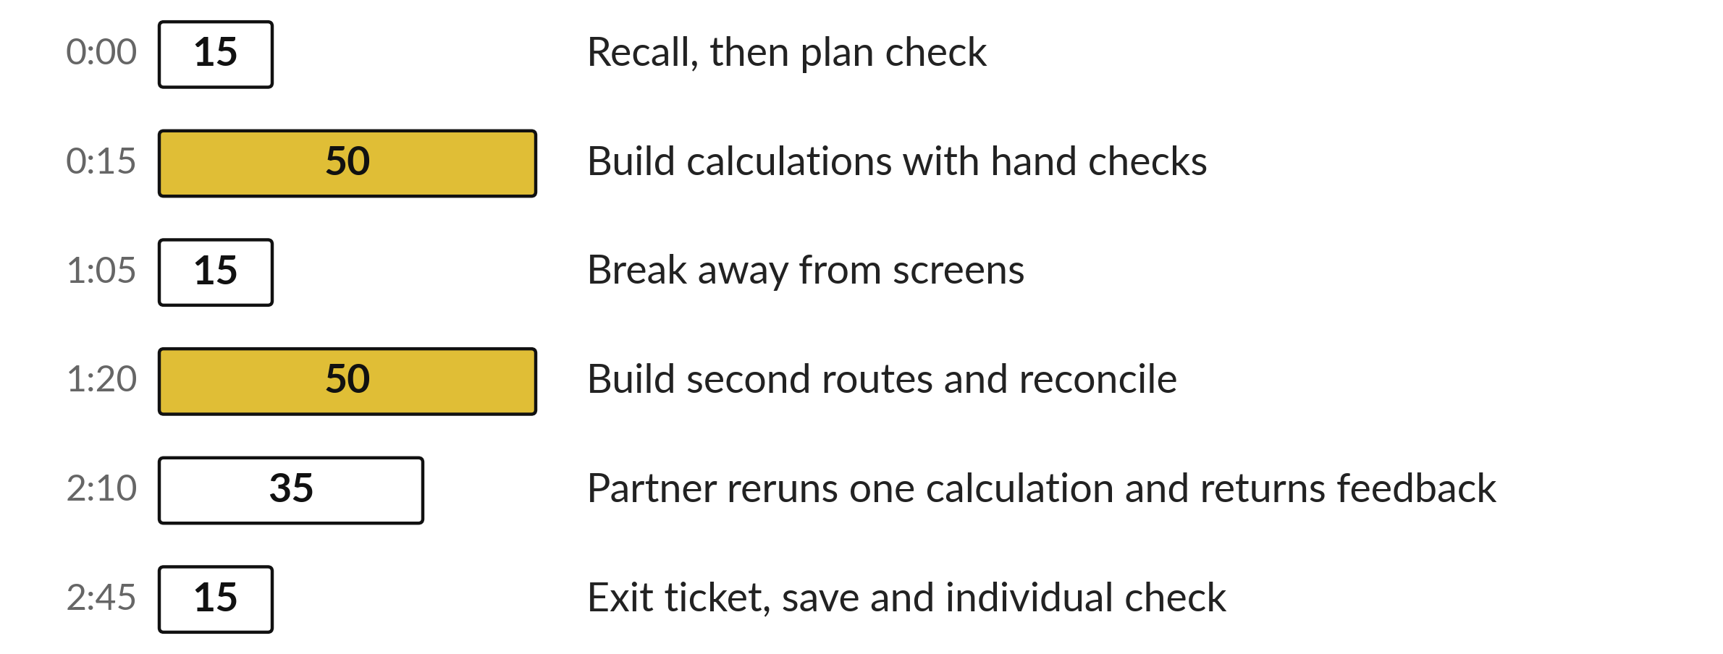
Today's plan in minutes
Most of the time is your own build, with a check and a partner.
Notes:
Here is how the 3 hours go. Each bar is as long as the time we spend on that part.
First, 15 minutes. Recall, then plan check. Then, 50 minutes. Build calculations with hand checks. After that, 15 minutes. Break away from screens. Next, 50 minutes. Build second routes and reconcile. Then, 35 minutes. Partner reruns one calculation and returns feedback. Then, 15 minutes. Exit ticket, save and individual check.
Most of the time is your own build, with a check and a partner. Ask me now if any part of the plan is unclear.

Slide 4
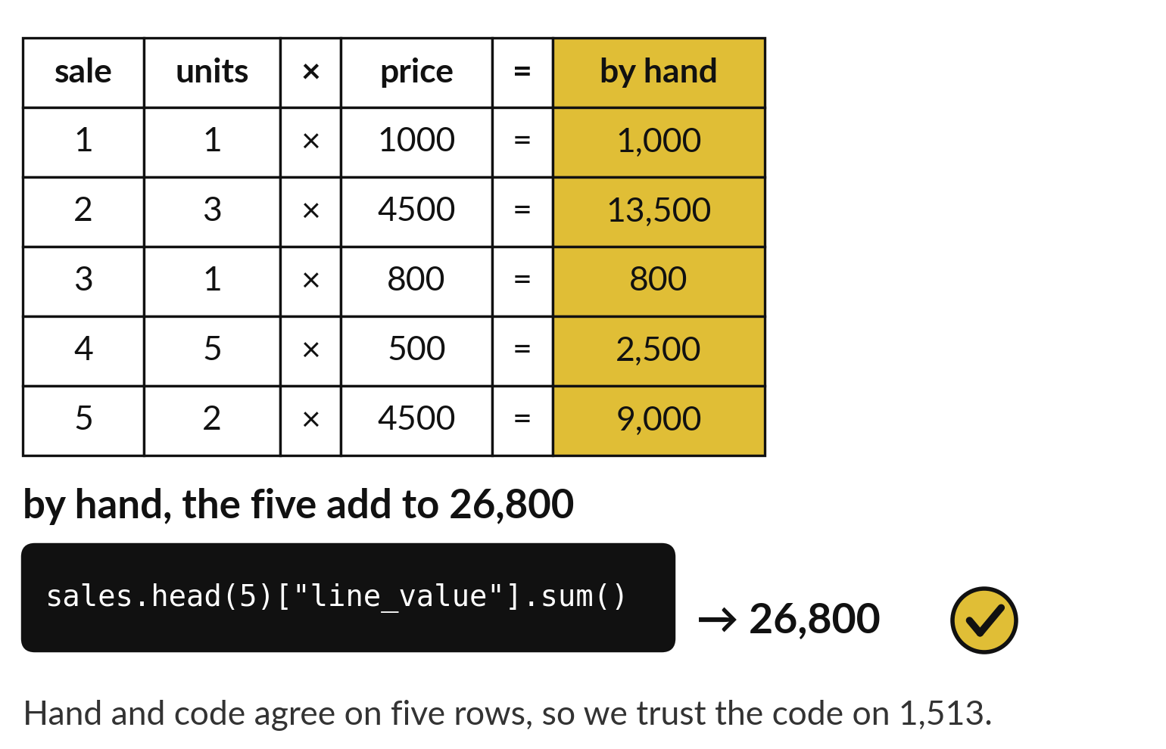
Check one calculation against a hand example
Pick five rows.
Work the answer out on paper.
The code must give the same number.
Notes:
Before you trust a calculation on fifteen hundred rows, test it on five. Take the first five sales and work out the line value for each by hand, units times price, then add them up. Then run the code on the same five rows. The two answers must agree.
If they agree, you can trust the code on the full table. If they do not, you found the mistake on a small example, where it is easy to see.

Slide 5
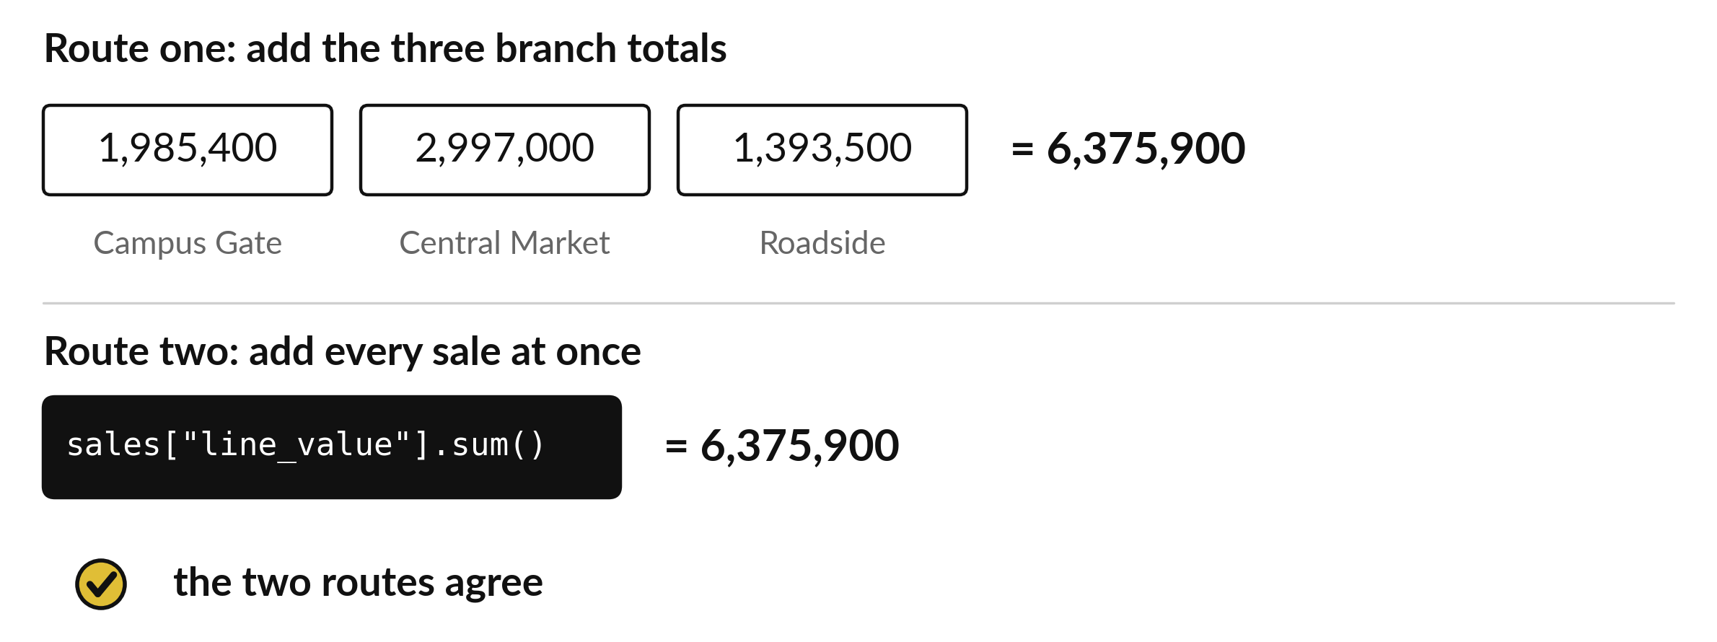
Two routes reach the same total, 6,375,900
Route one adds the branch totals. Route two adds every sale.
Notes:
A second route gives you a second chance to catch a mistake. Route one adds the three branch totals. Route two adds every sale at once. Both reach six million three hundred and seventy five thousand nine hundred.
When two independent routes agree, the chance that both are wrong in the same way is small. That is how a second route protects you from one slip in the first.

Slide 6
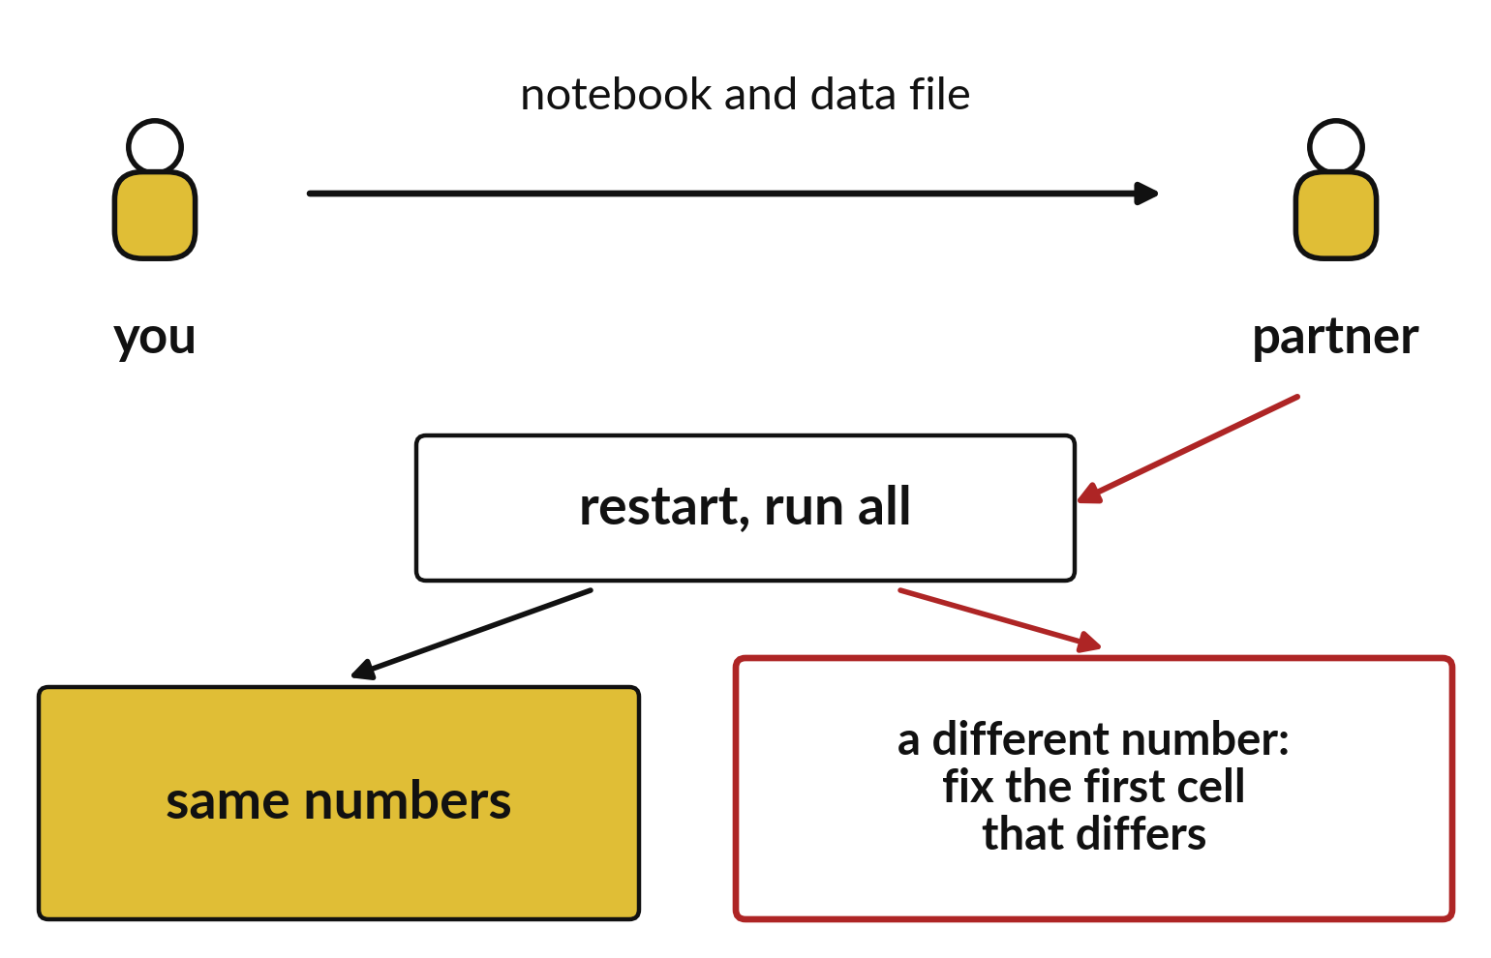
A partner reruns your notebook from the top
Send the notebook and the data file.
The partner restarts and runs all.
A different number means a hidden step.
Notes:
A partner is the best test of your notebook. You send the notebook and the data file. Your partner restarts the kernel and runs all the cells. If the numbers match yours, the notebook is reliable.
If a number is different, the first cell where it differs is the problem. Perhaps you used a file that only exists on your laptop. Find it and fix it.

Slide 7
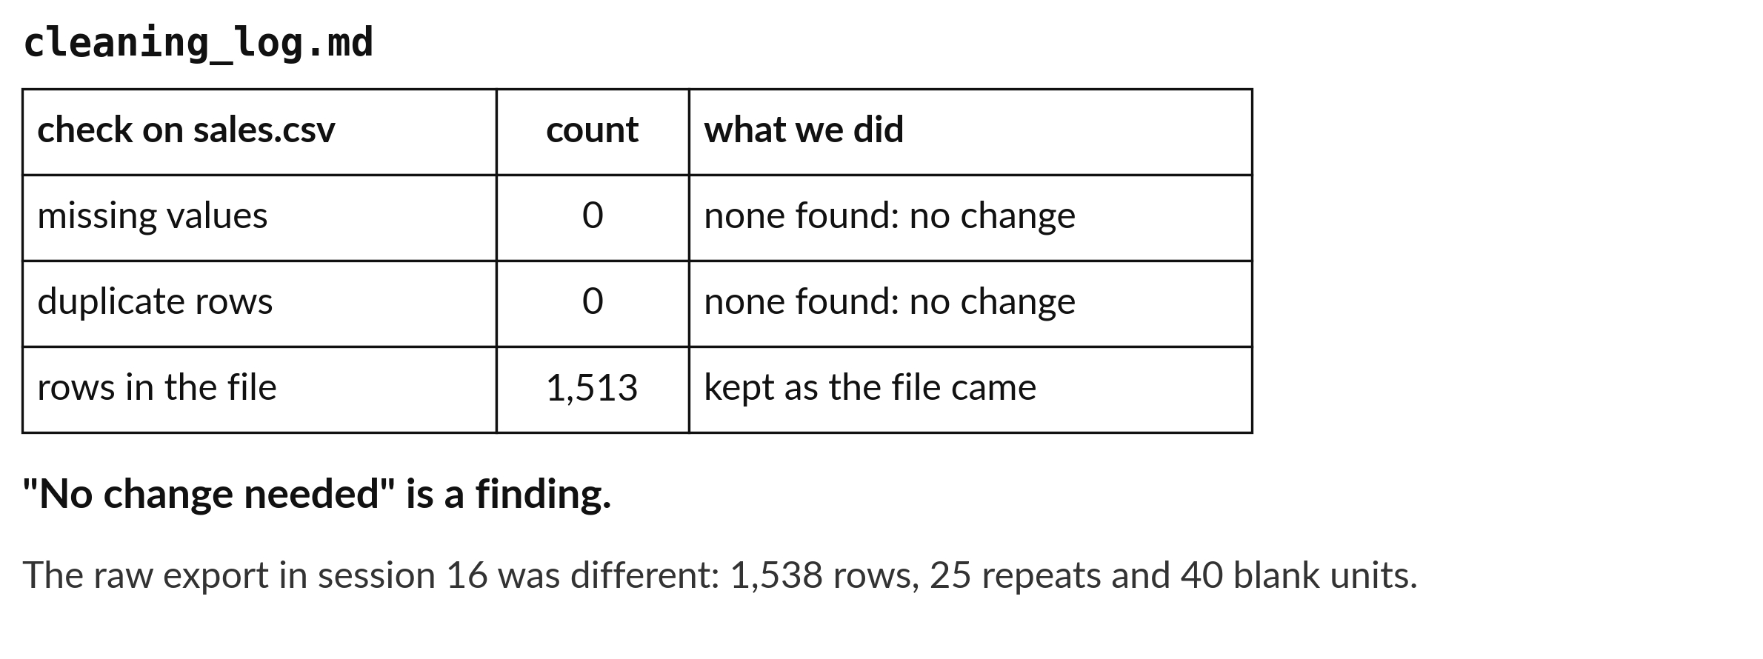
A cleaning log counts removed rows, even zero
If no change was needed, the log says so.
Notes:
The cleaning log has a line for every step you took, with the rows before and after. If your data needed no cleaning, the log still exists. It says that you checked for repeats and blanks, and found none. The sales file from session seven has one thousand five hundred and thirteen rows, no blanks and no repeats, so its log says no change. The raw export in session sixteen was different, with twenty five repeats and forty blank units.
A reader should never have to wonder whether you looked.

Slide 8

Make: your own version (1 of 2)
Work from a protected copy of the raw data.
Write the cleaning log, including a log that says no change was needed if that is true.
Build one calculation at a time.
Notes:
This is your own task for today. Take it one step at a time. If you get stuck for a few minutes, read your error message, check the error card, and then ask me.
Save it as DA20. I will come round to each of you and ask what you changed and how you checked it.
The rest of the brief is on the next slide.

Slide 9
Make: your own version (2 of 2)
For each, compare with a small hand-worked example and with a second route (pandas against NumPy, or a merged total against an unmerged one).
Ask a partner to rerun one calculation from your notebook.
Write down the first discrepancy they find and fix it.
Save it as DA20. Write two sentences: what you changed and how you checked it.
Notes:
Here is the rest of the brief. Take your time, and save your work as you go, because a saved file is the only thing I can mark.

Slide 10

Two errors you may meet today
It means: It depends on a value from a cell that no longer runs first.
Fix: Restart and run all. Move the first failing cell's dependency above it.
A calculation changes when the notebook is restarted
It means: A step uses a file path or setting that only works on your laptop.
Fix: Use paths that sit beside the notebook and state them in the first cell.
The partner gets a different answer
Notes:
Everyone meets errors, including me. Two are likely today, so let us meet them now.
This is the first one. You will see: A calculation changes when the notebook is restarted. It means this: it depends on a value from a cell that no longer runs first. To fix it, restart and run all. Move the first failing cell's dependency above it.
The next one. You will see: The partner gets a different answer. It means this: A step uses a file path or setting that only works on your laptop. To fix it, use paths that sit beside the notebook and state them in the first cell.
Keep this slide in mind when something stops working.

Slide 11
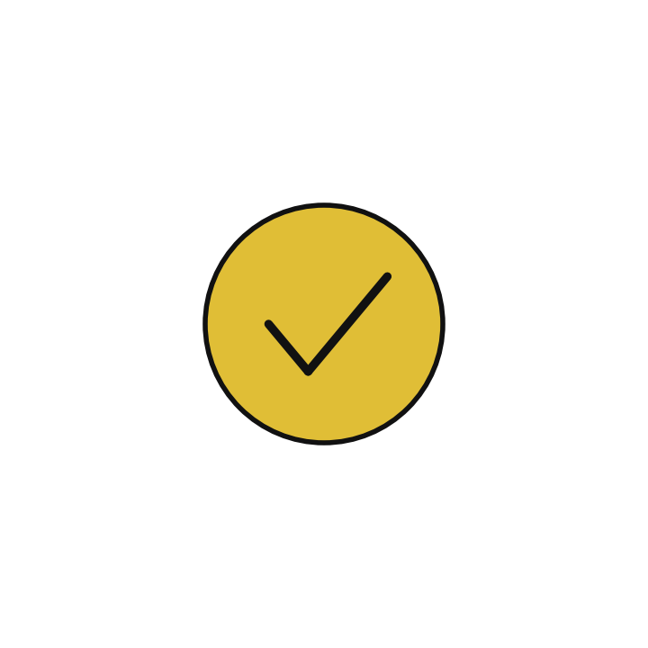
Finish this sentence in your notebook
Every number in my notebook has a check that someone else can rerun.
Then save your notebook, close it and open it again to check it saved.
Notes:
We are nearly done. Remember the question from the start of the session: Can a stranger follow my steps from the raw file to my numbers?
Write this sentence in your notebook and finish it your own way. Every number in my notebook has a check that someone else can rerun.
Then save your notebook, close it and open it again to check it saved.

