Slide 1
Numbers, names and
predicting Python output
Can I predict every line Python prints before I run it?
Machine Learning | Foundation lab F01
Holiday Data and AI Camp | The National ICT Innovation Hub, Nakawa
Notes:
Laptops open, please. Today is session 1 and our topic is numbers, names and predicting Python output.
By the end of today you will be able to explain the idea in your own words and run the worked example.
We will answer one question: Can I predict every line Python prints before I run it?

Slide 2
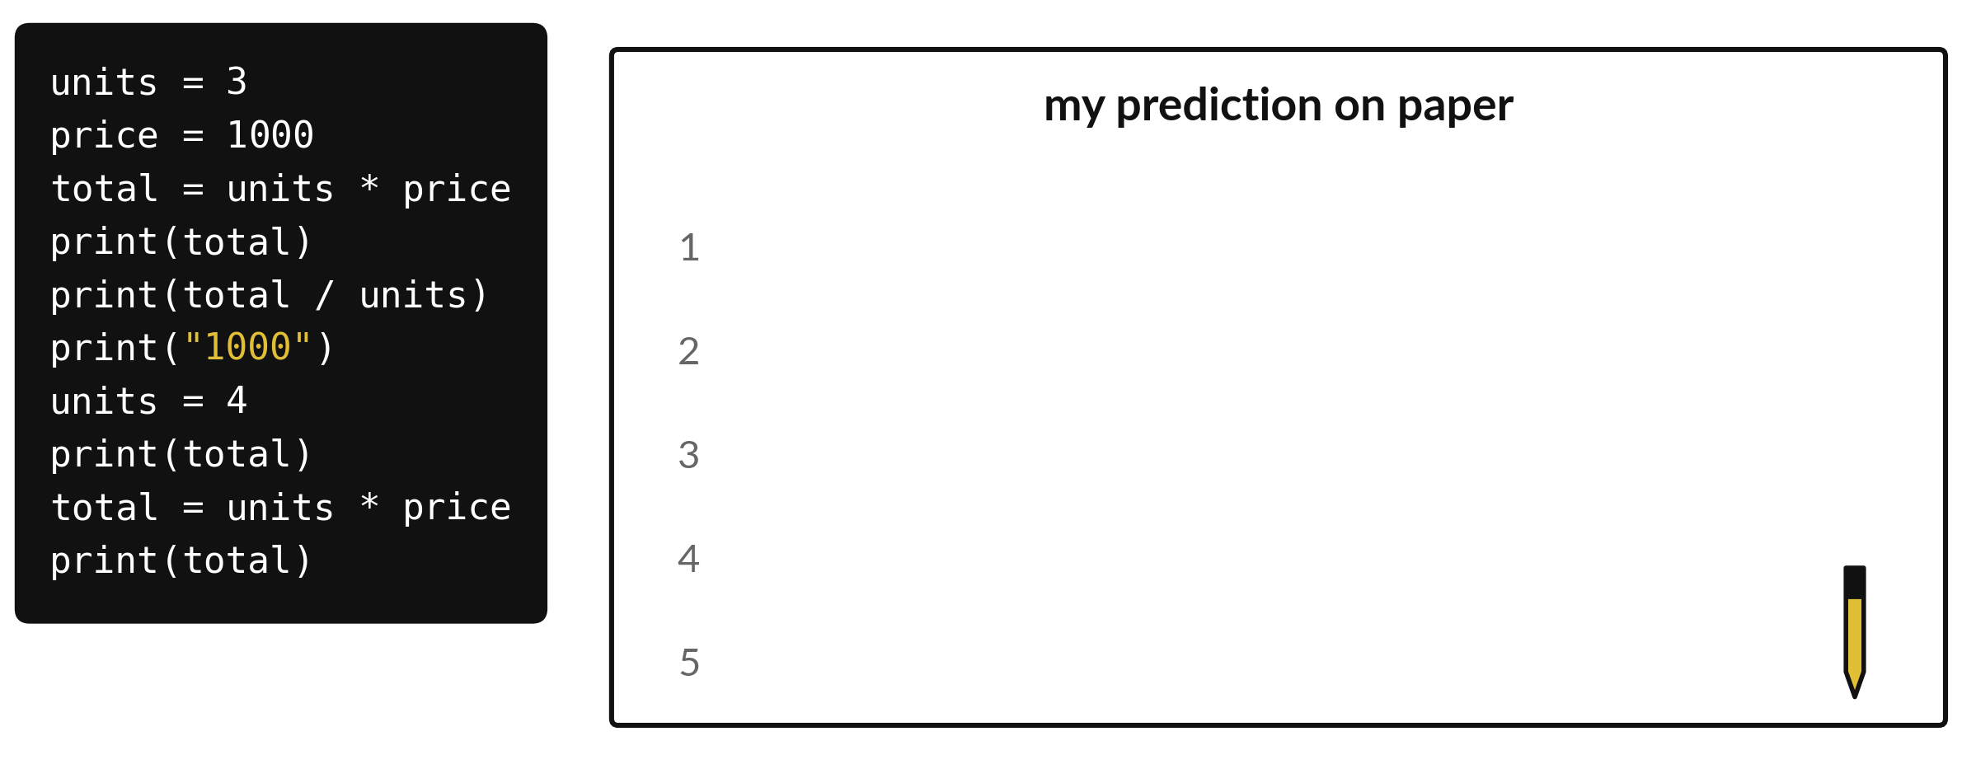
Can I predict every line
Python prints before I run it?
Notes:
In this lab you work like a computer. On the left is a short program. On the right is a sheet of paper with numbered lines, one for each thing the program will print. Your job is to fill in the paper before you run anything. The numbers on the paper mark one line for each thing the program prints. Then run the code and check your paper. A wrong guess is the best kind of lesson.

Slide 3


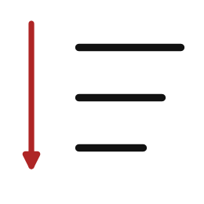
Words for today (1 of 2)
scalar
One number.
One price on a label.
name
A label that points to a value.
A tag on a box.
top to bottom
Python reads one line after another and does not look ahead.
Reading a recipe in order.
Notes:
First the words, because every one of them is used in the code later.
scalar. One number. An example from everyday life. One price on a label.
name. A label that points to a value. Here is a way to see it. A tag on a box.
top to bottom. Python reads one line after another and does not look ahead. A small example. Reading a recipe in order.

Slide 4
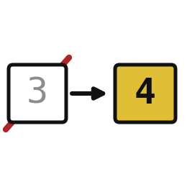
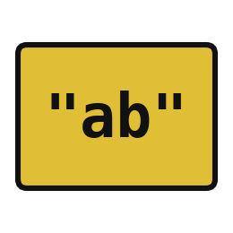

Words for today (2 of 2)
update
Giving an existing name a new value.
Crossing out a price and writing a new one.
string
Text inside quotation marks.
A word on a label.
prediction on paper
Writing what you expect before you run.
Guessing the match score before kick-off.
Notes:
Here are the rest of today's words.
update. Giving an existing name a new value. Picture this. Crossing out a price and writing a new one.
string. Text inside quotation marks. You have seen this before. A word on a label.
prediction on paper. Writing what you expect before you run. Guessing the match score before kick-off.

Slide 5
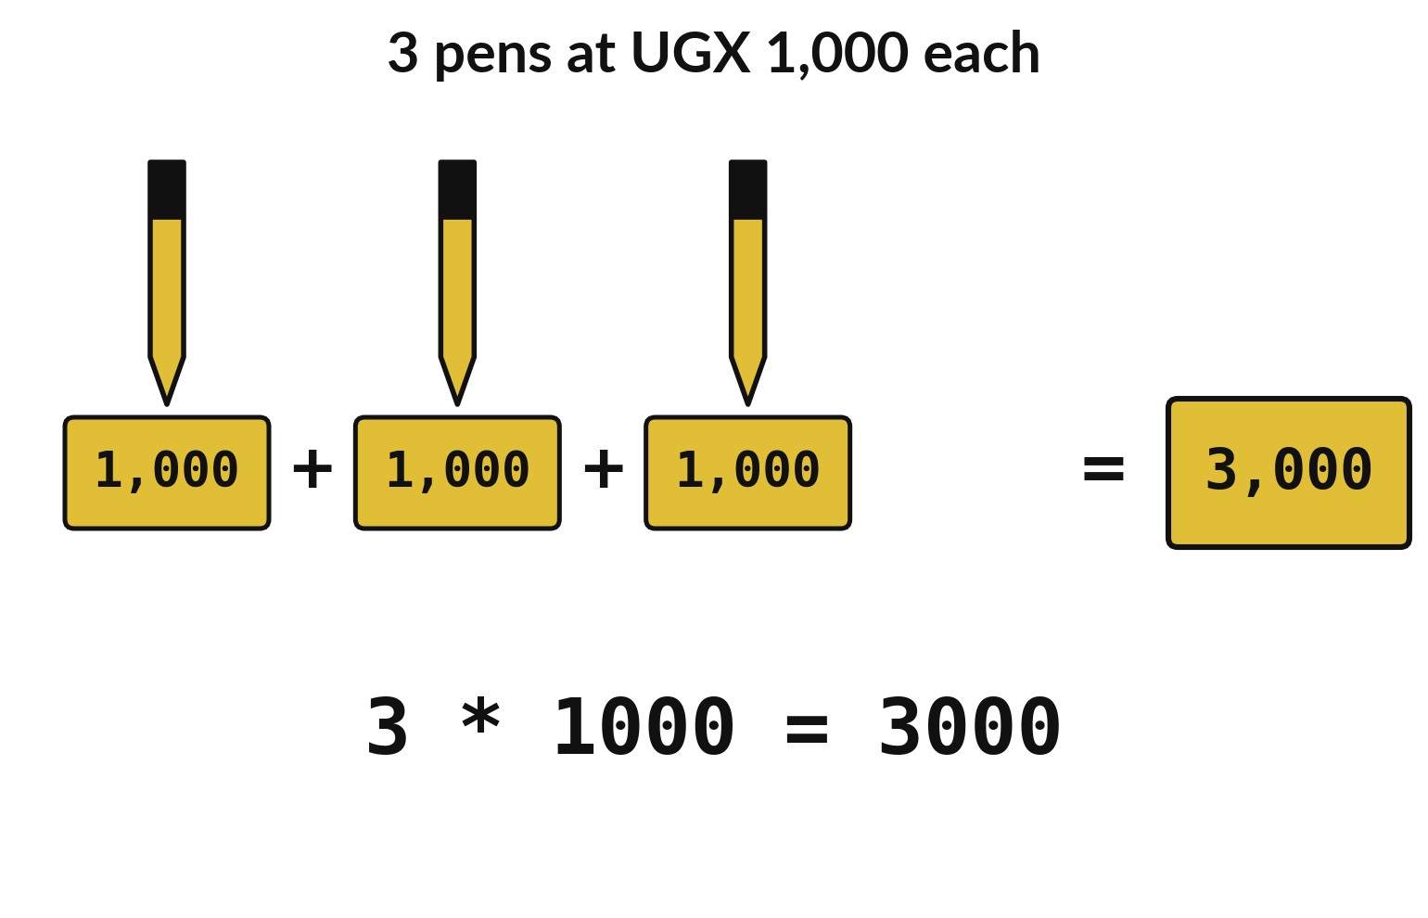
Multiplying adds the same number again, quickly
Three pens at UGX 1,000 add up to 3,000.
3 * 1000 gives the same total.
Check Python against paper.
Notes:
Start on paper, before any code. Draw three pens and write one thousand shillings on each. Add them: one thousand plus one thousand plus one thousand is three thousand. Now notice that three times one thousand gives the same answer. Multiplication is addition done quickly.
Python will do the same sum. If the paper answer and the Python answer ever disagree, one of them has a mistake, and finding it is the point of the lab.

Slide 6
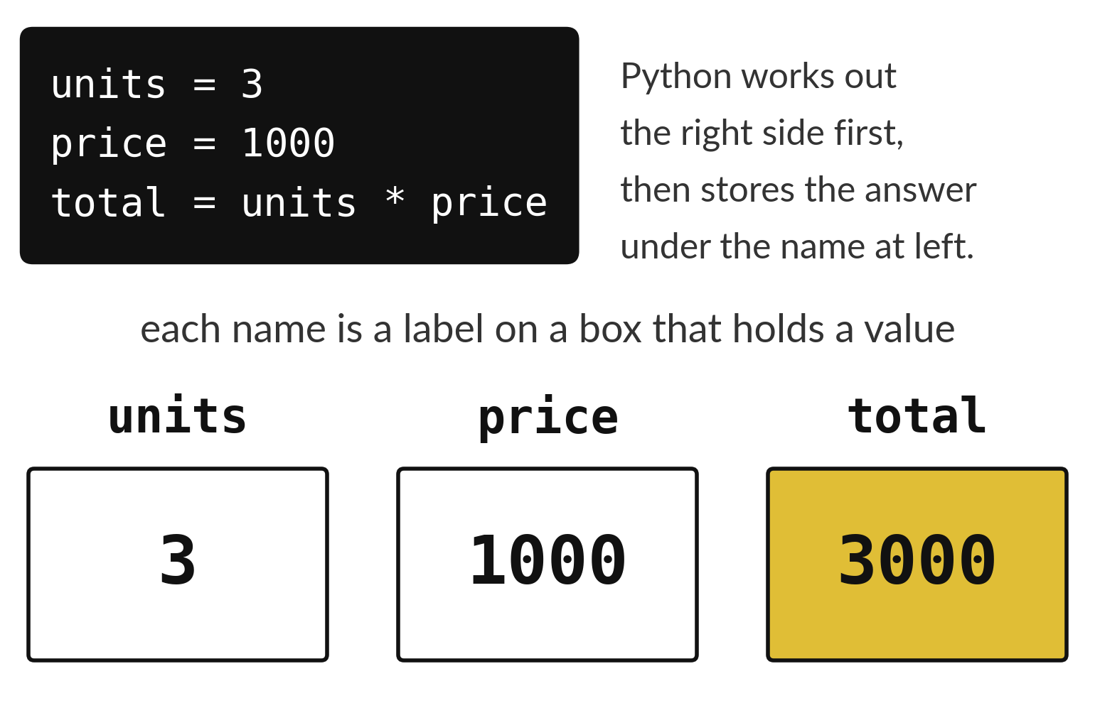
Names are boxes that hold values
units and price hold the inputs.
total holds the answer to a sum.
Each name points to one value.
Notes:
In the program, three names are created. Units holds three. Price holds one thousand. Total is worked out from the other two, so it holds three thousand.
Look at the picture and say each box aloud: units holds three, price holds one thousand, total holds three thousand. You will need this picture when you predict the printed lines.

Slide 7

Predict: names and totals
units = 3
price = 1000
total = units * price
print(total)
print(total / units)
print("1000")
units = 4
print(total)
total = units * price
print(total)
Work the paper example first: Draw three pens and label each UGX 1,000. Then predict every line the code will print.
Write your guess on paper before we run it.
Notes:
Python reads instructions from the top to the bottom, one at a time. A name points to a value.
Your turn to guess. Work the paper example first: Draw three pens and label each UGX 1,000. Then predict every line the code will print. Put it on paper first. We will check it together in a moment.

Slide 8
Run it: names and totals
3000
1000.0
1000
3000
4000
3000, 1000.0, 1000, 3000 and 4000, on separate lines.
The quoted 1000 is text.
Changing units alone does not recalculate an earlier total.
Notes:
I will run it, and you compare with your guess. Match each line of the output with the line of code that made it.
3000, 1000.0, 1000, 3000 and 4000, on separate lines. The quoted 1000 is text. Changing units alone does not recalculate an earlier total.
Check your paper. Were you close?

Slide 9
Investigate: names and totals
1. What does each line of the code do?
2. Which number surprised you?
units = 3
price = 1000
total = units * price
print(total)
print(total / units)
print("1000")
units = 4
print(total)
total = units * price
print(total)
Notes:
Now we look closely at names and totals. I have two questions for you.
Question one. What does each line of the code do? Talk it over with your neighbour for a minute.
Read each line aloud and say what it stores or prints.
Question two. Which number surprised you? Think about it for a moment, then tell the person next to you.
Here is how I would answer it. Say which printed value differed from your paper work, and why.

Slide 10
Modify: change one thing
In a new code cell calculate the price of 5 books at UGX 3000 each and print it.
Then tell your neighbour what changed and how you know.
units = 3
price = 1000
total = units * price
print(total)
print(total / units)
print("1000")
units = 4
print(total)
total = units * price
print(total)
Notes:
Time to experiment. In a new code cell calculate the price of 5 books at UGX 3000 each and print it. When you have run it, tell your neighbour what changed and how you know.
Here is what happens. 15000, then 6000.

Slide 11

Make: your own version
In a new code cell calculate the price of 5 books at UGX 3000 each and print it.
Change the quantity to 2 and recalculate.
In a text cell explain why the old total did not change until you recalculated it.
Save F01.ipynb.
Write two sentences: what you changed and how you checked it.
Notes:
This task is yours. Run your code after every step so you can see where a problem begins. If you get stuck for a few minutes, read your error message, check the error card, and then ask me.
Save it as F01. I will come round to each of you and ask what you changed and how you checked it.

Slide 12

Two errors you may meet today
It means: Python has not run a line that creates that name in this session.
Fix: Run the cell that creates the name first and check the spelling.
NameError: name 'total' is not defined
It means: The old total was worked out before the change.
Fix: Run the line that calculates the total again after you change an input.
The total did not change after I changed units
Notes:
Here are two errors from this session, so you recognise them when they appear.
This is the first one. You will see: NameError: name 'total' is not defined. It means this: Python has not run a line that creates that name in this session. To fix it, Run the cell that creates the name first and check the spelling.
The next one. You will see: The total did not change after I changed units. It means this: the old total was worked out before the change. To fix it, Run the line that calculates the total again after you change an input.
When you are stuck, read the last line of the message first.

Slide 13

Finish this sentence in your notebook
I can explain numbers, names and predicting Python output in my own words.
Then save your notebook, close it and open it again to check it saved.
Notes:
Last step. Our question for today was: Can I predict every line Python prints before I run it?
Finish this sentence in your notebook, in your own words. I can explain numbers, names and predicting Python output in my own words.
Then save your notebook, close it and open it again to check it saved.

