Slide 1
Variation, proportions
and probability
Two groups can have the same mean. How can I tell them apart?
Machine Learning | Foundation lab F03
Holiday Data and AI Camp | The National ICT Innovation Hub, Nakawa
Notes:
Here we go. Today is session 3 and our topic is variation, proportions and probability.
By the end of today you will be able to explain the idea in your own words and run the worked example.
We will answer one question: Two groups can have the same mean. How can I tell them apart?

Slide 2
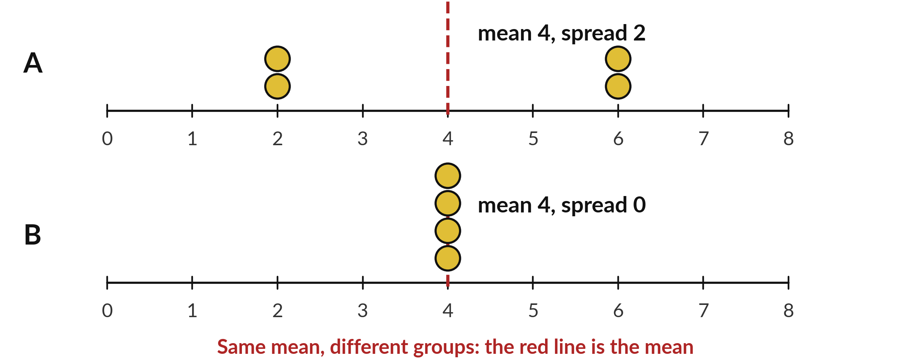
Two groups can have the same
mean. How can I tell them apart?
Notes:
Group A has the numbers two, two, six and six. Group B has four, four, four and four. Both have a mean of four. Yet they are very different groups, because A is spread out and B is not. In this lab you find a number that tells them apart, and you meet proportion and probability along the way.

Slide 3
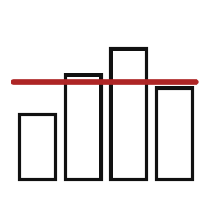
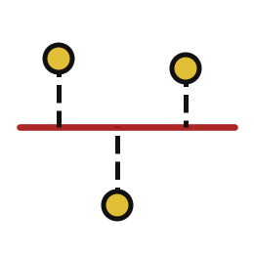
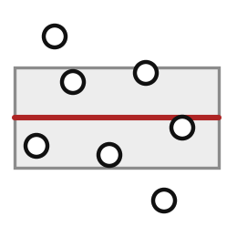
Words for today (1 of 2)
mean
The total shared out equally.
Sharing a bag of mandazi.
deviation
A value minus the mean; it can be negative.
How far a mark is from the class average.
standard deviation
A typical size of the deviations, in the original unit.
How spread out the marks are.
Notes:
Here are the words for today. Listen for the picture that goes with each one.
mean. The total shared out equally. Think of a shop. Sharing a bag of mandazi.
deviation. A value minus the mean; it can be negative. Imagine it like this. How far a mark is from the class average.
standard deviation. A typical size of the deviations, in the original unit. An example from everyday life. How spread out the marks are.

Slide 4
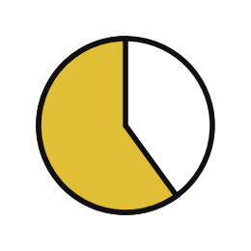


Words for today (2 of 2)
proportion
A part divided by the whole.
3 blue counters out of 5.
probability
How likely an outcome is under stated conditions.
A fair die gives a 6 about once in six throws.
observed fraction
What actually happened in a limited number of tries.
Ten throws of a die.
Notes:
Two more words to know before we start.
proportion. A part divided by the whole. Here is a way to see it. 3 blue counters out of 5.
probability. How likely an outcome is under stated conditions. A small example. A fair die gives a 6 about once in six throws.
observed fraction. What actually happened in a limited number of tries. Picture this. Ten throws of a die.

Slide 5
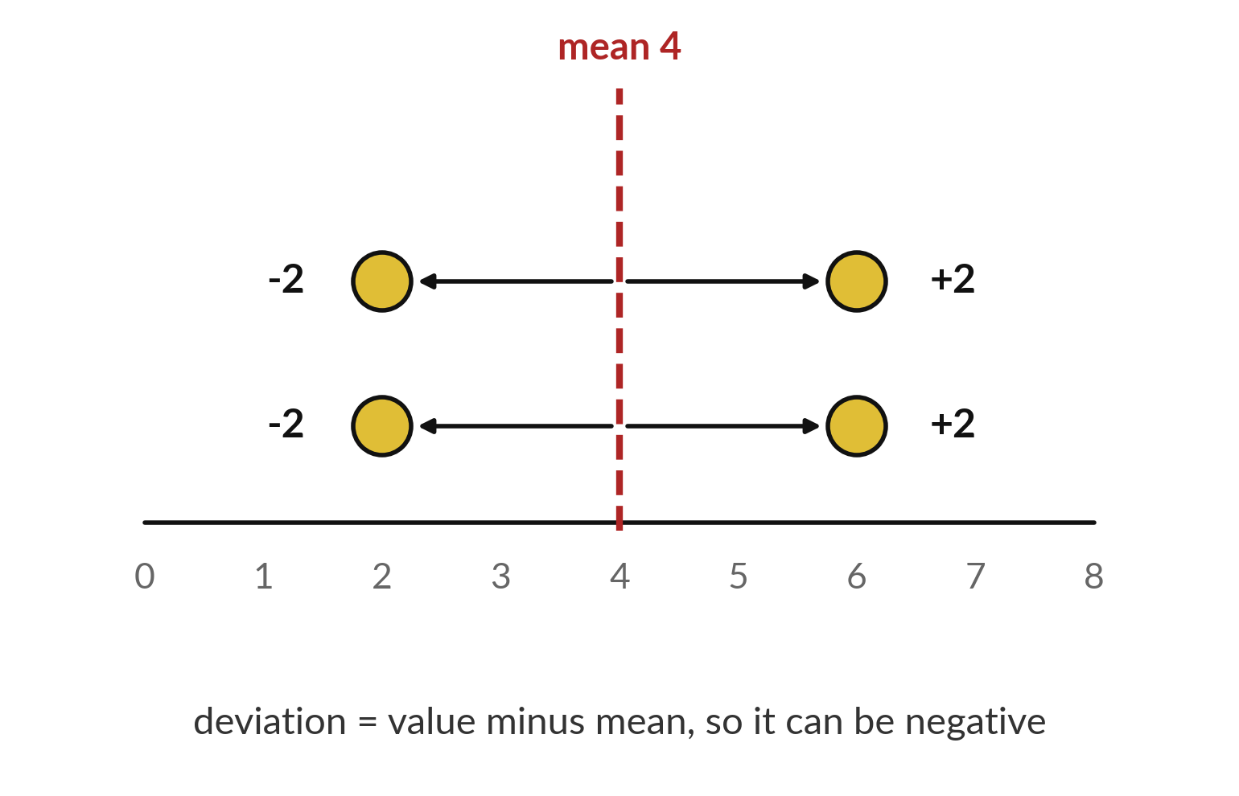
A deviation is how far a value sits from the mean
Subtract the mean from each value.
Below the mean gives a negative number.
Above the mean gives a positive number.
Notes:
The mean of two, two, six and six is four. For each value, subtract the mean. Two gives minus two. Six gives plus two. These gaps are called deviations, and they can be negative.
The standard deviation is a typical size of these gaps. For this group it is two.

Slide 6

Predict: spread and chance
import numpy as np
values = np.array([2, 2, 6, 6])
mean = values.mean()
deviations = values - mean
spread = values.std()
steady = np.array([4, 4, 4, 4])
print(mean, deviations, spread)
print(steady.mean(), steady.std())
print(2 / 6, 2 / 6 * 100)
Work the paper example first: Put four cards on the table: 2, 2, 6, 6. Then predict every line the code will print.
Write your guess on paper before we run it.
Notes:
The mean is a total divided by a count. Two groups can have the same mean and different spread.
Now your guess. Work the paper example first: Put four cards on the table: 2, 2, 6, 6. Then predict every line the code will print. Write one line on paper. I will give you a minute.

Slide 7
Run it: spread and chance
4.0 [-2. -2. 2. 2.] 2.0
4.0 0.0
0.3333333333333333 33.33333333333333
Line one: mean 4.0, deviations minus 2, minus 2, 2 and 2, spread 2.0.
Line two, the steady group: mean 4.0, spread 0.0.
Line three: 0.3333 and 33.33, a chance of 1 in 3, or 33.3 percent.
Notes:
Watch the output as it appears. Match each line of the output with the line of code that made it.
Line one: mean 4.0, deviations minus 2, minus 2, 2 and 2, spread 2.0. Line two, the steady group: mean 4.0, spread 0.0. Line three: 0.3333 and 33.33, a chance of 1 in 3, or 33.3 percent.
Tell the person next to you whether your guess matched.

Slide 8

Investigate: spread and chance
1. What does each line of the code do?
2. Which number surprised you?
Notes:
Now we look closely at spread and chance. I have two questions for you.
Question one. What does each line of the code do? Have a go in your head first.
Here is how I would answer it. Read each line aloud and say what it stores or prints.
Question two. Which number surprised you? Write your answer in one line before we compare.
What I would say is this. Say which printed value differed from your paper work, and why.

Slide 9

Modify: change one thing
Repeat for [1, 1, 5, 5].
Then tell your neighbour what changed and how you know.
Notes:
Your hands on the keyboard now. Repeat for [1, 1, 5, 5]. After you run it, say in one sentence what changed and how you checked.
You should see this. Mean 3.

Slide 10

Make: your own version
Repeat for [1, 1, 5, 5].
Explain the mean and spread in words.
A bag has 3 blue and 2 red counters.
State the chance of blue and its percentage, assuming each counter is equally likely.
Save F03.ipynb.
Write two sentences: what you changed and how you checked it.
Notes:
Now you do the real work yourself. Start with the first step. If you get stuck for a few minutes, read your error message, check the error card, and then ask me.
Save it as F03. I will come round to each of you and ask what you changed and how you checked it.

Slide 11

Two errors you may meet today
It means: The signed deviations were added without squaring them.
Fix: Square each deviation first, then add them.
The deviations add up to zero
It means: The whole was divided by the part.
Fix: Divide the part by the whole, then multiply by 100.
A percentage above 100
Notes:
Two things are likely to go wrong today. It helps to know them before they happen.
This is the first one. You will see: The deviations add up to zero. It means this: the signed deviations were added without squaring them. To fix it, square each deviation first, then add them.
The next one. You will see: A percentage above 100. It means this: the whole was divided by the part. To fix it, divide the part by the whole, then multiply by 100.
If you meet one of these, fix it and carry on. It happens to everyone.

Slide 12

Finish this sentence in your notebook
I can explain variation, proportions and probability in my own words.
Then save your notebook, close it and open it again to check it saved.
Notes:
Before we finish, go back to the question we began with: Two groups can have the same mean. How can I tell them apart?
Copy this sentence into your notebook and make it yours. I can explain variation, proportions and probability in my own words.
Then save your notebook, close it and open it again to check it saved.

