Slide 1
Arithmetic, converting
text and reading errors
How do I turn the text of a price into a number I can calculate with?
Machine Learning | Session 3 of 24 | Week 1, Python and a first prediction
Holiday Data and AI Camp | The National ICT Innovation Hub, Nakawa
Notes:
Laptops open, please. Today is session 3 and our topic is arithmetic, converting text and reading errors.
By the end of today you will be able to calculate with the five basic operators, turn text into a number, and find the line an error points to.
We will answer one question: How do I turn the text of a price into a number I can calculate with?

Slide 2
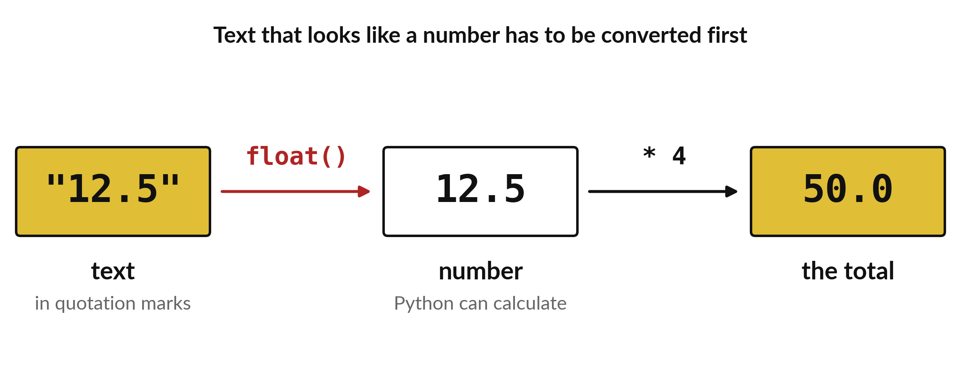
How do I turn the text of a price
into a number I can calculate with?
Notes:
Data often arrives as text. A price might be stored as the characters one, two, a point and five, with quotation marks around them. Python cannot multiply text. The picture shows the fix: convert the text into a number first, then calculate with it. Today you learn that conversion, the four arithmetic symbols, and how to read the error message when something goes wrong.

Slide 3

Three hours, mostly doing
Most of our time is spent doing, in small steps, with a guess before every run.
Notes:
Here is how the 3 hours go. Each bar is as long as the time we spend on that part.
First, 10 minutes. Recall. Then, 50 minutes. Block A. After that, 15 minutes. Break away from screens. Next, 50 minutes. Block B. Then, 40 minutes. Make. Then, 15 minutes. Exit ticket, save, and an individual check with each learner.
Notice how much of the time is yours. You listen for a short while and then you do. That is on purpose, because you learn this by doing it.

Slide 4
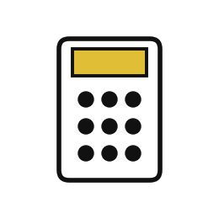


Words for today (1 of 2)
operator
A symbol that tells Python which calculation to do.
The plus and minus keys on a calculator.
parentheses
Brackets that make Python calculate the inside first.
Doing the part in brackets first in maths.
comment
A line starting with # that Python ignores and people read.
A note written in the margin.
Notes:
We need a few words today. For each one I will say what it means and give you something to picture.
operator. A symbol that tells Python which calculation to do. Imagine it like this. The plus and minus keys on a calculator.
parentheses. Brackets that make Python calculate the inside first. An example from everyday life. Doing the part in brackets first in maths.
comment. A line starting with # that Python ignores and people read. Here is a way to see it. A note written in the margin.

Slide 5
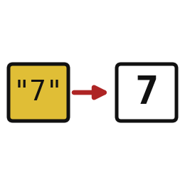


Words for today (2 of 2)
convert
Change a value from one type to another, such as text to a number.
Changing shillings into dollars before adding.
error message
Python telling you what it could not do and where.
A teacher marking the exact line you got wrong.
traceback
The list of lines Python followed before the error.
A trail of footprints that ends at the problem.
Notes:
More words for today.
convert. Change a value from one type to another, such as text to a number. A small example. Changing shillings into dollars before adding.
error message. Python telling you what it could not do and where. Picture this. A teacher marking the exact line you got wrong.
traceback. The list of lines Python followed before the error. You have seen this before. A trail of footprints that ends at the problem.

Slide 6
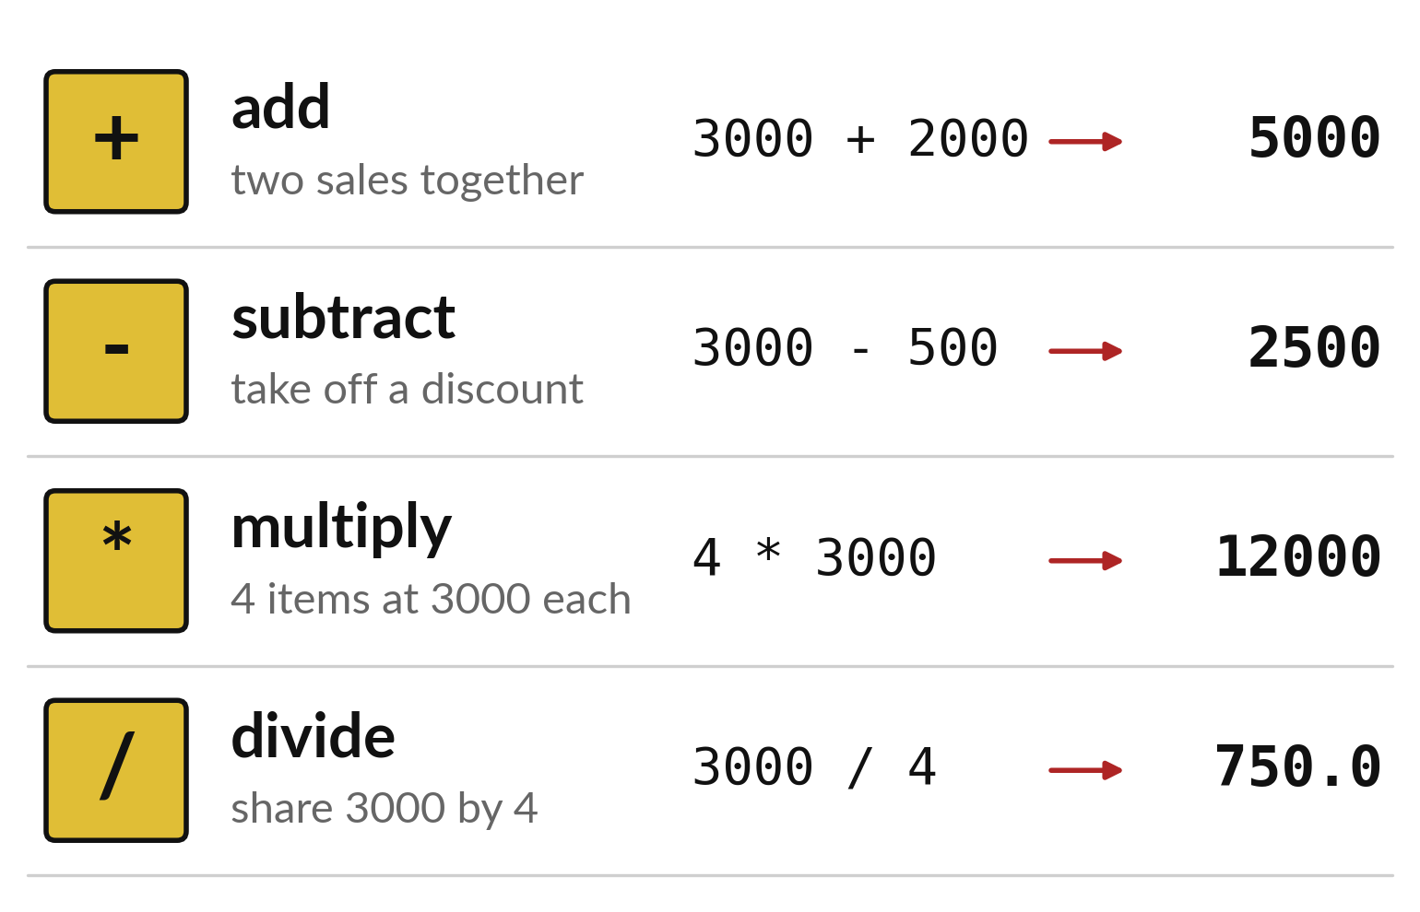
Four symbols do the arithmetic
Plus adds and minus subtracts.
The star multiplies.
The slash divides.
Notes:
Python uses the same four sums you know from school, but two of the symbols look different. Multiplication is a star, because a cross looks too much like the letter x. Division is a slash.
Python works out each answer the moment the cell runs. Which answer in the last column has a decimal point, and why do you think it does?

Slide 7
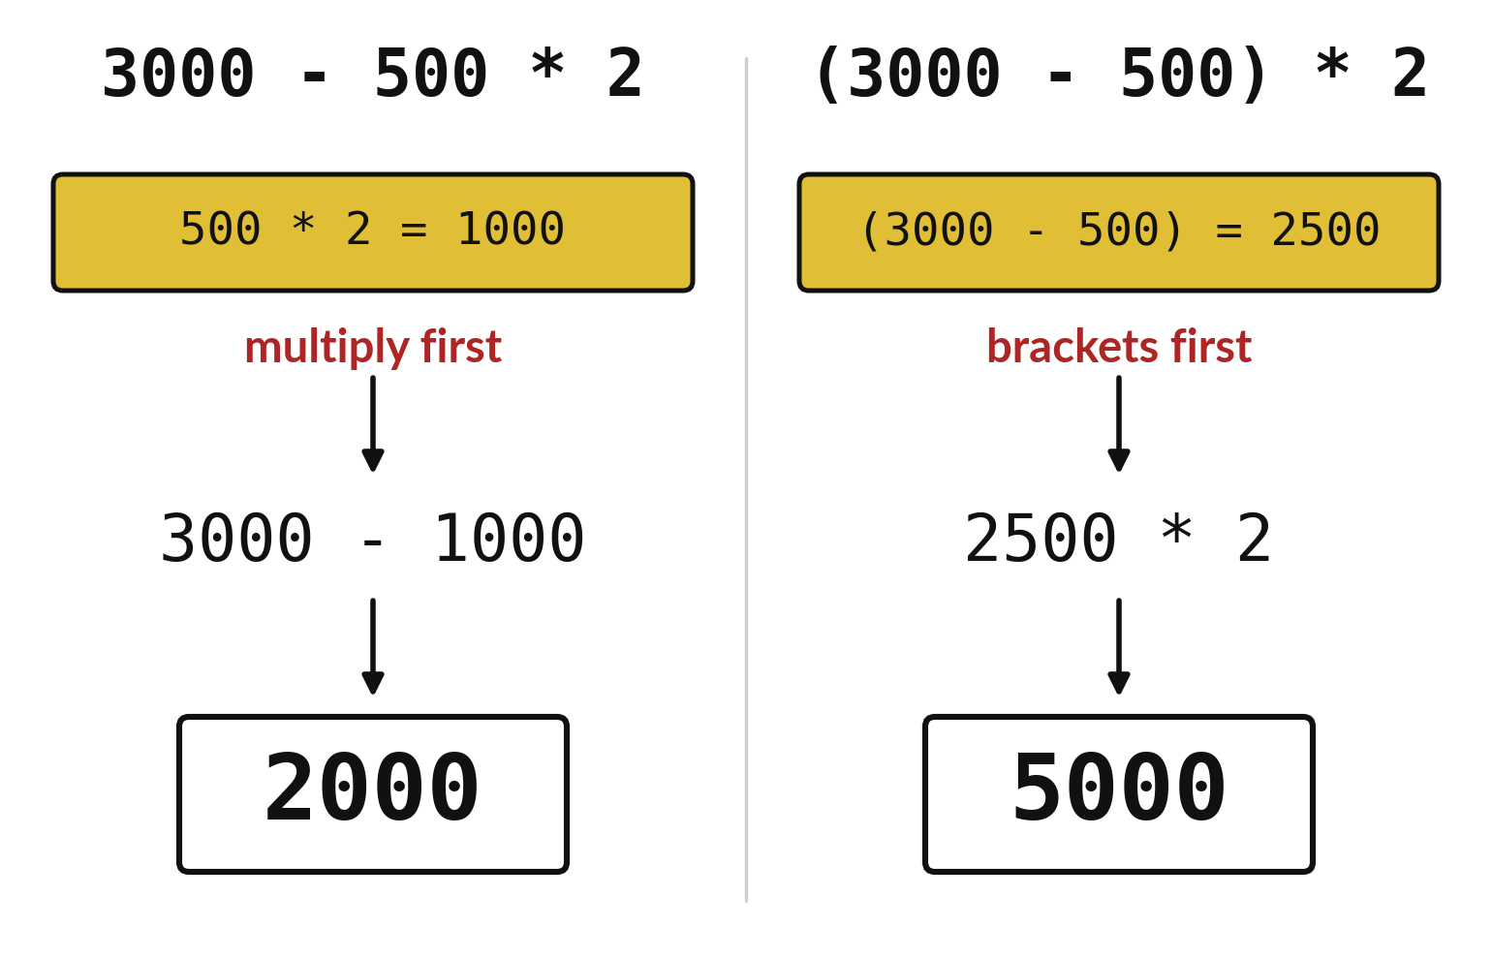
Brackets change the order
in which Python calculates
Python multiplies before it subtracts.
Brackets always go first.
Check a long sum by hand before you trust it.
Notes:
On the left there are no brackets. Python multiplies five hundred by two first, which gives one thousand, and then takes that from three thousand. The answer is two thousand. On the right the brackets force the subtraction first. Twenty five hundred times two is five thousand.
The same numbers give two different answers, so brackets are how you tell Python exactly what you mean. Which of these is the discount applied to each item? Check with the shop owner in your head.

Slide 8

Predict: The basic operators
price = 3000
total = price * 4
share = price / 4
no_brackets = price - 500 * 2
with_brackets = (price - 500) * 2
print(total, share, no_brackets, with_brackets)
Predict the four numbers before you run.
Write your guess on paper before we run it.
Notes:
Notice the difference the brackets make.
Your turn to guess. Predict the four numbers before you run. Put your guess on paper now, even if you are unsure.

Slide 9
Run it: The basic operators
12000 750.0 2000 5000
The cell prints 12000, 750.0, 2000 and 5000.
+ adds, - subtracts, * multiplies and / divides.
Multiplication happens before subtraction, so the brackets change the answer from 2000 to 5000.
Brackets are called parentheses.
Notes:
I will run it, and you compare with your guess. Match each line of the output with the line of code that made it.
The cell prints 12000, 750.0, 2000 and 5000. + adds, - subtracts, * multiplies and / divides. Multiplication happens before subtraction, so the brackets change the answer from 2000 to 5000. Brackets are called parentheses.
Check your paper. Were you close?

Slide 10

Investigate: The basic operators
1. Why do 2000 and 5000 differ?
2. Why is share 750.0 and not 750?
Notes:
Now we look closely at the basic operators. I have two questions for you.
Question one. Why do 2000 and 5000 differ? Think about it for a moment, then tell the person next to you.
Without brackets 500 * 2 happens first. With brackets 3000 - 500 happens first.
Question two. Why is share 750.0 and not 750? Have a go in your head first.
Here is how I would answer it. Division always gives a float in Python.

Slide 11

Modify: change one thing
Write the calculation for 3 books at UGX 3000 plus 2 pens at UGX 1000 in one line.
Then tell your neighbour what changed and how you know.
Notes:
Time to experiment. Write the calculation for 3 books at UGX 3000 plus 2 pens at UGX 1000 in one line. Then explain to your neighbour what the change did.
The result: 3 * 3000 + 2 * 1000 gives 11000.

Slide 12

Break
15 minutes away from your screen
Stand up. Drink some water. Tell someone what you guessed in the first half.
Notes:
Break time. 15 minutes away from your screens. Stand up, drink some water and tell someone what you guessed in the first half.
When we come back we start the second idea.

Slide 13
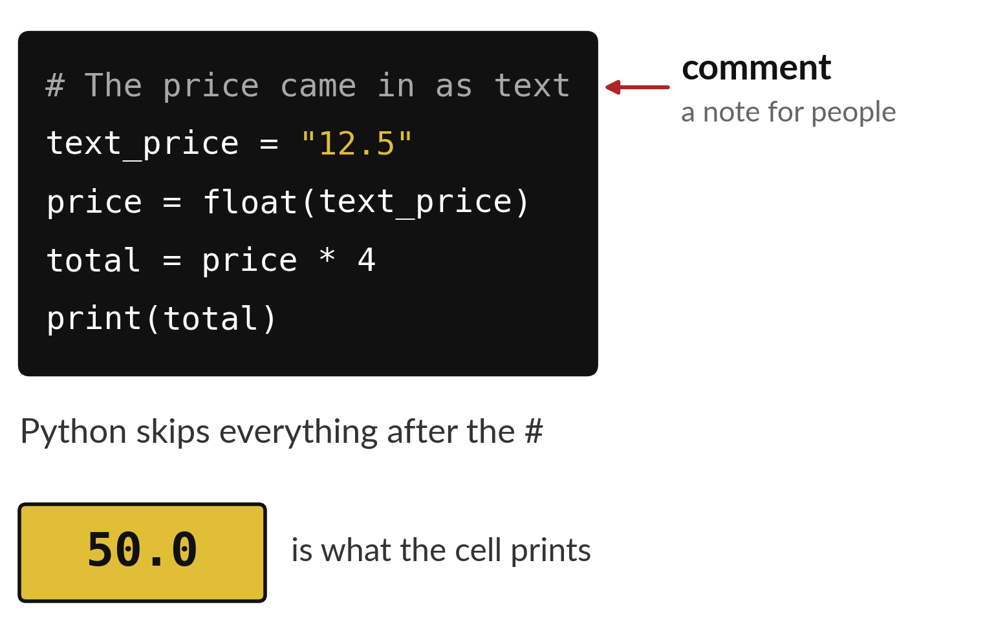
A comment is a note for
people that Python ignores
A comment starts with a hash sign.
Python skips everything after it.
A good comment says why you did it.
Notes:
The first line starts with a hash sign. That makes it a comment. Python reads straight past it. Comments are for the people who read your code, including you in a month when you have forgotten what the code was for.
The remaining lines convert the text twelve point five into a number, multiply it by four and print fifty. Write one comment in your own notebook today.

Slide 14
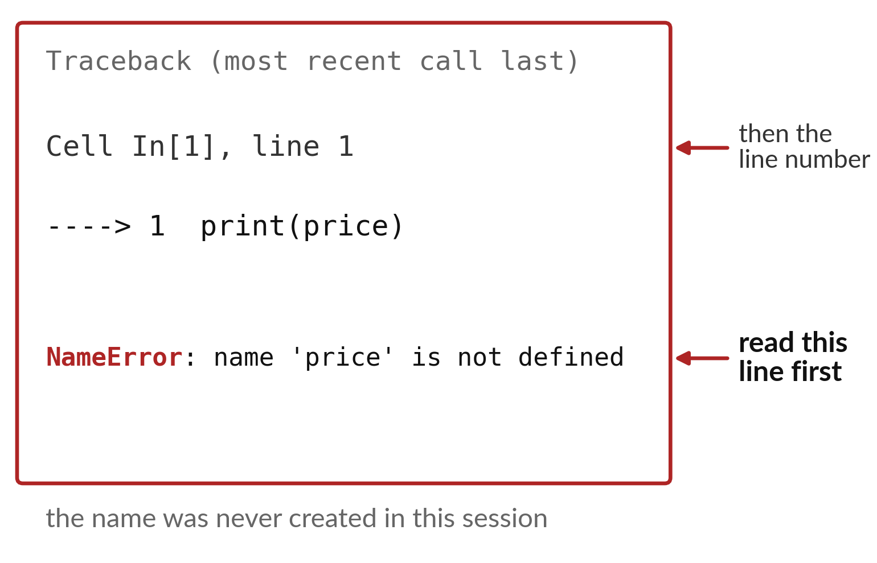
A NameError means Python
has never met that name
Read the last line first.
The line number says where to look.
Run the cell that creates the name, or fix its spelling.
Notes:
An error message looks long, but only two parts matter. At the bottom is the name of the error and a few words about what went wrong. Above it is the line number where Python gave up.
Here the bottom line says that price is not defined. Python has never been told what price means. What are the two quick things to check?

Slide 15

Predict: Text becomes a number
# The price came in as text
text_price = "12.5"
price = float(text_price)
total = price * 4
print(total)
Predict the output. Can Python multiply text by 4 and give 50.0?
Write your guess on paper before we run it.
Notes:
A price arrives as text from a form.
Now your guess. Predict the output. Can Python multiply text by 4 and give 50.0? Write one line on paper. I will give you a minute.

Slide 16
Run it: Text becomes a number
50.0
The cell prints 50.0.
float turns the text 12.5 into a number.
The line starting with # is a comment, which Python ignores.
If the text were abc, float would stop with a ValueError and the last line of the error would name the problem.
Notes:
Watch the output as it appears. Match each line of the output with the line of code that made it.
The cell prints 50.0. float turns the text 12.5 into a number. The line starting with # is a comment, which Python ignores. If the text were abc, float would stop with a ValueError and the last line of the error would name the problem.
Tell the person next to you whether your guess matched.

Slide 17
Investigate: Text becomes a number
1. Which line of an error message do you read first?
2. What does float("12,5") do?
# The price came in as text
text_price = "12.5"
price = float(text_price)
total = price * 4
print(total)
Notes:
Now we look closely at text becomes a number. I have two questions for you.
Question one. Which line of an error message do you read first? Have a go in your head first.
Here is how I would answer it. The last line. It names the kind of error and what went wrong.
Question two. What does float("12,5") do? Write your answer in one line before we compare.
What I would say is this. It stops with a ValueError, because Python does not accept a comma inside a number.

Slide 18
Modify: change one thing
Change the text price to "20" and run the cell again.
Then tell your neighbour what changed and how you know.
# The price came in as text
text_price = "12.5"
price = float(text_price)
total = price * 4
print(total)
Notes:
Your hands on the keyboard now. Change the text price to "20" and run the cell again. When you have run it, tell your neighbour what changed and how you know.
Here is what happens. The total becomes 80.0.

Slide 19
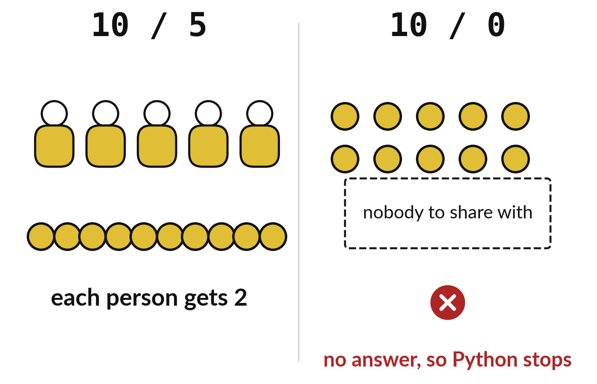
Nothing can be shared among zero people
Ten coins among five people gives two each.
Ten coins among nobody has no answer.
Python stops with a ZeroDivisionError.
Notes:
This is the picture behind one of the practice questions. Share ten coins among five people and everybody gets two. Share ten coins among nobody and the question stops making sense. There is no person to hand a coin to.
Python refuses to guess and stops with a ZeroDivisionError. Say it again in your own words in your notebook.

Slide 20

Make: your own version
Convert "12.5" to a number and calculate the price of four items.
Predict the answer before you run it.
Explain why nobody can divide by zero.
Save it as ML03. Write two sentences: what you changed and how you checked it.
Notes:
This is your own task for today. Take it one step at a time. If you get stuck for a few minutes, read your error message, check the error card, and then ask me.
Save it as ML03. I will come round to each of you and ask what you changed and how you checked it.

Slide 21

Two errors you may meet today
It means: The text has letters, a comma or a currency symbol inside it.
Fix: Remove everything except digits and one decimal point.
ValueError: could not convert string to float
It means: The calculation divides by zero.
Fix: Check the number you divide by; it must not be 0.
ZeroDivisionError: division by zero
Notes:
Everyone meets errors, including me. Two are likely today, so let us meet them now.
This is the first one. You will see: ValueError: could not convert string to float. It means this: the text has letters, a comma or a currency symbol inside it. To fix it, remove everything except digits and one decimal point.
The next one. You will see: ZeroDivisionError: division by zero. It means this: the calculation divides by zero. To fix it, check the number you divide by; it must not be 0.
Keep this slide in mind when something stops working.

Slide 22

Finish this sentence in your notebook
float turns text such as 12.5 into a number, and an error message names the problem on its last line.
Then save your notebook, close it and open it again to check it saved.
Notes:
We are nearly done. Remember the question from the start of the session: How do I turn the text of a price into a number I can calculate with?
Write this sentence in your notebook and finish it your own way. float turns text such as 12.5 into a number, and an error message names the problem on its last line.
Then save your notebook, close it and open it again to check it saved.

