Slide 1
Decisions and a
hand-written flower rule
How often does a three-line rule name the right flower?
Machine Learning | Session 4 of 24 | Week 2, Python you need
Holiday Data and AI Camp | The National ICT Innovation Hub, Nakawa
Notes:
Let us begin. Today is session 4 and our topic is decisions and a hand-written flower rule.
By the end of today you will be able to write an if, elif and else decision, test it at its boundary, and count how often a simple rule is right.
We will answer one question: How often does a three-line rule name the right flower?

Slide 2
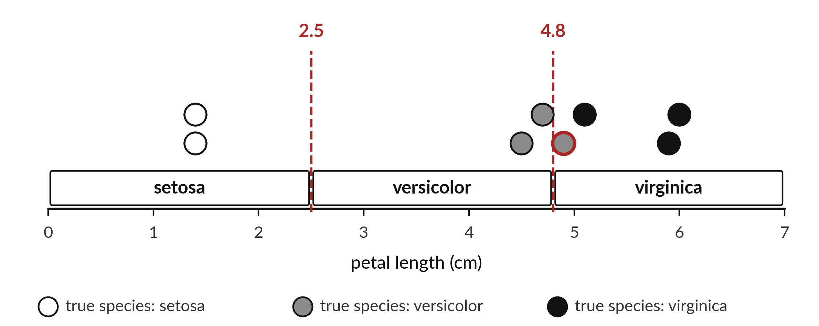
How often does a three-line
rule name the right flower?
Notes:
These dots are eight flowers. Each sits at its petal length. White dots are one kind of flower, grey another and black the third. The red dashed lines are two cut points. A flower to the left of the first line is called setosa, between the lines is called versicolor, and to the right of the second is called virginica. That is a rule written with three questions. Today you write the rule in Python, and then count how often it names the right flower.

Slide 3

Three hours, mostly doing
Most of our time is spent doing, in small steps, with a guess before every run.
Notes:
Here is how the 3 hours go. Each bar is as long as the time we spend on that part.
First, 10 minutes. Recall. Then, 50 minutes. Block A. After that, 15 minutes. Break away from screens. Next, 50 minutes. Block B. Then, 40 minutes. Make. Then, 15 minutes. Exit ticket, save, and an individual check with each learner.
Notice how much of the time is yours. You listen for a short while and then you do. That is on purpose, because you learn this by doing it.

Slide 4
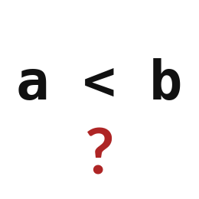
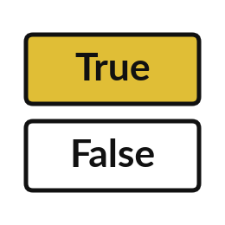
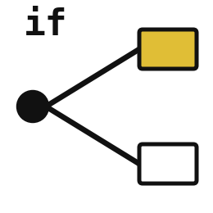
Words for today (1 of 2)
comparison
A question about two values that answers True or False.
Asking whether your money is at least the ticket price.
Boolean
A value that is either True or False.
A light switch that is on or off.
if
Runs the indented lines below it only when its question is True.
If it rains, take an umbrella.
Notes:
Here are the words for today. Listen for the picture that goes with each one.
comparison. A question about two values that answers True or False. A small example. Asking whether your money is at least the ticket price.
Boolean. A value that is either True or False. Picture this. A light switch that is on or off.
if. Runs the indented lines below it only when its question is True. You have seen this before. If it rains, take an umbrella.

Slide 5
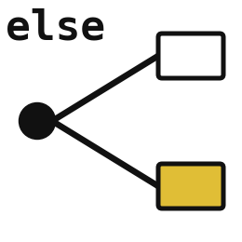
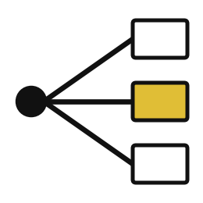
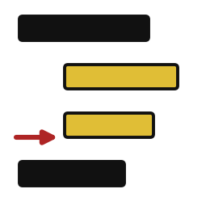
Words for today (2 of 2)
else
Runs when the if question was False.
Otherwise, leave the umbrella.
elif
Asks a second question when the first was False.
If it is raining take an umbrella, otherwise if it is cloudy take a hat.
indentation
Four spaces at the start of a line that show which instructions belong together.
Writing a sub-point under a heading.
Notes:
Two more words to know before we start.
else. Runs when the if question was False. Otherwise, leave the umbrella.
elif. Asks a second question when the first was False. Think of a shop. If it is raining take an umbrella, otherwise if it is cloudy take a hat.
indentation. Four spaces at the start of a line that show which instructions belong together. Imagine it like this. Writing a sub-point under a heading.

Slide 6
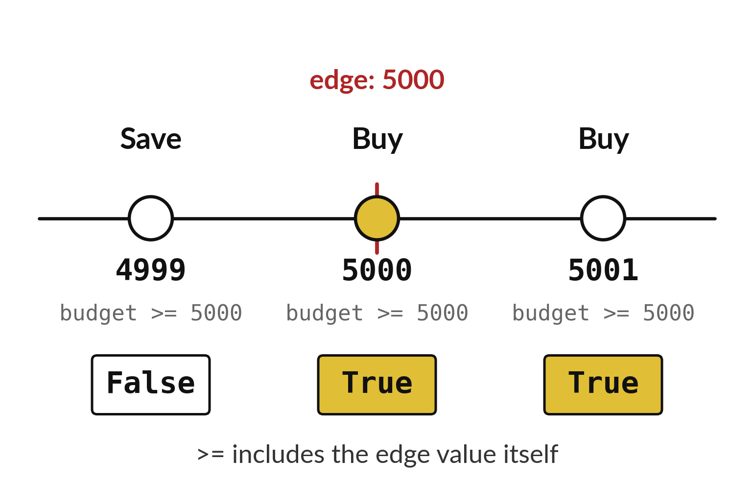
A comparison answers True or False
Three budgets test the same rule.
The edge value counts when you write >=.
Test just below, on and just above the edge.
Notes:
A comparison is a yes or no question. The ticket costs five thousand. Is the budget at least five thousand? For four thousand nine hundred and ninety nine the answer is False. For exactly five thousand it is True, because the symbol includes the edge itself. For five thousand and one it is True.
The edge is where mistakes hide, so we always test one value below it, the value on it and one above it.

Slide 7
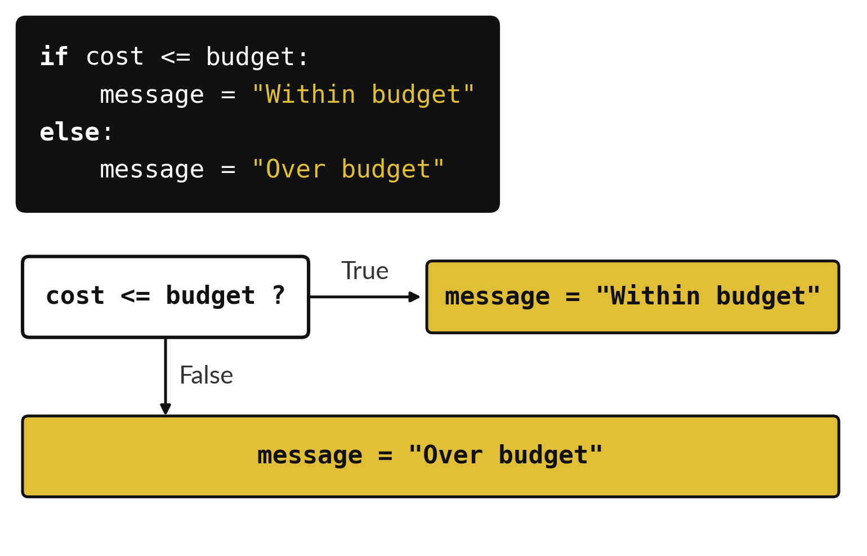
An if sends the program down one of two paths
True follows the indented if lines.
False follows the else lines.
Only one path runs each time.
Notes:
The if instruction is a fork in the road. Python asks the question in the box. If the answer is True it takes the path to the right. If the answer is False it goes down to the else. It never takes both paths.
The code above the flow chart is the same decision written for Python. With a cost of eight thousand and a budget of ten thousand, which box do you reach?

Slide 8

Predict: A decision with if and else
budget = 10000
cost = 8000
if cost <= budget:
message = "Within budget"
else:
message = "Over budget"
print(message)
Predict the message that will print.
Write your guess on paper before we run it.
Notes:
A student has UGX 10000 and an item costs UGX 8000.
Make a prediction. Predict the message that will print. Write one line on paper. I will give you a minute.

Slide 9
Run it: A decision with if and else
Within budget
The cell prints Within budget.
cost <= budget is a comparison and its answer is True, which is a Boolean.
if runs the indented lines when the answer is True and else runs them when it is False.
Notes:
Running it now. Match each line of the output with the line of code that made it.
The cell prints Within budget. cost <= budget is a comparison and its answer is True, which is a Boolean. if runs the indented lines when the answer is True and else runs them when it is False. The four spaces at the start of the lines are indentation.
Keep your guess. We use it in the next step.

Slide 10

Investigate: A decision with if and else
1. What is the answer to 5000 >= 5000?
2. What does = do compared with ==?
Notes:
Now we look closely at A decision with if and else. I have two questions for you.
Question one. What is the answer to 5000 >= 5000? Have a go in your head first.
Let me answer it. True. >= means at least.
Question two. What does = do compared with ==? Write your answer in one line before we compare.
The answer is this. = stores a value under a name. == asks whether two values are equal.

Slide 11
Modify: change one thing
Set cost to 12000 and run the decision again.
Then tell your neighbour what changed and how you know.
budget = 10000
cost = 8000
if cost <= budget:
message = "Within budget"
else:
message = "Over budget"
print(message)
Notes:
Make one small change. Set cost to 12000 and run the decision again. After you run it, say in one sentence what changed and how you checked.
You should see this. The message is Over budget.

Slide 12

Break
15 minutes away from your screen
Stand up. Drink some water. Tell someone what you guessed in the first half.
Notes:
Break time. 15 minutes away from your screens. Stand up, drink some water and tell someone what you guessed in the first half.
When we come back we start the second idea.

Slide 13
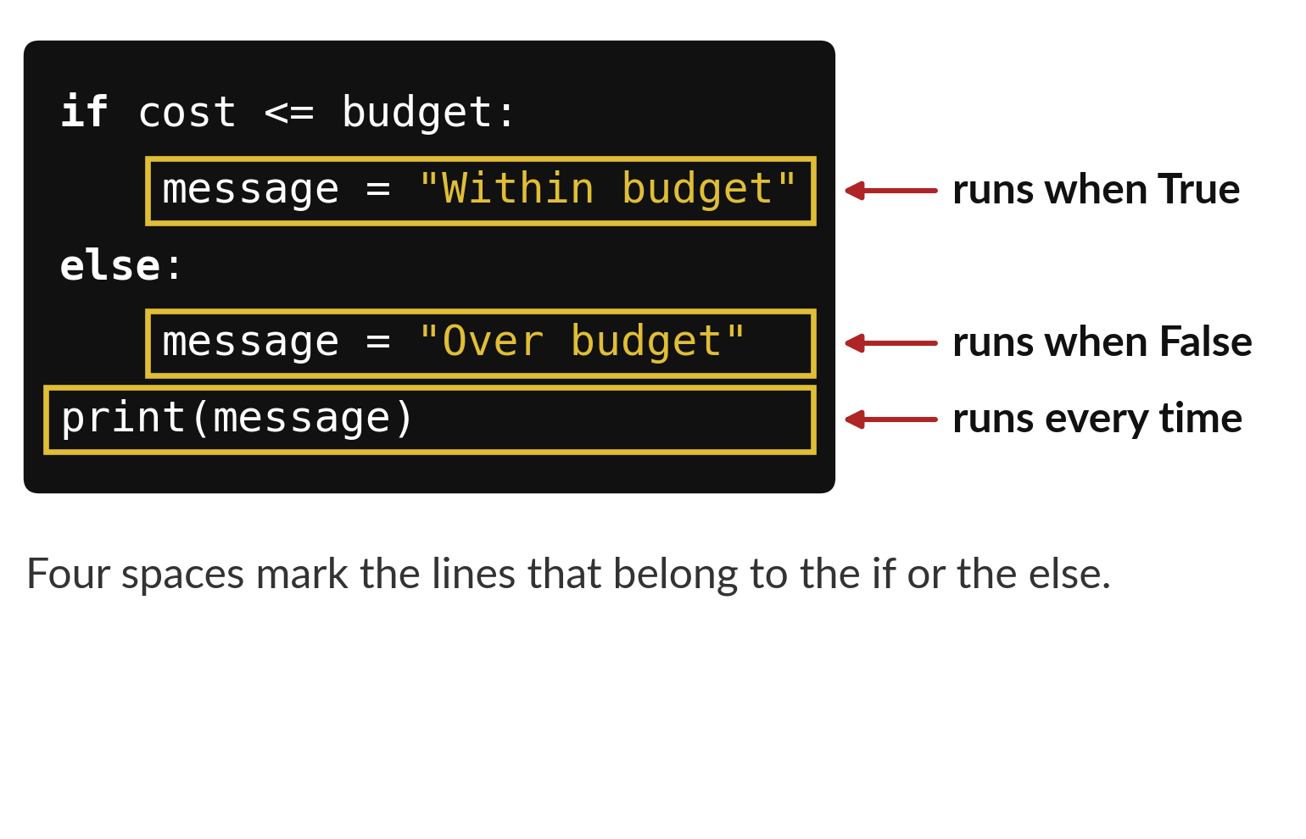
Four spaces tell Python
which lines belong to the if
Lines pushed in by four spaces belong to the if or else.
The unindented line runs every time.
A colon ends each if and else line.
Notes:
Python uses spaces to understand your code. The two lines that start with four spaces belong to the if and the else above them. They sit inside the fork. The last line has no spaces, so it sits outside the fork and runs every time.
If you forget the spaces, Python stops with an IndentationError. Which lines run when the answer is True?

Slide 14
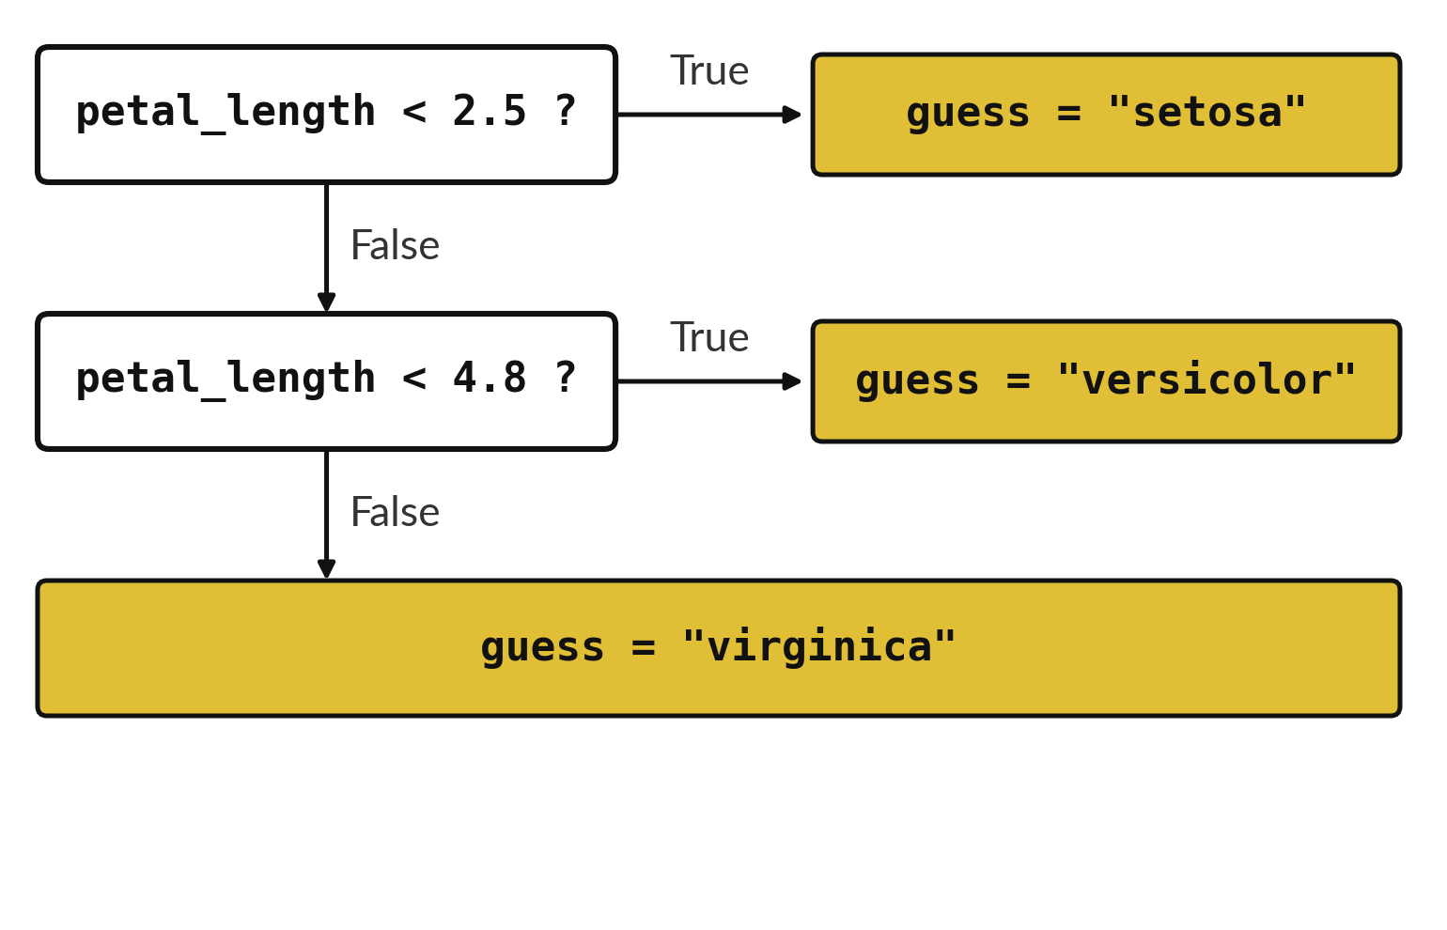
An elif asks a second question
when the first is False
Python asks the questions from the top down.
It stops at the first True answer.
else catches every flower that is left.
Notes:
This is the flower rule as a ladder of questions. First: is the petal shorter than two and a half? If yes, the guess is setosa and we stop. If no, we drop to the next question: is it shorter than four point eight? If yes, versicolor. Only when both answers are no do we reach the last box, virginica.
Try a petal of four point seven. Which box do you reach?

Slide 15
Predict: A rule that names a flower
petal_length = 4.7
if petal_length < 2.5:
guess = "setosa"
elif petal_length < 4.8:
guess = "versicolor"
else:
guess = "virginica"
print(guess)
Look at the rule. Predict which species it names for a petal length of 4.7 centimetres.
Write your guess on paper before we run it.
Notes:
The iris data records flowers of three species. Petal length helps tell them apart.
Time to commit to an answer. Look at the rule. Predict which species it names for a petal length of 4.7 centimetres. Jot it on paper before anyone speaks.

Slide 16
Run it: A rule that names a flower
versicolor
The cell prints versicolor.
elif asks a second question only when the first answer was False.
Try the eight petal lengths.
The true species are setosa twice, versicolor three times and virginica three times.
The rule gets seven right and misses the 4.9 flower.
Notes:
Now we run it. Match each line of the output with the line of code that made it.
The cell prints versicolor. elif asks a second question only when the first answer was False. Try the eight petal lengths. The true species are setosa twice, versicolor three times and virginica three times. The rule gets seven right and misses the 4.9 flower.
If your guess was off, find the line that surprised you.

Slide 17
Investigate: A rule that names a flower
1. Which of the eight flowers does the rule get wrong?
2. How would you move the rule so that 4.9 is right?
3. What is the accuracy on these eight flowers?
petal_length = 4.7
if petal_length < 2.5:
guess = "setosa"
elif petal_length < 4.8:
guess = "versicolor"
else:
guess = "virginica"
print(guess)
Notes:
Now we look closely at A rule that names a flower. I have three questions for you.
Question one. Which of the eight flowers does the rule get wrong? Write your answer in one line before we compare.
The answer is this. The one with petal length 4.9. It is versicolor, and the rule says virginica.
Question two. How would you move the rule so that 4.9 is right? Say it quietly to yourself before anyone answers.
Raise the 4.8 limit to 5.0. Then check whether the 5.1 flower is still right.
Question three. What is the accuracy on these eight flowers? Give it thirty seconds and then we will hear a few answers.
Here is how I would answer it. 7 right out of 8, which is 87.5%.

Slide 18
Modify: change one thing
Set petal_length to 4.9 and run the rule.
Then tell your neighbour what changed and how you know.
petal_length = 4.7
if petal_length < 2.5:
guess = "setosa"
elif petal_length < 4.8:
guess = "versicolor"
else:
guess = "virginica"
print(guess)
Notes:
Now it is your turn to change something. Set petal_length to 4.9 and run the rule. Then explain to your neighbour what the change did.
The result: It prints virginica, which is wrong for this flower.

Slide 19
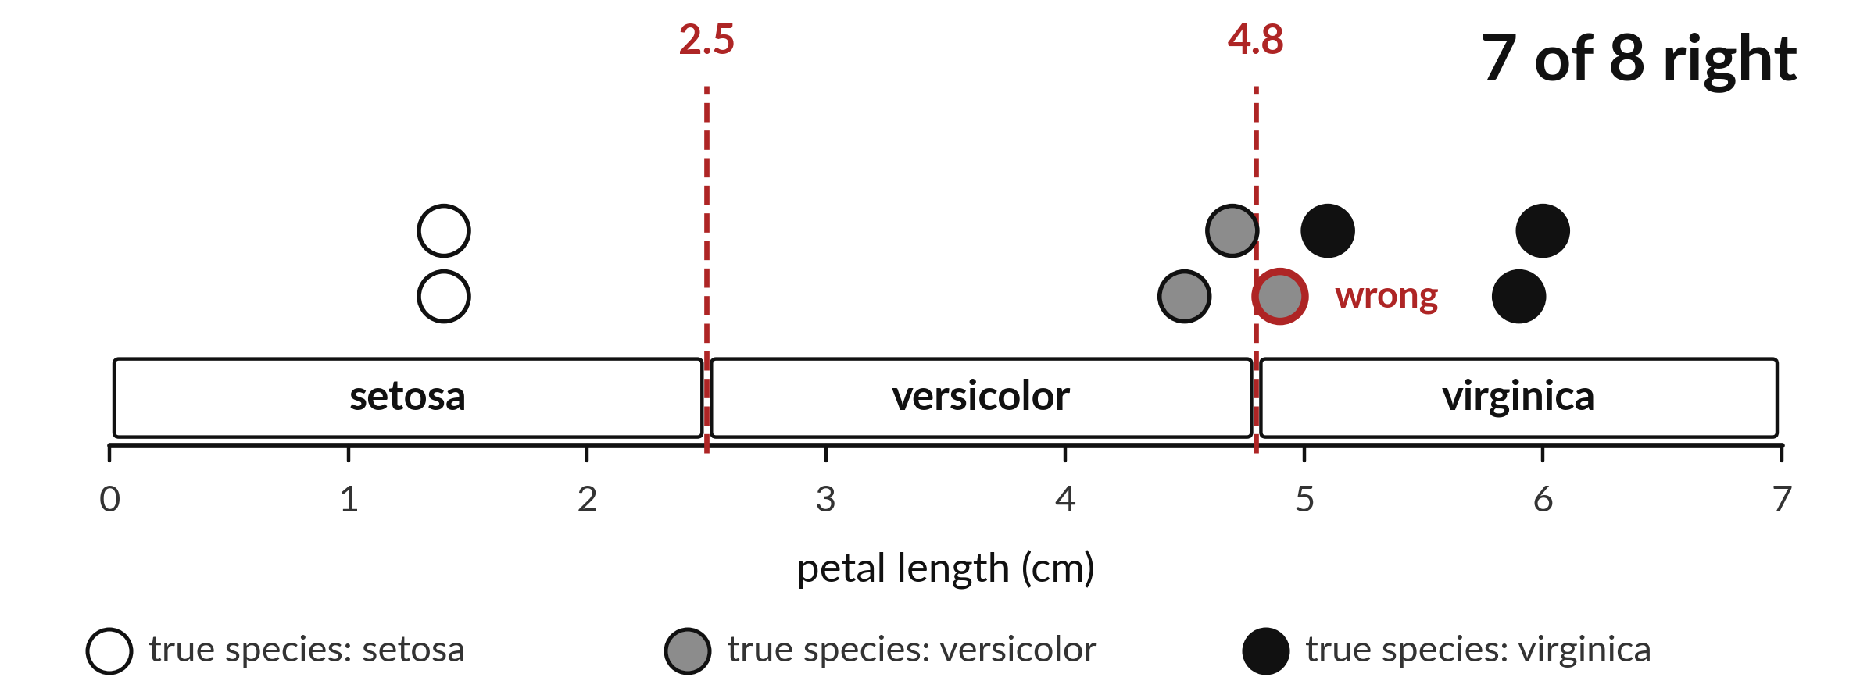
The rule names seven of
the eight flowers correctly
A red ring marks a flower the rule gets wrong.
Notes:
Here is the same picture again, now with a verdict. Seven of the eight flowers sit in the zone that carries their own name. One does not. A versicolor with a petal of four point nine falls just past the second cut, so the rule calls it virginica.
A rule that is right most of the time is useful, and it is also honest to say how often it is wrong. Where would you move the second cut to fix this one flower, and what might that break?

Slide 20

Make: your own version
A ticket costs UGX 5000.
Write a decision that prints Buy when the budget is at least 5000 and Save otherwise.
Test 4999, 5000 and 5001.
Then say how many of the eight flowers your flower rule names correctly.
Write two sentences: what you changed and how you checked it.
Notes:
Now you do the real work yourself. Start with the first step. If you get stuck for a few minutes, read your error message, check the error card, and then ask me.
Save it as ML04. I will come round to each of you and ask what you changed and how you checked it.

Slide 21

Two errors you may meet today
It means: The line after if, elif or else does not start with spaces.
Fix: Add four spaces at the start of each line inside the block.
IndentationError: expected an indented block
It means: A colon is missing at the end of an if, elif or else line.
Fix: Put a colon at the end of the line.
SyntaxError: invalid syntax
Notes:
Two things are likely to go wrong today. It helps to know them before they happen.
This is the first one. You will see: IndentationError: expected an indented block. It means this: the line after if, elif or else does not start with spaces. To fix it, add four spaces at the start of each line inside the block.
The next one. You will see: SyntaxError: invalid syntax. It means this: A colon is missing at the end of an if, elif or else line. To fix it, put a colon at the end of the line.
If you meet one of these, fix it and carry on. It happens to everyone.

Slide 22

Finish this sentence in your notebook
A decision runs different lines depending on a True or False question, and a simple rule can be tested by counting how often it is right.
Then save your notebook, close it and open it again to check it saved.
Notes:
Before we finish, go back to the question we began with: How often does a three-line rule name the right flower?
Copy this sentence into your notebook and make it yours. A decision runs different lines depending on a True or False question, and a simple rule can be tested by counting how often it is right.
Then save your notebook, close it and open it again to check it saved.

